Slide 1


Data Management Project
Group 7
Debarati Saha
Soumya Chava
Hanyaqian Yuan
Eyohas Haile

Slide 2

Introduction
MyFitnessPal is an online calorie counter which helps users to lose weight by tracking calorie intake and calorie burnt quickly.
This app solves a real-life purpose of fitness and weight management and relies strongly on its database. It has several features and is extensive. Having a “structured database” is of utmost importance for the app, and that’s why we chose myfitnesspal. We will design a database to facilitate the following functions:
Create user profile
Record the food intake and the corresponding calorie intake
Record the exercise and corresponding calorie burnt
Record water consumption
Set Goals for themselves

Slide 3
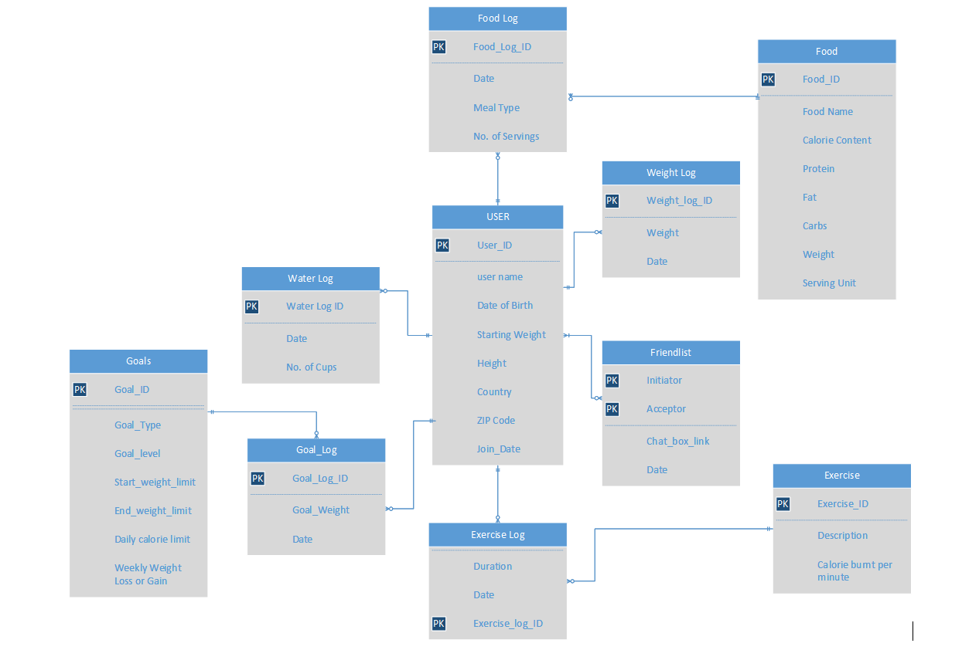
ERD

Slide 4
ERD Breakdown
User
Every user needs to create a profile to use the application. The user database will store the name, date of birth, current weight, height, country of origin, ZIP code Goal Weight and Join Date of the user.
Calories Consumed
The Database enables users to view the calories consumed by them. This is facilitated by the User, Food & Food Log entities.
The food database will store all different kind of foods a person can eat. Each food will have a corresponding name, Calorie Content, Protein, Fat, Carbs, Weight and Serving Unit.
Whenever User eats something, they will create a record in Food_Log table, mentioning when they had that food, in which meal (Breakfast/lunch/dinner), and the number of servings they had. The food log table stores details such as Date, Meal type and No. of servings.
Each User can have 0 to many Food logs and every food log will be associated with one and only one User.
Each Food log can have one and only one food item and any food item can be used 0 to many food logs.

Slide 5
ERD Breakdown (Cont’d)
Calories burned
Exercise Database is useful for determining the calories burnt through various forms of exercises.
This is facilitated by the User, Exercise and Exercise Log entities.
The exercise database will have a unique ID (Exercise_ID) for each exercise, description and calories burnt per minute.
Exercise log database is useful for recording the exercises the user does each day and how long does every exercise last.
Each User can have 0 to many Exercise logs and every exercise log will be associated with one and only one User.
Each Exercise log can have one and only one exercise and any exercise can be used 0 to many exercise logs.

Slide 6
ERD Breakdown (Cont’d)
Water Log
The water log database stores the amount of water consumed by a user through the day. Each entry has a unique Water_log_ID, Date of Consumption, No. of cups consumed.
Each user can have 0 to many water logs and each water log will be associated with one and only one user.
Weight Log
The weight log database stores the changes in weight that the user updates. Each update of weight will have its own unique weight_log_id. It stores further details such as Weight and Date.
Each user can have 0 to many weight logs and each weight log will be associated with one and only one user.

Slide 7
ERD Breakdown (Cont’d)
Goals Each user in the app can set goals for themselves. They will be advised on how many calories they can consume per day depending on their body weight and their selected goal. They will also be advised how much weight they should gain or lose each week to reach that goal, based on the difficulty level of the goal.
This is facilitated by the User, Goals and Goal Log entities.
The Goals database will have a unique ID (Goal_ID) for each goal, Goal_type, Goal_level, Start_weight_limit, end_weight_limit, Daily_calorie_limit, Weekly_weight_loss_or_gain.
Goal_log is useful for recording the goals each user has set for themselves throughout their life in the app. It store a unique Goal_log_ID and Date.
Each User can have 0 to many Goal logs and every goal log will be associated with one and only one User.
Each Goal log can have one and only one goal and any goal can be used 0 to many goal logs.

Slide 8
ERD Breakdown (Cont’d)
Friendlist Any user on the app can connect their social media profiles to the app which will sync their existing friend base and show the user all their friends who are currently using the app. Now the user can add all these people as their friends in the app, and the app will provide a chatbox link so that they can chat with each other within the app. This is an optional feature that could be used at the users discretion.
This is facilitated by the friendlist entity. Which saves data such as initiator, acceptor and Date.
It saves the user Id of the intiator and also the user ID of the person who receive the request and accepts the request(Acceptor) and the Date on which they have become friends.

Slide 9
New Feature 1 - Trainer
Users can connect with a trainer that is best suited for them. While choosing trainer, users can see information about the trainers for example trainer experience, skill set, etc.
Each trainer has a fixed hiring price, user can hire a trainer only after paying the hiring price.
User_trainer database stores the data of all the users who have opted to get a trainer.
Each User can have 0 to many trainers and vice-versa.

Slide 10
Trainer ERD

Slide 11
New Feature 2 - Challenges
Any two users who are friends with each other can challenge each other to compare what portion of their target weight goal (loss/gain) they have achieved in a certain period of time. These challenges will be pre-established in the app.
To achieve this we added 1 new entities to the ERD that is Challenges. Each challenge will have a unique challenge ID. This entity will also store user Id of the challenger, the user ID of the opponent, the start_date and end_date of the challenge.

Slide 12
Challenges ERD

Slide 13
Updated ERD

Slide 14
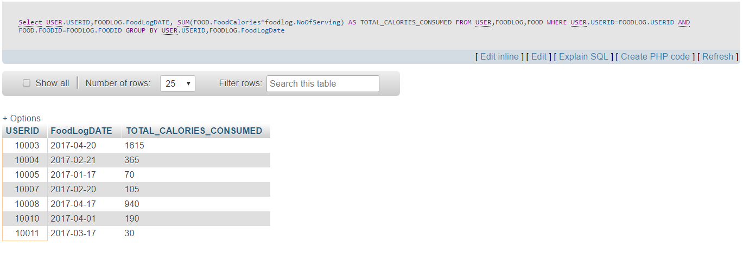
Scenario 1 – Calorie Intake
Calories consumed by users per day, calculated from their food log. Select USERID, FOODLOG.FoodLogDATE,
SUM(FOOD.FoodCalories*foodlog.NoOfServing) AS TOTAL_CALORIES_CONSUMED
FROM FOODLOG,FOOD
WHERE FOOD.FOODID=FOODLOG.FOODID
GROUP BY USERID, FOODLOG.FoodLogDate

Slide 15
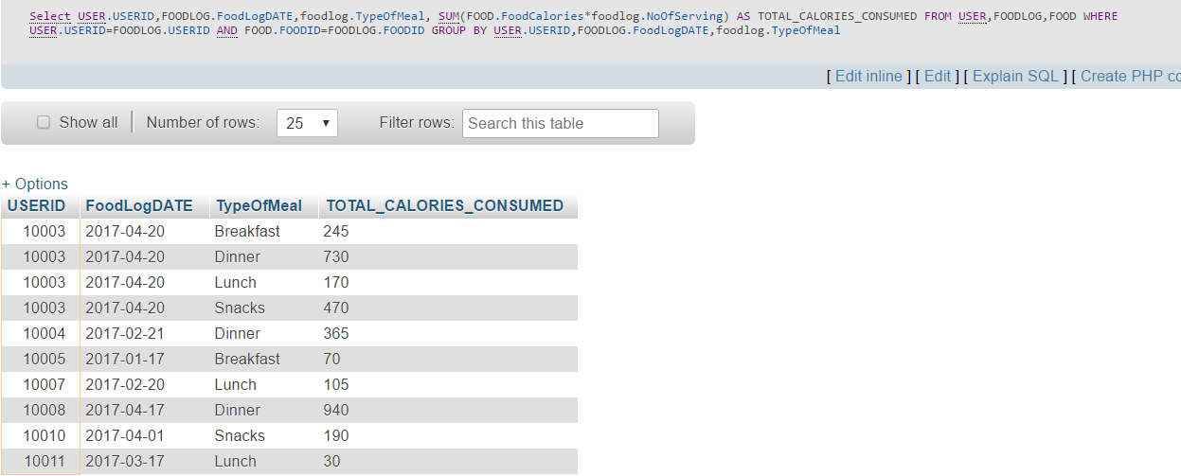
Scenario 1 – Calorie Intake
Calories consumed by users per day per meal:
Select USERID, FOODLOG.FoodLogDATE, foodlog.TypeOfMeal,
SUM(FOOD.FoodCalories*foodlog.NoOfServing) AS TOTAL_CALORIES_CONSUMED
FROM FOODLOG,FOOD
WHERE FOOD.FOODID=FOODLOG.FOODID
GROUP BY USERID, FOODLOG.FoodLogDATE, foodlog.TypeOfMeal

Slide 16
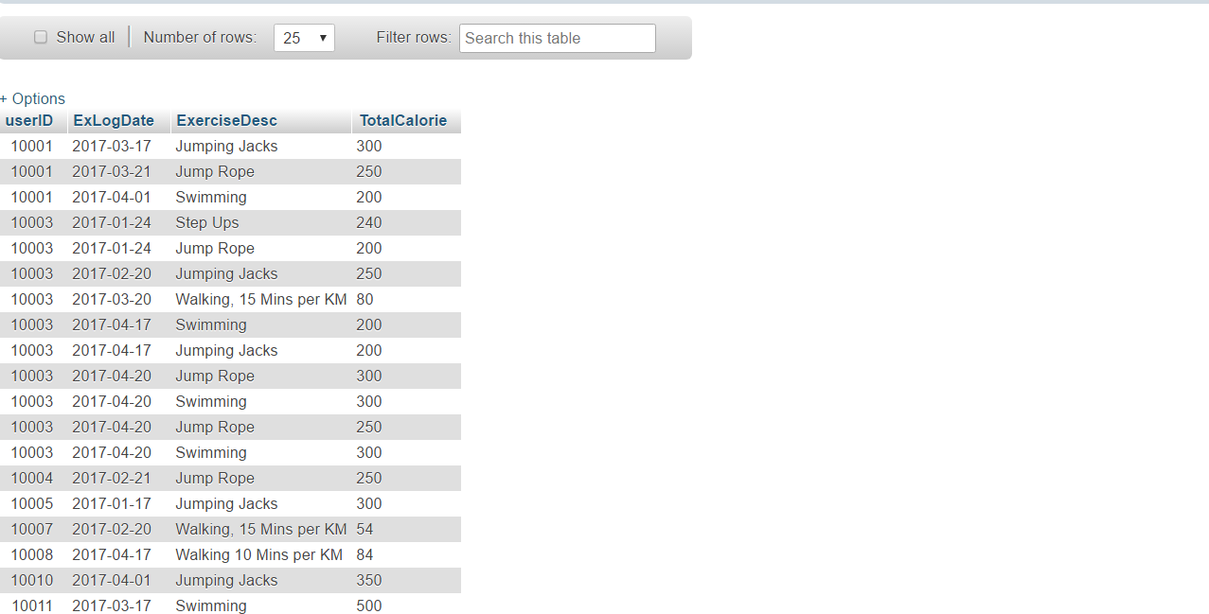
Scenario 2 – Calorie Burnt
Total calories burnt by a user per day per exercise. SELECT userID, exerciselog.ExLogDate, exercise.ExerciseDesc, SUM(exerciselog.Duration*EXERCISE.CalBurnedPerMin) AS TotalCalorie
From Exerciselog join exercise
on exerciselog.ExerciseID=exercise.ExerciseID
GROUP BY userid, ExLogDATE, exerciselogID

Slide 17
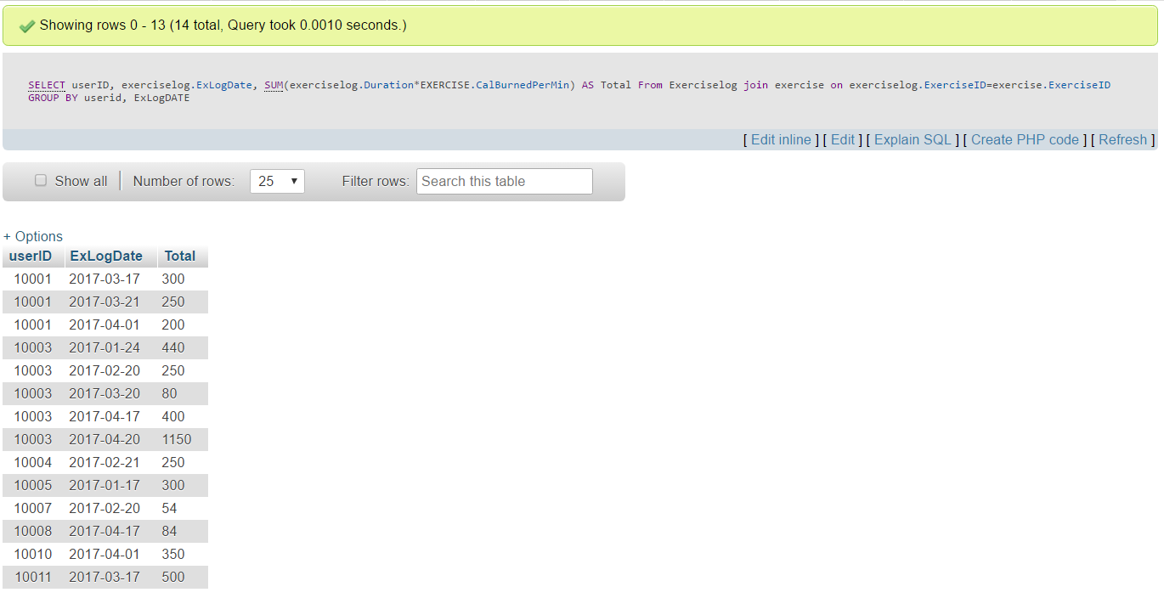
Scenario 2 – Calorie Burnt
Total calorie burnt per user per day:
SELECT userID, exerciselog.ExLogDate,
SUM(exerciselog.Duration*EXERCISE.CalBurnedPerMin) AS Total
From Exerciselog join exercise
on exerciselog.ExerciseID=exercise.ExerciseID
GROUP BY userid, ExLogDATE

Slide 18
Scenario 3 – Weight Journey
The weight journey of any user, i.e. how much weight a user has lost or gained till date, since he/she has joined the app
[Users who never logged their weight after joining, the weight loss value will show as ‘0’ for them]:
SELECT u.UserID, u.StartingWeight, gl.Goal_Weight,
wl.LatestWeightLogDate,wl.Weight AS LatestWeight,
COALESCE((u.StartingWeight-wl.Weight),0) AS WeightLoss
FROM User AS u INNER JOIN goallog AS gl ON u.userID = gl.UserID
LEFT JOIN
(select UserID, Weight, max(weightLogDate) as LatestWeightLogDate
from weightlog
group by UserID) wl
ON wl.UserID = u.UserID

Slide 19
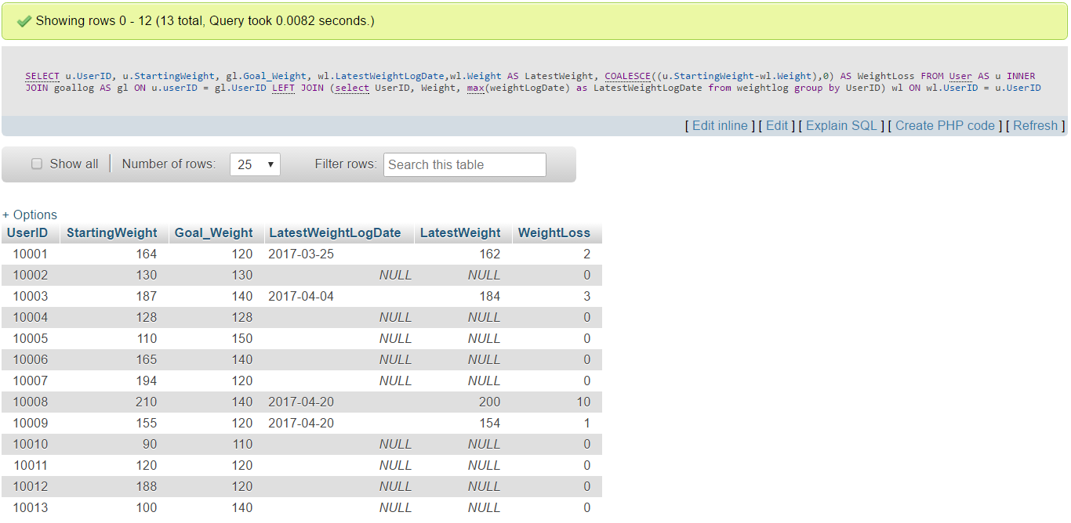
Scenario 3 – Weight Journey

Slide 20
Q&A

