Slide 1
How to Run WEKA
Demo SVM in WEKA
T.B. Chen
2008 12 21

Slide 2
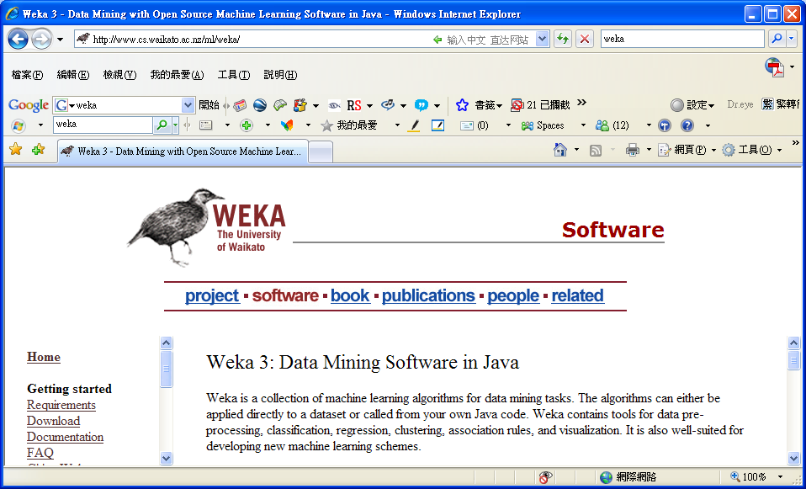
Download- WEKA
Web pages of WEKA as below:
http://www.cs.waikato.ac.nz/ml/weka/

Slide 3
The Flow Chart of Running SVM in WEKA
Selected Test Options
Cross-validation
Folds = Observations
Prepared
a training dataset
Selected
Response
Response should be
categorical variable.
Opening WEKA
Software
Results
Opening A
Training Dataset
Perdition error rates,
confusion matrix,
model estimators,
Prediction
information
Selected SVM
module in WEKA
Choosing proper
parameters in SVM

Slide 4
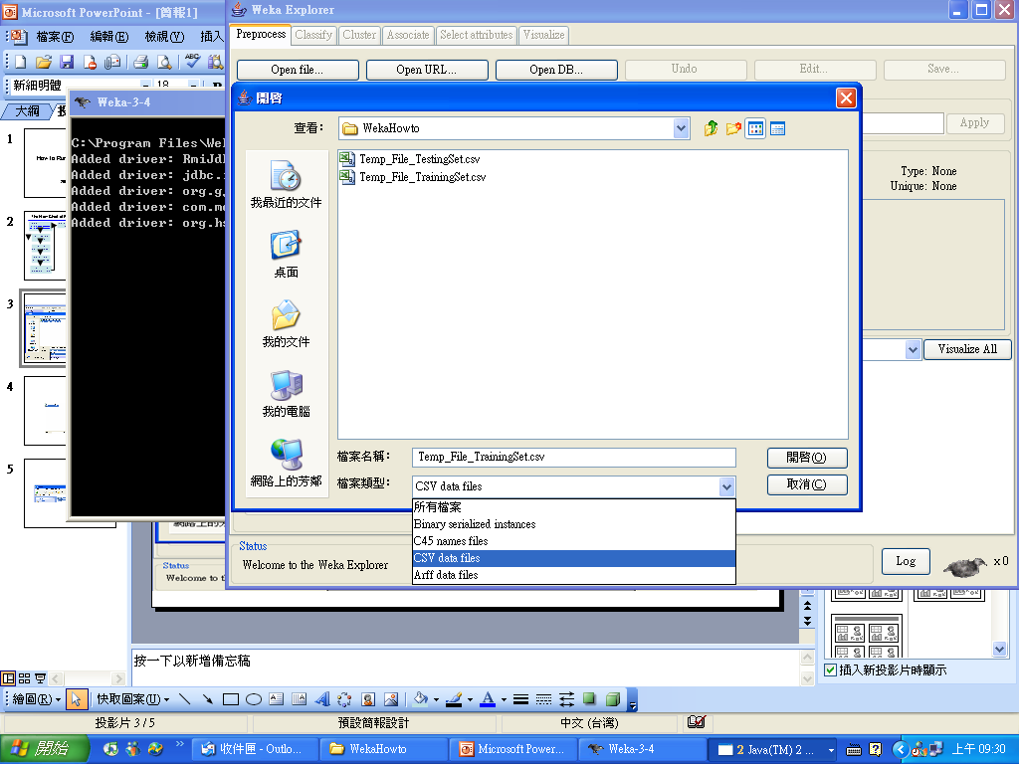
Open an Training Data with CSV Format (Made by Excel)
1
3
3
4
2

Slide 5
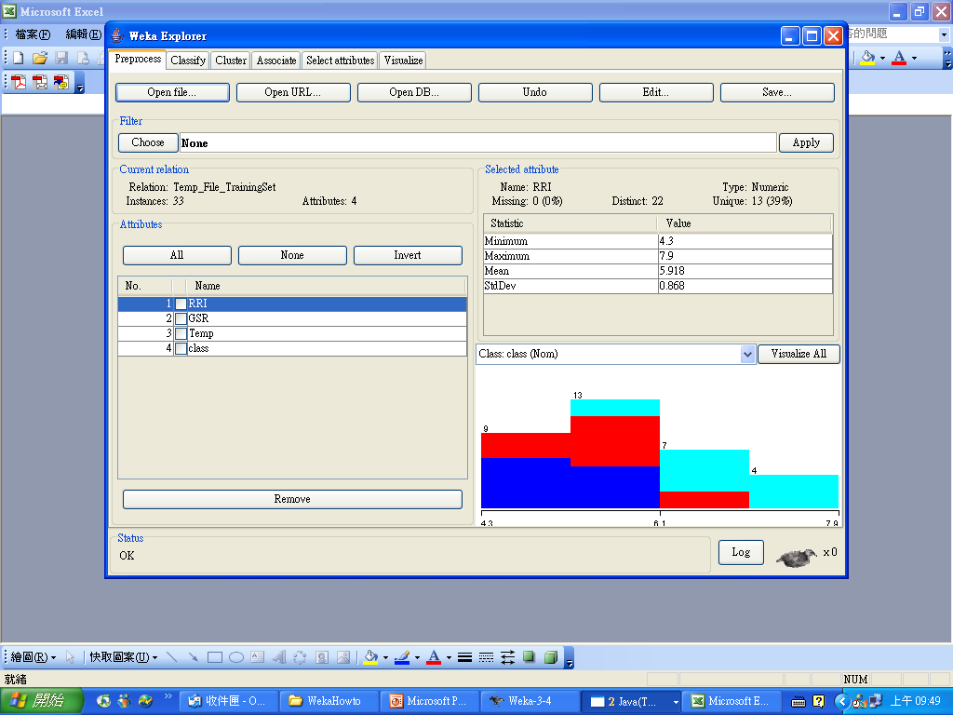
Selected Classifier in WEKA
Choose classifier
Number of observations
Variables in training data.

Slide 6
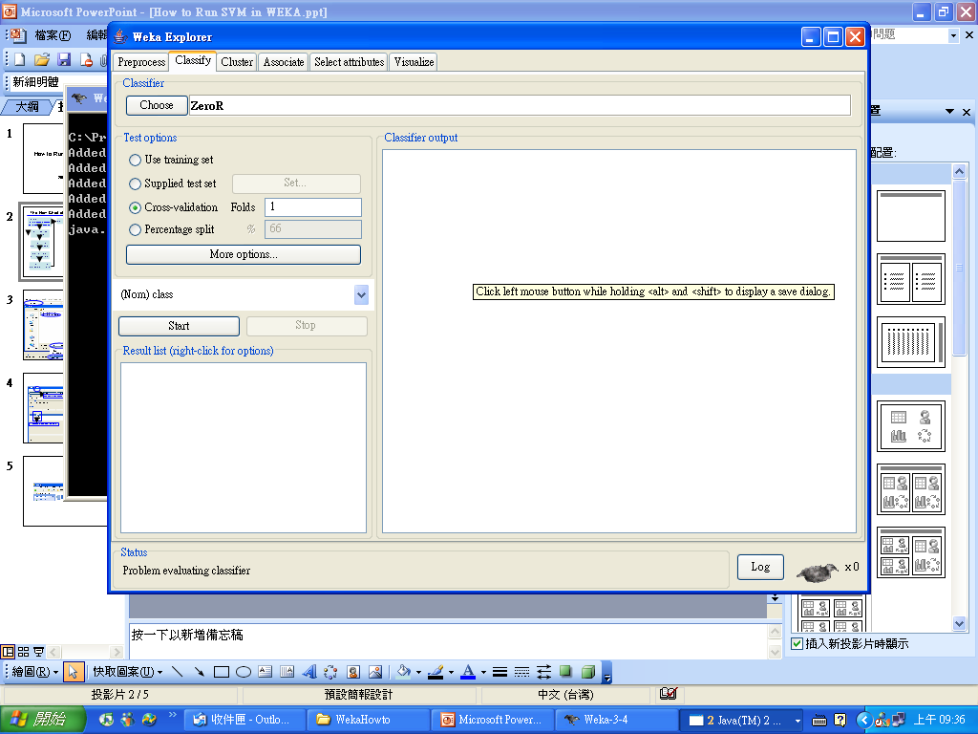
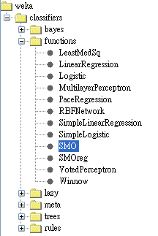
Choose SVM in WEKA

Slide 7
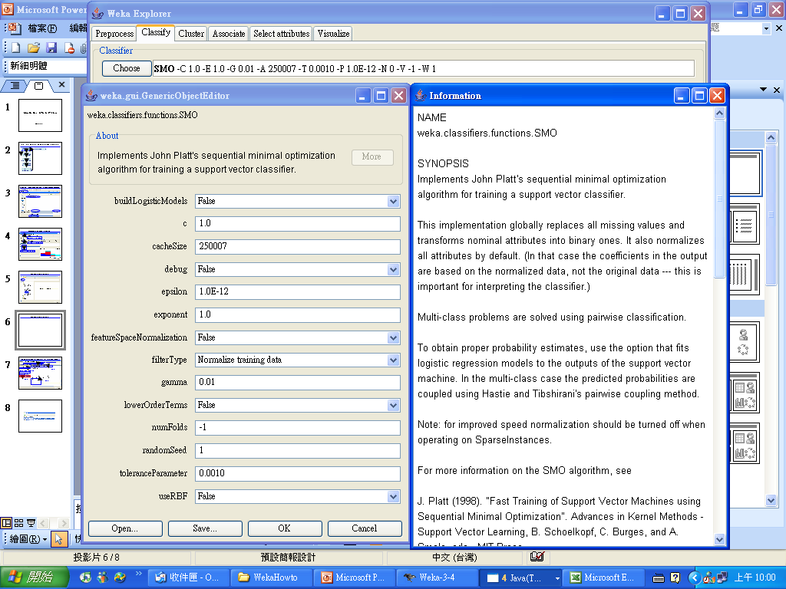
Choose Parameters in SVM with Information of Parameters
Using left bottom of mouse to click the white bar to show parameters window.
Pushing “more” show the definitions of parameter.

Slide 8
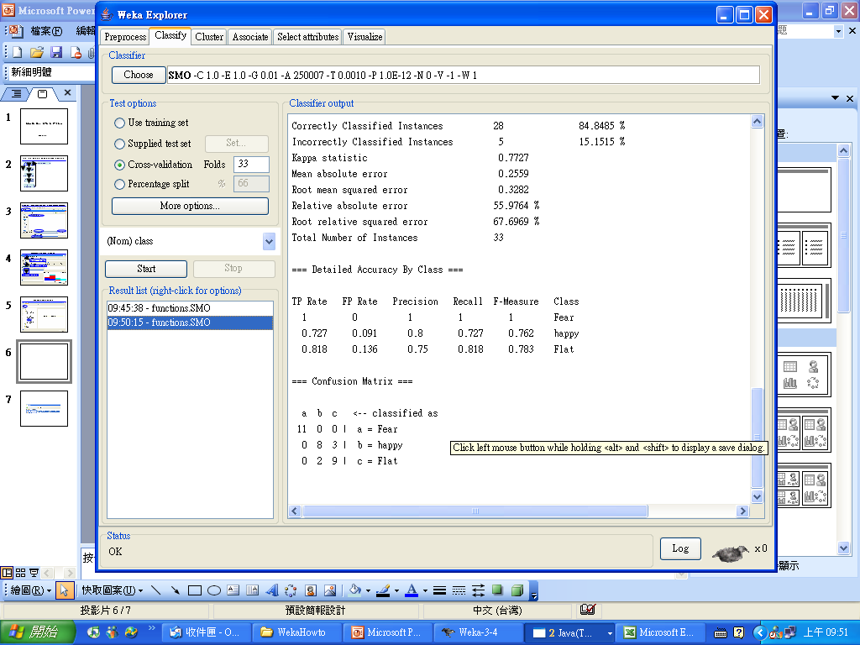
Running SVM in WEKA fro Training Data
SVM module with learning parameters
If numbers of fold = numbers of observation, then called “leave-one-out”.
Running results
Selected the response variables
Start running
Running results
Running results

Slide 9
Weka In C
Requirements
  WEKA
  http://www.cs.waikato.ac.nz/ml/weka/
  JAVA: (Free Download) http://www.java.com/zh_TW/download/index.jsp
  A C/C++ compiler
    DEV C++
    VC++
    Others

Slide 10
Demo NNge Run In C
NNge: (Nearest-neighbor-like algorithm)
1st step: Full name of Nneg.
[Name: weka.classifiers.rules.NNge]
2nd step: Understanding parameters of Nneg from Weka.
3rd step: Command line syntax
java -cp C:/Progra~1/Weka-3-4/weka.jar weka.classifiers.rules.NNge -G 5 -I 3 -t C:/Progra~1/Weka-3-4/data/weather.arff -x 10

Slide 11
Command line syntax
JAVA file for Weka
Command line syntax:
C:\>java -cp C:/Progra~1/Weka-3-4/weka.jar weka.classifiers.rules.NNge -G 5 -I 3 -t C:/Progra~1/Weka-3-4/data/weather.arff -x 10
- Description:
-t filename: Training data input
-G 5: Sets the number of attempts for generalization is 5.
-I 3: Sets the number of folder for mutual information is 3.
-x 10: 10-folds cross-validation
Full name of NNge in Weka
Training data must save as *.arff

Slide 12

Example C File
char SynStr[512];//Create String Variable
sprintf(SynStr,"java -cp C:/Progra~1/Weka-3-4/weka.jar weka.classifiers.rules.NNge -G %d -I %d -t %s -x %d > List.txt",iG,iI,argv[1],iX); //Print Command line syntax to SynStr
system(SynStr);//Now, Using system() to run it.
Viewing a Demo C Codes

Slide 13
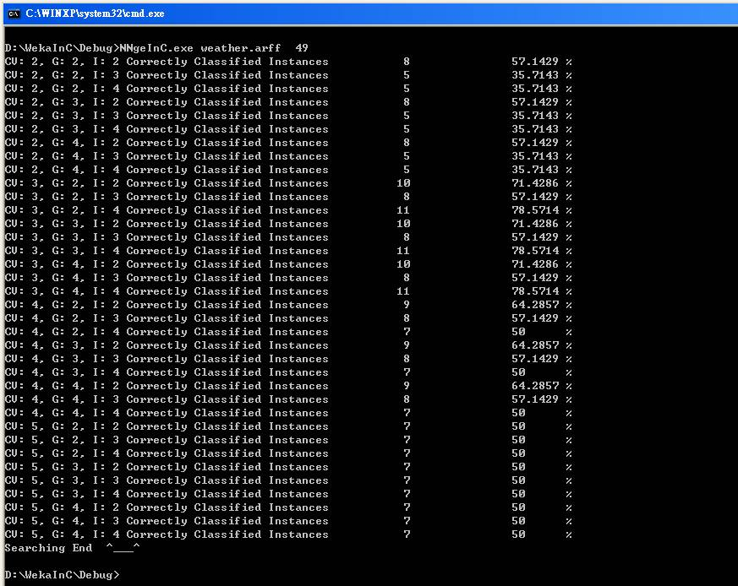

Slide 14
Enjoy It!
^________^

