Slide 1
Topic Modeling on Indian Research Papers
By:
Apoorva K H
Aarti Jivrajani
Debarati Das

Slide 2
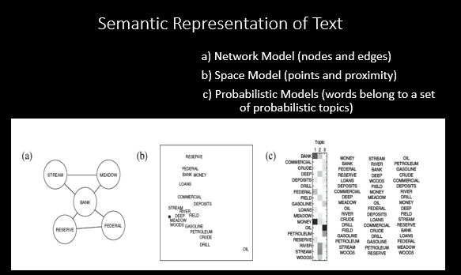
What is Text Mining ?

Slide 3
What is a “Topic” ?
A topic, in this context, can be described as a recurring pattern of co-occurring words.
A Topic can be thought of as a “BAG” of words.
ANALOGY 1 : TREASURE HUNT
ANALOGY 2 : HIGHLIGHTER

Slide 4
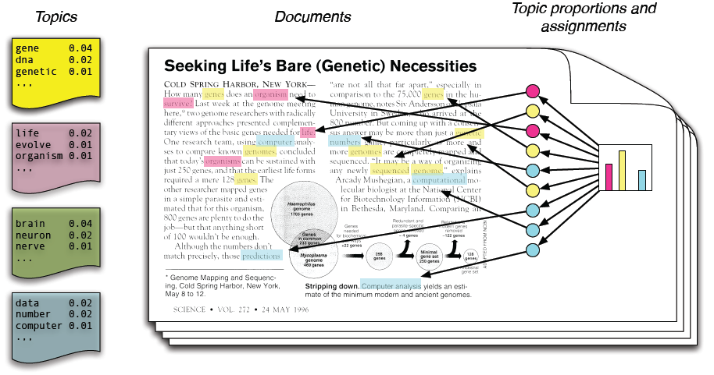
ANALOGY 2: A LAYMANS VIEW

Slide 5
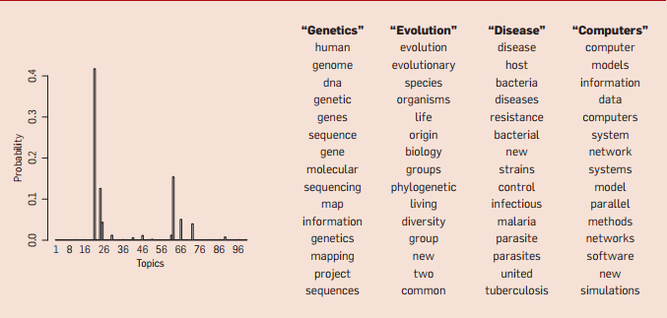

Slide 6
Problem Definition
Given Indian Research Papers from the year 2013 as a dataset – come up with a graphical depiction of all the major topics that exist in the dataset.
Using two different Topic modelling techniques and contrast them over the same dataset.
Using Graphical Metrics depict which topics were in vogue during the year 2013.
Supervised ML/Semi-supervised ML
Social Network Analysis
Graph Theory
Triad of Techniques Used

Slide 7
1.Text processing
Tokenization
Stop Word Removal
N-Grams Preservation
Cleaning the Dataset(Punctuation etc.)
Bag of Words

Slide 8
2. Topic Extraction
Topic Modeling programs do not know the meanings of words in a text
They assume that the author has composed that document by selecting words from possible baskets of words where each basket corresponds to a topics

Slide 9
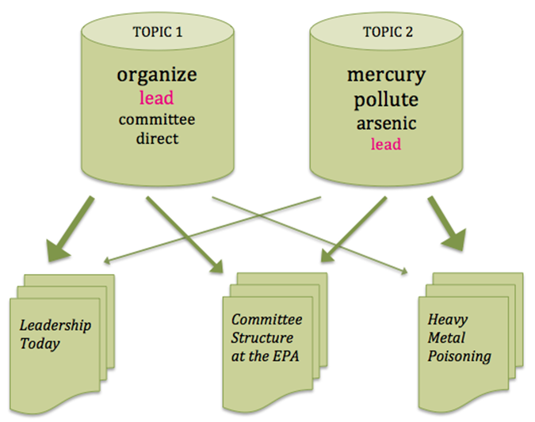
We mathematically decompose a text into the probable baskets from whence the words first came. The program goes through this process several times until it settles on the most likely distribution of words into baskets, which we call topics.

Slide 10
3.Two Approaches applied and compared:
Latent Dirichlet Allocation (Probabilistic Approach)
Non-Negative Matrix Factorization

Slide 11
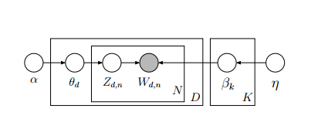
LATENT DIRICHLET ALLOCATION
LDA is a generative probabilistic model for collections such as text corpora.
LDA is a three-level hierarchical Bayesian model

Slide 12
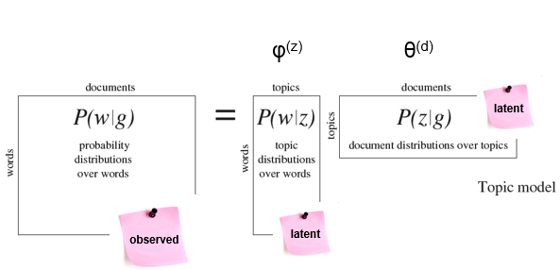
The algorithm involves asking two essential questions.
How much does the Document like the Topic?
How much does the Topic like the Word?
There are three variables that appears from this process.

Slide 13
Non-Negative Matrix Factorization
(NMF)
NMF (Non-negative matrix factorization) is a semi-supervised family of algorithms that simultaneously perform dimension reduction and clustering.
NMF produces a “parts-based” decomposition of the latent relationships in a data matrix.

Slide 14
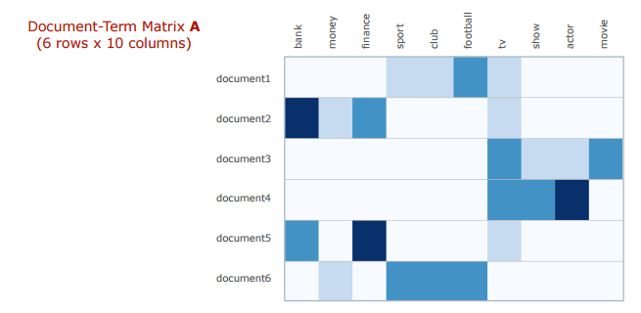
Construct vector space model for documents (after stopword filtering), resulting in a term-document matrix A. Here each row is a document, each term is a column, and a blue entry indicates that a term appears in a document at least once.

Slide 15
Apply TF-IDF term weight normalisation to A.
Normalize TF-IDF vectors to unit length.
Initialise factors
Apply Projected Gradient NMF to A.

Slide 16
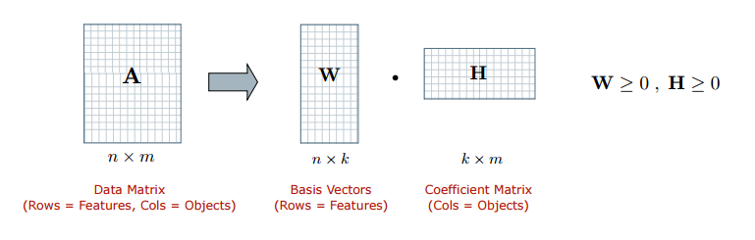
Factorizes it into two smaller non-negative matrices W and H, each having k dimensions.
The rows of the matrix W provides weights for the input documents relative to the k topics – these values indicate the strength of association between documents and topics. The columns of the matrix W provide weights for the terms relative to the topics

Slide 17
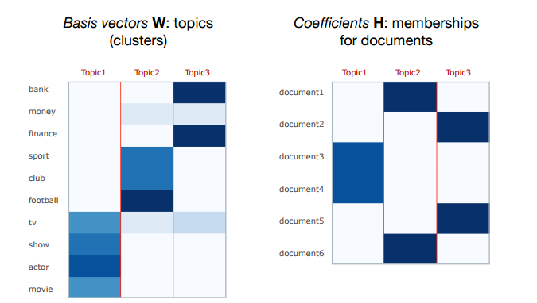
The resulting k topics are defined by: (a) topic descriptions as given by the top-ranked terms in the columns of the factor W; (b) document membership weights as given by the values in the rows of H.

Slide 18
N-GRAM PRESERVATION
Initially Topics were obtained in the form of Bag of Words(BOW)
These Words are combined to get n-grams
The Dataset contains descriptors for each Research paper
Keeping descriptors as reference, the n-grams were obtained and inserted back into the bag of words

Slide 19
Result Analysis
1. How many topics should be learned?
2. How many learned topics are useful?
3. How do these topics relate to often used semantic tests?
4. How well do these topics identify similar documents?
Topic Coherence measures score a single topic by measuring the degree of semantic similarity between high scoring words in the topic. There are two measures

Slide 20
Both measures compute the coherence of a topic as the sum of pairwise distributional similarity
The UCI metric(Newmann.) :
Computed by counting word co-occurrence frequencies.
This metric can be thought of as an extrinsic comparison to known semantic evaluations.
The UMass metric(Mimno):
defines the score to be based on document co-occurrence
This metric is more intrinsic in nature.
It attempts to confirm that the models learned data are in the corpus.

Slide 21
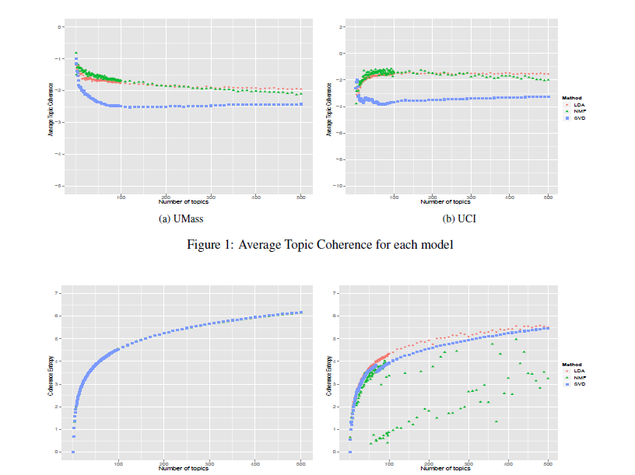

Slide 22
