Slide 1
An Econometric Analysis of Obesity
Debarshi Dutta

Slide 2
Adult BMI and Obesity
BMI* – ratio of the weight (in Kg) and the square of height (in m)
Unit: kg/m²
An adult is obese* if their calculated BMI is 30.0 or above.
BMI range | Category
<18.5 | Underweight
18.5 - <25.0 | Normal
25.0 - <30.0 | Overweight
>=30.0 | Obese
Notes:
Class 1: BMI of 30 to < 35
Class 2: BMI of 35 to < 40
Class 3: BMI of 40 or higher. Class 3 obesity is sometimes categorized as “extreme” or “severe” obesity.

Slide 3
Obesity- an epidemic
Obesity is recognized as a standalone disease by the CDC
Leads to co-morbidities like
Type 2 diabetes and prediabetes
Cancer
Coronary Artery Disease (CAD)
Obesity in children is rising as well
causes dyslipidemia, hypertension, and hyperinsulinemia later in life

Slide 4
Obesity- in numbers
Prevalence in Adults*
42.4% in 2017-2018.
Spike of ~12% from 1999–2000
Severe obesity increased from 4.7% to 9.2%
Prevalence in Children*
18.5% = ~13.7 million children and adolescents (aged 2-19)
Obesity is expensive to treat ($$$$)
Estimated annual medical cost - $147 billion (2008)
+$1,429 in average more than the non obese people/year

Slide 5
Motivation: What is the working hypothesis
Who is most susceptible-
Low income households
Households with no cars
Low access to grocery stores
Families with children eligible for free lunch
Participants of the SNAP program
WIC participants

Slide 6
The Data
The data is from the USDA ATLAS
It is collected from multiple sources and cover a range of years and geographic levels.
Obesity rates in the data set used in the paper are from 2010 released in 2011 by the USDA.
The data comprises of two hundred and eleven variables in three categories-
Food Choices- the proximity of the population divided by counties to healthy, affordable food
Health and Well being- describes diabetes, and obesity rates
Community Characteristics- demography divided by age and race, income and poverty, metro and non metro status of a county, availability of recreational facilities.

Slide 7
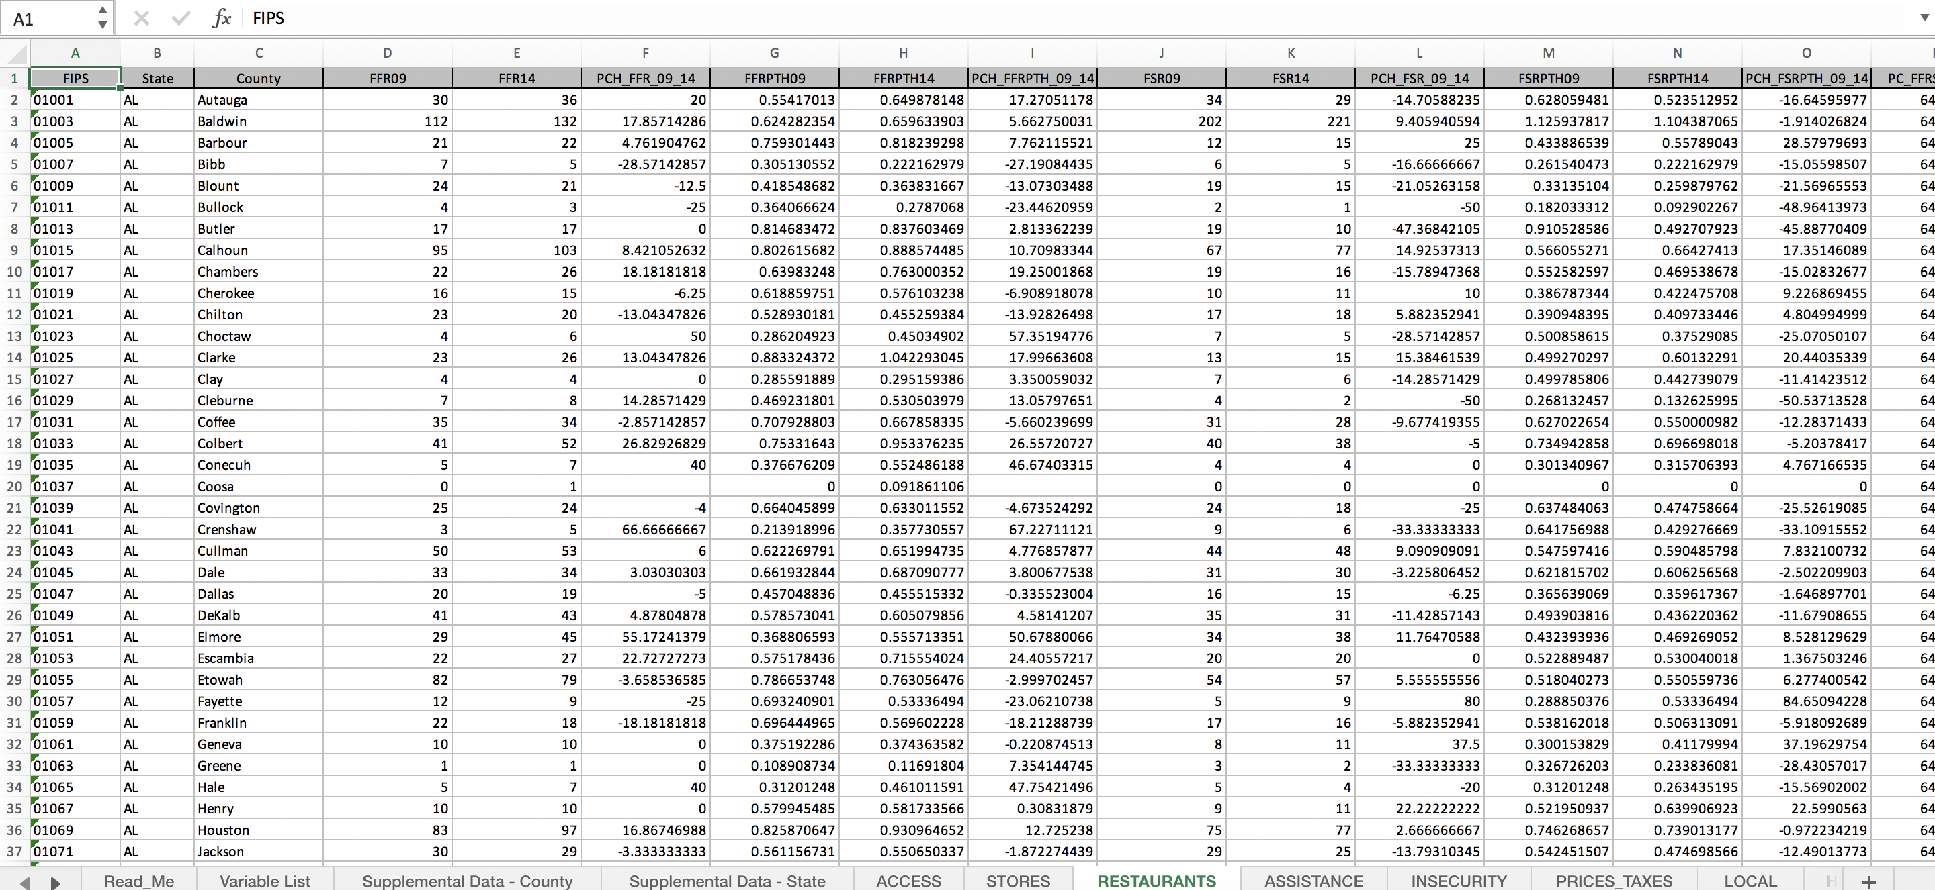
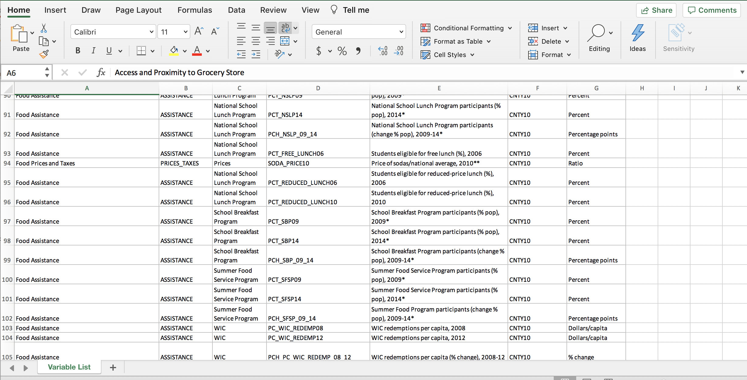
The Data

Slide 8
Pre-Processing
The data is available across multiple excel sheets.
Was combined into one comma separated value file containing sixty six relevant columns
The general principle of operation for combining the data was, that after importing a spreadsheet, the feature correlation was collected.
The features with low correlation were dropped.
Dependent variable- adult obesity rate*, is for the year 2010.
Any data after that year was dropped
For data missing for the year 2010, the available data closest to 2010 was used

Slide 9
Training and Testing
EDA of Training Data
Modeling
Testing

Slide 10
Training and Testing
EDA of Training Data
Modeling
Testing

Slide 11
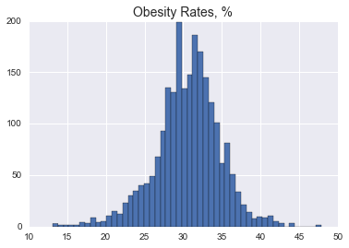
EDA of Training Data
Outliers- using Histogram analysis
Notes:
A histogram analysis (5.1) was performed for the outliersof the dependent variable (PCTOBESEADULTS10). Any value beyond three standard deviations of the mean of thedependent variable is defined as an outlier.There are 23 rows with outliers in the outcome variable n the training data

Slide 12
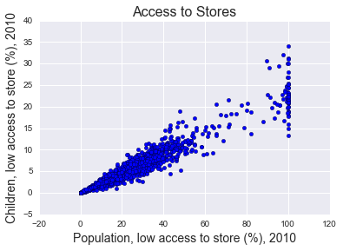
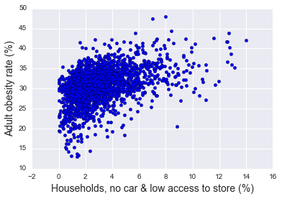
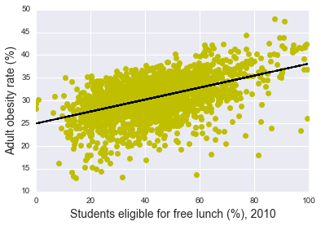
EDA of Training Data
Correlation of the Adult Obesity Percent to Low income households
All 'Access and Proximity' predictor variables with the exception of PCT_LACCESS_HHNV10 are highly correlated
Notes:
Low income households- No car and low access to grocery stores
• Households with students eligible for free lunch

Slide 13
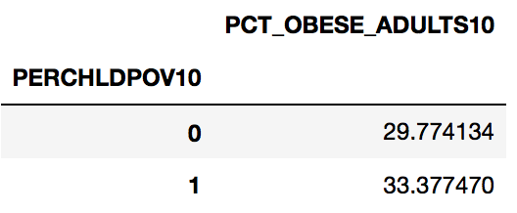
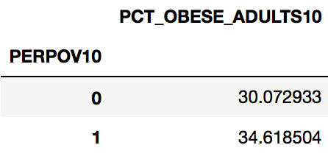
EDA of Training Data
average of obesity rate for Persistent-poverty counties, 2010
average of obesity rate for Persistent-child-poverty counties, 2010

Slide 14
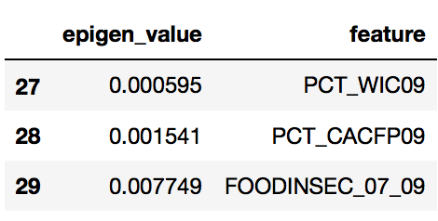
EDA of Training Data
Test for Multicollinearity
Eigen values and Eigen Vectors were used
The Eigen vectors were found for the features who Eigen values were close to zero
Features with eigen vectors that are NOT close to zero i.e strong correlation
The best feature was kept for testing and the rest were dropped
WIC participants (% pop), 2009
Child & Adult Care (% pop), 2009
Household food insecurity (%, three-year average), 2007-09
Notes:
Multicollinearity is a problem which occurs if one of the columns of the X matrix is exactly or nearly a linear combination of the other columns
multicollinearity will be approximate, arising from the fact that our explanatory variables are correlated with each other (i.e. they essentially measure the same thing
If one of the eigenvalues is zero then the matrix is singular

Slide 15
Training and Testing
EDA of Training Data
Modeling
Testing

Slide 16
Modeling
Two modeling techniques used
Random Forest
Linear Regression

Slide 17
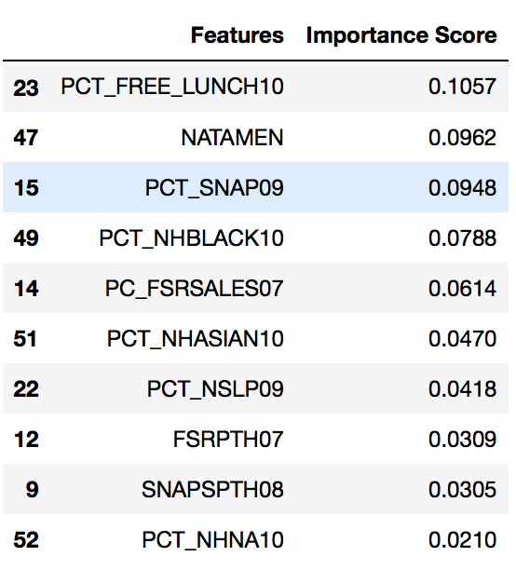
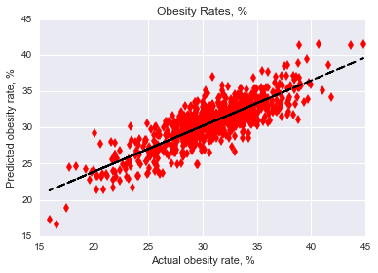
Modeling
Random Forest*
Used to find feature importance
Estimators (n) =100
MSE for training set = 5.39
R-squared = 0.685776
Notes:
NATAMEN - ERS natural amenity index, 1999

Slide 18
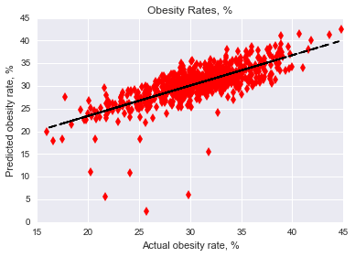
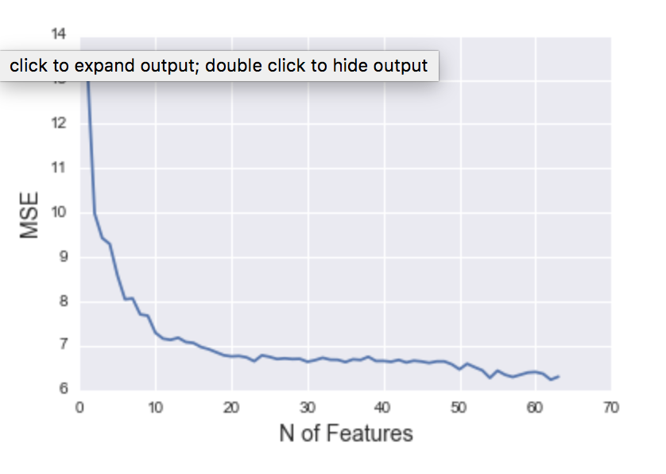
Modeling
Linear Regression Model*
MSE for training set = 8.619311726714356
Notes:
NATAMEN - ERS natural amenity index, 1999

Slide 19
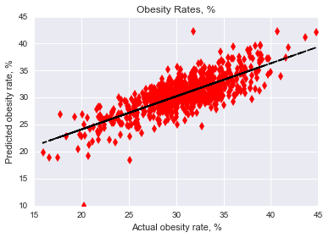
Modeling
Linear Regression Model with top 80% features from Random Forest
Top 80% of features by importance score
22 features
MSE for training set = 7.660215
R-squared = 0.588249
Notes:
NATAMEN - ERS natural amenity index, 1999

Slide 20

Analysis
Linear Regression Model without outliers
Notes:
NATAMEN - ERS natural amenity index, 1999

Slide 21
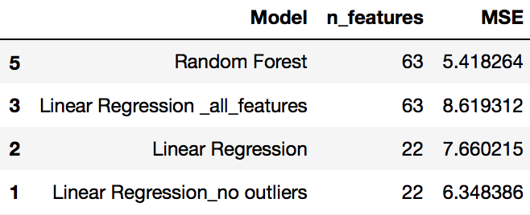
Training
Training model performance comparison
Notes:
NATAMEN - ERS natural amenity index, 1999

Slide 22
Training and Testing
EDA of Training Data
Modeling
Testing

Slide 23
Testing
The trained model was tested with the all non- collinear features and best feature out of collinear feature set.
MSE calculated - 9.3571769776865317
Notes:
NATAMEN - ERS natural amenity index, 1999

Slide 24
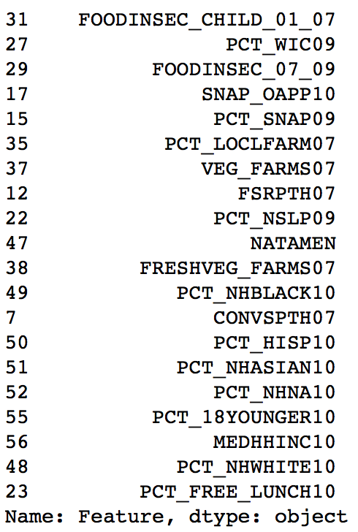
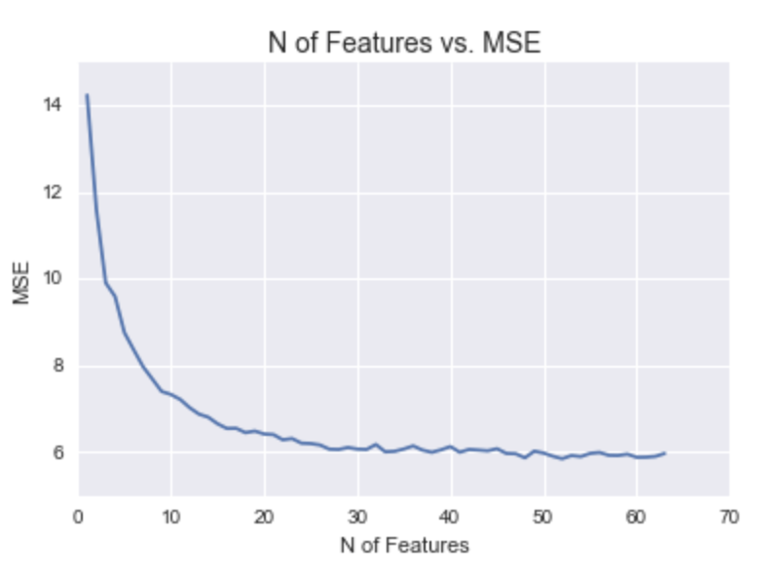
Feature Selection
Technique used - Recursive Feature Elimination*

Slide 25
Conclusion
Counties with a high poverty rate have around 4-5% higher obesity rate than others.
Percentage of students in a county who are eligible for free lunch program have the strongest correlation with a predictor variable, that is they are at a higher risk than others to be obese- which is the other hypothesis.
The feature selection from the Linear Regression model shows that
child food insecurity percentage in households aggregated over the years 2001-07 is the highest ranked feature. This is significant because the response variable adult obesity rateis for the year 2010.
Inferences made from the other top features such as- WIC participants from the year 2009, state widefood insecurity aggregated over 2007-09 and SNAP participants from year 2009 also verify the initial hypothesis

Slide 26
THANK YOU!

