Slide 1
CISC 5352- Artificial Intelligence in Fintech Quiz (2)
Debarshi Dutta

Slide 2
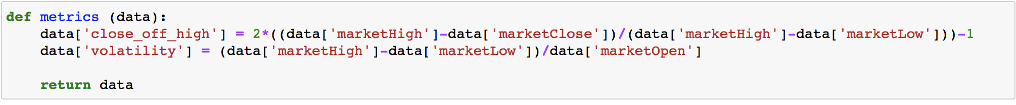
Two new variables added
Close off high
Volatility

Slide 3
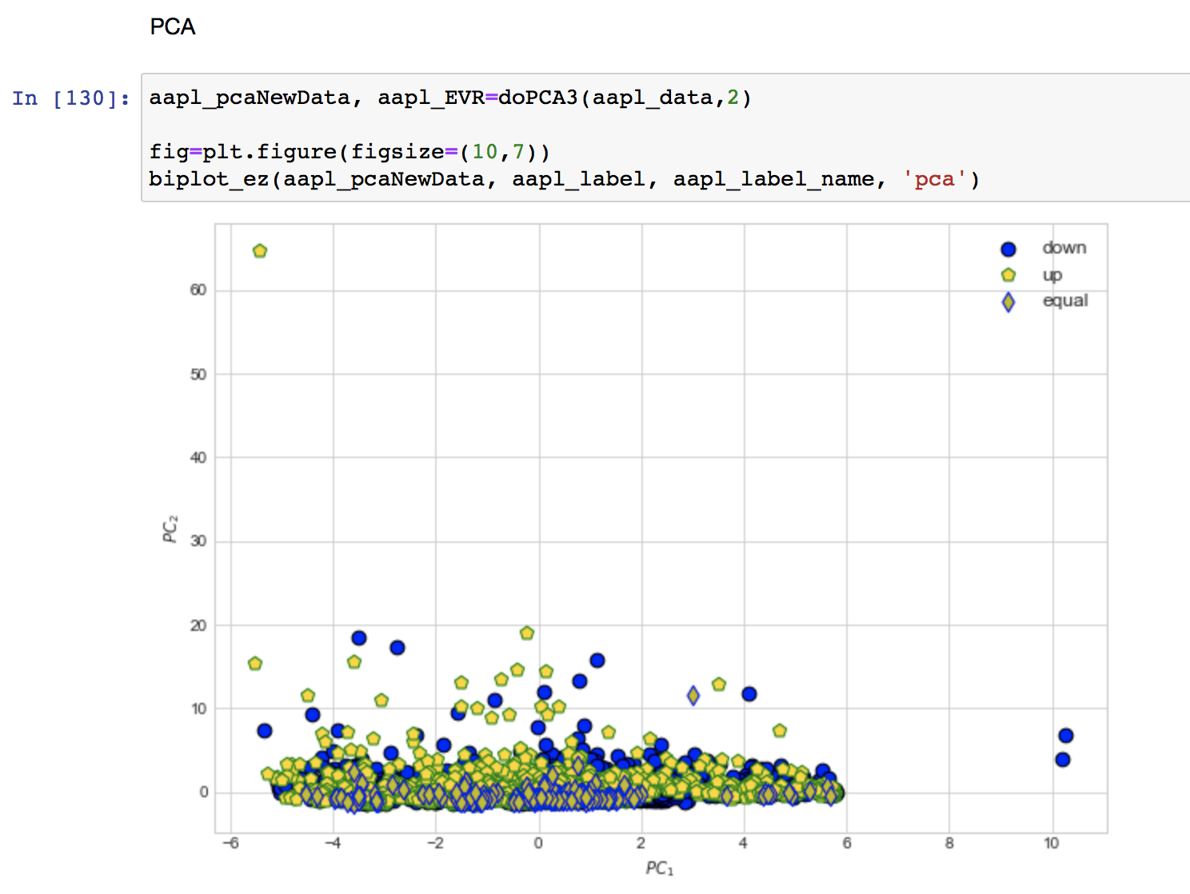
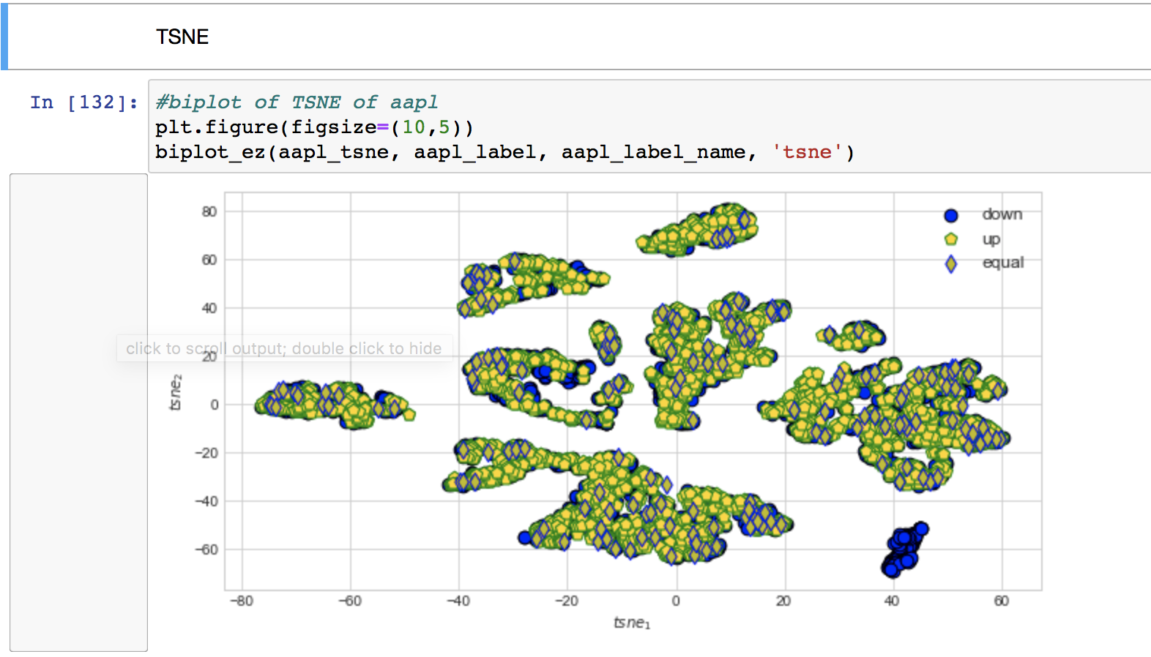
Biplot - AAPL

Slide 4
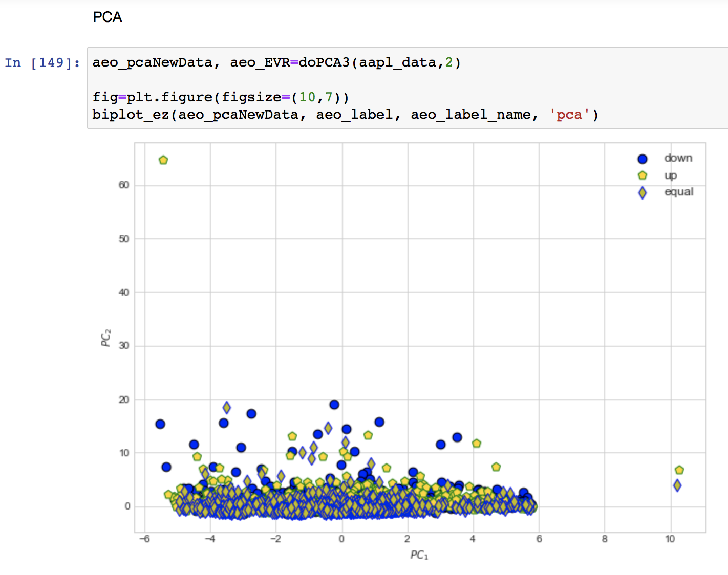
AEO
The t-SNE biplot for the AEO dataset threw up an error. This is due to the existence of Nan’s the introduction of the two new metrics have led to.
So t-SNE is more sensitive to the addition of new variables

Slide 5
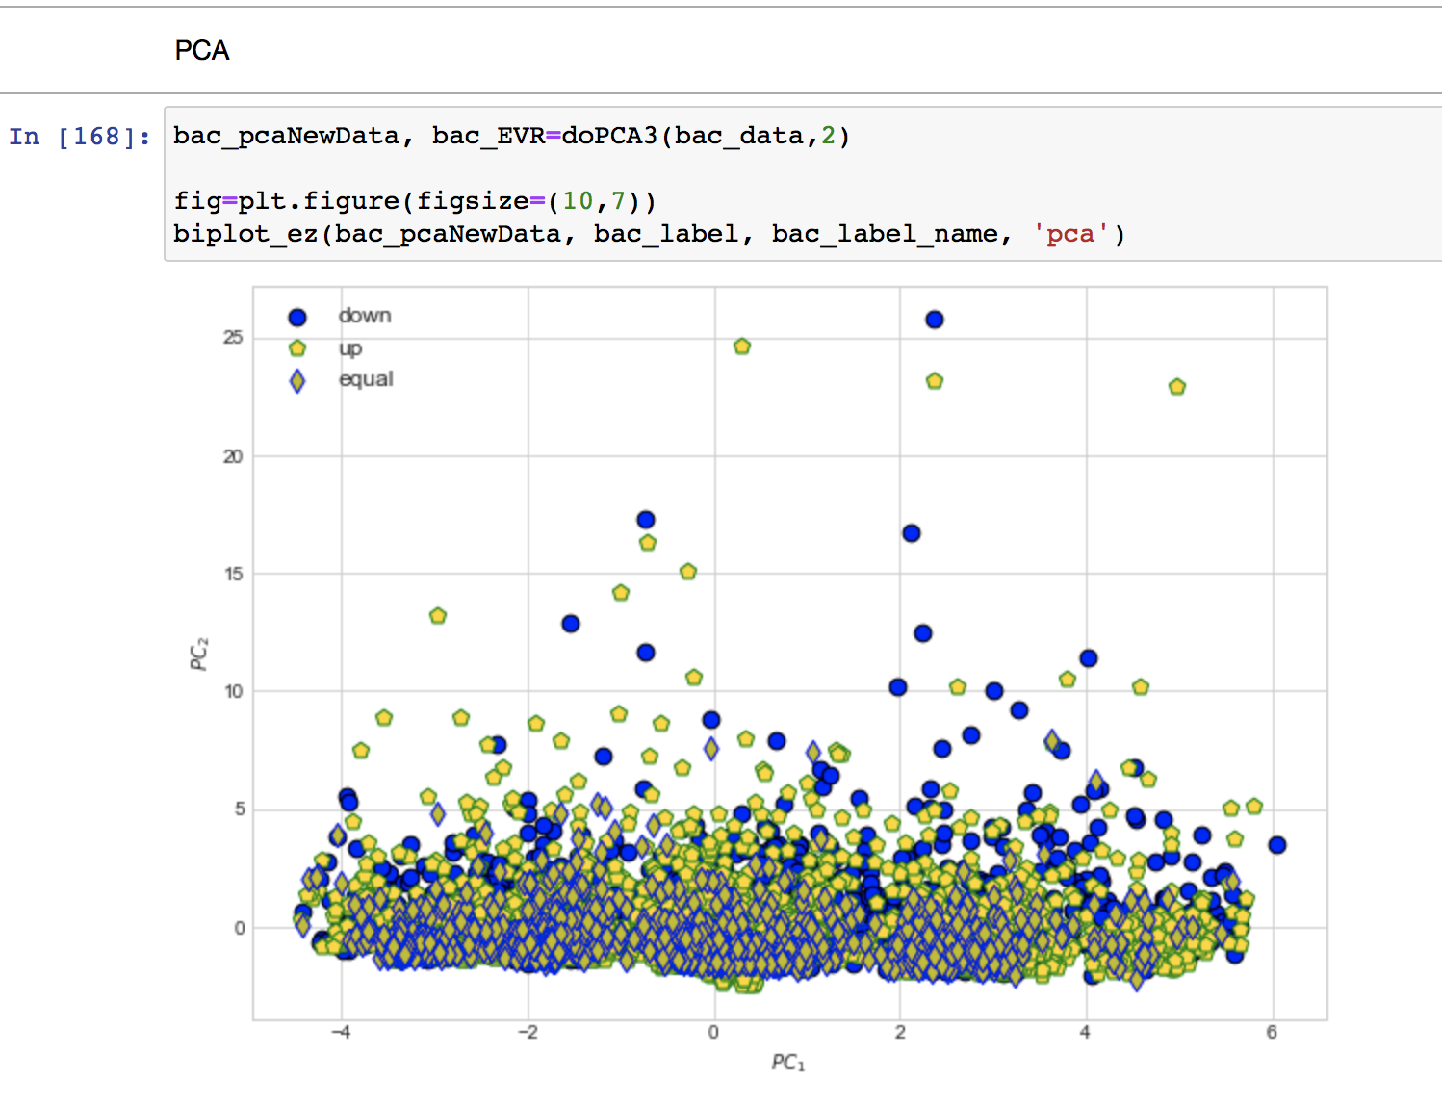
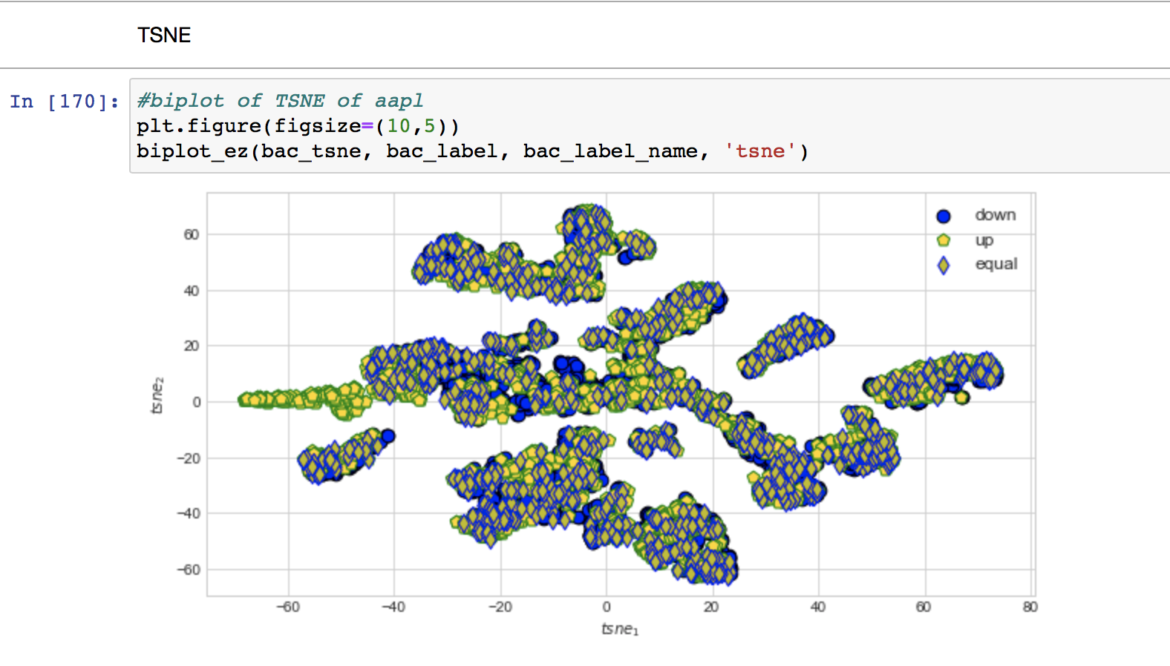
BAC

Slide 6
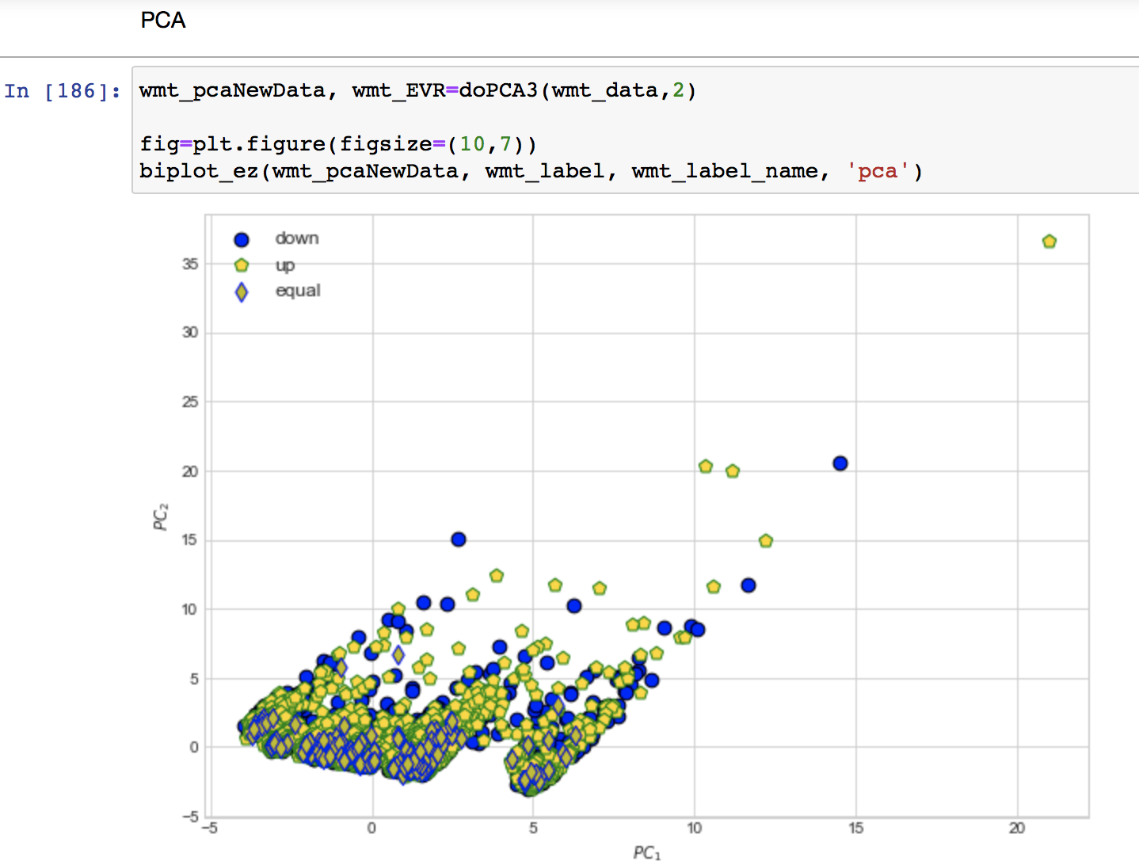
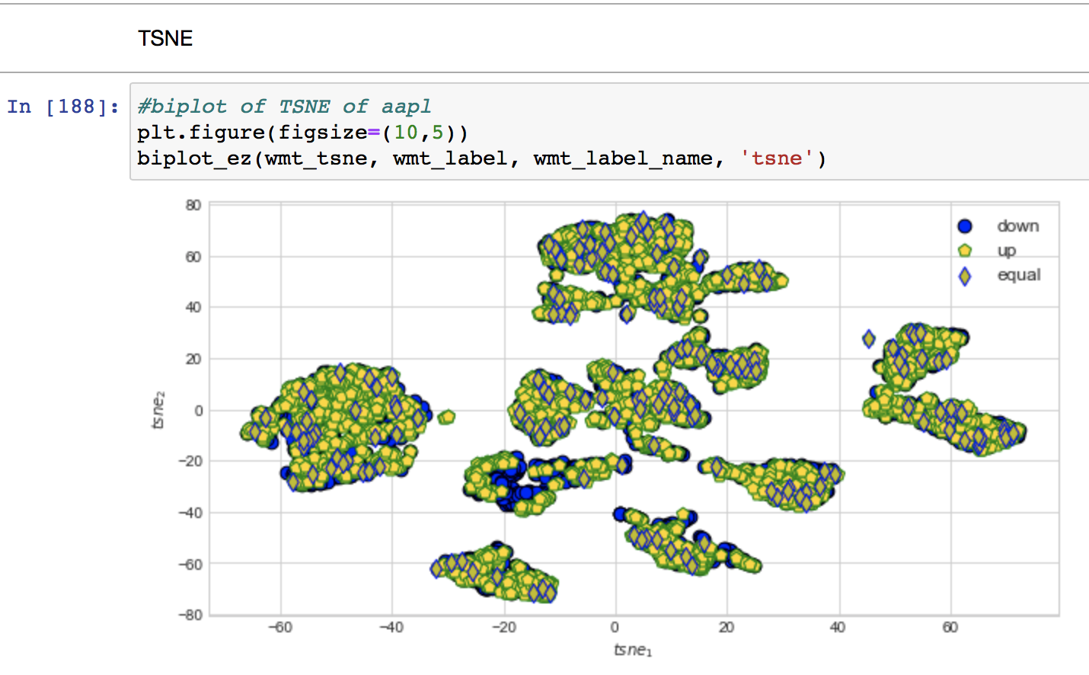
WMT

Slide 7
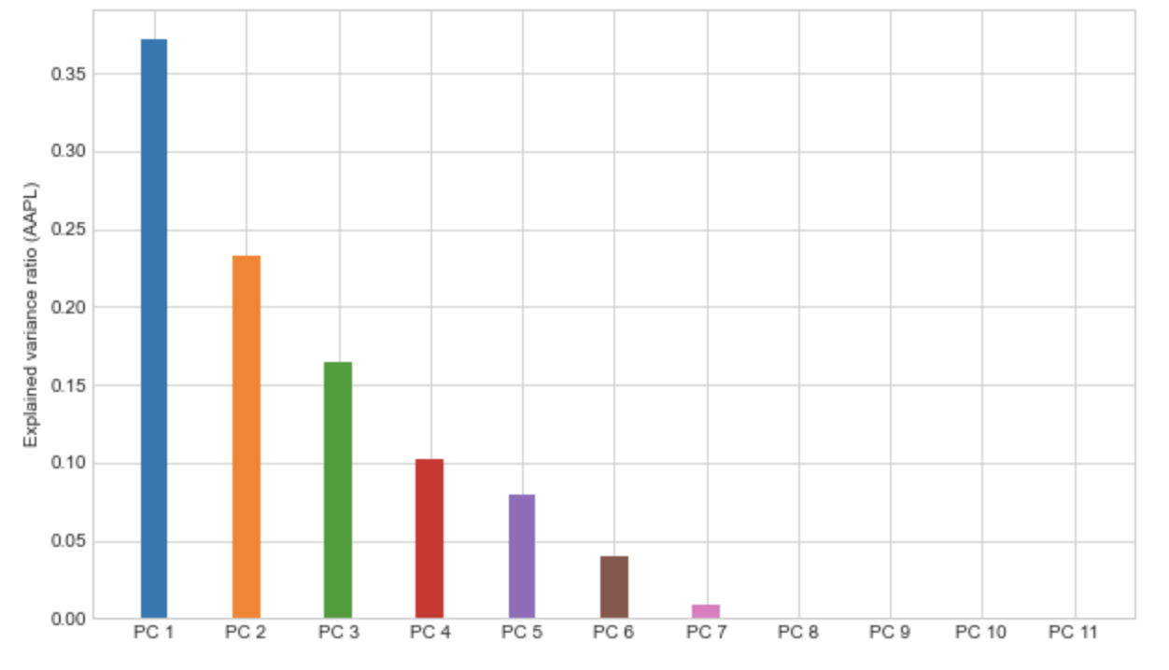
AAPL - EVR

Slide 8
Find five nearest neighbors of each sample in the input space and its projection in the PCA subspace. How many percents of a neighbor will repeat themselves in the PCA subspace?

Slide 9
Steps
Finding the top 5 neighbors for the raw data
Normalize the data
Find the pairwise distance matrix relative to every datapoint
Databases have 5850 rows
So this will be a dataframe of dimension 5850 x 5850
Sort the above by row to get an index matrix
Slice the top 5 columns for the nearest 5 neighbors
Finding the top 5 neighbors for the PCA subspace
Project the raw data in the PCA subspace
Repeat the above three steps after
Slice the top 5 columns for the nearest 5 neighbors
Finding the overlap
Merge the two matrices of the raw data and the PCA data
the number of columns indicates the overlap

Slide 10
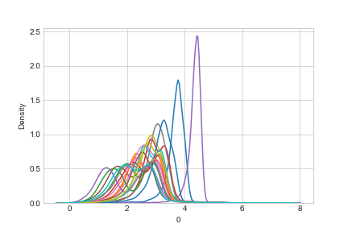
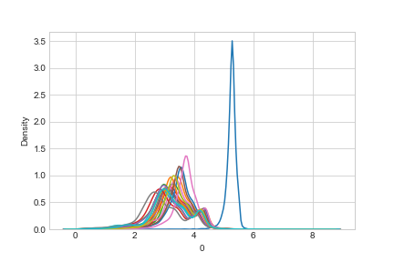
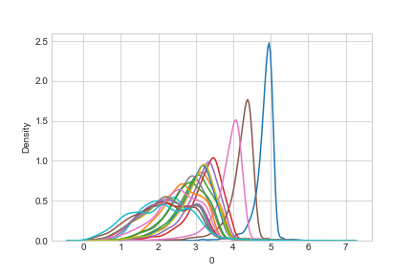
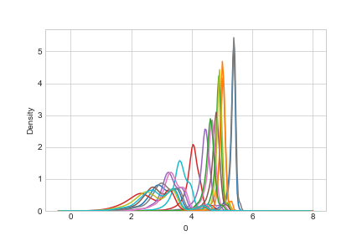
KDE plot of the sorting
distances
Clockwise from top left-
AAPL, AEO, WMT, BMC

Slide 11
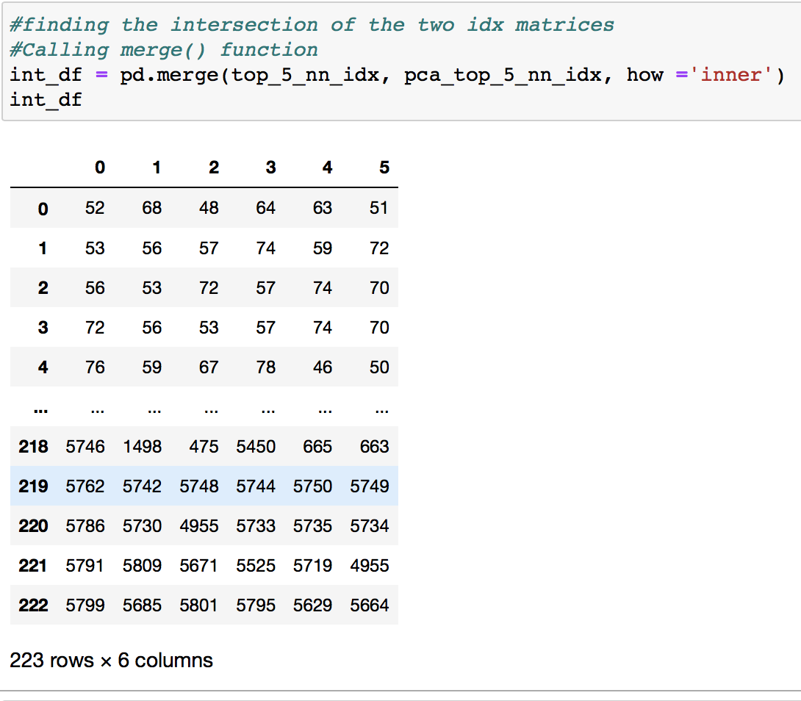
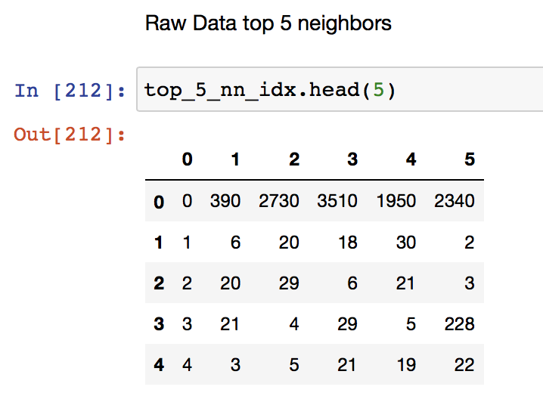
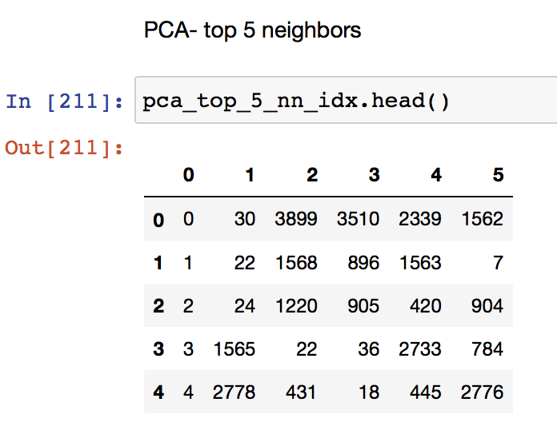
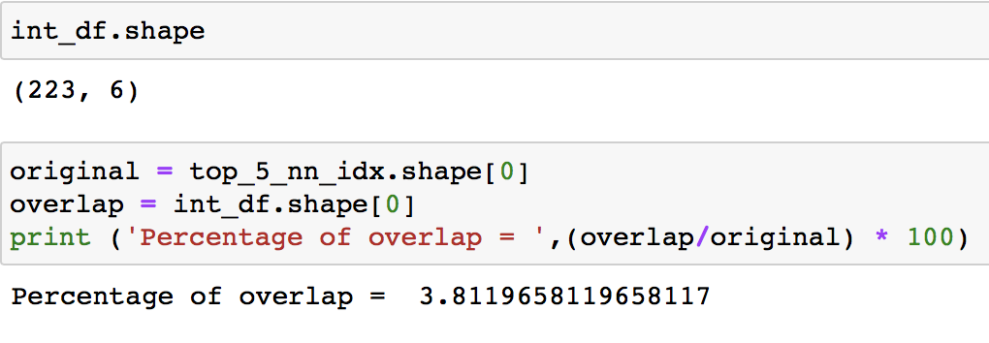
AAPL
Overlap

Slide 12
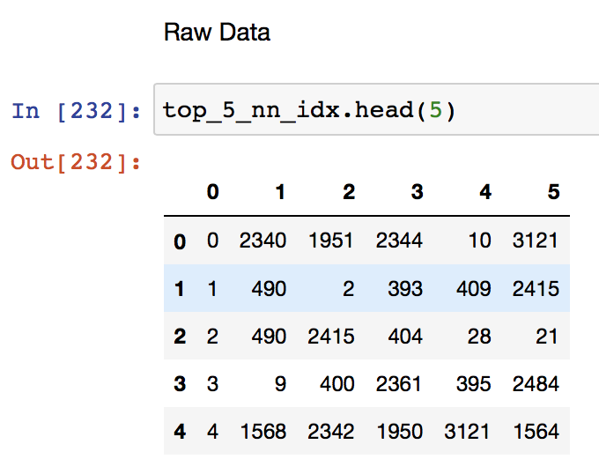
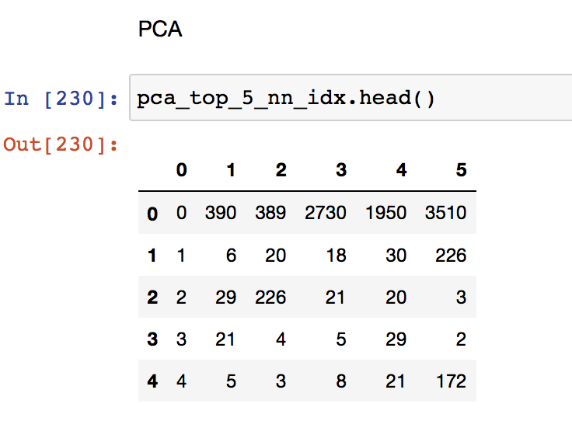
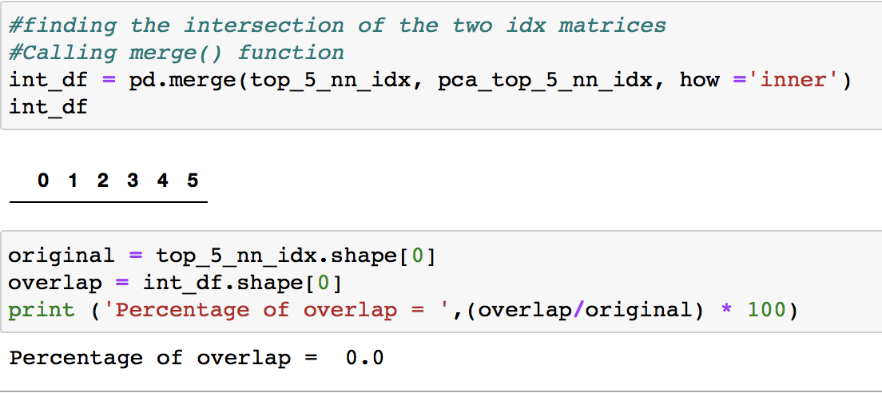
AEO
Overlap

Slide 13
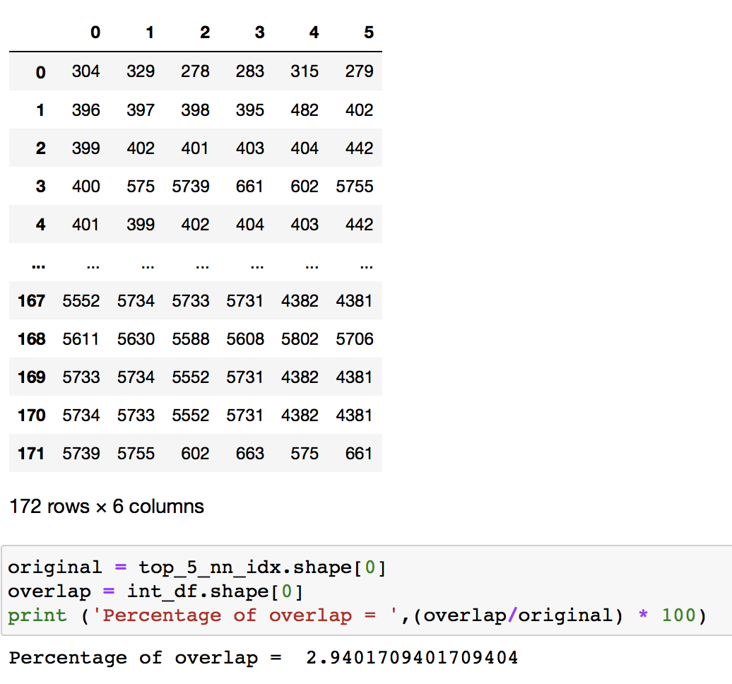
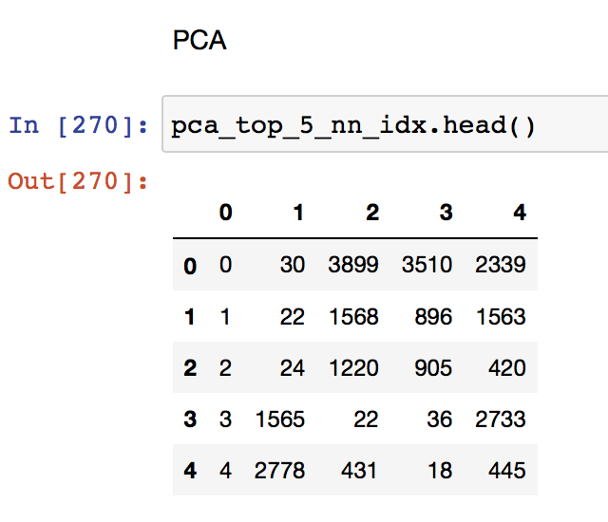
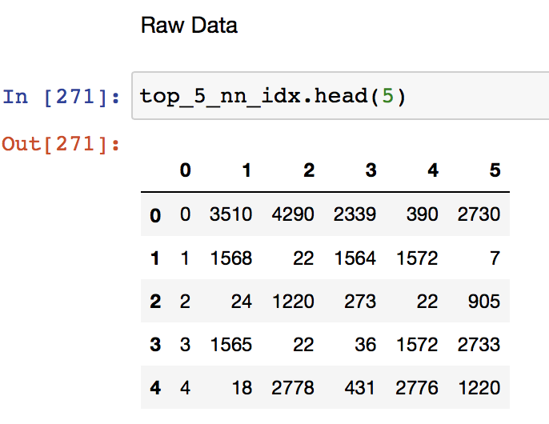
BAC Dataset
Overlap
Top 5 Neighbors

Slide 14
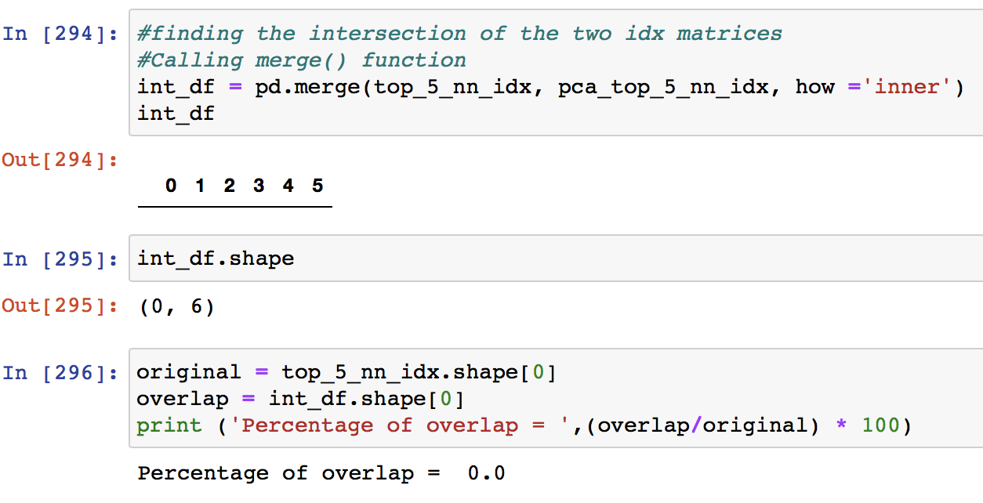
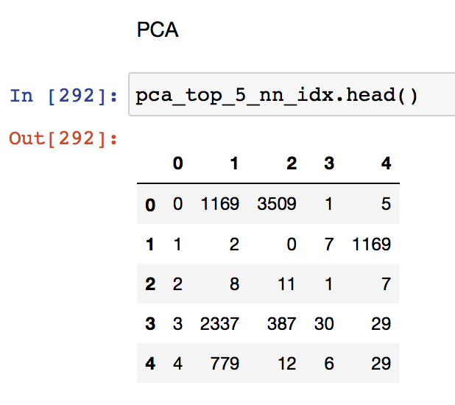
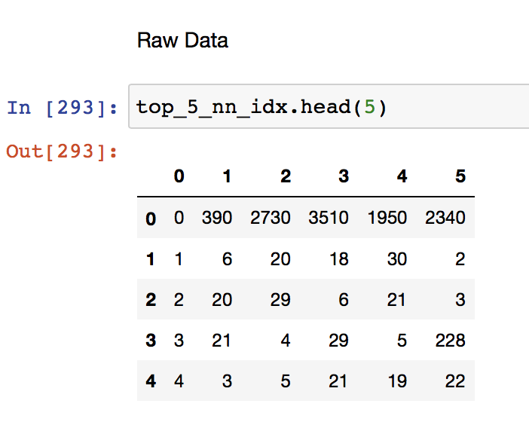
WMT Dataset
Overlap
Top 5 Neighbors

Slide 15
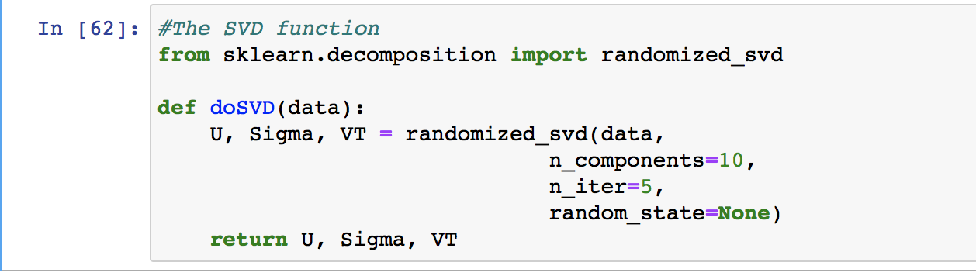
Using SVD to find top features
SVD function- randomized_svd from sklearn.decomposition
The function
Takes an np array as input
Returns three variables
U is the column orthogonal matrix, which is the decomposed matrix.
Sigma is the diagonal matrix
VT is the column orthogonal matrix

Slide 16
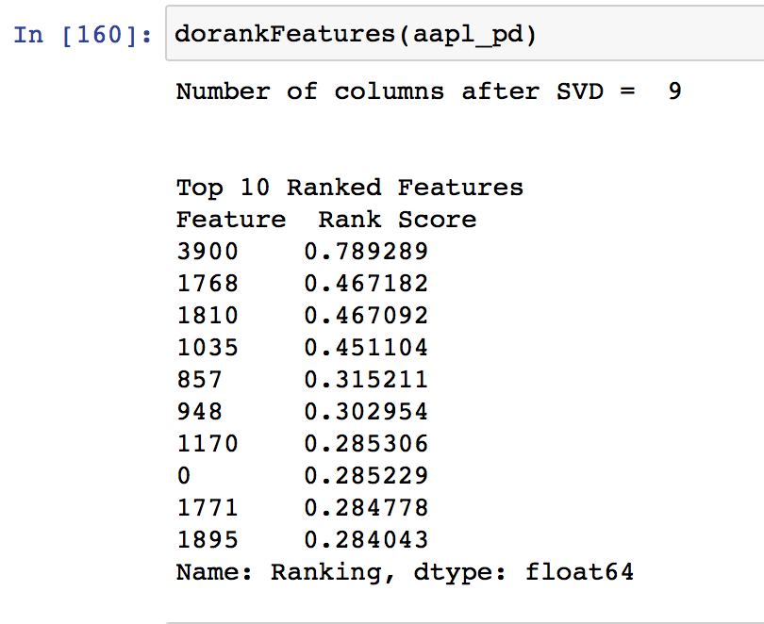
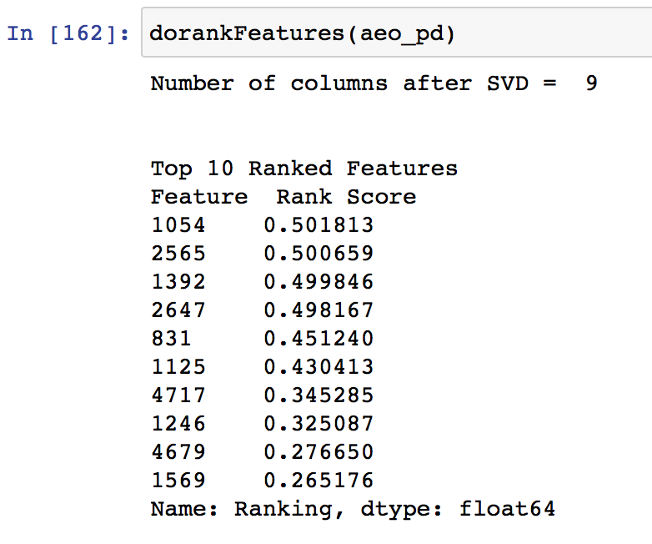
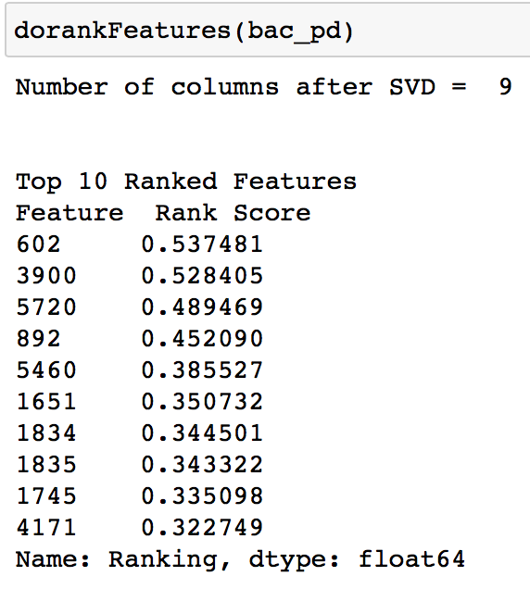
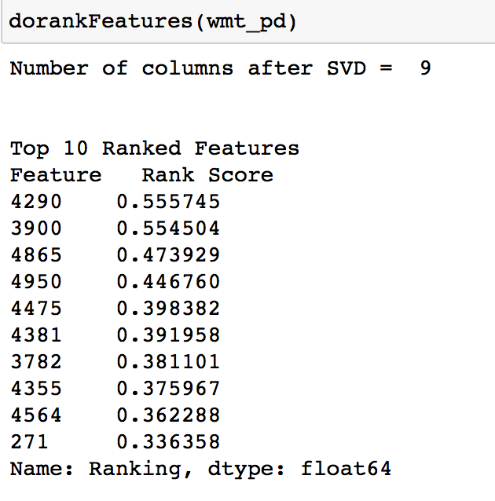
Output
Clockwise from top left-
AAPL, AEO, WMT, BAC

