Slide 1
CISC 5352 MiniProject: Machine learning in Implied volatility Pricing and Credit risk analytics
Debarshi Dutta

Slide 2
Selective Learning analytics (80 points)
• dataset: NBoption.csv
• Visualize OTM, ITM, and ATM by using PCA, t-SNE and UMAP

Slide 3
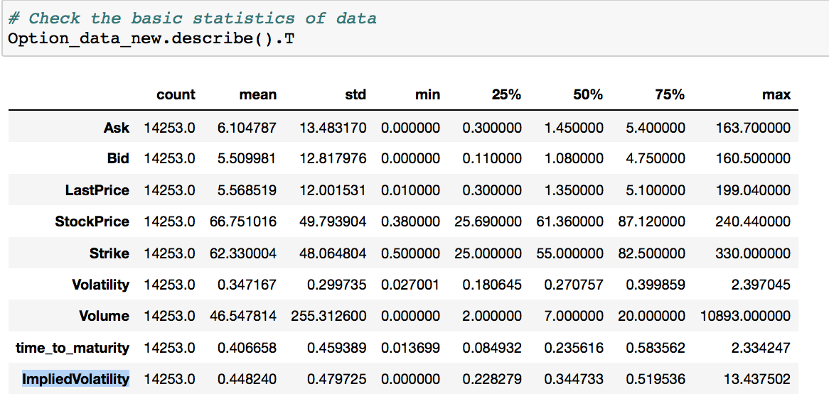
The Option Data
Book-Keeping The DataType column was dropped
The column ImpliedVolatility is the label
The data was normalized using the MinMaxScaler

Slide 4
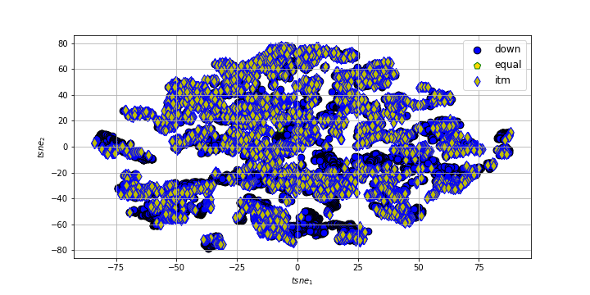
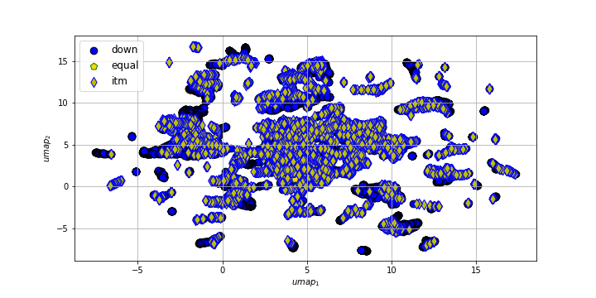
Selective Learning analytics
t-SNE
UMAP
*Perplexity of t-SNE is taken as 50
For UMAP - n_neighbors=10,min_dist=0.1,metric='euclidean',init='random'

Slide 5
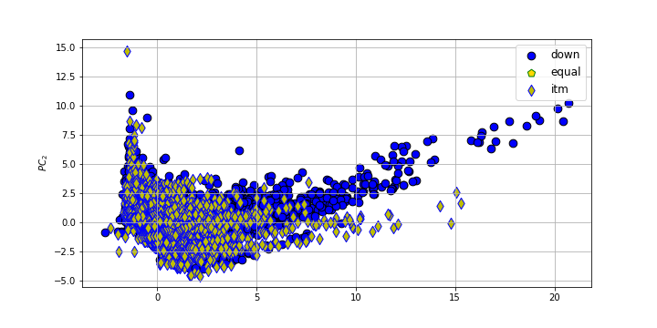
Selective Learning analytics
PCA

Slide 6
Selective Learning analytics (80 points)
The number of nearest neighbors: k = 10
– Note: you should try selective learning both two stages: training
clean and test clean
– It’s your freedom
∗ to choose kernels in SVM
∗ to choose distance measures in k-NN
– Only do adaptive learning for SVM and the dataset
– Why do OTM options fit machine learning better?
– Apply adaptive learning to your option data.
Apply selective learning for this dataset and compare its results with original machine learning methods
– Learning machines: k-NN, SVM, Random forest, DNN, anad Gradieent boosting
– Training/test partition: 80% training data and 20% test data
– Train-train/train-test partition: 80%: 20%
– Bad guys: the samples whose values error = |V olatility−predictedV olatility| are at the bottom 10% of all train-test samples
–

Slide 7
R² score
The Regression score is calculated through the r2_score method, which is part of sklearn.metrics library
Syntax:
r2_score(test_data_impliedVolatility,predictedImpliedVotatility)
test_data_impliedVolatility - is the y_train_label after partitioning the data predictedImpliedVotatility- is the predicted y_train_label after testing the trained model
R2_score is an indication of the fit of the model

Slide 8
The “bad guys”
Steps:
Calculate error = abs*(predictedImpliedVotatility- test_data_impliedVolatility)
Sort the error in descending order, so that the highest error is at the top
Multiply the length of the error array with 0.01 (for the top 10% error values), (let this value be x)
The length of the array in this case is 28.5, so the round function was used
The length is 29
Slicing the error array from 0 to x will have the datapoints in decreasing order of error value, with the highest being at the top.
* indicates absolute value

Slide 9

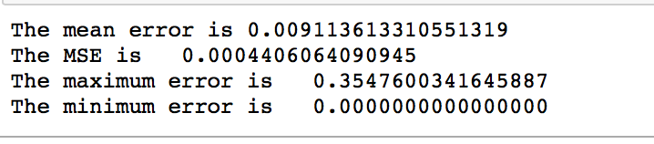
k-NN
Performance
Parameters
n_neighbors=10, weights='distance', metric='manhattan'

Slide 10
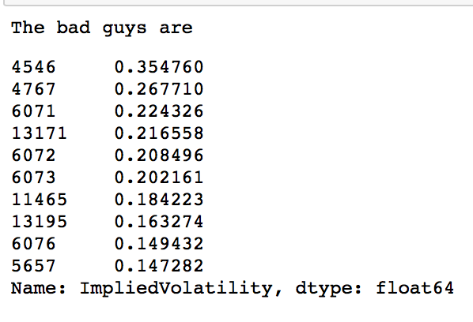
k-NN: Bad guys

Slide 11
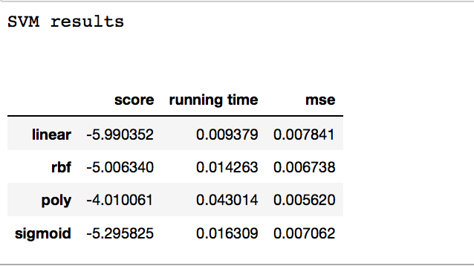
SVM
Parameters-
k = 10
test_percent=0.4
random_state=42
Kernels used
linear
Rbf
Poly'
sigmoid

Slide 12

Random Forest
Parameters
'n_estimators': 30, 'Max_depth':8, 'min_samples_split': 2
Performance

Slide 13
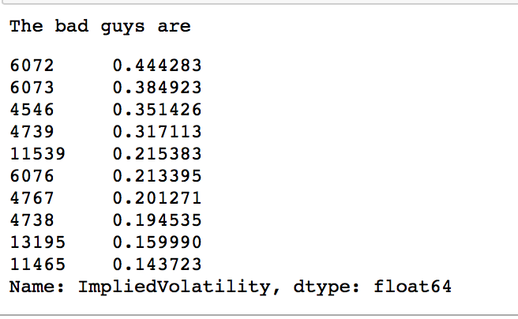
Random Forest: Bad guys

Slide 14

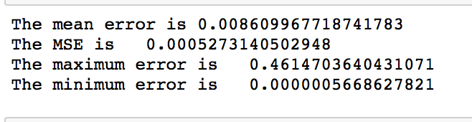
Gradient Boosting
Parameters
n_estimators = 2000, max_depth = 8 learning_rate = 0.01 loss = 'ls'
Performance

Slide 15
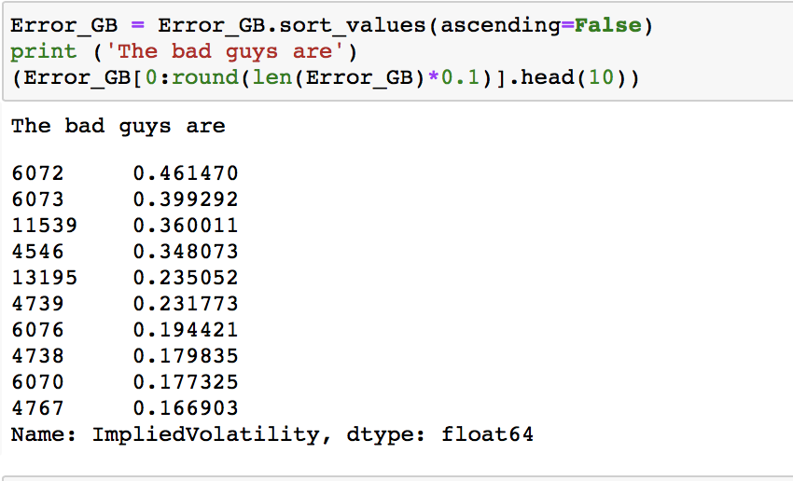
Gradient Boosting: Bad guys

Slide 16

DNN
Parameters
hidden_layer_sizes=(64,64,64), activation="relu" , random_state=1, max_iter=2000
Performance

Slide 17
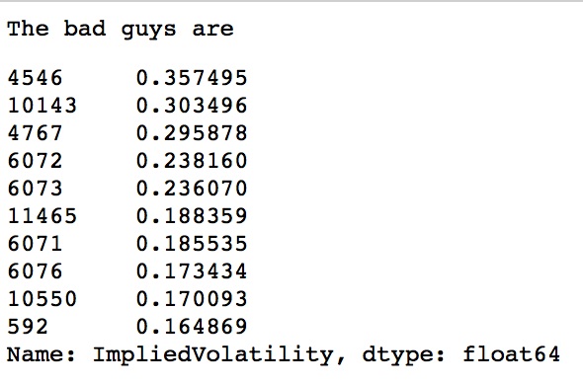
DNN: Bad guys

Slide 18
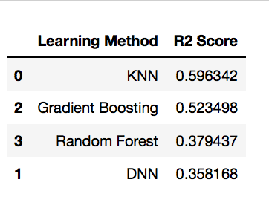
Performance comparison
As the table indicates, KNN has the best regression score, so it has performed the best.
DNN on the other performed the worst

Slide 19
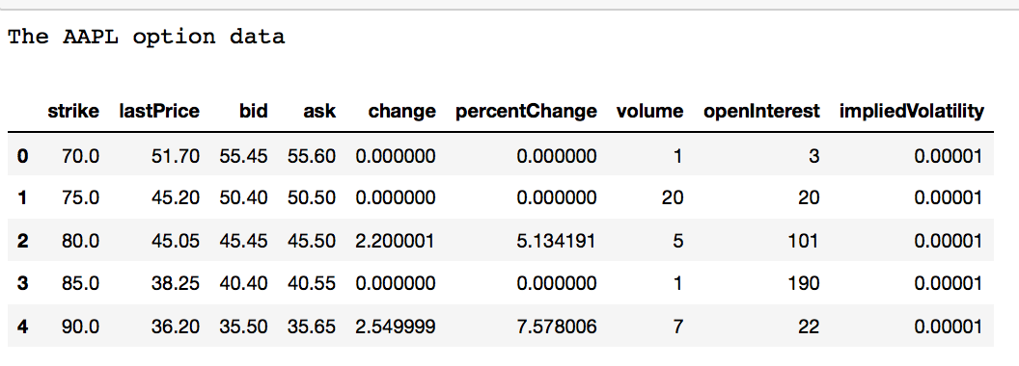
Adaptive learning to the option data - aapl
Option Data- aapl downloaded from Yahoo finance
Parameters-
aapl.option_chain('2021-04-30')
After book keeping the data has (49, 9) dimensions

Slide 20
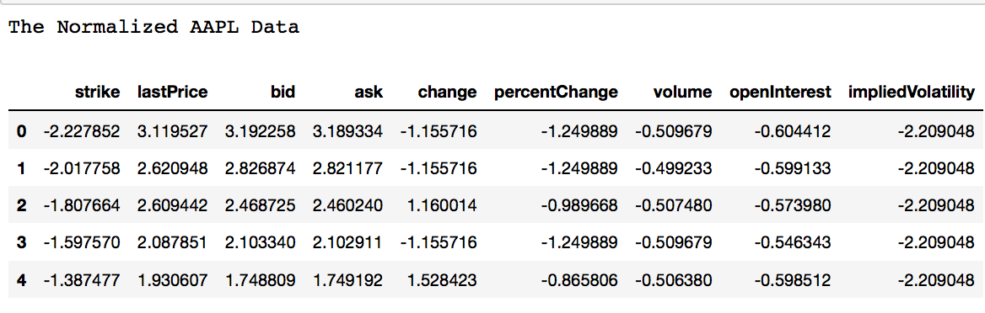
Adaptive learning to the option data - aapl
Option Data- aapl downloaded from Yahoo finance
Parameters-
Data normalized using the StandardScaler

Slide 21
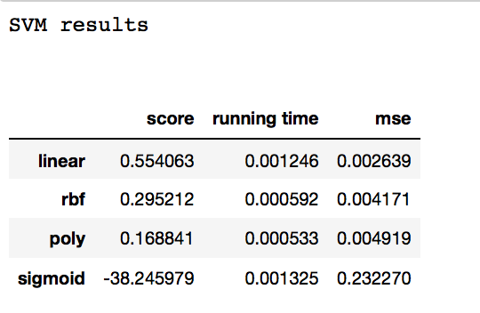
SVM on the aapl data
Parameters-
k = 10
test_percent=0.4
random_state=42
Kernels used
linear
Rbf
Poly'
sigmoid

Slide 22
Revisit Credit Risk Analytics
The file credit_risk_small_data_0.02.csv has 2405 credit records with the following variables
1. Visualize data at least using t-SNE
2. Partition data as 80% for training and 20% for testing and use K-NN and SVM, to conduct credit risk analytics, i.e. do classification to determine good or bad credit records.
3. Compute all classification measures and F1-measure
4. Find all samples in ’TP’/’TN’/’FP’/’FN’ class
a) TP class: the positive samples that are correctly predicted (b) TN class: the negative samples that are correctly predicted
(c) FP class: the negative samples that are falsely predicted (d) FN class: the positive samples that are falsely predicted
5. Develop your own method to overcome the imbalance issue (extra credits 20 points)

Slide 23
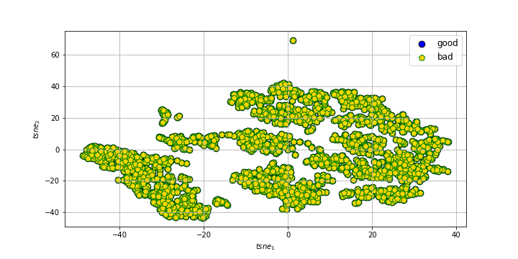
Revisit Credit Risk Analytics
Visualize data using t-SNE

Slide 24
Partition data as 80% for training and 20% for testing and use K-NN and SVM, to conduct credit risk analytics, i.e. do classification to determine good or bad credit records.

Slide 25
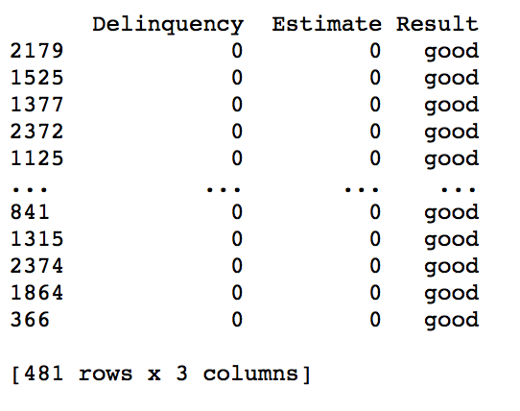
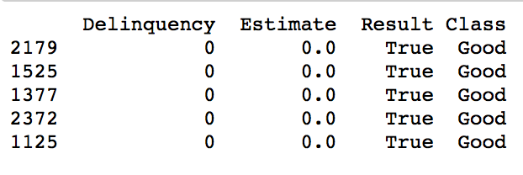
k-NN for credit risk
SVM for credit risk

Slide 26
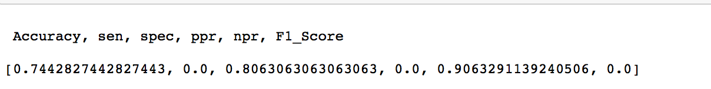
Compute all classification measures and F1-measure

Slide 27
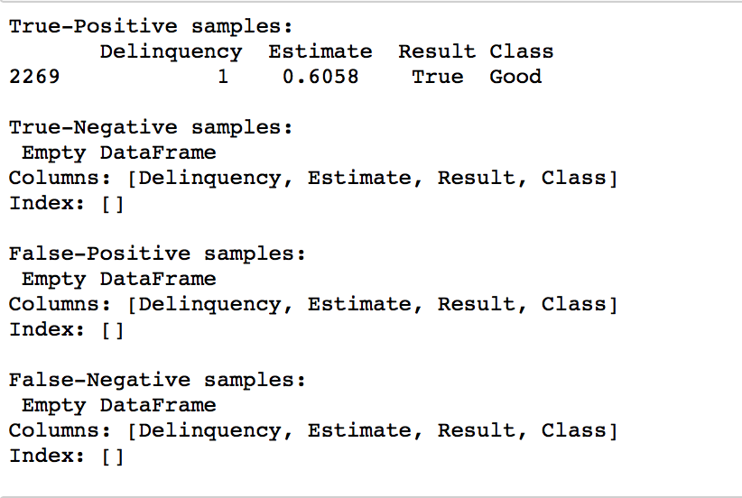
Find all samples
’TP’/’TN’/’FP’/’FN’ class
(a) TP class: the positive samples that are correctly predicted
(b) TN class: the negative samples that are correctly predicted
(c) FP class: the negative samples that are falsely predicted
(d) FN class: the positive samples that are falsely predicted

Slide 28
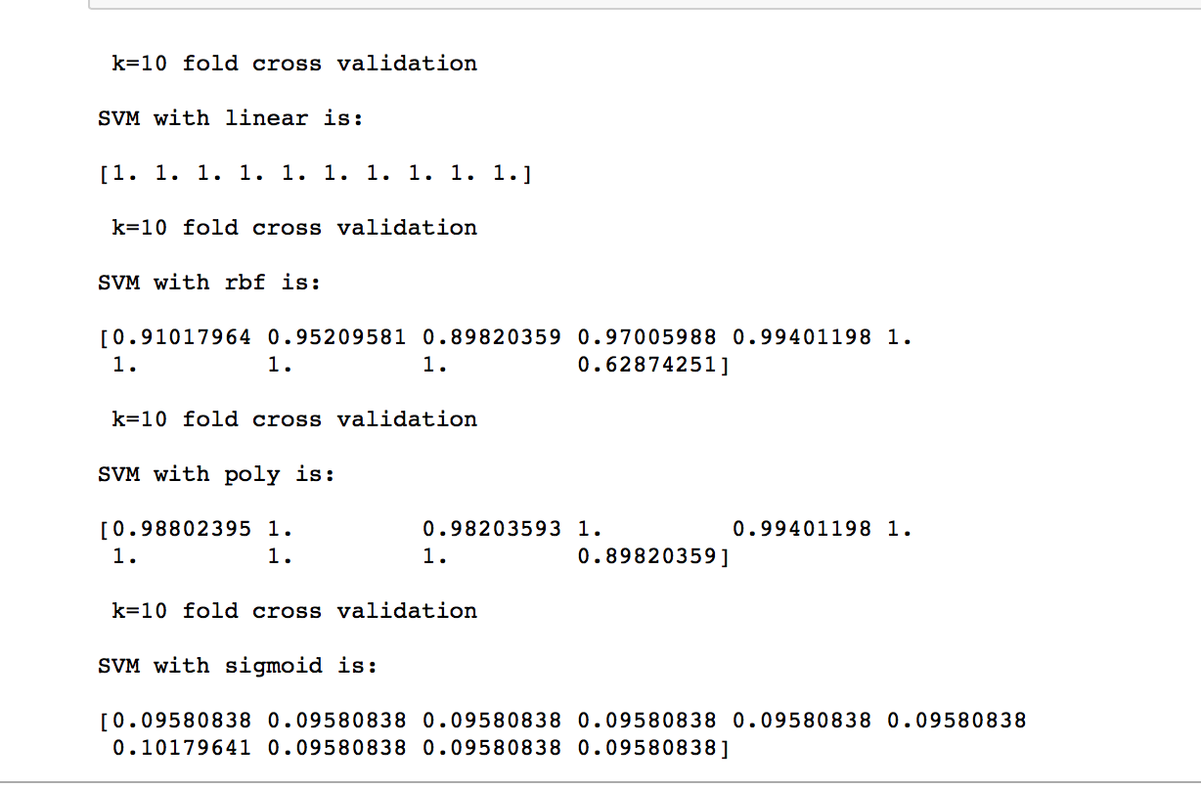
Conduct k-fold (k=10) cross validation for the data and use the following prediction to conduct classifications and compare their results
∗ SVM with ’linear’, ’rbf’, ’poly’, and ’sigmoid’ respectively

Slide 29
Conduct k-fold (k=10) cross validation for the data and use the following prediction to conduct classifications and compare their results
∗ Compare the support vectors under different kernels.
Kernel | Number of Support Vectors
linear | 28
rbf | 442
poly | 1253
sigmoid | 1336

Slide 30
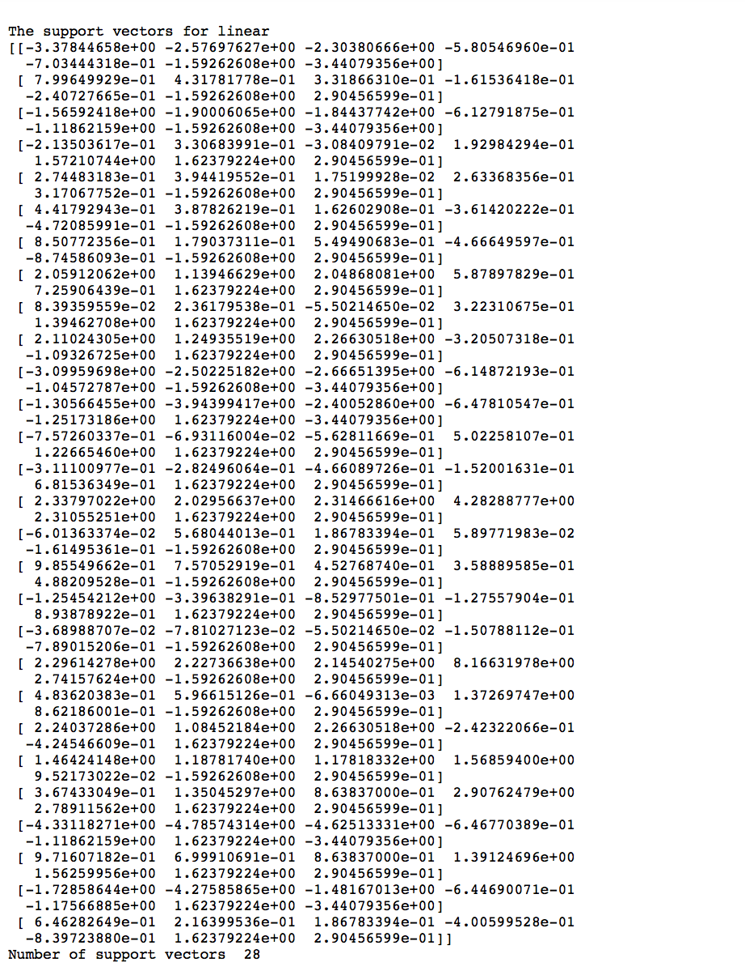
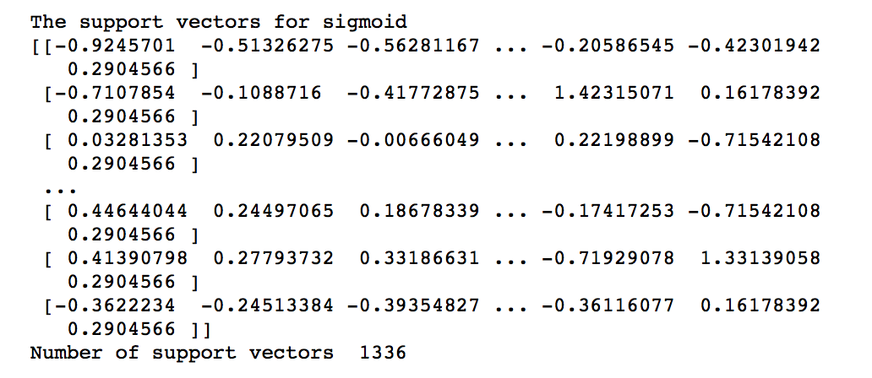
Output-1

Slide 31
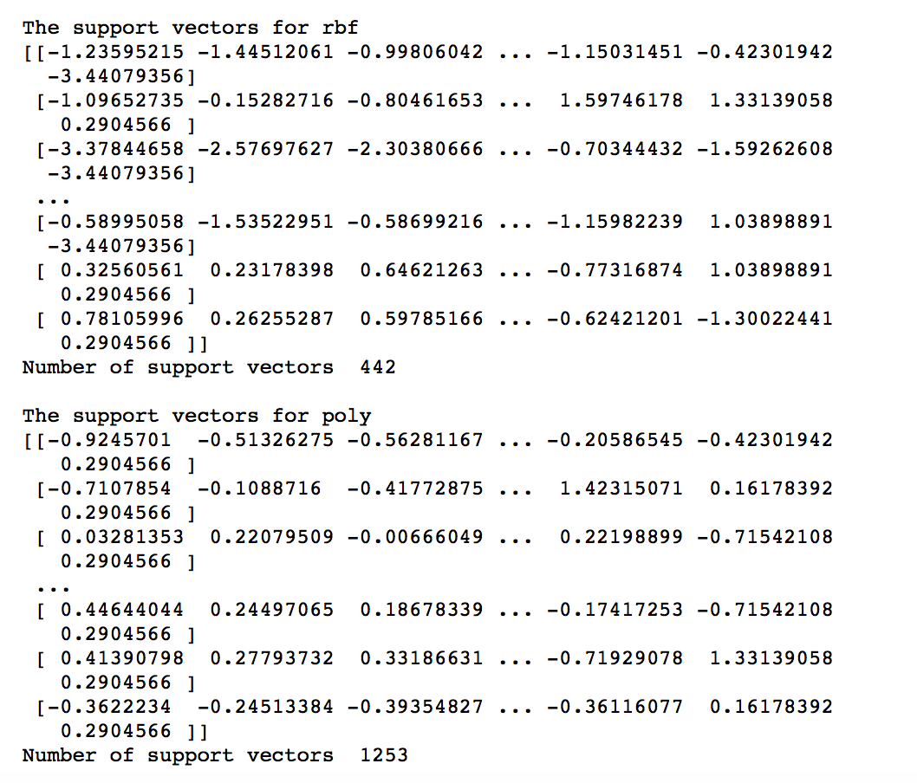
Output-2

