Slide 1
CISC5352 Artificial Intelligence in Fintech Quiz
(3)
Debarshi Dutta

Slide 2
Add at least 4 variables to the HFT datasets in Quiz 2. One variable should be Bolling band
Close_off_high
Volatility
true_Range
Bollinger band - daily moving average

Slide 3
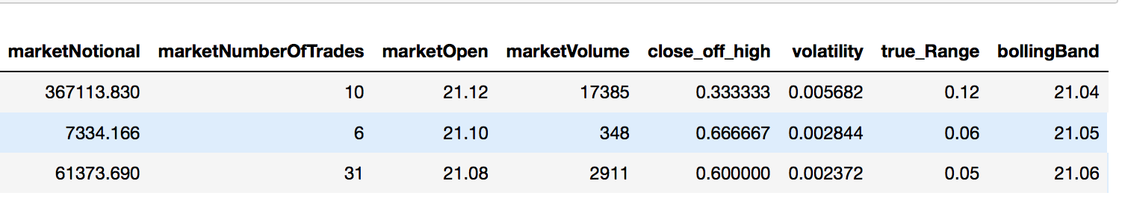
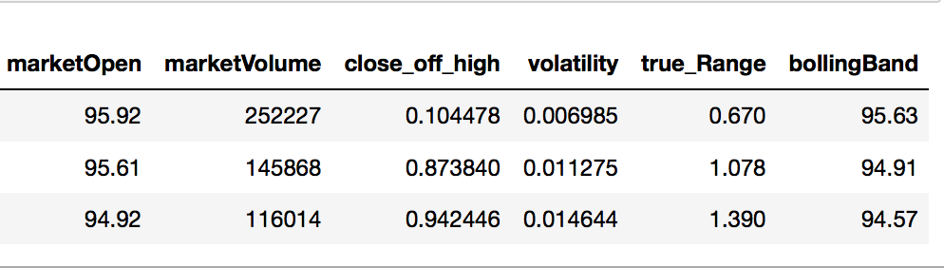
Output

Slide 4
Rank Features
Steps
Calculate the Explained Variance Ratio (EVR)
Add a ‘Rank’ column to the Pd Dataframe, which calculates the square root of the dot product
Sort in descending according to the Rank

Slide 5
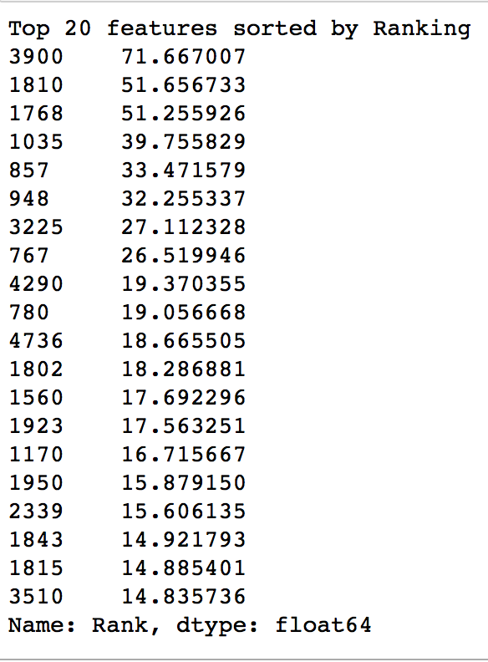
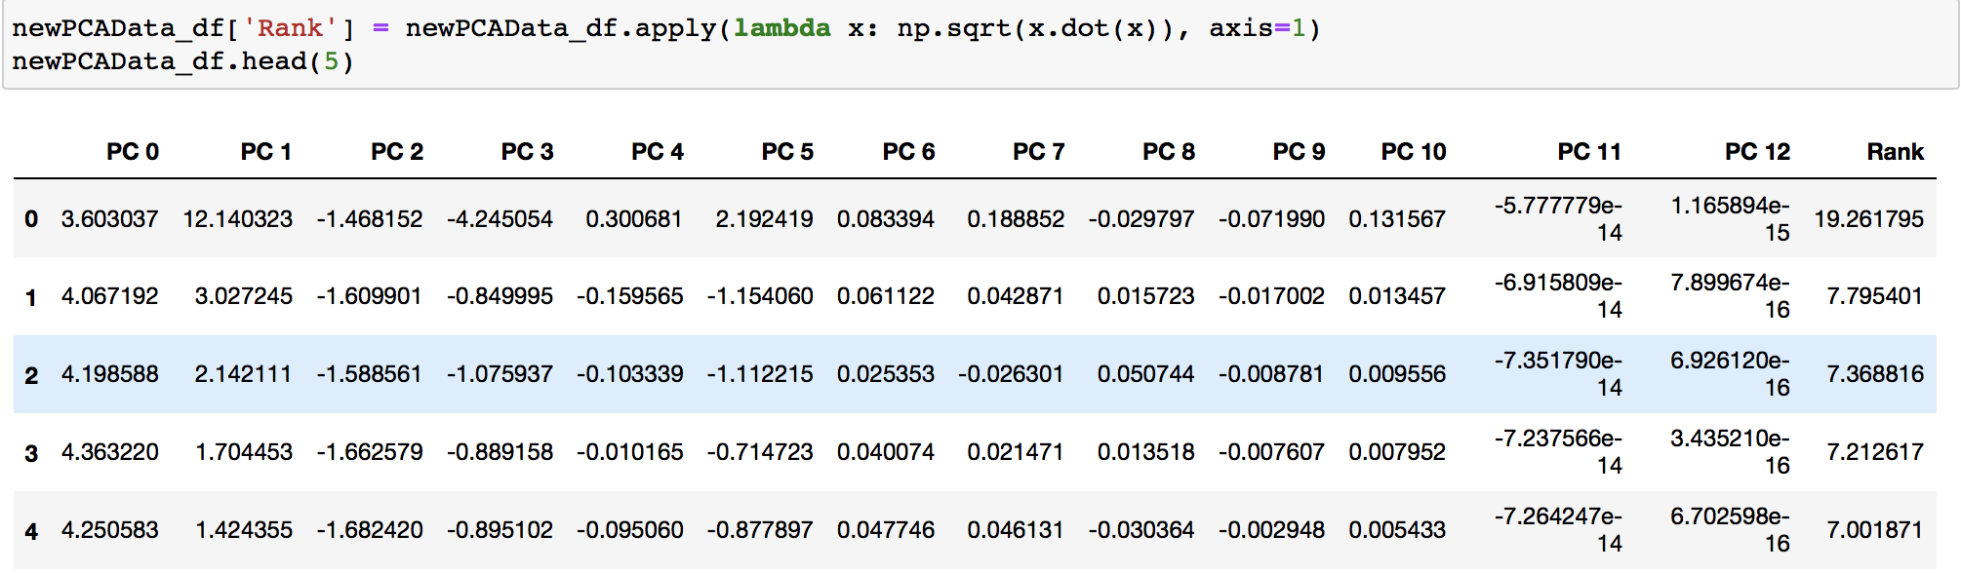
Rank Features
Output shown for aapl data

Slide 6
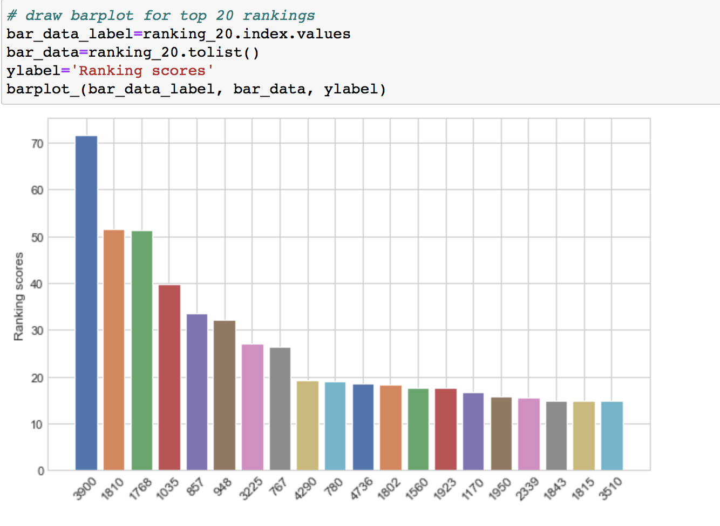
Rank Observations
Output shown for aapl data

Slide 7
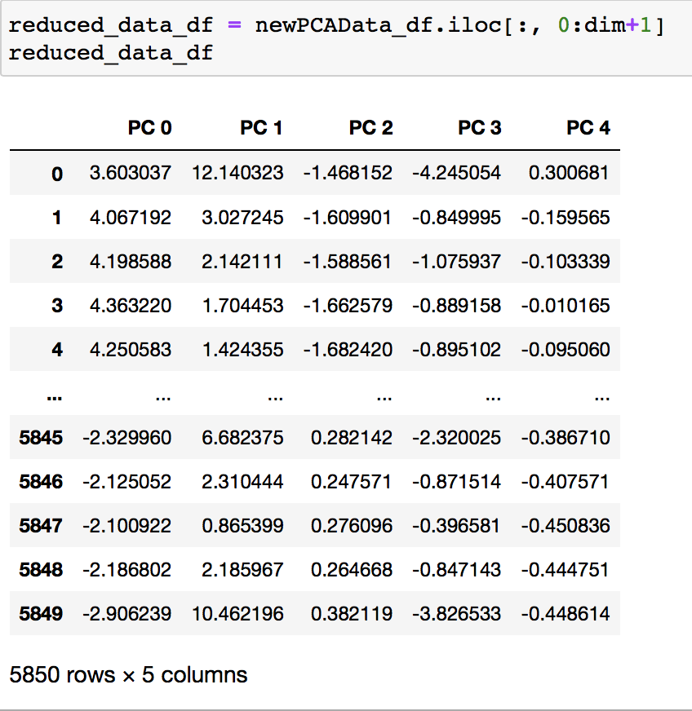
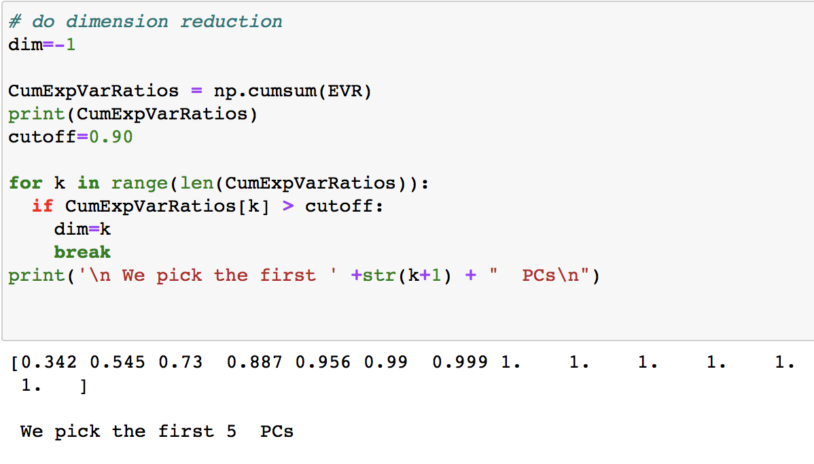
Dimension Reduction
Output shown for aapl data
Steps
Taking the threshold as 0.90
Compare the cumulative sum of EVR with the threshold
Accept only those which are less than the EVR
The number of instances shows the number of PC’s
Slice the PCA decomposed data according to the number of instances calculated above

Slide 8
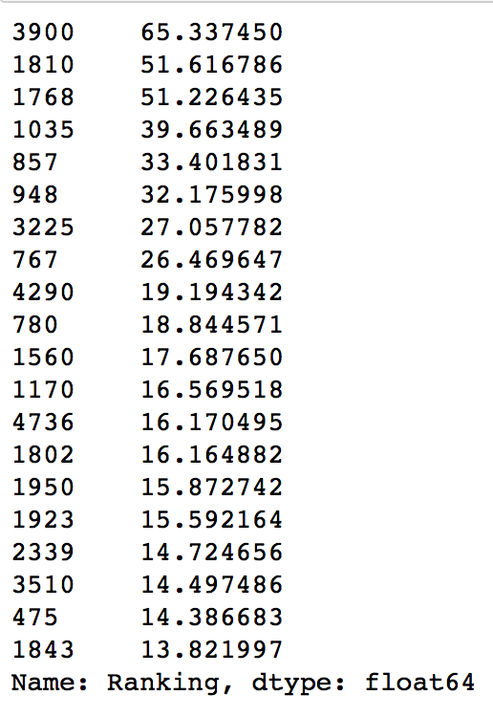
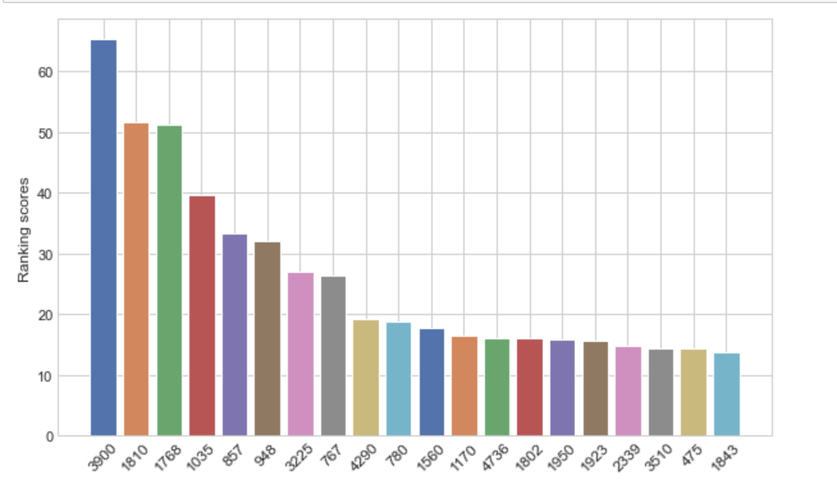
Ranking the features and
Observations of the reduced data
Output shown for aapl data

Slide 9
Ranking using t-SNE
t-SNE is stochastic every run will lead to slightly different outputs. This can be solved by fixing the value of random_state parameter for all the runs. t-SNE shrinks widespread data and expands densely packed data. It is hence suggested not to decide the size and density/spread/variance of the clusters based on the output.
t-SNE doesn’t retain the distance between clusters from the raw data. Distance between clusters might vary post dimensionality reduction in t-SNE. It is recommended not to obtain any conclusions solely from the distance between the clusters.
t-SNE is highly affected by parameters. Since every run produces slightly different results, it is wise not to use t-SNE to rank features, since ranking is calculated based on distances.

Slide 10
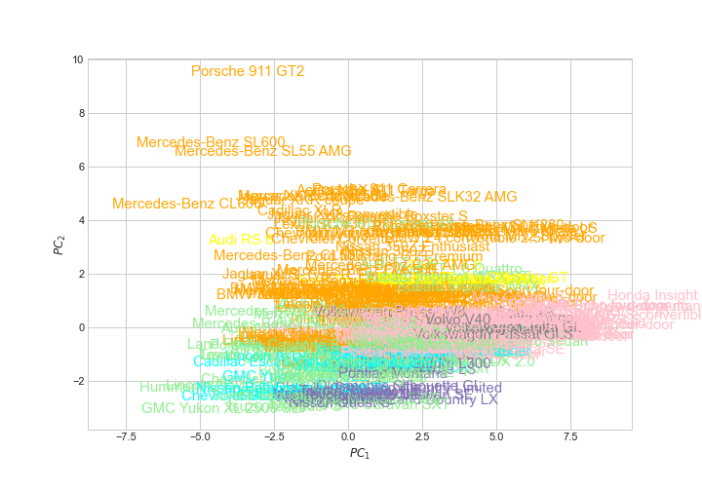
B. PCA biplot

Slide 11
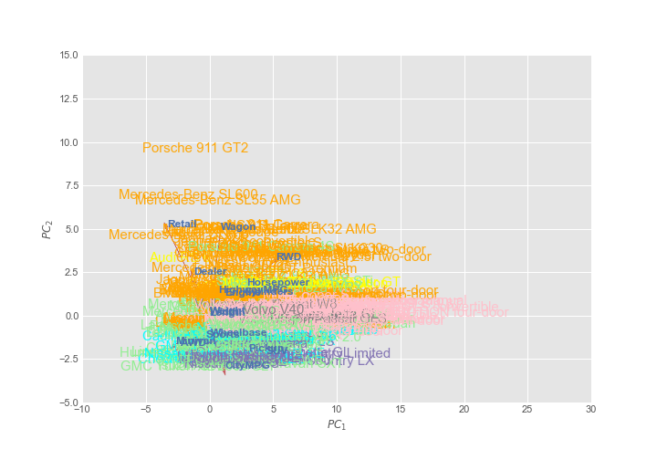
PCA triplot

Slide 12

Rank 20 outliers using PCA
Reason:
PCA minimizes the sum of 𝐿2 norms of the residuals of the decomposition, i.e
If 𝑌 is the raw data (𝑚 x 𝑛), and 𝑋 is the PCA basis (𝑘 x 𝑛),
then the decomposition will strictly minimize
Steps:
Import raw data and normalize it
Implement PCA on the normalized data
Take the inverse transform of the PCA data
The dimensions should be identical, if the np array converged
Find the MSE Score between the two-
(PCA_data - inverse transform of PCA_data)²
The difference is the outlier between the two
Sort the outliers in descending order according to the MSE Score which is the distance
Display the top 20 outliers
PCA minimizes the sum of 𝐿2 norms making it sensitive to outliers.
So, the MSE is the distance between the PCA data and the inverse transform of the PCA data
The outliers can then be ranked by sorting by the distance, which is the MSE score

Slide 13
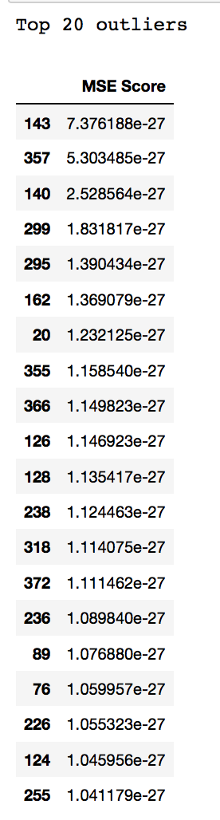
Rank 20 outliers using PCA- output

Slide 14
Can you use t-SNE to rank outliers? why?
t-SNE does not preserve distances nor density. It only to some extent preserves nearest-neighbors. So clustering and finding the outliers of the cluster(s) will not work because the accuracy of the clusters provided by t-SNE is not high.
Distance between clusters might vary post dimensionality reduction in t-SNE. It is recommended not to obtain any conclusions solely from the distance between the clusters.
Since t-SNE cannot maintain the distances, it should not be used to find and rank outliers

Slide 15
C. PCA using SVD
Steps:
Convert pd DataFrame to an np array
Center the array
Implement the SVD function from the python library which will return 3 variables-
U, S, VT
Build the Sigma from the S
To check if the SVD decomposition is correct
Take the dot product of S and VT = a
Take the dot product of U and a = b
If the SVD decomposition is correct,
Then the initial np array will be same as b

Slide 16
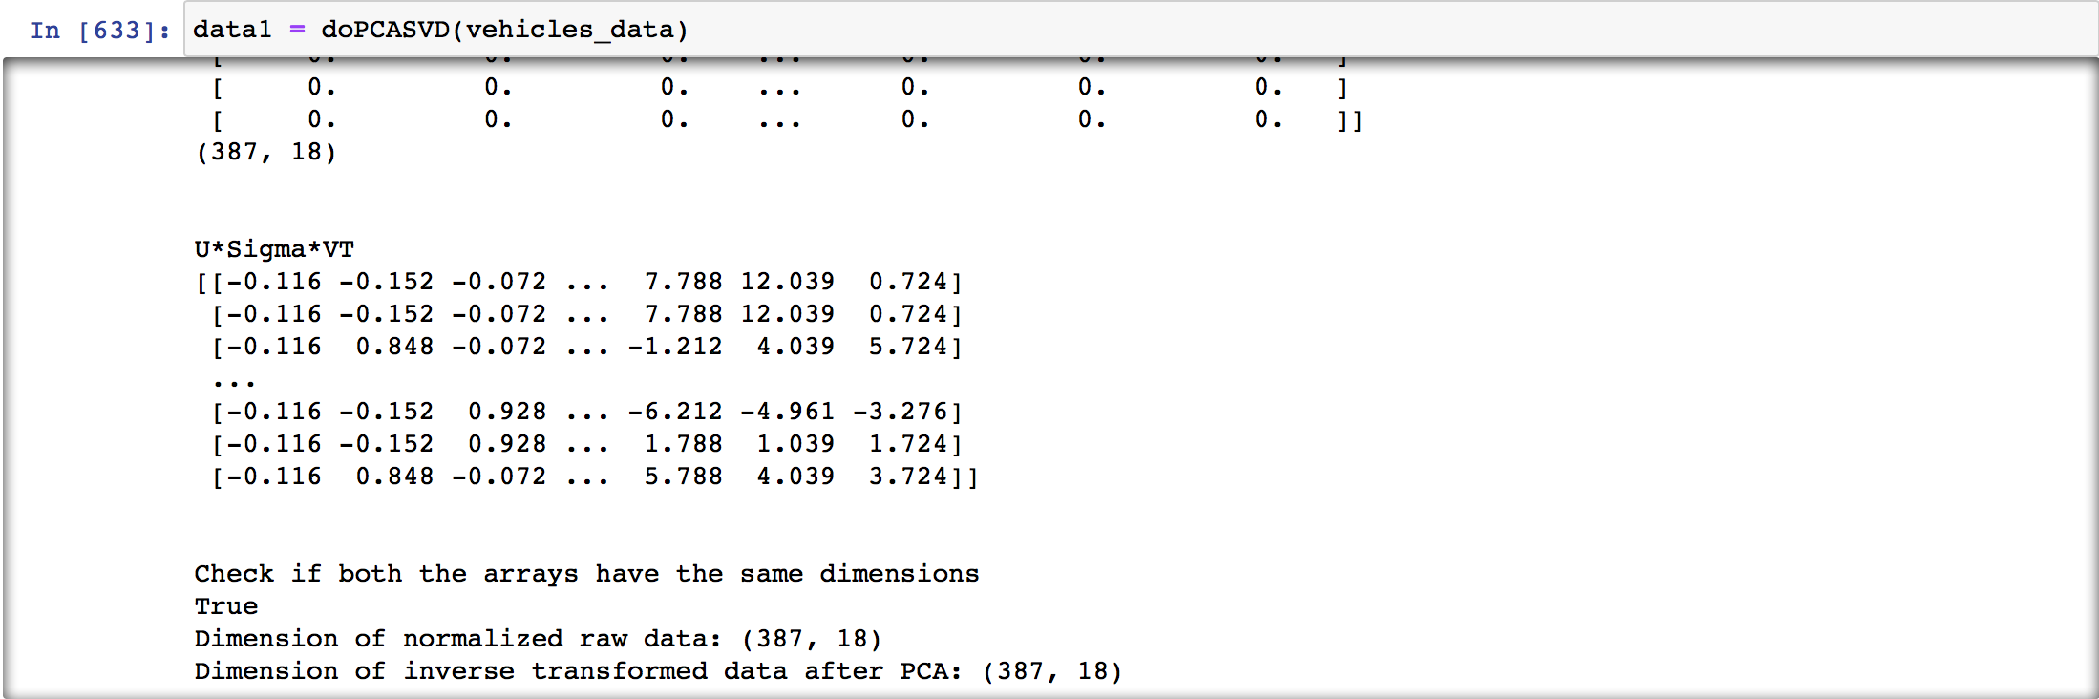
PCA using SVD- output

Slide 17
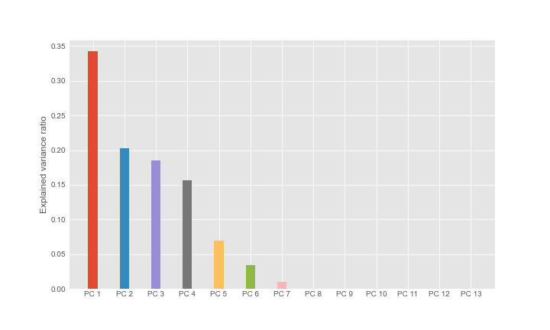
PCA Analysis of Goldman Sachs* Data
Explained Variance Ratio
¹The dataset is downloaded from Yahoo finance on 03/20/2021- Date Range - 01/01/2000 - 03/01/2021

Slide 18
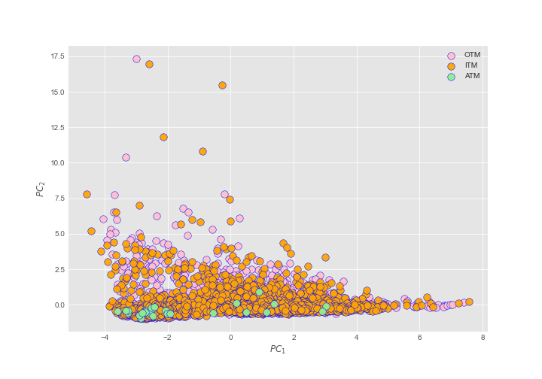
PCA Analysis of Goldman Sachs
Dot Biplot

Slide 19
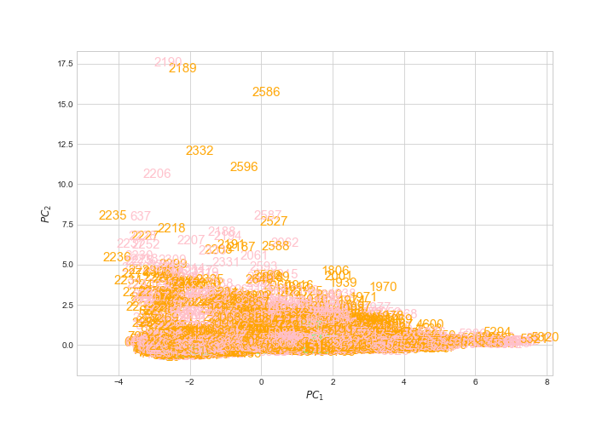
PCA Analysis of Goldman Sachs
Biplot

Slide 20
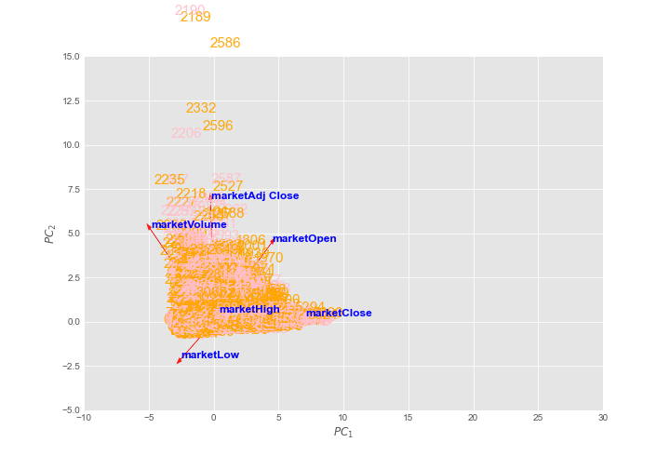
PCA Analysis of Goldman Sachs
TriPlot

Slide 21
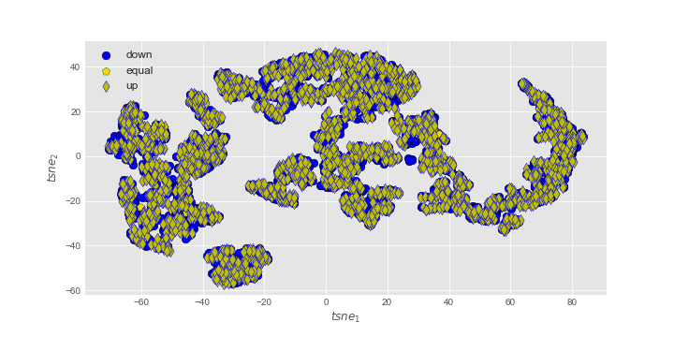
PCA Analysis of Goldman Sachs
t-SNE Biplot

