Slide 1
Microsoft Engage - WIT Hackathon Women “Health and Fitness 360” App
(https://womenhealth360.herokuapp.com)
By:
Debarshiya Chandra
Vellore Institute of Technology
Email: debarshiya@gmail.com

Slide 2
Why is this application necessary today?
In this fast moving world, health tends to take a back seat for most people.
People struggle to keep a track of their health due to busy lifestyle.
Women also have specific health requirements which are usually neglected due to their work and lifestyle.
This web application would help women in tracking all their health and wellness requirements at one place.
It would also be very helpful for women to maintain a healthy lifestyle by regularly monitoring their health parameters, medications, workout routine and diet.

Slide 3
Salient Features in this Application
Workout Routine
Exercise Statistics
Health Parameters
Wellness Planner
Health Alert
Resources
Discussions section

Slide 4

Women Health 360
Home Exercise Statistics
Username
Logout
Workout Routine
Wellness Planner
Health Parameters
Health Alert
Resources
Discussions

Slide 5
Details of the Features
Workout Routine:
This feature will allow the user to lodge their workout details.
They can choose the type of exercise and enter details about regarding the duration, intensity etc. of the workout.
Exercise Statistics:
The exercise details entered in the workout routine section will be used for analysis and displayed to the user.
This analysis will also be used to suggest specific workouts and diet according to the need of the user.

Slide 6
Health Parameters:
The user can enter various health parameters like height, weight, blood pressure, blood sugar and menstruation cycle related details.
This feature would help them monitor these parameters as well.
Wellness Planner:
This feature would allow user to lodge their medications, dietary plans, medical history like blood tests schedule, routine checkup schedule etc.
It would help the user to plan their schedule efficiently and effectively.

Slide 7
Health Alert:
The user will get regular alert to help them follow the Wellness Planner efficiently.
The information collected in various sections will also be analyzed and the user will be alerted of their health conditions and possible health complications.
The user will also be informed of the medical experts they can contact for any health conditions.
Resources:
The user will have access to various health and wellness articles and blogs.
Discussions:
The users will have an opportunity to connect with other users to and have conversations.

Slide 8
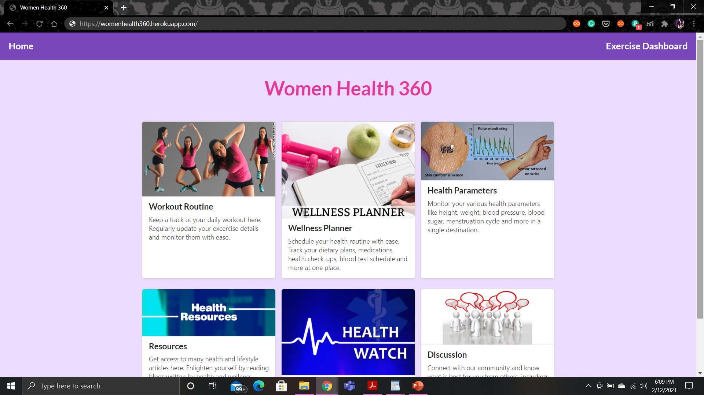

Slide 9
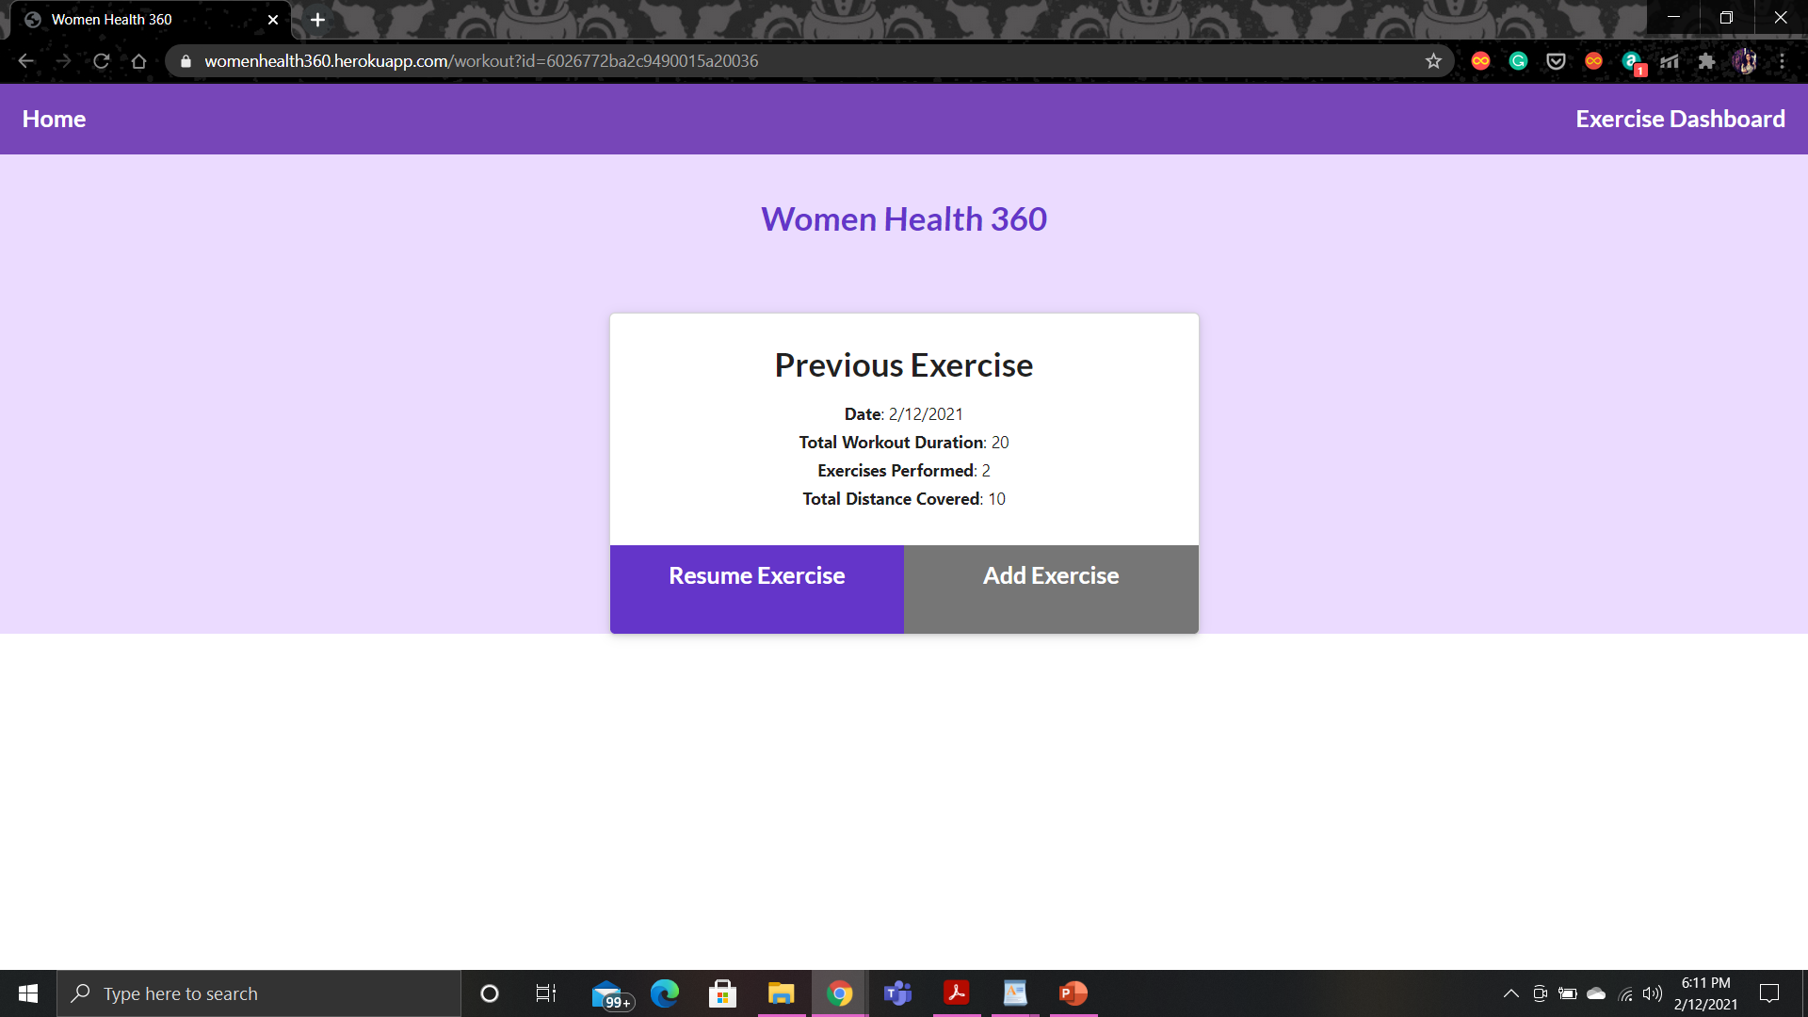

Slide 10
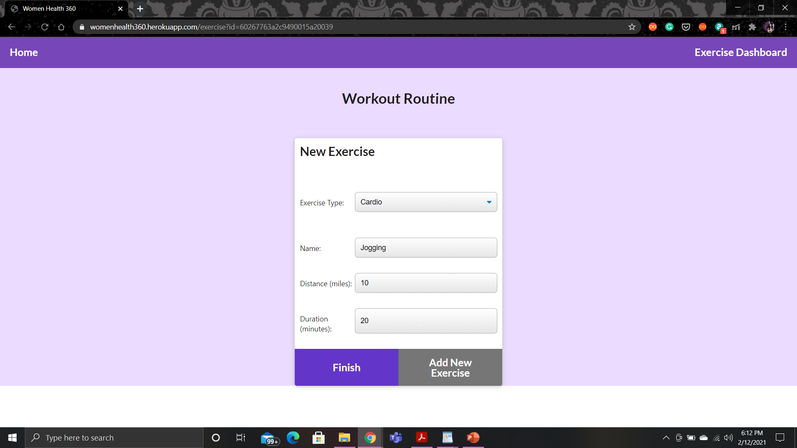

Slide 11
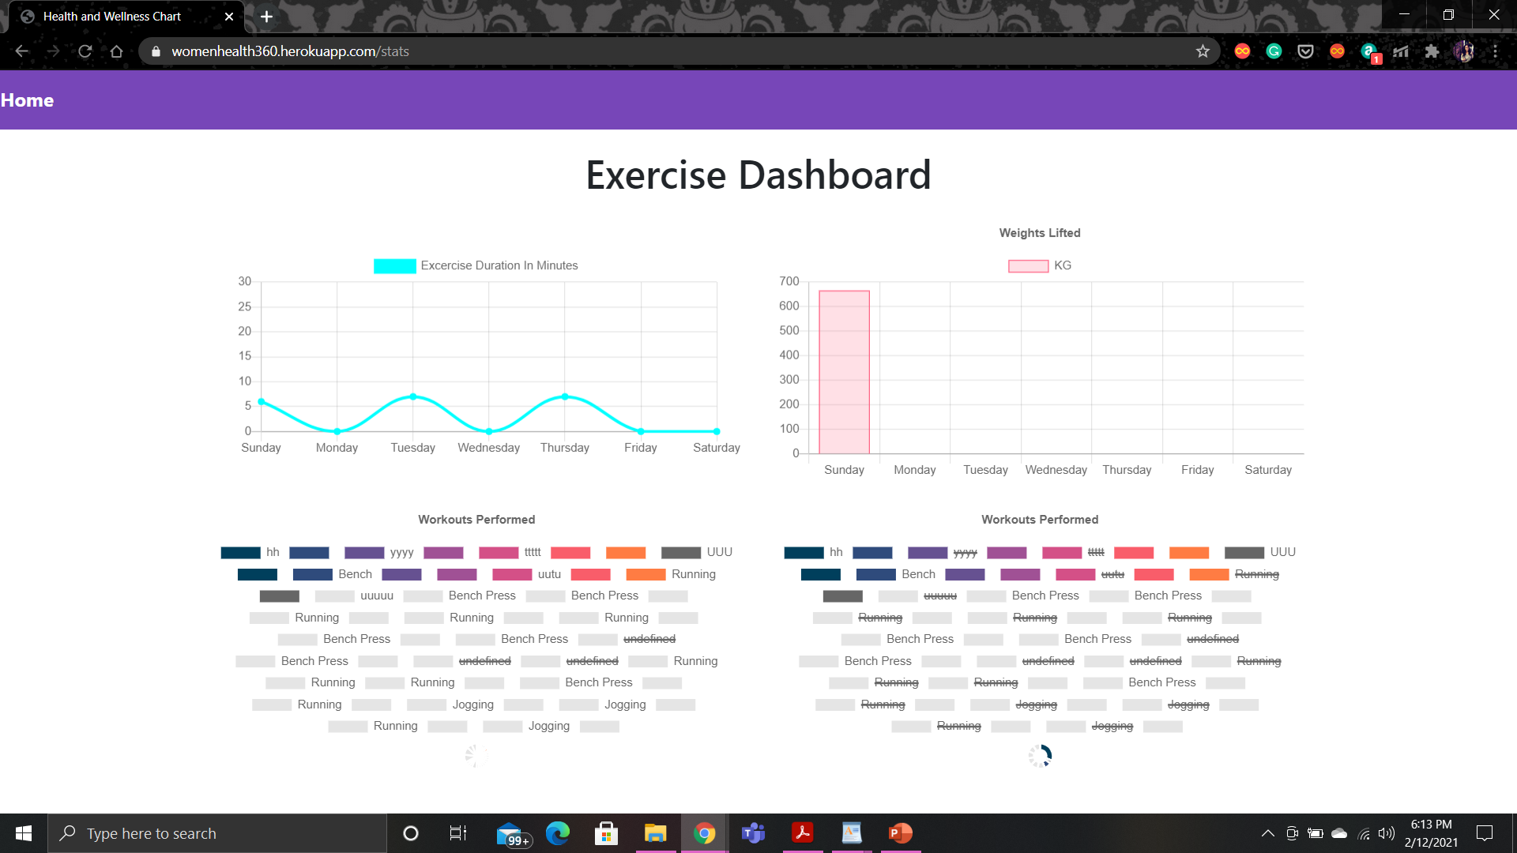

Slide 12
Planned tasks to be implemented
A login page should be created to personalize the web application. At present, a Home page has been implemented. However, the Home page should appear after Login.
In workout routine section, more exercises should be added specifically related to women health. Also, the user should have the flexibility to add new type of exercise.
For other sections, the relevant pages have to be linked similar to the workout routine section.
Machine Learning can be used for better predictions of Health Alerts.

Slide 13
Thank You

