Slide 1
DEBARUN BANERJEE Data Analytics Batch: WTS-ACDMY-7979-5280 Student ID: WAPL30052520769
Flight Performance and Reliability Dashboard

Slide 2
Introduction
Background:
The aviation industry deals with thousands of daily flights, where maintaining punctuality, reliability, and customer satisfaction is a key challenge. The dataset used in this project contains detailed information on flight operations — including flight IDs, airlines, departure and arrival times, delays, cancellations, and routes — representing real-world aviation data.
Significance:
Efficient analysis of flight data helps airlines and airport authorities identify patterns of delay, cancellation, and performance differences across regions and time periods. By understanding these trends, decision-makers can improve scheduling efficiency, reduce delay causes, and enhance overall service reliability.

Slide 3
Problem Statements
✔ Problem Statement 1
Flight delay and punctuality patterns are inconsistent across airlines, cities, and regions, making it difficult to understand where and why delays occur.
✔ Problem Statement 2
Cancellation rates vary across carriers and routes, but the specific airlines or paths contributing most to cancellations are unclear.
✔ Problem Statement 3
Flight performance fluctuates across different hours, days, and months, yet these time-based variations are not clearly identified.
✔ Problem Statement 4
Operational efficiency among airlines differs, but there is no clear comparison showing which carriers perform better in terms of delays and on-time performance.

Slide 4

Objectives of the Analysis
To analyze flight punctuality and delay patterns across airlines, cities, and regions using pivot tables and charts.
To identify cancellation trends and find which airlines or routes have higher cancellation rates.
To examine performance variations by time period (hour of departure, day of week, month, etc.).
To compare operational efficiency among airlines based on average delay and on-time performance.

Slide 5
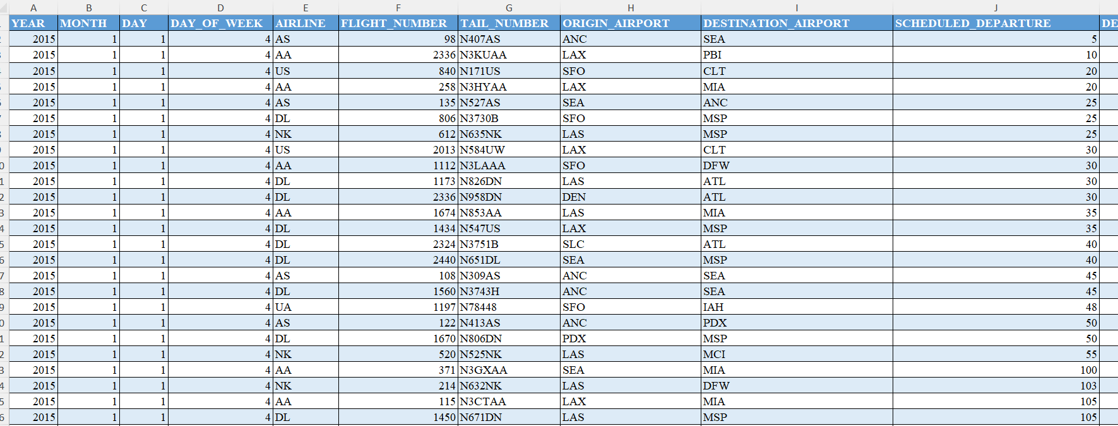

About the Dataset
The dataset contains detailed flight operation records used for analyzing airline performance and punctuality. It includes around 10, 000 rows and 37 columns, covering key aspects of flight schedules, delays, and cancellations.
Date, Region, City, Airline – operational and geographical details.
Departure & Arrival Time/Delay – performance indicators.
Cancelled Flights, Distance, Route – efficiency and reliability metrics.
Aircraft Type & Tail Number – equipment and operational data.

Slide 6
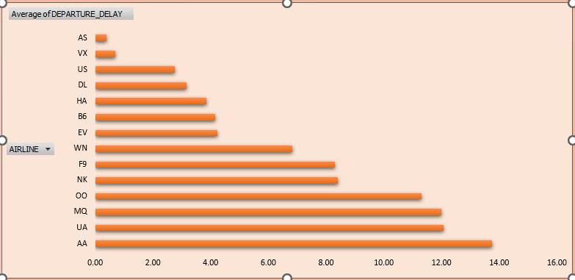
Average of Departure Delay
The chart compares the average departure delays across different airlines, helping identify which carriers tend to be more punctual or prone to delays.
A horizontal bar chart format is used, with airline codes on the y-axis and average delay times (in minutes) on the x-axis, making it easy to scan and compare delay levels side by side.

Slide 7
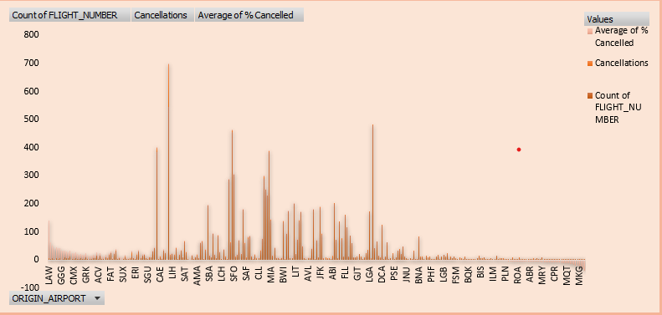
Flights Cancelled by Origin
This chart compares flight volume, cancellations, and cancellation rates across various origin airports, offering a multi-dimensional view of airport reliability.
Each airport is represented by three bars—blue for total flights, orange for number of cancellations, and gray for average percentage cancelled—allowing quick visual comparison of both absolute and relative cancellation metrics.

Slide 8
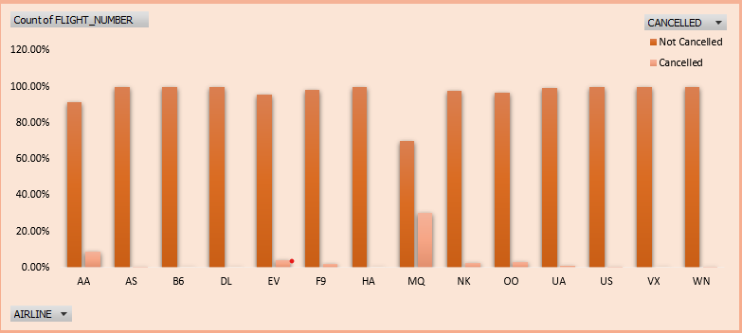
Flight Cancelled Analysis
Most airlines maintain cancellation rates below 10%, but MQ (~30%) and NK (~20%) stand out with significantly higher cancellation percentages, suggesting potential operational challenges.
This chart compares the percentage of cancelled vs. non-cancelled flights across different airlines, offering a clear snapshot of airline reliability.
Most airlines maintain cancellation rates below 10%, but MQ (~30%) and NK (~20%) stand out with significantly higher cancellation percentages, suggesting potential operational challenges.

Slide 9
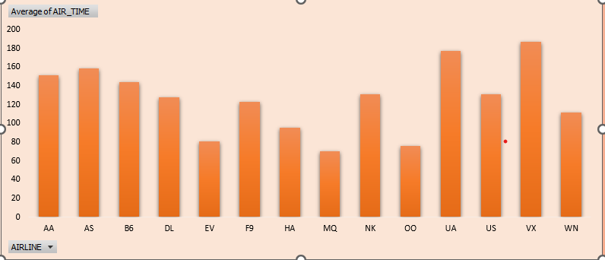
Average Air Time of Airlines
The chart shows the average air time (in minutes) for flights operated by different airlines.
Airlines like HA and B6 have longer average air times, suggesting more long-haul routes, while MQ and OO show shorter durations, likely due to regional operations.

Slide 10
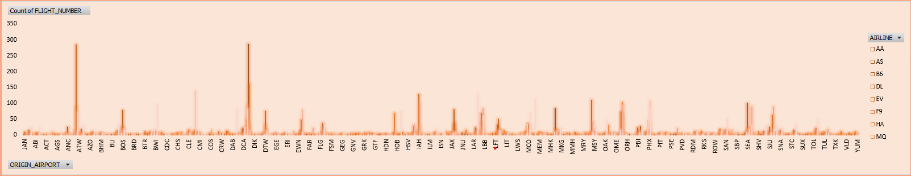
No. of Flights per Origin Airport
The chart shows the count of "DIST_NUMBER" across various origin airports, with each airport represented by a group of color-coded bars.
Airports like ATL and DEN have taller bar clusters, suggesting higher overall counts and broader category distribution, while others show fewer or more concentrated category activity.

Slide 12
Key Insights
Cancellation rates vary notably across regions, indicating differences in operational efficiency and external factors. Some airlines show consistently higher average delays, reflecting potential scheduling or resource management challenges.
Delays tend to fluctuate across different times of day, highlighting the influence of peak-hour traffic and congestion.
Certain routes handle a significantly larger volume of flights, emphasizing key travel corridors in the network.
Interactive slicers enable comparison of performance metrics by region, airline, and time, supporting quick and data-driven decisions.

Slide 13

Recommendations
Enhancing Scheduling Efficiency: Utilizing delay trend analysis to adjust flight schedules during peak hours and minimize congestion-related delays.
Monitoring and Address High-Risk Areas: Identifying regions, routes, or airlines with frequent disruptions and implement targeted operational improvements.
Strengthening Data Collection and Analysis: Incorporating more detailed operational and weather data to gain deeper insights and improve future predictive accuracy.

Slide 14

Conclusion
Flight delays and cancellations show clear patterns across regions, airlines, and peak time periods, emphasizing areas for operational focus.
Pivot table and dashboard analysis provided actionable insights into high-risk routes, scheduling bottlenecks, and airline performance differences.
Applying targeted scheduling improvements, monitoring critical routes, and leveraging interactive dashboards can significantly enhance punctuality and overall operational efficiency.

Slide 15


