Slide 1
India-Rainfall-Analysis-1901-2015
DEBARUN BANERJEE WEBSKITTERS ACADEMY DATA ANALYTICS BATCH Batch ID: WTS-ACDMY-7979-5280 Student ID: WAPL30052520769

Slide 2

Introduction
India is heavily dependent on rainfall for agriculture, water resources, and overall climate balance.
This project analyzes historical rainfall trends across different Indian subdivisions and districts.
The study focuses on understanding rainfall distribution, seasonal dependency, and long-term variability patterns.
The main aim is to derive useful insights from rainfall data for better climate awareness and regional planning.

Slide 3
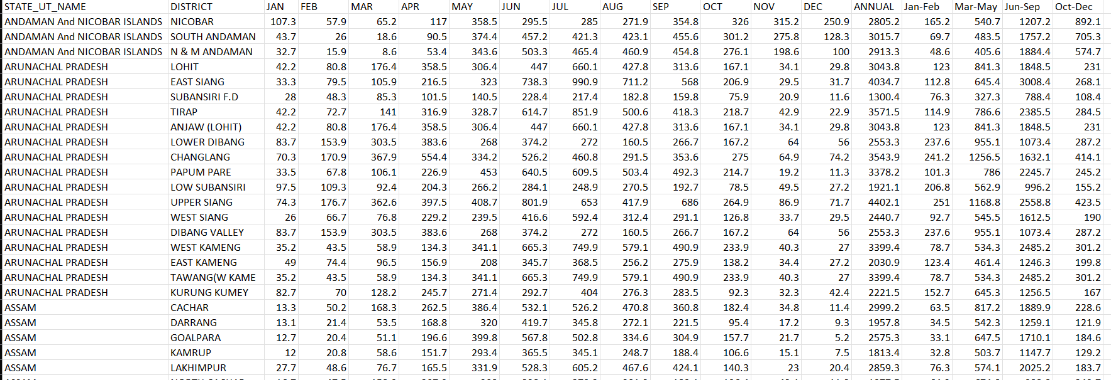
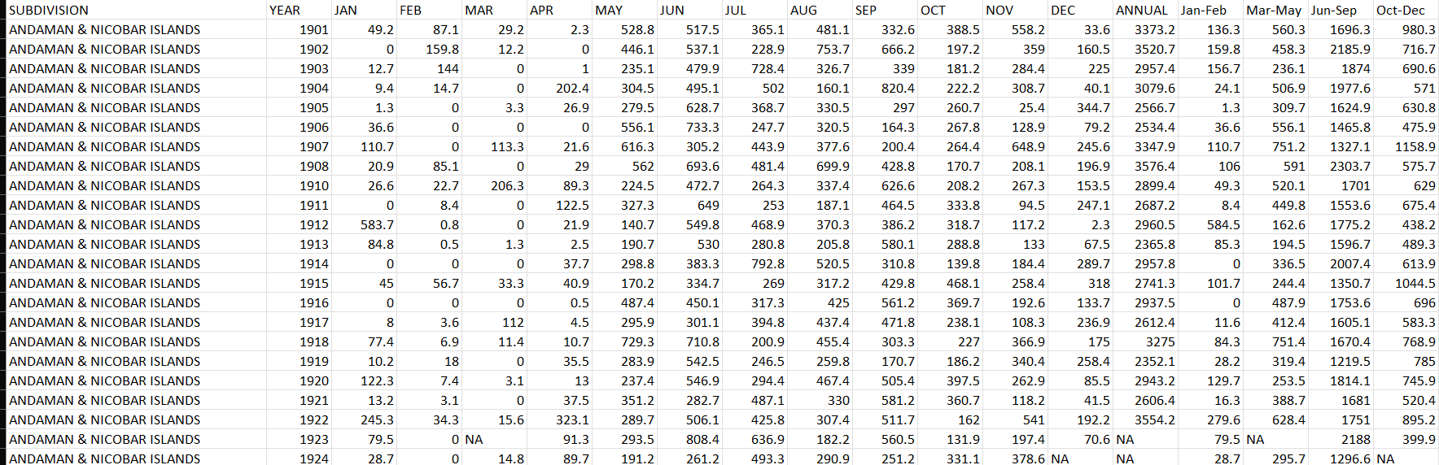
About the Dataset
The datasets were downloaded from Kaggle and contain historical rainfall records of India.
Dataset 1: rainfall in India 1901-2015.csv contains 4116 rows and 19 columns, covering subdivision-wise monthly and annual rainfall data.
Dataset 2: district wise rainfall normal.csv contains 641 rows and 19 columns, representing district-level normal rainfall patterns.
These datasets are useful for studying long-term rainfall trends, seasonal distribution, and regional comparisons.

Slide 4

Study Objectives
To analyze historical rainfall trends in India from 1901 to 2015.
To compare rainfall distribution across Indian subdivisions and districts.
To identify seasonal rainfall dependency, especially the contribution of monsoon rainfall.
To study rainfall variability and detect regions with unstable rainfall patterns.

Slide 5
Problem Statements
To analyze rainfall patterns in India and understand regional as well as seasonal rainfall behavior.
Which Indian subdivisions receive the highest and lowest annual rainfall?
How has rainfall changed across different decades in India?
How strongly is India’s annual rainfall dependent on the monsoon season?

Slide 6
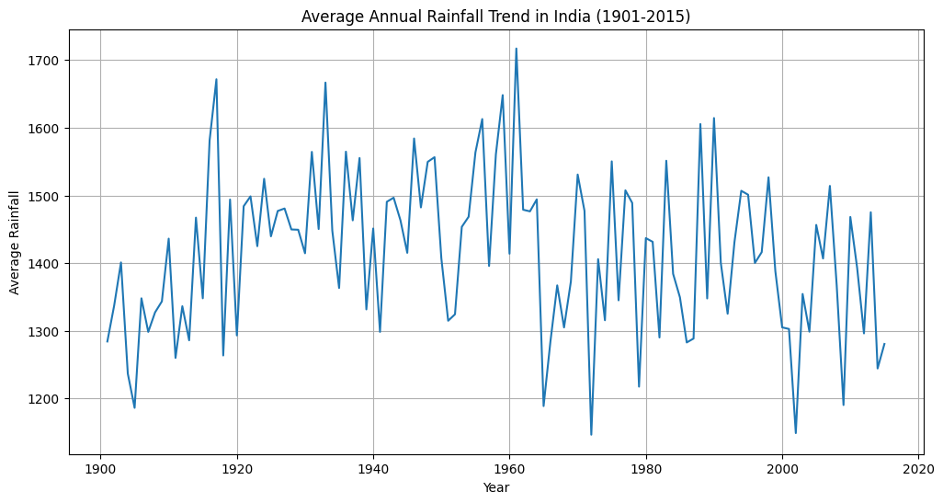
Average Annual Rainfall Trend (1901–2015)
India's annual rainfall swung between ~1,150 mm and ~1,720 mm over 115 years — a 570 mm range that makes "average" rainfall almost meaningless as a planning metric.
The wettest year was ~1961 (~1,720 mm) and the driest followed just 4 years later (~1,150 mm) — proof that India's rainfall has no memory.
Post-2000 values consistently hover near the lower band of 1,250–1,300 mm, quietly suggesting a drying trend that nobody in power seems to be talking about.

Slide 7
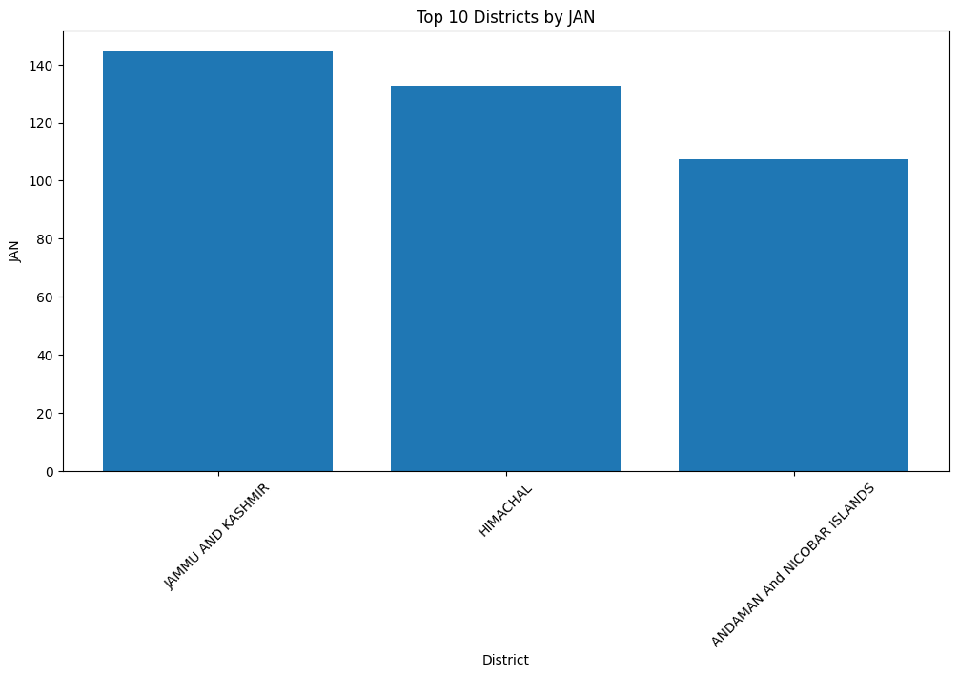
Top Districts by January Rainfall
In India's driest month, only 3 districts register meaningful rainfall — Jammu & Kashmir (~145 mm), Himachal Pradesh (~133 mm), and Andaman & Nicobar (~107 mm) — the rest of India is essentially a desert in January.
J&K topping the January chart is counterintuitive until you realize western disturbances dump winter precipitation on the Himalayas while the rest of India basks in dry cold.
The steep drop-off between the 3 bars tells the real story — no 4th region even comes close, making winter rain an extreme geographic privilege in India.

Slide 8
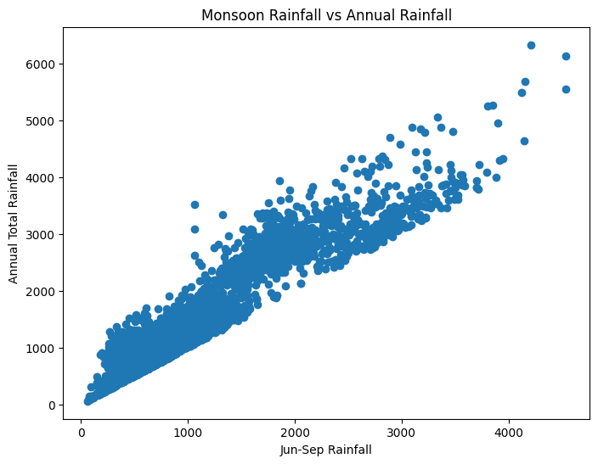
Monsoon vs Annual Rainfall
The tight diagonal cluster confirms what farmers have known for centuries: monsoon rainfall is annual rainfall — the two are almost the same number with a different label.
Most districts sit in the 500–2,500 mm monsoon range mapping to 1,000–3,500 mm annual — a near 1:1 relationship that exposes India's terrifying dependence on 4 months.
The outliers pushing past 6,000 mm annually are the Northeast and Western Ghats pockets — they live in a completely different hydrological reality from the rest of the country.

Slide 9
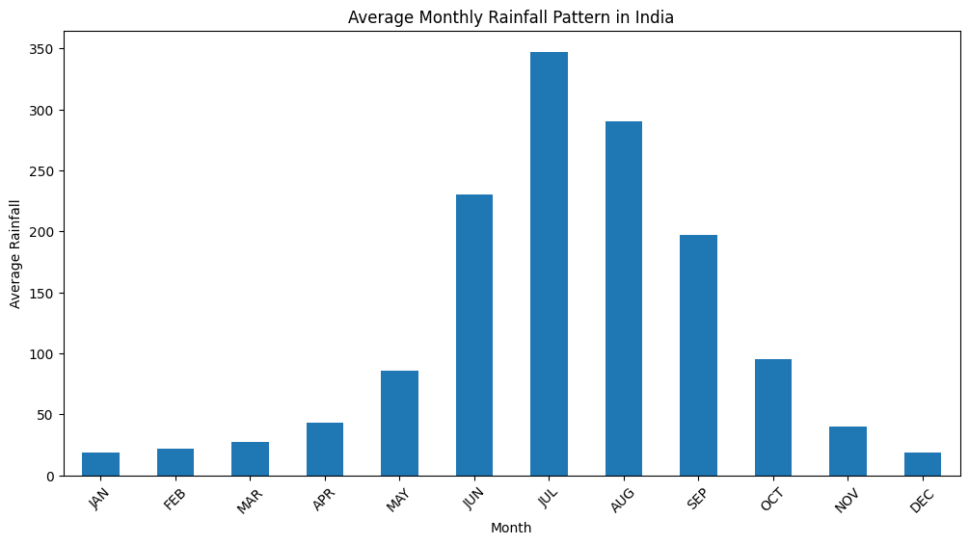
Average Monthly Rainfall Pattern
July alone delivers ~348 mm — more than the combined total of January through May (~215 mm), which means a single monsoon month outweighs 5 pre-monsoon months.
The cliff-drop after September is brutal — October halves to ~96 mm, November crashes to ~40 mm, December flatlines at ~20 mm — the monsoon doesn't retreat, it vanishes.
The bar chart essentially looks like a mountain with one sharp peak — visually confirming that India's water calendar has one season that matters and eleven that don't.

Slide 10
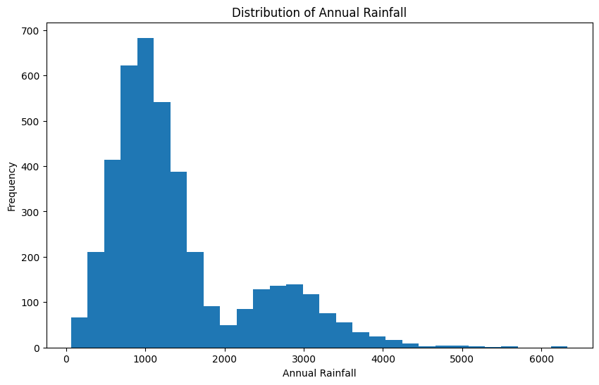
Distribution of Annual Rainfall
The distribution peaks sharply at 800–1,000 mm with nearly 700 data points — this is what a "normal" Indian district looks like, perpetually teetering on the edge of water stress.
The right-skewed long tail stretching to 6,500 mm means a small number of extremely wet regions are pulling India's national average upward, flattering the true experience of most districts.
A subtle secondary hump at 2,400–3,000 mm reveals two distinct rainfall worlds within one country — the dry majority and the drenched coastal-northeast minority living on different planets climatically.

Slide 11
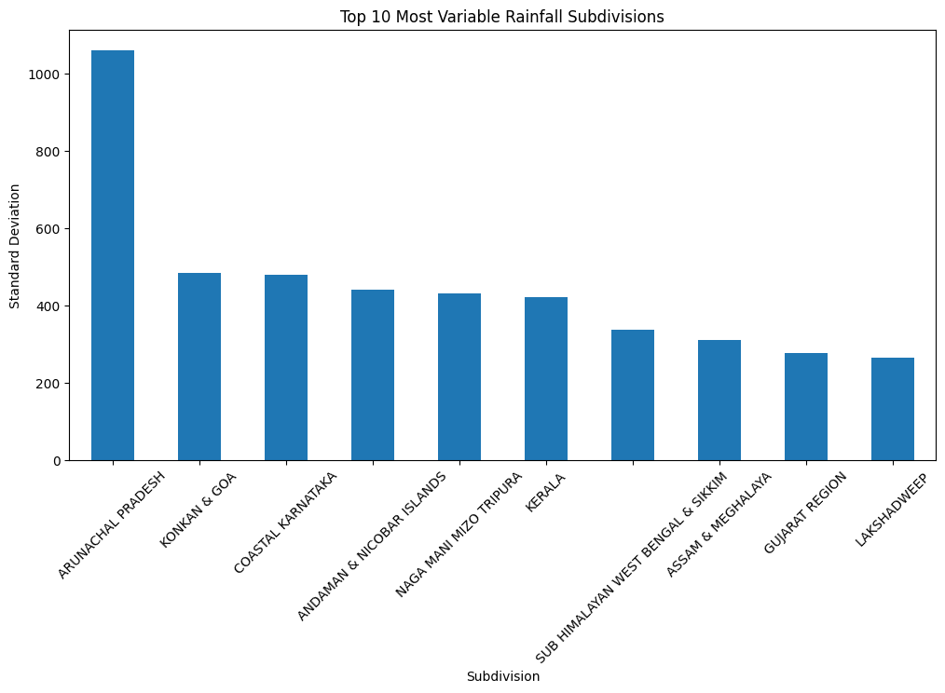
Top 10 Most Variable Rainfall Subdivisions
Arunachal Pradesh stands alone with a standard deviation exceeding 1,050 mm — its year-to-year rainfall swings more than the entire annual total of many Indian districts.
The next 5 regions — Konkan & Goa, Coastal Karnataka, Andaman & Nicobar, Naga-Mani-Mizo-Tripura, Kerala — all cluster between 420–490 mm SD, revealing that high rainfall and high volatility are inseparable twins in India.
Every single region on this list is coastal or Northeastern — inland India may be drier, but at least it's predictably drier; these regions get the rain and the chaos.

Slide 12
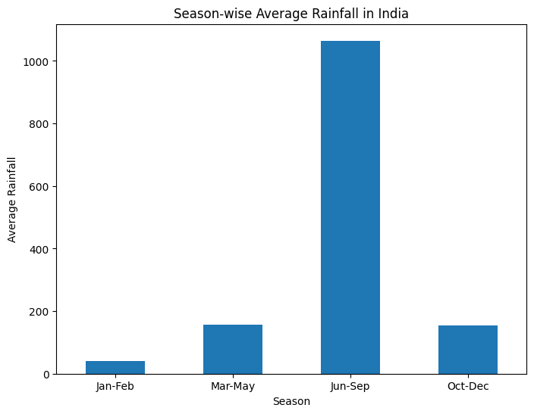
Season-wise Average Rainfall
The Jun–Sep bar towers at ~1,060 mm while the other three seasons combined barely cross 360 mm — this isn't a seasonal distribution, it's a seasonal dictatorship.
Pre-monsoon (Mar–May) and post-monsoon (Oct–Dec) are nearly identical at ~155–160 mm — symmetrical shoulders flanking a giant, making the monsoon look even more dominant by comparison.
Winter (Jan–Feb) contributes a negligible ~45 mm — statistically, India has one real wet season and three dry ones dressed up with different names.

Slide 13
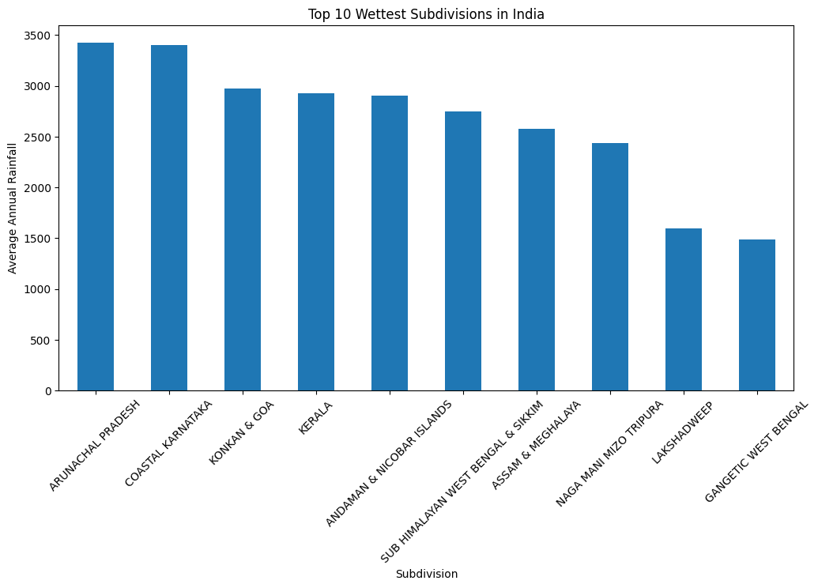
Top 10 Wettest Subdivisions
Arunachal Pradesh (~3,420 mm) and Coastal Karnataka (~3,400 mm) lead the list — a Himalayan frontier state and a Western Ghats strip receiving more rain annually than most countries see in a lifetime.
The entire top 7 is split between two geographic features — the Western Ghats (Konkan & Goa, Kerala, Coastal Karnataka) and the Northeast (Arunachal, Assam & Meghalaya, Naga-Mani-Mizo-Tripura, Sub-Himalayan West Bengal & Sikkim) — India's two rain-catching machines.
Gangetic West Bengal at ~1,490 mm barely makes the top 10 — and it's the only Indo-Gangetic Plain entry, a reminder that the most densely farmed region of India is also among the least watered.

Slide 14

Key Insights
Monsoon months (June–September) contribute the largest share of India’s annual rainfall.
Northeastern and coastal subdivisions show the highest rainfall, while western dry regions receive the least rainfall.
Certain subdivisions show high rainfall variability, indicating unpredictable climate conditions.
Decade-wise analysis suggests fluctuations in rainfall trends rather than a constant pattern.

Slide 15
Recommendations
It is recommended to improve water harvesting and storage systems in low-rainfall regions.
It is suggested to strengthen flood preparedness in high-rainfall and highly variable rainfall zones.
It is also endorsed to use rainfall pattern analysis for agricultural planning and crop selection.
It is also encouraged to focus on region-specific climate adaptation and water management strategies.

Slide 16

Conclusion
Indian rainfall distribution is highly uneven across regions and seasons.
The Indian climate remains strongly dependent on monsoon rainfall.
Historical rainfall analysis helps understand long-term climate variability and regional risks.

