Slide 1
AI Job Replacement: 2020-2026
DEBARUN BANERJEE WEBSKITTERS ACADEMY DATA ANALYTICS BATCH Batch ID: WTS-ACDMY-7979-5280 Student ID: WAPL30052520769

Slide 2
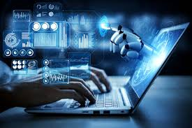
Introduction
This project analyzes how increasing AI adoption levels are influencing automation risk, skill gaps, and salary dynamics across industries, job roles, and countries from 2020–2026.
The analysis focuses on identifying whether AI is causing immediate wage disruption or gradually reshaping workforce requirements through rising automation exposure and widening skill gaps.
The objective is to provide data-driven insights that help organizations anticipate workforce transformation, reskilling needs, and long-term talent strategy in an AI-driven economy.

Slide 3
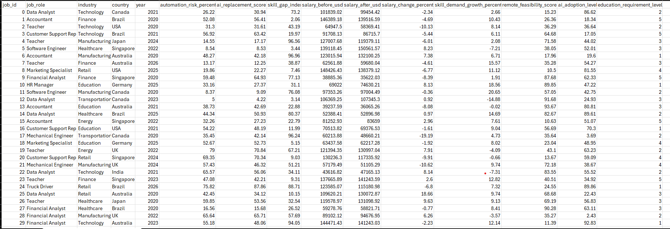
About the Dataset
The dataset was sourced from Kaggle and contains multi-dimensional information on AI adoption levels, job roles, industries, countries, automation risk percentages, salary change metrics, and skill gap indices from 2020 to 2026.
It integrates both workforce impact indicators (automation risk, skill gap index) and economic indicators (salary change %, salary impact categories), enabling cross-sectional and trend-based analysis.
The structured format allows relational modeling across industry, geography, and time, making it suitable for building an interactive Power BI dashboard with KPIs, drillthrough, and comparative insights.

Slide 4
Study Objectives
To compare automation risk levels across industries and countries using interactive map and industry-level visuals, identifying sectors most vulnerable to AI-driven disruption.
To evaluate the relationship between skill gap index and automation exposure across job roles, highlighting areas where reskilling interventions are most urgent.
To assess salary change trends alongside automation risk levels to determine whether AI adoption is leading to wage growth, stagnation, or structural compensation shifts.

Slide 5
Problem Statements
As AI adoption accelerates across industries, organizations lack clear visibility into which sectors, job roles, and regions are most exposed to automation risk and widening skill gaps, making workforce planning uncertain and reactive.
There is limited clarity on how automation risk varies across industries and countries, making it difficult to prioritize strategic workforce interventions.
Organizations struggle to identify which job roles face the highest skill gap pressure, increasing the risk of talent shortages and inefficient reskilling investments.
The relationship between automation exposure and salary changes remains ambiguous, raising concerns about whether AI adoption is creating value or amplifying economic disparity.

Slide 6
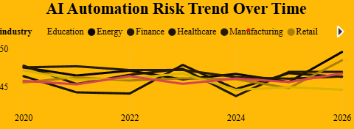
AI Automation Risk Trend Over Time
Automation risk remains consistently elevated across industries over the observed period, indicating that AI-driven disruption is not a short-term fluctuation but a sustained structural shift.
While industries follow slightly different trajectories, the overall movement suggests convergence in risk exposure, implying that AI impact is becoming widespread rather than sector-specific.
Temporary dips and recoveries in certain industries reflect adaptive responses such as digital transformation and reskilling efforts, yet the broader upward direction signals increasing long-term automation pressure.

Slide 7
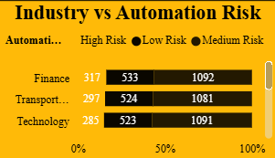
Industry vs Automation Risk
Across industries, the distribution of low, medium, and high automation risk indicates that exposure is not isolated to a single sector but structurally embedded across finance, transportation, and technology.
The presence of substantial medium- and high-risk segments within each industry suggests that automation vulnerability exists at the job-role level rather than uniformly across the entire sector.
This pattern highlights the need for industry-specific workforce strategies, where organizations must identify high-risk roles internally instead of assuming broad sector-level immunity.

Slide 8
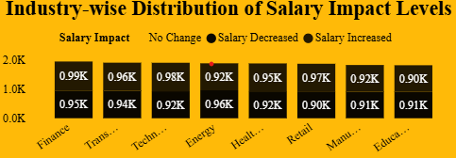
Industry-wise Distribution of Salary Impact Levels
Salary outcomes across industries appear relatively balanced between increases, decreases, and no-change categories, suggesting that AI adoption is not triggering uniform wage disruption.
The coexistence of salary growth and decline within the same industries indicates differentiated impact at the role level, where high-skill positions may benefit while routine roles face downward pressure.
This distribution reinforces the idea that AI is reshaping compensation structures selectively, emphasizing skill intensity and adaptability rather than broadly suppressing wages across sectors.

Slide 9
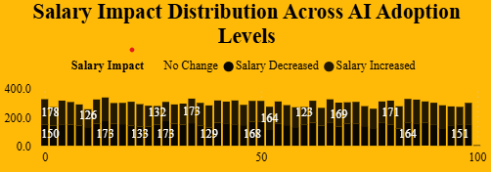
Salary Impact Distribution Across AI Adoption Levels
Salary impact categories remain distributed across all levels of AI adoption, indicating that higher adoption does not automatically translate into uniform salary decline or growth.
The presence of both salary increases and decreases even at higher adoption levels suggests that AI rewards roles aligned with emerging skills while simultaneously displacing routine functions.
This pattern implies that AI adoption acts as a differentiator rather than a direct suppressor of wages, reinforcing the importance of skill alignment in determining compensation outcomes.

Slide 10
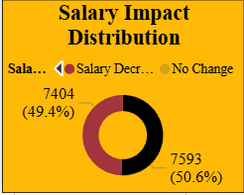
Salary Impact Distribution
The overall distribution shows a near-balanced split between salary decreases and stable outcomes, indicating that AI-driven disruption is significant but not universally negative.
The absence of extreme imbalance suggests that workforce impact is transitional rather than catastrophic, with many roles maintaining compensation stability despite automation pressures.
This equilibrium highlights a critical insight: AI adoption is reshaping job structures gradually, where wage pressure is concentrated in specific roles rather than uniformly affecting the entire labor market.

Slide 11
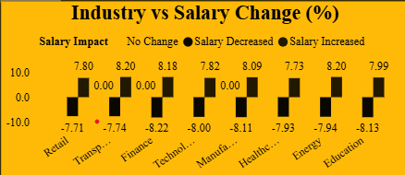
Industry vs Salary Change (%)
Salary structures across industries remain largely stable, reflecting an emphasis on maintaining consistency rather than making significant adjustments.
Reductions in pay are evident across all sectors, pointing to a broad market trend shaped by wider economic pressures.
No sector shows signs of salary growth, underscoring a cautious approach by employers focused on cost control and risk management.

Slide 12
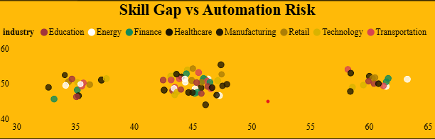
Skill Gap vs Automation Risk
Industries cluster into distinct groups of automation risk, showing that some sectors face significantly higher exposure to automation than others.
Skill gaps remain evident across all industries, highlighting the need for continuous workforce development regardless of automation risk levels.
The combination of high automation risk and notable skill gaps in certain sectors signals urgent priority areas for reskilling and adaptation strategies.

Slide 13
Key Insights
Industries cluster into distinct groups of automation risk, showing that some sectors face significantly higher exposure to automation than others.
Skill gaps remain evident across all industries, highlighting the need for continuous workforce development regardless of automation risk levels.
The combination of high automation risk and notable skill gaps in certain sectors signals urgent priority areas for reskilling and adaptation strategies.

Slide 14
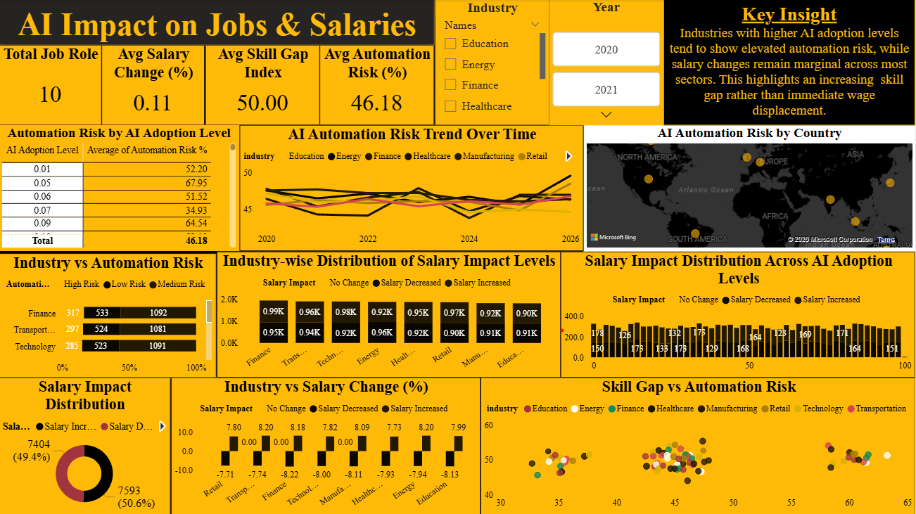
Final Dashboard

Slide 15
Recommendations
It is recommended to implement reskilling initiatives that directly address workforce skill gaps, ensuring employees remain relevant in evolving roles.
It is suggested to promote continuous learning frameworks across industries, enabling adaptability as automation reshapes job requirements.
It is endorsed to design sector-specific strategies that balance automation adoption with human expertise, safeguarding productivity and resilience.

Slide 16
Conclusion
The alignment of skill gaps with automation risk highlights the urgency for industries to proactively prepare their workforce for technological disruption.
Cross-sector patterns reveal that no industry is immune, reinforcing the importance of collective investment in reskilling and adaptability.
The overall trend underscores that balancing automation adoption with human capability is essential to sustain competitiveness and resilience in the future economy.

