Slide 1
ASTRAM Congestion Copilot
Forecasting event-driven congestion — and the plan to clear it
Gridlock Hackathon 2.0 · Round 2 (Prototype) · Theme 2
Event-Driven Congestion (Planned & Unplanned)

Slide 2
THE PROBLEM
Events break traffic faster than crews can react
▸
Rallies, festivals, sports, construction & sudden gatherings cause localized breakdowns.
▸
Today: event impact isn't quantified in advance.
▸
Resource deployment is experience-driven, not data-driven.
▸
No post-event learning system to improve next time.
Theme 2 asks two things — forecast impact AND recommend manpower, barricading & diversion. Most stop at prediction. We do both.

Slide 3
OUR SOLUTION
A working forecast-to-dispatch prototype
▸ FORECAST — clearance time as a P10 / P50 / P90 interval, not a fragile guess.
▸ RECOMMEND — response team, crew count, equipment, barricading & diversion.
▸ DISPATCH — shift-level pre-positioning plan by corridor × time window (CSV/JSON).
▸ PREVENT — recurring waterlogging / pothole / construction hotspots.
Live Streamlit app · trained on real ASTRAM / BTP event data.

Slide 4
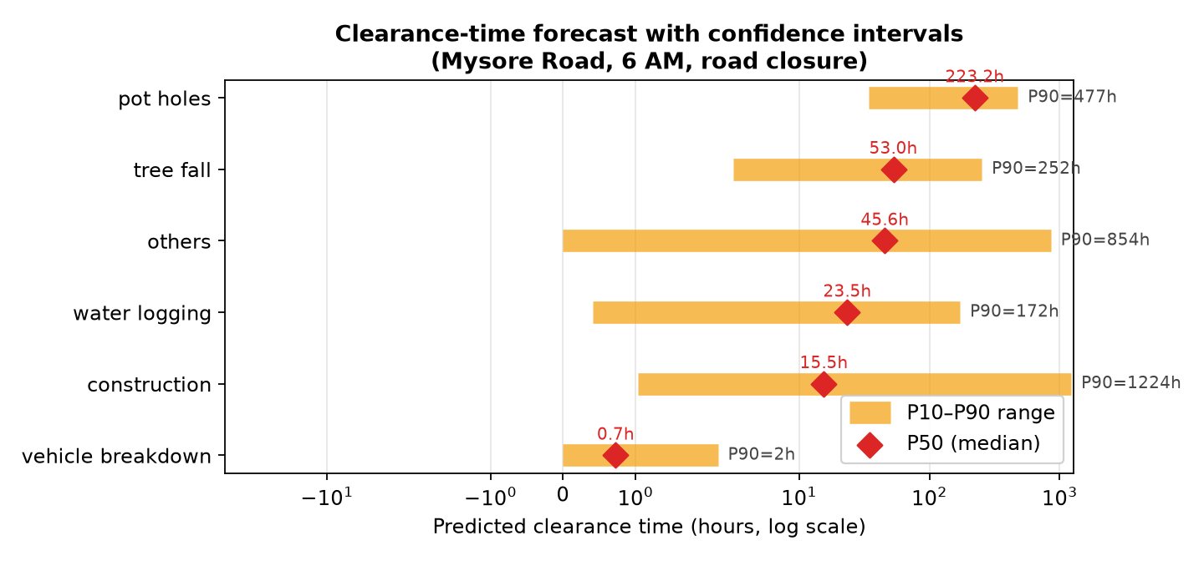
FORECAST
Why a range beats a single number

Slide 5
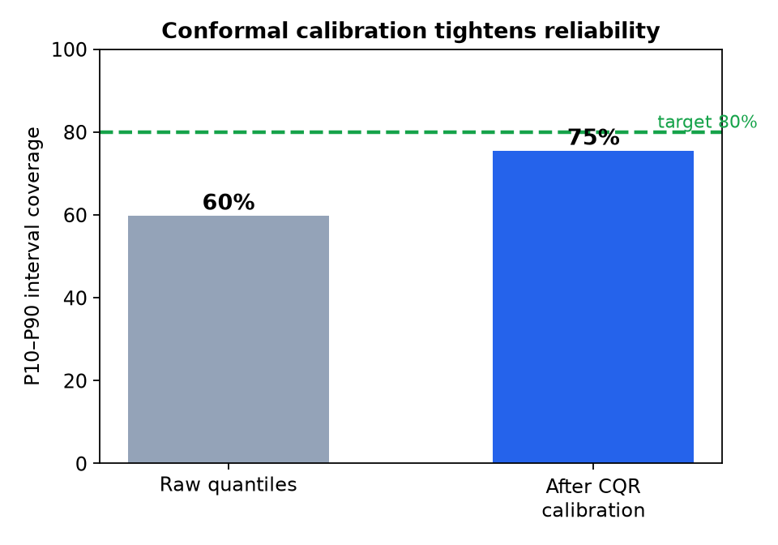
THE MODEL
Calibrated, leakage-safe, honest
▸
LightGBM on log-resolution + quantile models (P10/P50/P90).
▸
Dedicated models for high-variance causes (potholes, construction).
▸
Conformalized Quantile Regression calibrates the intervals.
▸
Strict temporal validation — train on earlier events, test on later.

Slide 6
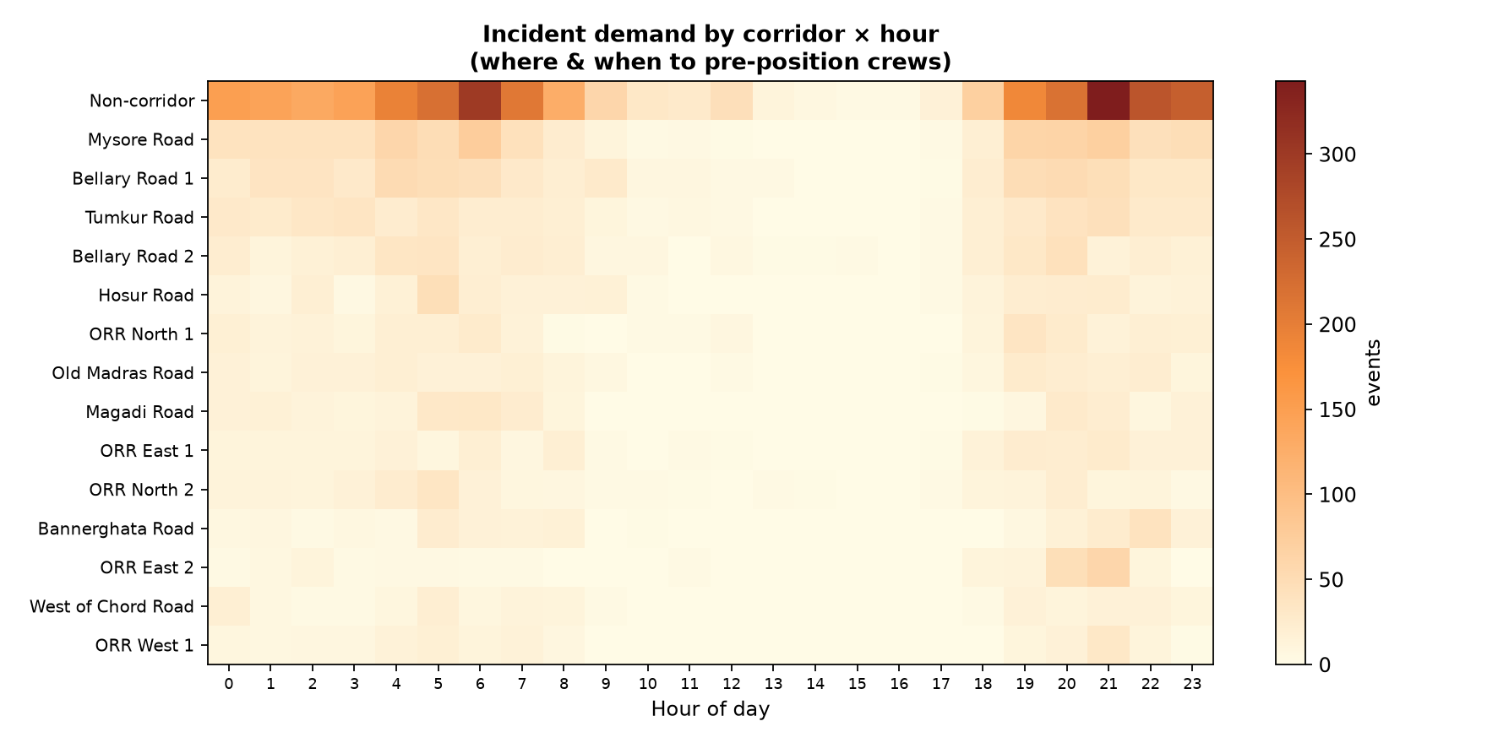
DISPATCH
Where & when to pre-position crews

Slide 7
PERFORMANCE
Honest numbers (temporal hold-out)
1.4 h
~0.7 h
75%
Typical (median) error
Vehicle breakdown P50 (60% of all events)
P10–P90 coverage (60% → after CQR)
Mean error looks large only because rare multi-day infrastructure incidents dominate the average — which is exactly why we report intervals. Surfaced in the app's Model Card, not hidden.

Slide 8
DEMO & IMPACT
From incident to action in one screen
▸
Breakdown, Mysore Rd, 6 AM → ~0.7 h, HIGH, 2 towing units.
▸
Waterlogging + closure → ~24 h (P90 ~170 h), CRITICAL, pumps + diversion.
▸
Dispatch tab → demand heatmap + downloadable staging plan.
▸
Hotspots tab → preventive-maintenance targets.
Built on real BTP data · deployable today · scales to live ASTRAM feeds.
Thank you.

