Slide 1

Presentation on project Phase-1 Implementing CACDES: Centralized Access Control in a Distributed Environment System
By Akshat Joshi
Department of Information Technology,
DIT University Dehradun
Under Mrs Garima Verma
Department of Information Technology,
DIT University Dehradun

Slide 2
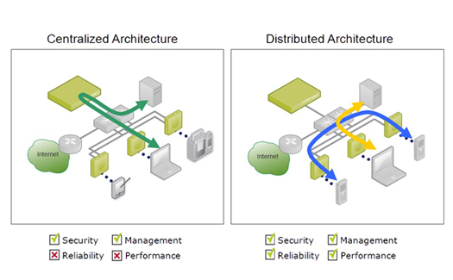
Introduction
A distributed system is one in which both data and transaction processing is divided between one or more computers connected by a network, each computer playing a specific role in the system.

Slide 3
Introduction Contd..
The project is based on research paper titled “Implementation of highly efficient Authentication and Transaction Security”.
In this project we are implementing one module of the paper.
The objective of this module is to create a distributed environment and to provide centralized access control over it.

Slide 4
Introduction Contd..
Structure Chart :

Slide 5
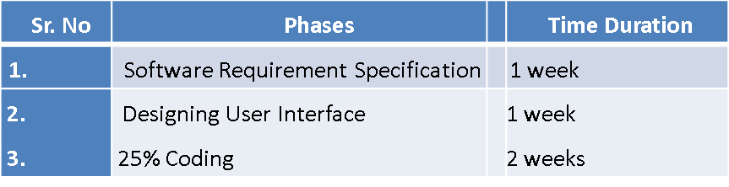
Methodology
The methodology used to develop this project is Java TCP Socket programming and data base management system. The project is divided in following modules –
Analysis
Design
Implementation and Testing
We will work on this project in three phases.
Phase 1: This phase will be covered in 6th semester. Phase 1 is further divided into following phases:-

Slide 6
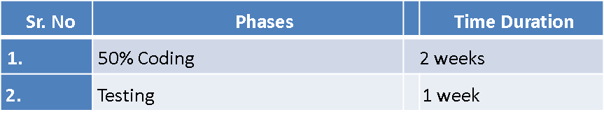
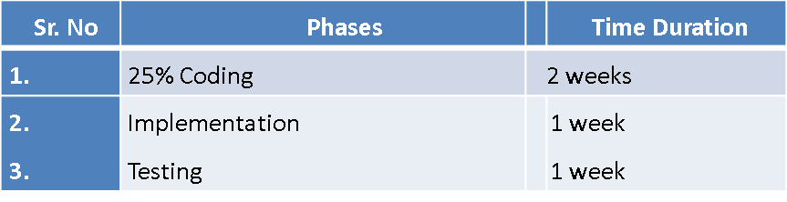
Phase 2: This phase will be covered in 7th semester. Phase 2 is further divided into following phases:-
Phase3: This phase will also be covered in 7th semester. Phase 2 is further divided into following phases:-

Slide 7
Implementation Details
Hardware Requirements
Minimum three interconnected working systems, with:
Processor : Pentium IV
RAM : 512 MB
Hard disk : 40 GB
Software Requirements
J2SDK
Netbeans
MySql
Apache Tomcat Server
Microsoft word 2000

Slide 8
Modules Covered in Phase 1
Client Control Module
This module is for registration of client on awt based GUI.
Register - First time mandatory registration for new clients. Requires name, username, password and email address.
Login - User enters his/her credentials which are stored in a database.
Forgot Password - In the case when client forgets his/her login password, the client can request for a new password through email verification.

Slide 9
Access Control Module
This module is responsible for user verification.
If the verification is successful a unique code is generated and sent back to client, otherwise Access is denied.
Client Verification Module
This module has the following functions:
Unicode and username sent to data server from access server.
Sends username and Unicode to data server from client.
Data server verifies Unicode & username.
If code & username is verified, permission is granted.

Slide 10
Technological Learning after this Project
Although our proposed application can support as many computer systems as required, The foremost challenge for us, would be implementing this distributed network on more than two computer systems. The next challenge to achieving our objective would be designing the distributed environment as it would require a deep understanding of various concepts that have been and haven’t been introduced in my engineering course.

Slide 11
Advantages
Performance
The collection of processors can provide higher performance.
Scalability
If required more processing, we can add more systems to the distributed environment.
Fault Tolerance
If one machine gets faulty, other machines can still survive in the network.

Slide 12
Economic
Cost effective over other mainframes.
Sharing data or resources
Shared data is essential to many applications such as banking, reservation systems etc., other resources (expensive printers) can also be shared.
Communication
Facilitates human-to-human communication.
Data Replication
Data can be replicated at multiple terminals to ensure that there will be no data loss.

Slide 13
Limitations
Although we are providing many security features in our project, we are not covering some aspects such as different kinds of attacks like Device Hacks, Distributed Denial of Service, Distributed Port scan Attack, ARP spoofing etc.
Also in the unfortunate event when our access server is hacked, the hacker can gain access into our system using the credential data stored with the access server.

Slide 14
Future Enhancement Scope
Emailing feature and code regeneration in the case if client forgets password.
Device identification through MAC Verification.
Integrating more clients and data servers in the distributed environment.
Decentralizing the Access Control by using Global Positioning System technology.

