Slide 1

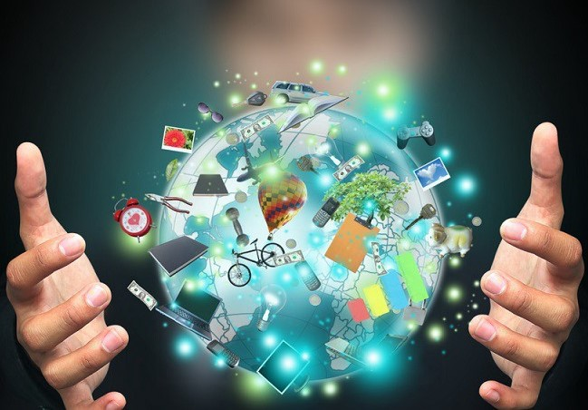
INNOVATION OF SCIENCE
Mini Project : English
Course : B. Tech (CSE)
Batch : 2020-24
Group Members:
Tirthajyoti Nag
Jayasree Ghosh
Manona Mukherjee
Sayani Ghatak

Slide 2
ACKNOWLEDGEMENT
I would like to express my special thanks of gratitude to my teacher Sudeshna Roy Chowdhury and our HOD sir, Mr. Saikat Maity who gave us the golden opportunity to do this wonderful project on the topic Innovation of Science.
I would also like to thank all our group members for their co-operation and hard work.

Slide 3
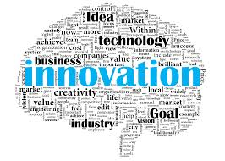
INTRODUCTION
Innovation is all about a new idea, a new method or a modified device.
It’s basically the introduction of something new.
Innovation can refer to something big; innovative i.e. a change made to an existing product, idea or field.
Science, technology and innovation have boosted development to a great extent.

Slide 4
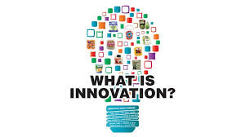
WHAT IS INNOVATION?
CREATIVITY is about new ideas where INNOVATION is the profitable implementation of these ideas.
Everyone seems to have an opinion about INNOVATION and there is an enormous amount of conflicting about information.
A need for facts resides instead of opinions.

Slide 5
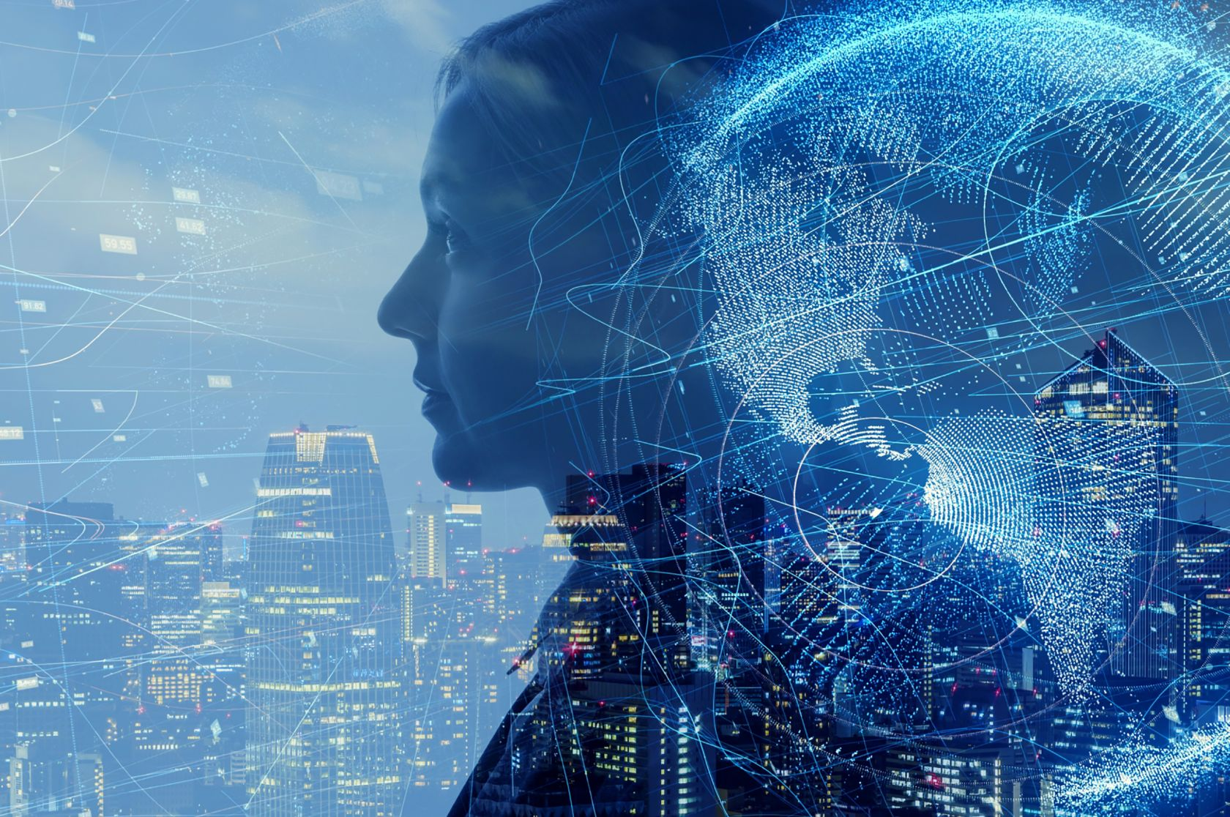
HOW INNOVATION OF SCIENCE HELPED US?
Science and technology have become an important part in our day-to-day life.
From getting up in the morning with our alarm clocks ringing to going to bed after switching of our lights, we are surrounded by science and technology.
It is hard to imagine our lives without science nowadays.
Indeed our existence itself depends on Science.

Slide 6
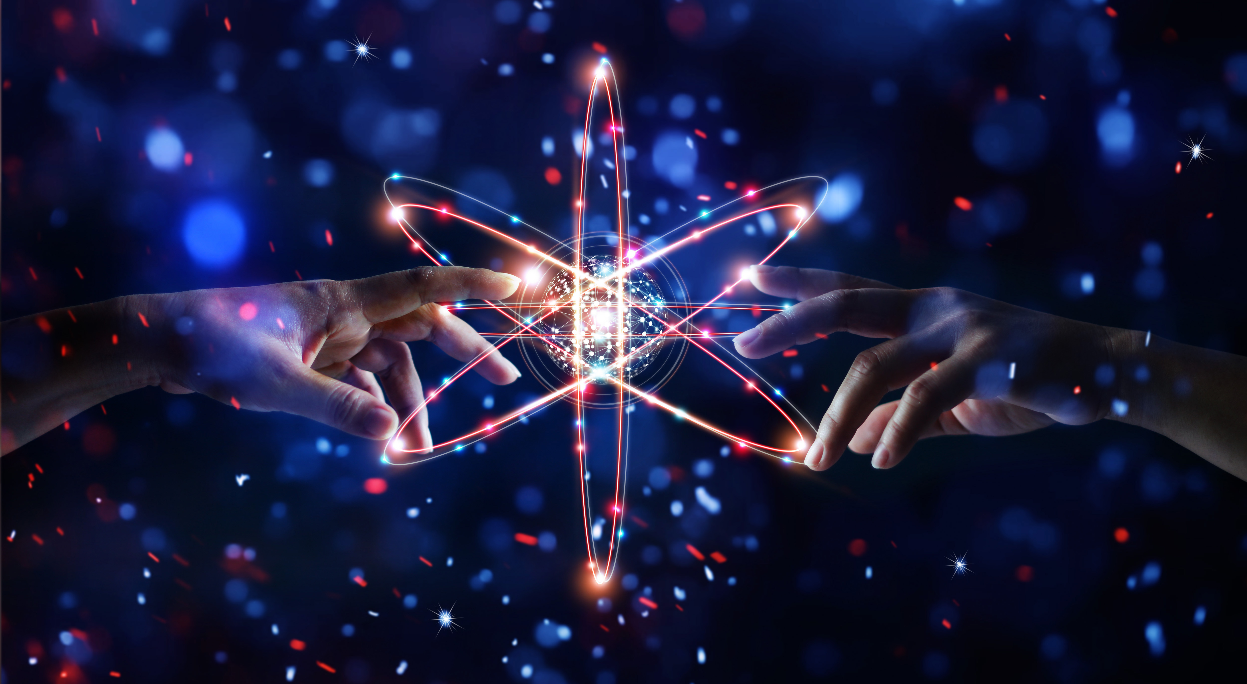
HOW ARE WE DEPENDENT ON SCIENCE?
Science and technology have become an integral part of our lives.
Trying to imagine what life would be like without science and technology is practically impossible.
Science and technology have made our life easier, more convenient, safer, and more enjoyable.

Slide 7
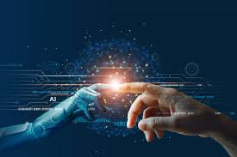
SCIENCE MADE IMPOSSIBLE TO POSSIBLE
Science made our “digital world possible”.
It invented “vaccines” for various diseases.
Science has made “travelling” possible to any corner of the world.
Science has developed “computers” to a vital component of our lives.
“Artificial intelligence” has helped in new discoveries of various research fields.

Slide 8
HOW SCIENCE MADE OUR LIVES EASIER?
Since the 16th century, science has given us electricity and anaesthetics, internet, vaccines and good anti-cancer drugs.
Science made everything easier. Previously we used to write letters for communication. But nowadays people use social media for communications.
Science recently invented 5G network for faster speed.
It also invented AI robots, the most renouned one is “SOPHIA’’.

Slide 9
Science has also helped man to conquer the moon and explore space.
Not only this, Science has shown its magic by inventing Covid-19 vaccines within 1 year. Naturally it takes around 2-3 years for preparinig any vaccines.
Without Science and its Innovations it would have been is impossible to study in this pandemic situation.
Its only Science and its Innovations which made impossible to possible.

Slide 10
IS SCIENCE A BLESS OR A CURSE?
Yes , Science being a big boon, its also a curse to all.
It is indeed a boon and a blessing, if used for the benefit of mankind and for constructive purposes unless it becomes a tool in the hand of a few selfish and evil-minded people.
Science has destroyed the old social system. People feel shy while interacting in real world whereas they have more than 1k friends in social media platform.
People forgot to respect others.

Slide 11
Science made people lazier.
Birds are in danger for the
It is destroying our simple and healthy lifestyle.
Crime and terrorism has extended to an extent.
Work overload .
Job insecurity.
Digital media manipulation.
Detachment from the real world and living in fantasy or virtual world.

Slide 12
CONCLUSION
The impact of science and technology on modern society is broad and wide-ranging, influencing such areas as politics, diplomacy, defense, economy, medicine, transportation, agriculture,capital improvement, and many more.
The fruits of science and technology fill every corner of our lives.
Since we are gifted with Science and Technology we should use it wisely and carefully.

Slide 13


