Slide 1
Vid2Seq: Large-Scale Pretraining of a Visual Language Model
for Dense Video Captioning
Antoine Yang et. al
(https://antoyang.github.io/vid2seq.html)

Slide 2
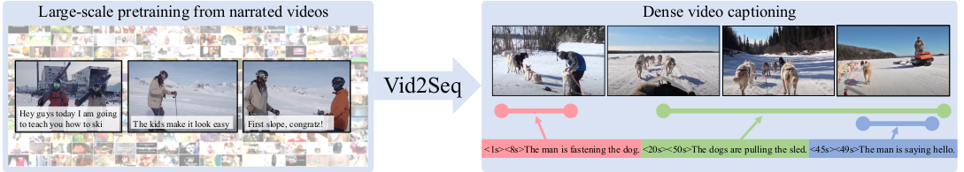
Problem (Dense Video Captioning)
Given a untrimmed video, the goal is to generate captioning of all events in the video.
There is difference between Dense Video and Standard Video Captioning. Standard Video Captioning aims to generate a single caption for a short video clip.
Dense video captioning needs to localise the events in minutes-long videos, in order to given caption for each event in the video.

Slide 3
Possible Solutions
Of the solution is by using Divide and Conquer. First localise the content of the video first. And then for each of them generate a caption.
Another approach is to learn both the task jointly.
Now second approach will tend to learn better relations among the two task, but the data needed to train this is large.
Large Human annotated data is not possible so we need to look some pseudo ways to get this data.
And train on some proxy task.

Slide 4
Data Generation
For dataset used are divided in two parts.
First is for pretraining. This uses YT-temporal 1B
For video clip captioning they have used MSR-VTT and MSVD
And for training on downstream task they have used three dataset Youcook2, ViTT, Activity Net Captions.
The architecture takes video as an input. And divides it into frames, with speed of 1FPS.
Using the same video, we use the speech by using speech to text Google Cloud API.

Slide 5
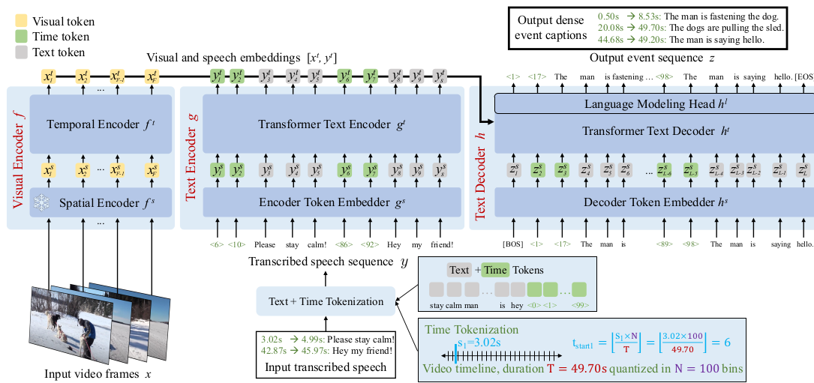
Architecture

Slide 6
Time Tokenization
We start from a text tokenizer with a vocabulary size V , and augment it with N additional time tokens, resulting in a tokenizer with V + N tokens.
The time tokens represent relative timestamps in a video, as we quantize a video of duration T into N equally-spaced timestamps.
In detail, they have used the Sentence Piece tokenizer with vocabulary size V = 32, 128 and N = 100.
We pass the text in format of <timestamp start> s1 s2 … sn <timestamp end>
This format is same across the text encode and decoder for the model.

Slide 7
Architecture (Visual encoder)
Visual encoder. The visual encoder operates on a sequence of F frames x ∈ R^{F ×H×W ×C} where H, W and C are the height, width and the number of channels of each frame.
A visual backbone f ^{s} first encodes each frame separately and outputs frame embeddings x^{s} = f ^{s}(x) ∈ R ^{F ×d} , where d is the embedding dimension.
Then a transformer encoder f ^{t} models temporal interactions between the different frames, and outputs F contextualized visual embeddings x^{t} = f ^{t} (x^{s} + x^{p} ) ∈ R ^{F ×d}, where x^{p} ∈ R ^{F ×d} are learnt temporal positional embeddings, which communicate time information from visual inputs to the model.
CLIP ViT-L/14 [22, 77] at resolution 224 × 224 pixels is used here.

Slide 8
Text encoder
An embedding layer g ^{s} ∈ R^{(V +N )×d} embeds each token independently and outputs semantic embeddings y ^{s} = g^{s} (y) ∈ R^{S×d} .
Then a transformer encoder g^{t} computes interactions in the transcribed speech sequence and outputs S contextualized speech embeddings y^{t} = g^{t} (y s) ∈ R R^{S×d}.
T5 is used for initialization here.

Slide 9
Text decoder
We concatenate the visual and speech embeddings.
Text decoder is based causal transformer decoder h^{t}.
Decoder h^{t} that cross-attends to the encoder outputs, and at each autoregressive step k, self-attends to the previously generated tokens ẑ_{<k}^{t} to output a contextualized representation.
is the decoder token embedding layer.
Then a language modeling head h^{l} ∈ R^{d×(V +N )} predicts a probability distribution over the joint vocabulary of text and time tokens in order to predict the next token in the event sequence.

Slide 10
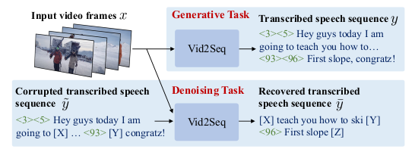
Pretraining
Pretraining tasks. To train Vid2Seq on unlabeled narrated videos, we design two pre training objectives.
Top: generative objective, given visual inputs x only, the task is to generate the transcribed speech sequence y.
Bottom: denoising objective, given visual inputs x and the corrupted speech sequence ỹ, the task is to generate the sequence of recovered speech segments ȳ.

Slide 11

Training Objective
Formally, given visual inputs x, encoder text sequence y and a decoder target text sequence z, both objectives are based on minimizing the following loss:
where L is the length of the decoder target sequence, w^{k} is the weight for k-th token in the sequence, which we set to w^{k} = 1 ∀k in practice, θ denotes the trainable parameters in the model and p^{θ} is the output probability distribution over the vocabulary of text and time tokens.

Slide 12
Sampling
Nucleus sampling, a threshold probability value (p) is chosen, typically between 0 and 1. The model generates a probability distribution over all possible output tokens, and then selects the smallest set of tokens whose cumulative probability mass exceeds p. This set of tokens is known as the nucleus.
ArgMax Sampling: The model then randomly selects an output token from the nucleus, weighted by their individual probabilities. This allows for a more diverse set of possible outputs compared to argmax sampling, as the model is not restricted to always selecting the most likely token.
Beam search, the model generates a probability distribution over all possible output tokens, and selects the top-k tokens with the highest probabilities, where k is a pre-determined hyperparameter called the beam size. The model then generates all possible combinations of these top-k tokens as prefixes for the next set of tokens, and generates a new set of top-k candidates for each prefix.

Slide 13
More Objective …
Generative objective:
This objective uses the transcribed speech as a (pseudo-)supervisory signal to teach the decoder to predict a sequence of events given visual inputs
Given video frames x, which are fed to the encoder, the decoder has to predict the transcribed speech sequence y, which serves as a proxy dense event captioning annotation.
No text input is given to the encoder for this task as using transcribed speech both as input and target would lead the model to learn text-only shortcuts

Slide 14
More Objective …
Denoising objective:
As no text input is given to the encoder for the generative proxy task, the generative objective only trains the visual encoder and the text decoder, but not the text encoder.
Denoising objective that aims at jointly aligning the visual encoder, the text encoder and the text decoder.
Inspired by T5 in the text domain, we randomly mask spans of (text and time) tokens in the transcribed speech sequence with a probability P and an average span length M .

Slide 15
Evaluation metrics
For captioning they have used CIDEr and METEOR
CIDEr (Consensus-based Image Description Evaluation) algorithm first generates a set of candidate captions for each image, and then compares them to a set of reference captions that have been provided by human annotators.
CIDEr uses a variant of the TF-IDF weighting scheme to compute the similarity between two captions. It also incorporates n-gram matching.
METEOR (M) takes into account a wider range of linguistic phenomena, including synonyms, paraphrases, and word order variations, which are important for evaluating the fluency and adequacy of translations.
These metrics do not take into account the story of the video. Therefore we also use SODAc (S) for an overall dense video captioning evaluation.

Slide 16
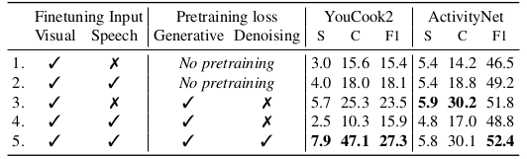
Effect of input modalities and pretraining losses

Slide 17
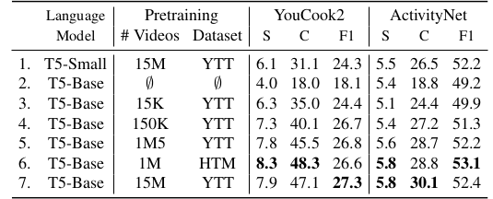
Effect of language model size and pretraining data.

Slide 18
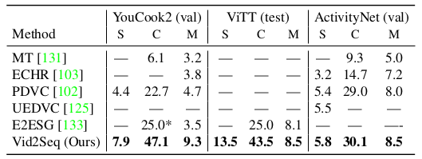
Comparison to the state of the art for dense video captioning.

Slide 19
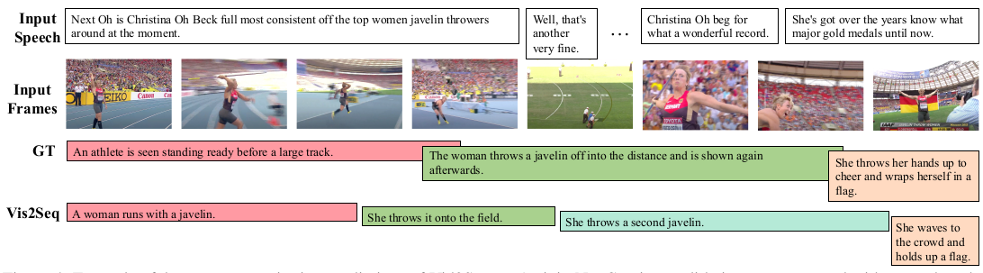
Example of Video2Seq on ActivityNet

Slide 20
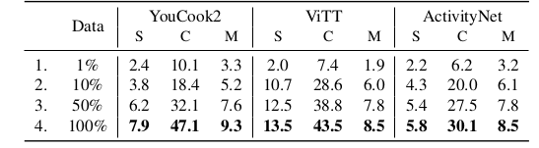
Few-shot dense video captioning
To further evaluate the generalization capabilities of our pretrained Vid2Seq model, they propose a new few-shot dense video captioning setting where they finetune Vid2Seq using only a fraction of the downstream training dataset.

Slide 21
Conclusion
Vid2Seq, a visual language model that performs dense video captioning by generating a single sequence of tokens including both text and time tokens given multimodal inputs.
Vid2Seq benefits from large-scale pretraining on unlabeled untrimmed narrated
Vid2Seq achieves state-of-the-art results on various dense event captioning datasets
The sequence-to-sequence design of Vid2Seq has the potential to be extended to a wide range of other video tasks

Slide 22
Learning For Me
Usually now a days researcher are taking a complex problem and try to solve it with weak supervision and more data.
Importance of Proxy task
Scale of Data Matters. Human annotation is costly so try to get an approximately good large data
In multimodal setup Joint learning with more data give usually better results.

Slide 23
THANK YOU !!!

