Slide 1
IPL Performance Dashboard & Insights
Exploratory Data Analysis (EDA) | KPIs | Insights & Recommendations

Slide 2
Objectives
1. Analyze player and team performance trends in IPL. 2. Identify top scorers, bowlers, and fielders. 3. Study toss decisions and their impact on match results. 4. Evaluate team success factors. 5. Provide actionable recommendations.

Slide 3
Methods
• Data collected from IPL Document datasets. • Data cleaning: handled missing values, standardized team/player names. • Built relational model and created New Necessary Measures by DAX. • Conducted EDA using Power BI. • Built dashboards for batting, bowling, fielding, toss, and venues, etc.

Slide 4
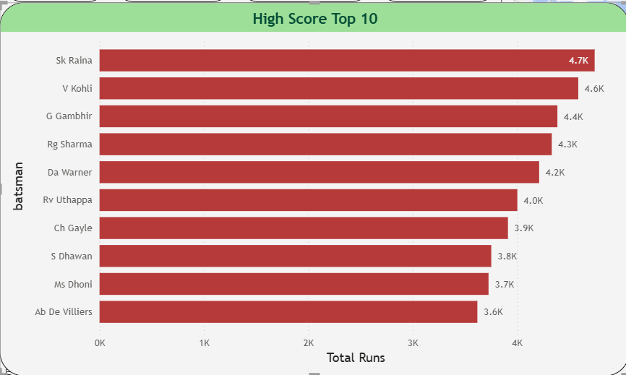
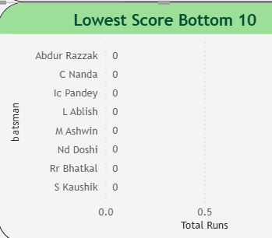

Top Scorers & Lowest Scorers
Suresh Raina, Virat Kohli, and Rohit Sharma emerge as top scorers. Several players remain with negligible runs (e.g., Abdur Razzak).

Slide 5
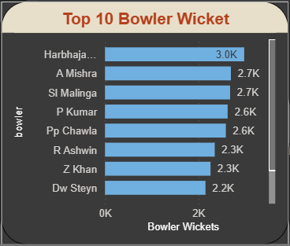

Top Bowlers & Wickets
Harbhajan Singh, Amit Mishra, and Lasith Malinga dominate with highest wickets. Some bowlers failed to pick any wickets despite opportunities.

Slide 6
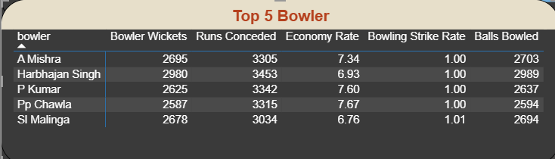
Top 5 Bowlers Analysis
Amit Mishra & Harbhajan Singh are most economical among top wicket-takers. Malinga balances wickets with a strong economy rate.

Slide 7
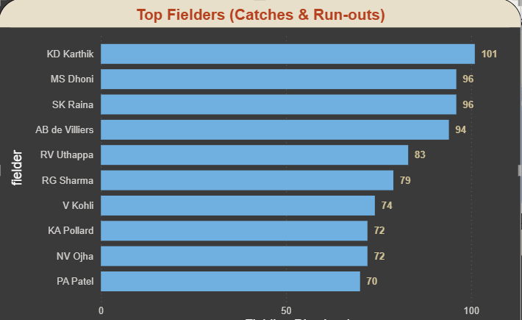
Top Fielders
Karthik, Dhoni, and Raina top the fielding chart with 90+ dismissals. Strong contribution of wicket-keepers in top list.

Slide 8
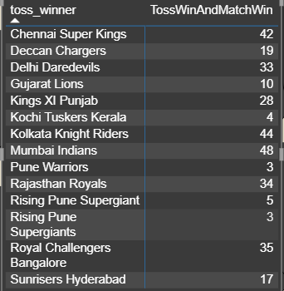
Toss Decisions & Match Winners
Mumbai Indians and CSK win the most tosses and matches. Teams winning toss don't always convert into match winners.

Slide 9
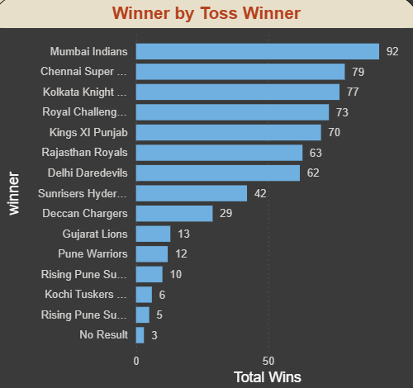
Most Successful Teams
Mumbai Indians, CSK, and KKR consistently top in terms of victories. These teams also win often after toss advantage.

Slide 10
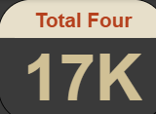
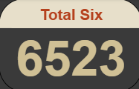
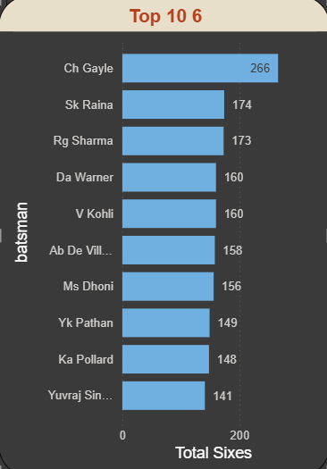
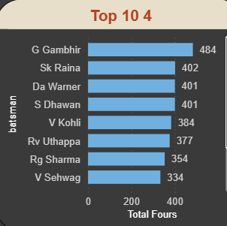
Most Sixes & Fours
Chris Gayle dominates six-hitting, while Raina leads in boundaries. Highlights aggressive vs consistent batting styles.

Slide 11
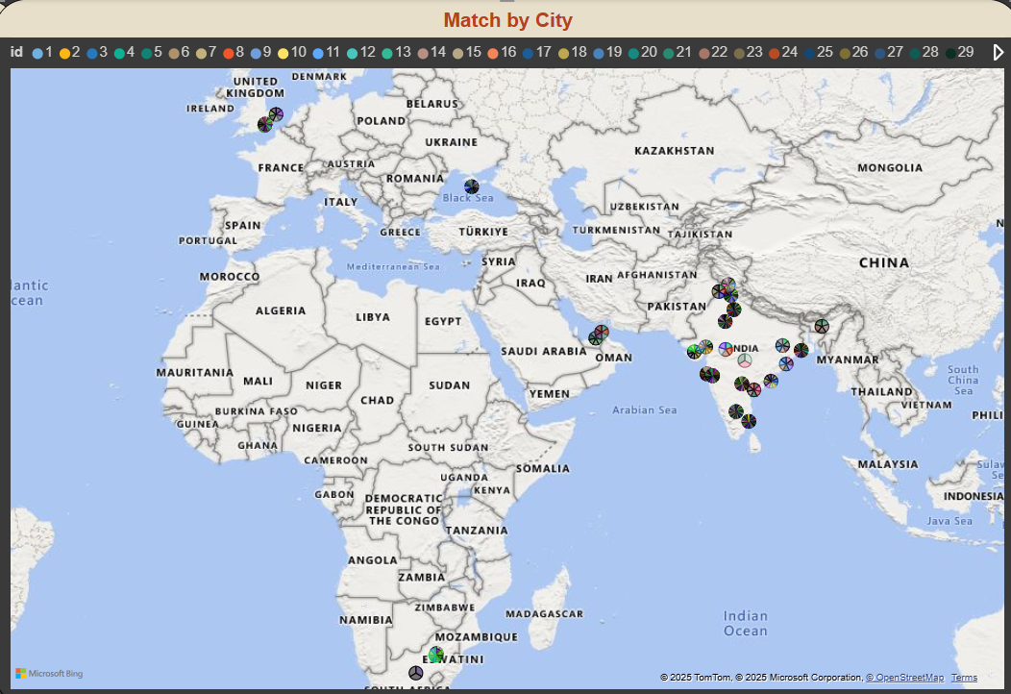
Matches by City & Stadiums
Mumbai & Kolkata host maximum matches. Wankhede & Eden Gardens are most influential venues.

Slide 12
Recommendations
1. Teams should analyze opponents' selection after toss win. 2. Invest in fielding units—impactful in close matches. 3. Bowlers like Mishra & Malinga show the value of balance between wickets & economy. 4. Focus recruitment on consistent run-scorers rather than short-term hitters. 5. Explore venue-specific strategies (Eden Gardens vs Wankhede).

Slide 13
Conclusion
The IPL analysis highlights key performers, team dominance, and tactical toss decisions. The insights provide evidence-based recommendations for team strategies, performance improvement, and fan engagement.

