Slide 1
CYBAGE HACKATHON 2026
AI-Powered End-to-End
Software Delivery
TEAM
MAP MINDS
Hi-Tech Vertical
From Jira ticket to production — powered by AI and AWS.
THEME: DARK FACTORY | FROM CODE TO DEPLOY
AUTOMATED
INTELLIGENT
GOVERNED
Reduce manual delivery overhead
AI agents handle delivery stages
Human control at critical gates
MAP MINDS | HI-TECH | CYBAGE HACKATHON 2026

Slide 2
THE PROBLEM
02
Software delivery is still too manual and fragmented
Teams move through multiple handoffs, tools and decision points before a change reaches production.
Requirements, planning, coding, validation, review and deployment are disconnected — creating avoidable manual effort and limited end-to-end visibility.
PROBLEM STATEMENT
Manual effort
Slow delivery
Inconsistent quality
Repeated handoffs and coordination across delivery stages.
Engineering time is spent moving work between tools and people.
Implementation, testing and review practices vary by change.
Late risk detection
Limited traceability
AI without guardrails
Quality and security issues can surface after development work.
Hard to connect decisions, artifacts, evidence and recovery history.
Automation needs controls so mistakes do not propagate downstream.
OUR RESPONSE
Orchestrate the full delivery lifecycle with AI agents, automated validation and human governance.
MAP MINDS | HI-TECH | CYBAGE HACKATHON 2026

Slide 3
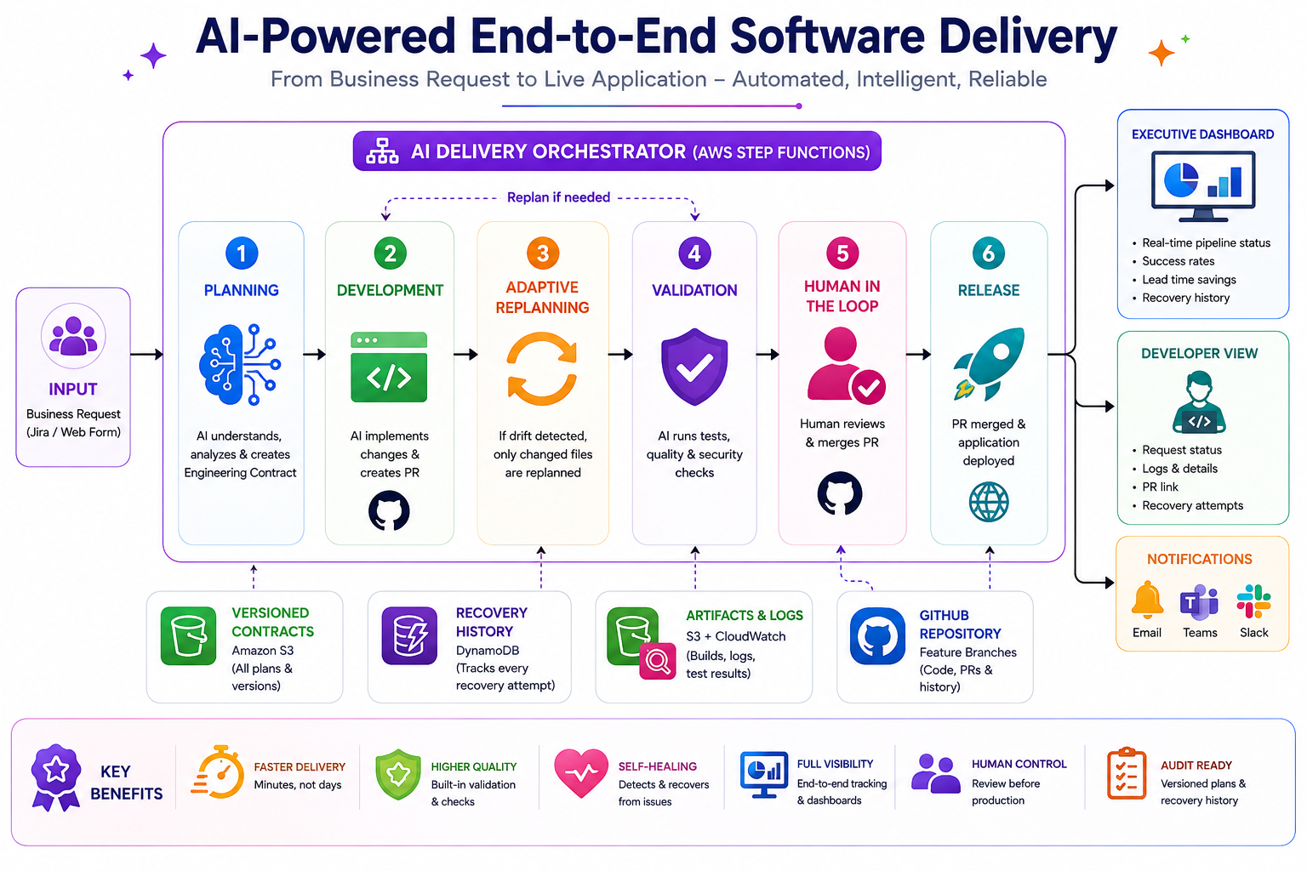
RESOLUTION + TECHNOLOGY
03
An AI-orchestrated path from Jira request to deployed application
AWS Step Functions coordinates specialized delivery agents, evidence collection, recovery and human approval.
TECHNOLOGY
STACK
AWS Step Functions
Workflow orchestration
AWS Lambda
Agent execution
Amazon S3
Contracts + artifacts
DynamoDB
Workflow / recovery state
CloudWatch
Logs + observability
GitHub
Branches + PRs
Jira
Business request
AI / LLM
Planning + implementation
MAP MINDS | HI-TECH | CYBAGE HACKATHON 2026

Slide 4
FUTURE ENHANCEMENTS
04
What we can add next?
Extend the POC into a broader, more autonomous engineering platform.
Integrated testing & scanning
AI code review agent
Auto PR merge agent
Connect third-party testing, code quality, vulnerability and security scanning tools.
Add an independent review agent to assess implementation quality before approval.
Merge approved PRs automatically when all required validation and policy gates pass.
PRD → Jira automation
Multi-model validation
Enterprise integrations
Generate Jira tickets from a PRD stored in S3, reducing manual requirement creation.
Use an independent model or agent to challenge plans and reduce model-specific errors.
Expand connectors across repositories, CI/CD platforms, ticketing and governance tools.
MAP MINDS | HI-TECH | CYBAGE HACKATHON 2026

Slide 5
MAP MINDS
05
QUESTIONS & DISCUSSIONS
THANK YOU !
MAP MINDS | HI-TECH | CYBAGE HACKATHON 2026

