Slide 1


Perennation Computer Solutions Global Pvt. Ltd
CORPORATE OFFICE BRANCH OFFICE
DN 36, Primac Tower 11th Flr. Room No. 1101 91/39H, Bosepukur Road Kasba,
Saltlake City Sector –V . Kolkata-700042
Kolkata -700091
Notes:
Instructors Notes:
This guide will provide a basic introduction to WebSphere Portal and its concepts.

Slide 2
WELCOME..
PCS Global welcomes you in the most significant phase of your academic journey.
It is the time when you will gain your own recognition by showcasing your skills and competencies to the outside world.
CORPORATE OFFICE BRANCH OFFICE
DN 36, Primac Tower 11th Flr. Room No. 1101 91/39H, Bosepukur Road, Kol- 700042
Sector –V. Saltlake Kolkata -700091

Slide 3
Agenda
You will get a flavor of Industry.
How Industrial training will help you to apply your thoughts in practical
You will know What is C and its usage
You will be able to do basic C language programming.
CORPORATE OFFICE BRANCH OFFICE
DN-51 Merlin Infinite ,Sector –V .Saltlake Kolkata -91, Unit – 914 91/39H, Bosepukur Road, Kolkata-42
CORPORATE OFFICE BRANCH OFFICE
DN 36, Primac Tower 11th Flr. Room No. 1101 91/39H, Bosepukur Road, Kol- 700042
Sector –V. Saltlake Kolkata -700091

Slide 4
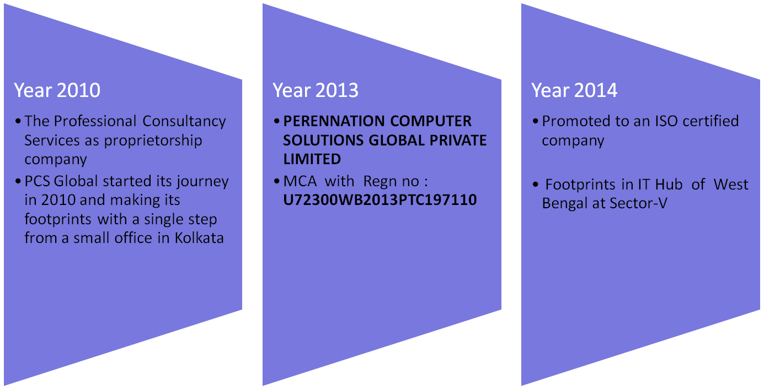
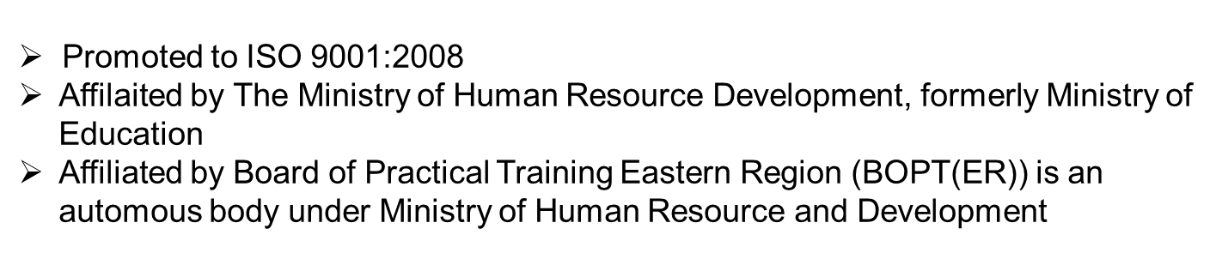
Making of PCS Global Private Limited
CORPORATE OFFICE BRANCH OFFICE
DN-51 Merlin Infinite, Sector– V. Saltlake Kolkata -91. 91/39H, Bosepukur Road, Kol-42
CORPORATE OFFICE BRANCH OFFICE
DN 36, Primac Tower 11th Flr. Room No. 1101 91/39H, Bosepukur Road, Kol- 700042
Sector –V. Saltlake Kolkata -700091

Slide 5
Current Operation Process
DEVELOPMENT
Java/ J2EE
Android
PHP
Data Analytics
Testing
Hadoop
ORACLE/SQLSERVER/MySql
IOT
IT
Consulting
Business Solution
Outsourcing
HR Process
Corporate Training
Java/ J2EE
Android
PHP
Data Analytics
Testing
Hadoop
ORACLE/SQLSERVER/MySql
IOT
CORPORATE OFFICE BRANCH OFFICE
DN-51 Merlin Infinite , Sector –V . Saltlake, Kolkata -91, Unit – 914 91/39H, Bosepukur Road,Kol-42
CORPORATE OFFICE BRANCH OFFICE
DN 36, Primac Tower 11th Flr. Room No. 1101 91/39H, Bosepukur Road, Kol- 700042
Sector –V. Saltlake Kolkata -700091

Slide 6
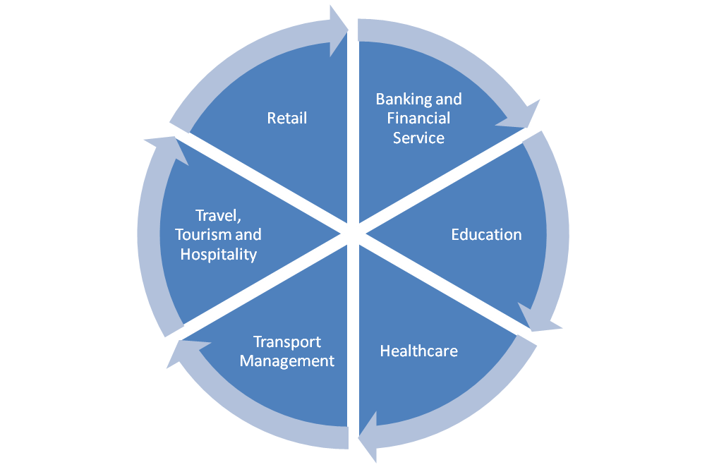
Domains We Work
CORPORATE OFFICE BRANCH OFFICE
DN-51, Merlin Infinite , Sector-V, Saltlake, Kol-91 91/39H, Bosepukur Road,Kol-42
CORPORATE OFFICE BRANCH OFFICE
DN 36, Primac Tower 11th Flr. Room No. 1101 91/39H, Bosepukur Road, Kol- 700042
Sector –V. Saltlake Kolkata -700091

Slide 7
Why PCS Global?
CORPORATE OFFICE BRANCH OFFICE
DN-51 Merlin Infinite ,Sector –V .Saltlake Kolkata -91, Unit – 914 91/39H, Bosepukur Road, Kolkata-42
CORPORATE OFFICE BRANCH OFFICE
DN 36, Primac Tower 11th Flr. Room No. 1101 91/39H, Bosepukur Road, Kol- 700042
Sector –V. Saltlake Kolkata -700091

Slide 8
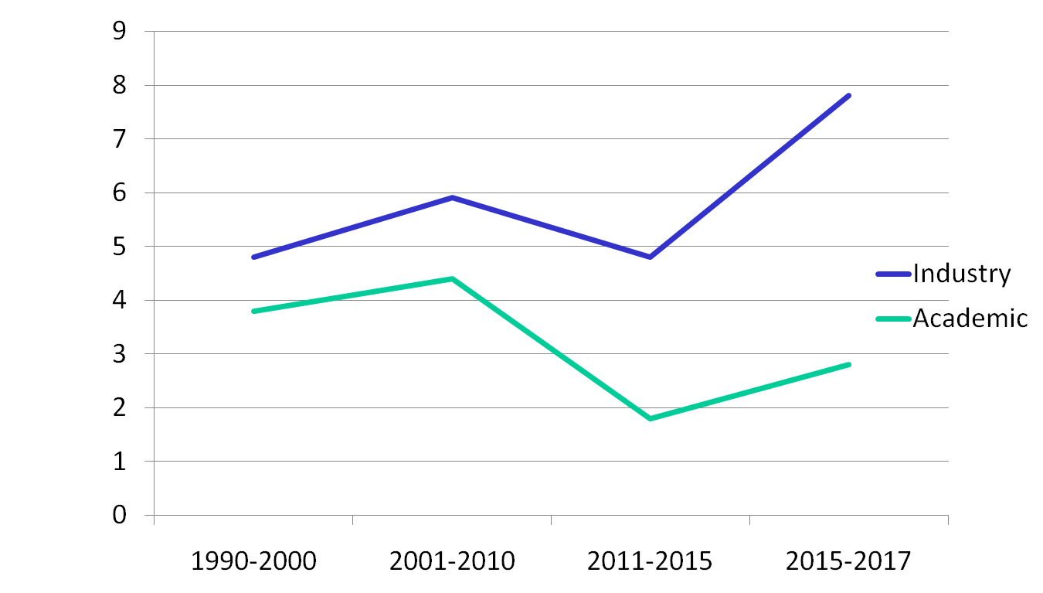
Survey graph Industry-Academic
CORPORATE OFFICE BRANCH OFFICE
DN-51 Merlin Infinite ,Sector –V .Saltlake Kolkata -91, Unit – 914 91/39H, Bosepukur Road, Kolkata-42
CORPORATE OFFICE BRANCH OFFICE
DN 36, Primac Tower 11th Flr. Room No. 1101 91/39H, Bosepukur Road, Kol- 700042
Sector –V. Saltlake Kolkata -700091

Slide 9
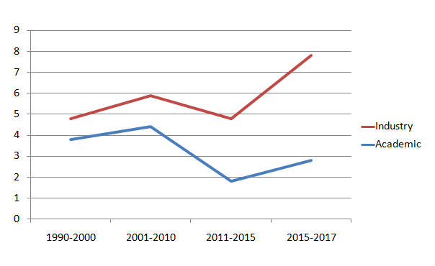
Knowledge GAP
GAP
CORPORATE OFFICE BRANCH OFFICE
DN-51 Merlin Infinite ,Sector –V .Saltlake Kolkata -91, Unit – 914 91/39H, Bosepukur Road, Kolkata-42
CORPORATE OFFICE BRANCH OFFICE
DN 36, Primac Tower 11th Flr. Room No. 1101 91/39H, Bosepukur Road, Kol- 700042
Sector –V. Saltlake Kolkata -700091

Slide 10

Industry is Growing Fast
CORPORATE OFFICE BRANCH OFFICE
DN-51 Merlin Infinite ,Sector –V .Saltlake Kolkata -91, Unit – 914 91/39H, Bosepukur Road, Kolkata-42
CORPORATE OFFICE BRANCH OFFICE
DN 36, Primac Tower 11th Flr. Room No. 1101 91/39H, Bosepukur Road, Kol- 700042
Sector –V. Saltlake Kolkata -700091

Slide 11
This is WHY PCS Global
PCS Global is it-self an industry
PCS Global maintains Industry level development and coding standard
PCS Global focused and promoting Make-In-India strategy.
CORPORATE OFFICE BRANCH OFFICE
DN-51 Merlin Infinite ,Sector –V .Saltlake Kolkata -91, Unit – 914 91/39H, Bosepukur Road, Kolkata-42
CORPORATE OFFICE BRANCH OFFICE
DN 36, Primac Tower 11th Flr. Room No. 1101 91/39H, Bosepukur Road, Kol- 700042
Sector –V. Saltlake Kolkata -700091

Slide 12
Survival of the fittest
It is not the strongest of the species , nor the most intelligent ,but the one who is most responsive to change.
– Charles Darwin 1809
CORPORATE OFFICE BRANCH OFFICE
DN-51 Merlin Infinite ,Sector –V .Saltlake Kolkata -91, Unit – 914 91/39H, Bosepukur Road, Kolkata-42
CORPORATE OFFICE BRANCH OFFICE
DN 36, Primac Tower 11th Flr. Room No. 1101 91/39H, Bosepukur Road, Kol- 700042
Sector –V. Saltlake Kolkata -700091

Slide 13
Thank You
Our knowledge is our strength….
CORPORATE OFFICE BRANCH OFFICE
DN-51 Merlin Infinite , Sector –V . Saltlake Kolkata -91, Unit – 914 91/39H, Bosepukur Road, Kol-42
CORPORATE OFFICE BRANCH OFFICE
DN 36, Primac Tower 11th Flr. Room No. 1101 91/39H, Bosepukur Road, Kol- 700042
Sector –V. Saltlake Kolkata -700091

