Slide 1
Introduction to HTML
The text that browsers understand

Slide 2
So what is it?
HTML is a markup language that defines the structure of your content. HTML consists of a series of elements, which you use to enclose, or wrap, different parts of the content to make it appear a certain way, or act a certain way.
The enclosing tags can make a word or image hyperlink to somewhere else, can italicize words, can make the font bigger or smaller, and so on.

Slide 3
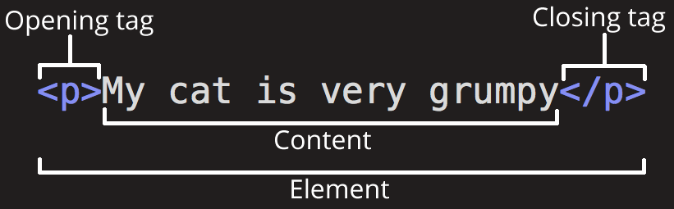
Anatomy

Slide 4
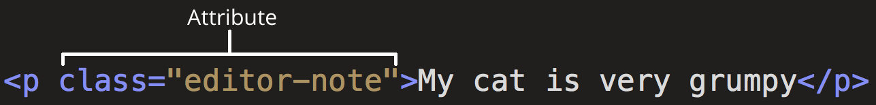
Attributes

Slide 5


Nesting

Slide 6

Empty Elements

Slide 7
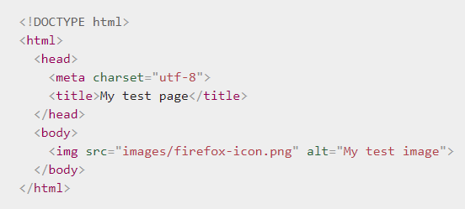
The HTML Document

Slide 8
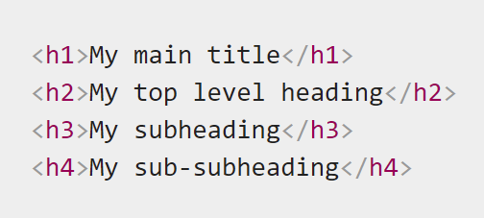
Headings

Slide 9
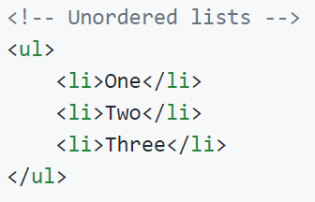
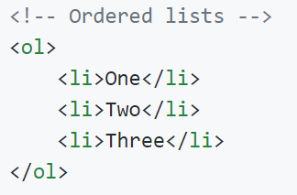
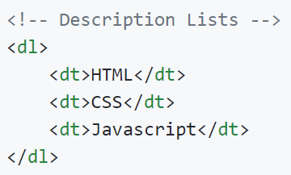
Lists

Slide 10
Links

Slide 11
Image Tag

Slide 12
Block v/s Inline Element
Block | Inline
A Block-level element occupies the entire space of the parent (container) such as <div> and <p> in the example . | Inline as the name says “included as a part of the main text and not as a separate section”. Inline elements occupy the space as needed within the space defined by the main element. Unlike block-level elements, they do not begin on new lines.
<div>,<p>,<article>,<section>,<figure>,<footer> | <a>,<span>,<img>,<code>,<cite>,<button>,<input>

