Slide 1
HTML & Accessibility
- forms, inputs, tables, Semantic, ARIA etc

Slide 2
More HTML elements
<tables>
<input>
<select>
<form>
<audio> & <video>

Slide 3
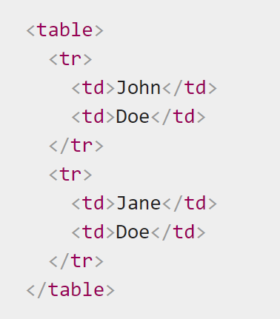
Tables

Slide 4
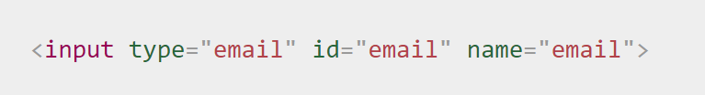
Input
https://developer.mozilla.org/en-US/docs/Web/HTML/Element/input

Slide 5
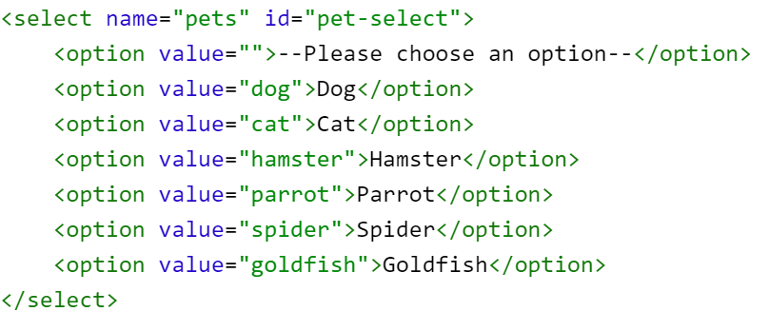
Select

Slide 6
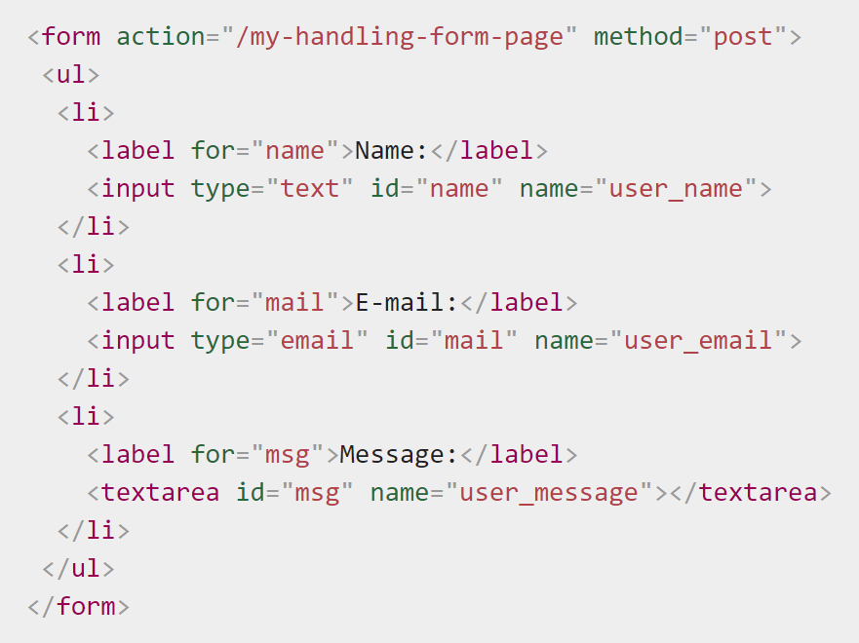
Forms

Slide 7
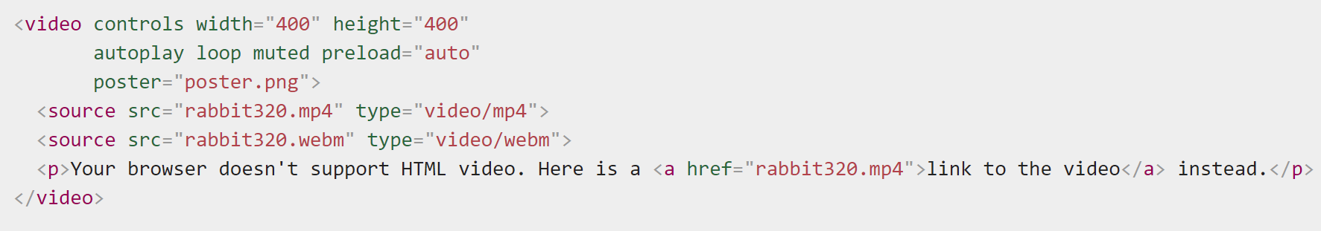
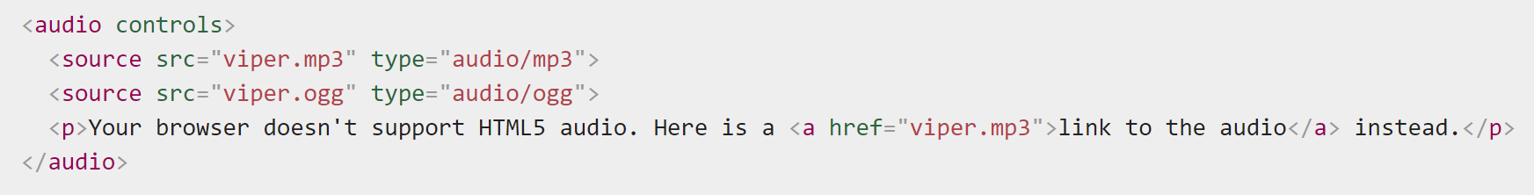
Audio & Video

Slide 8
Semantic
Semantics is the practice of giving content on the page meaning and structure by using the proper element. Semantic code describes the value of content on a page, regardless of the style or appearance of that content.
https://developer.mozilla.org/en-US/docs/Glossary/Semantics

Slide 9
Accessibility
Accessible Rich Internet Applications (ARIA) is a set of attributes that define ways to make web content and web applications (especially those developed with JavaScript) more accessible to people with disabilities.
Available before HTML5
https://developer.mozilla.org/en-US/docs/Web/Accessibility/ARIA

Slide 10
Reference Links
https://html.com/tables/
https://www.lullabot.com/articles/what-heck-aria-beginners-guide-aria-accessibility

