Slide 1

CSS
The make up for webpages

Slide 2
Introduction
Cascading Style Sheets (CSS) is a stylesheet language used to describe the presentation of a document written in HTML or XML (including XML dialects such as SVG, MathML or XHTML). CSS describes how elements should be rendered on screen, on paper, in speech, or on other media.

Slide 3
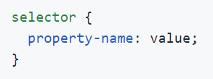
Selectors, Properties and values
But How To Connect and Apply Styles?

Slide 4
Applying Styles
Priority
Inline
Internal
External
Three Ways
Inline
Internal/Same HTML page
External File
Internal and External have same priority but different order

Slide 5
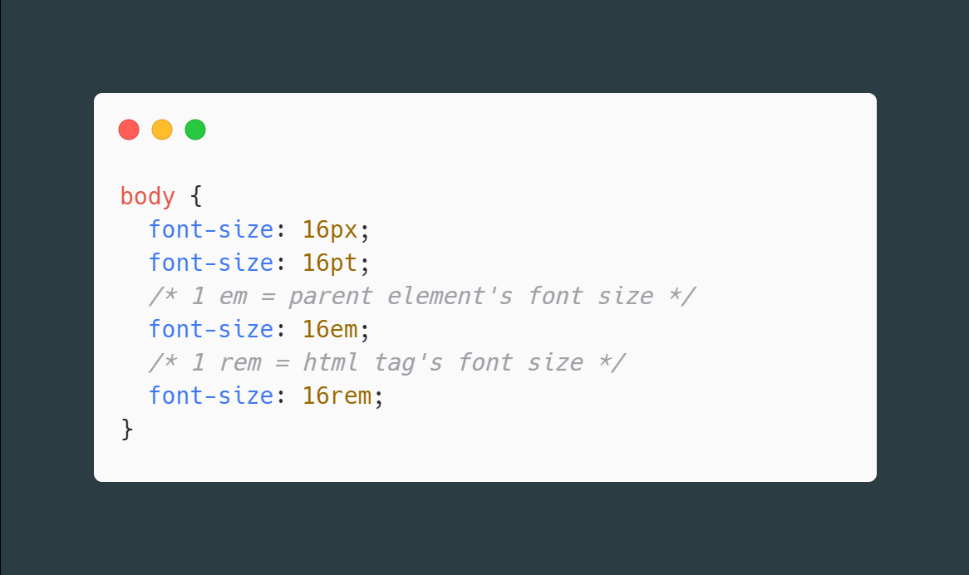
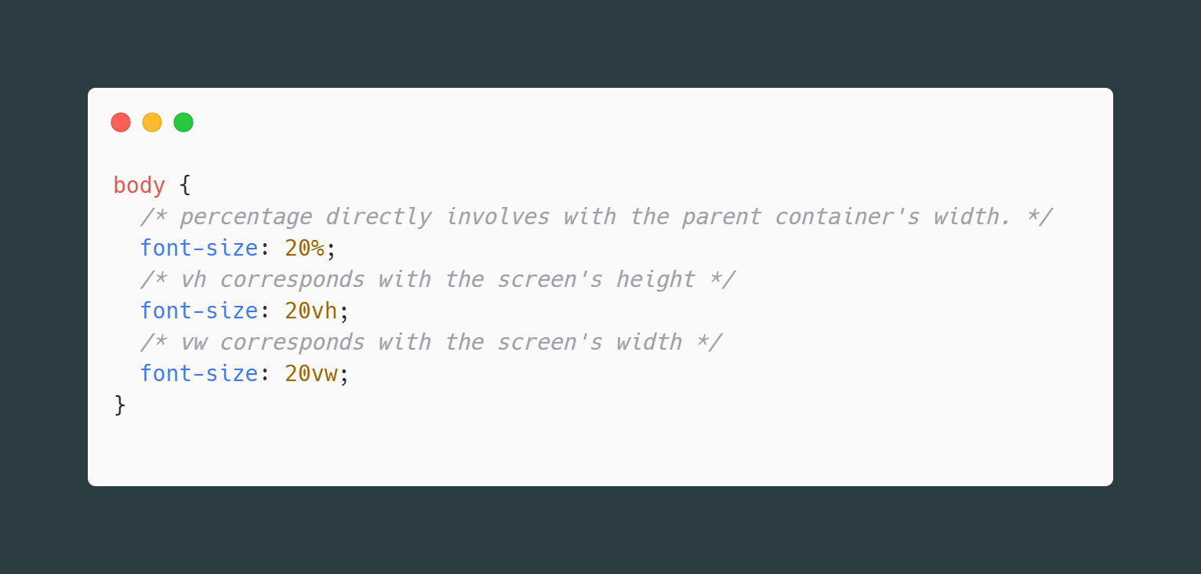
Common CSS properties/Values
Length

Slide 6
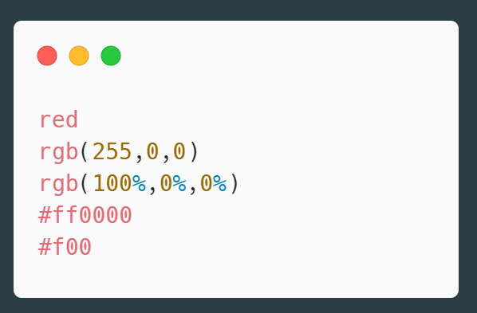
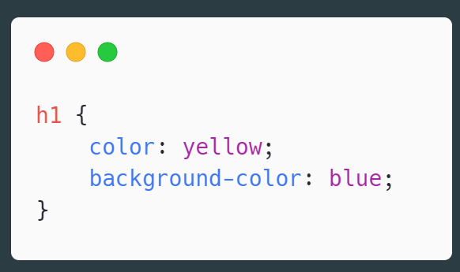
Common CSS properties/Values
Colors

Slide 7
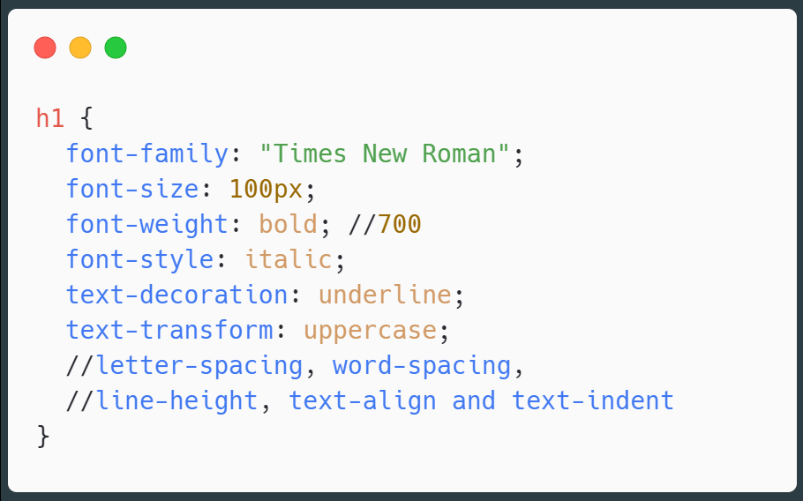
Common CSS properties/Values
Styling Text

Slide 8
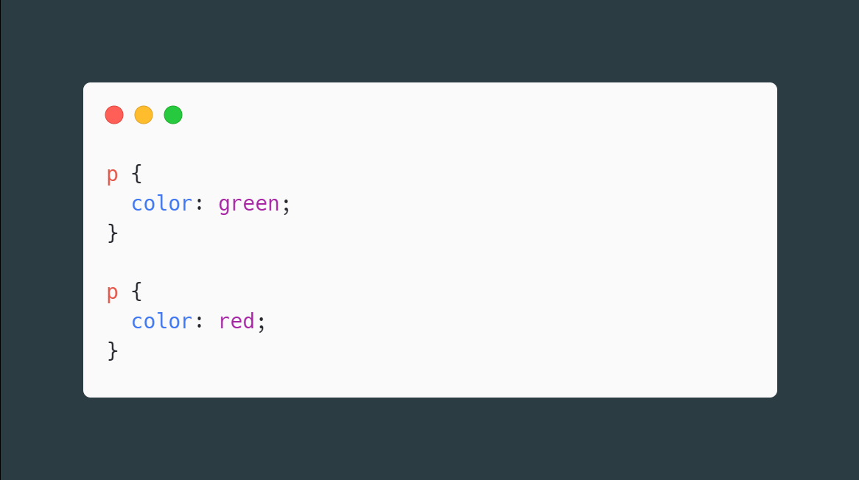
Cascading (The How and Where)

Slide 9
Types of selectors
Tag/Type
Class
ID
Multi Elements
Child
Immediate Child
Sibling
Immediate Sibling

