Slide 1

CSS
The make up for webpages

Slide 2
CSS reset
https://gist.github.com/DavidWells/18e73022e723037a50d6

Slide 3
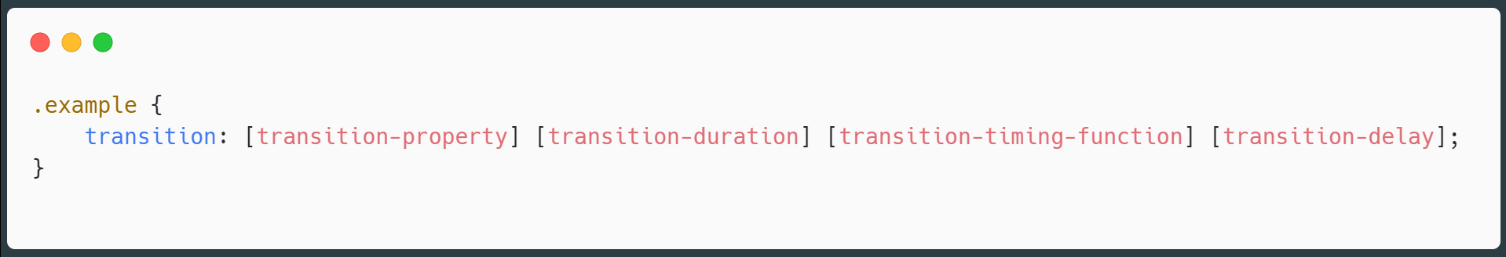
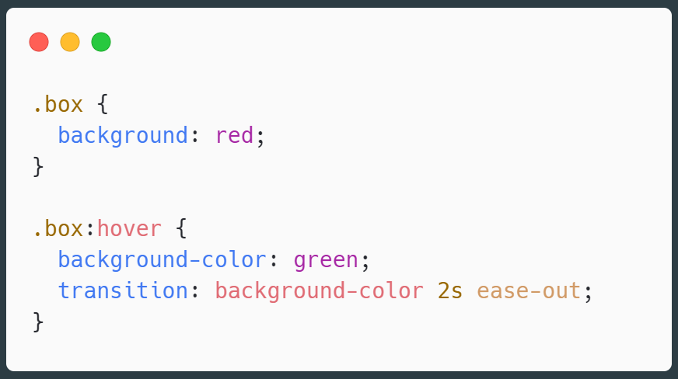
Transitions

Slide 4
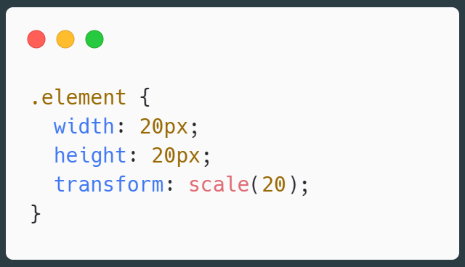
Transform
https://css-tricks.com/almanac/properties/t/transform/

Slide 5
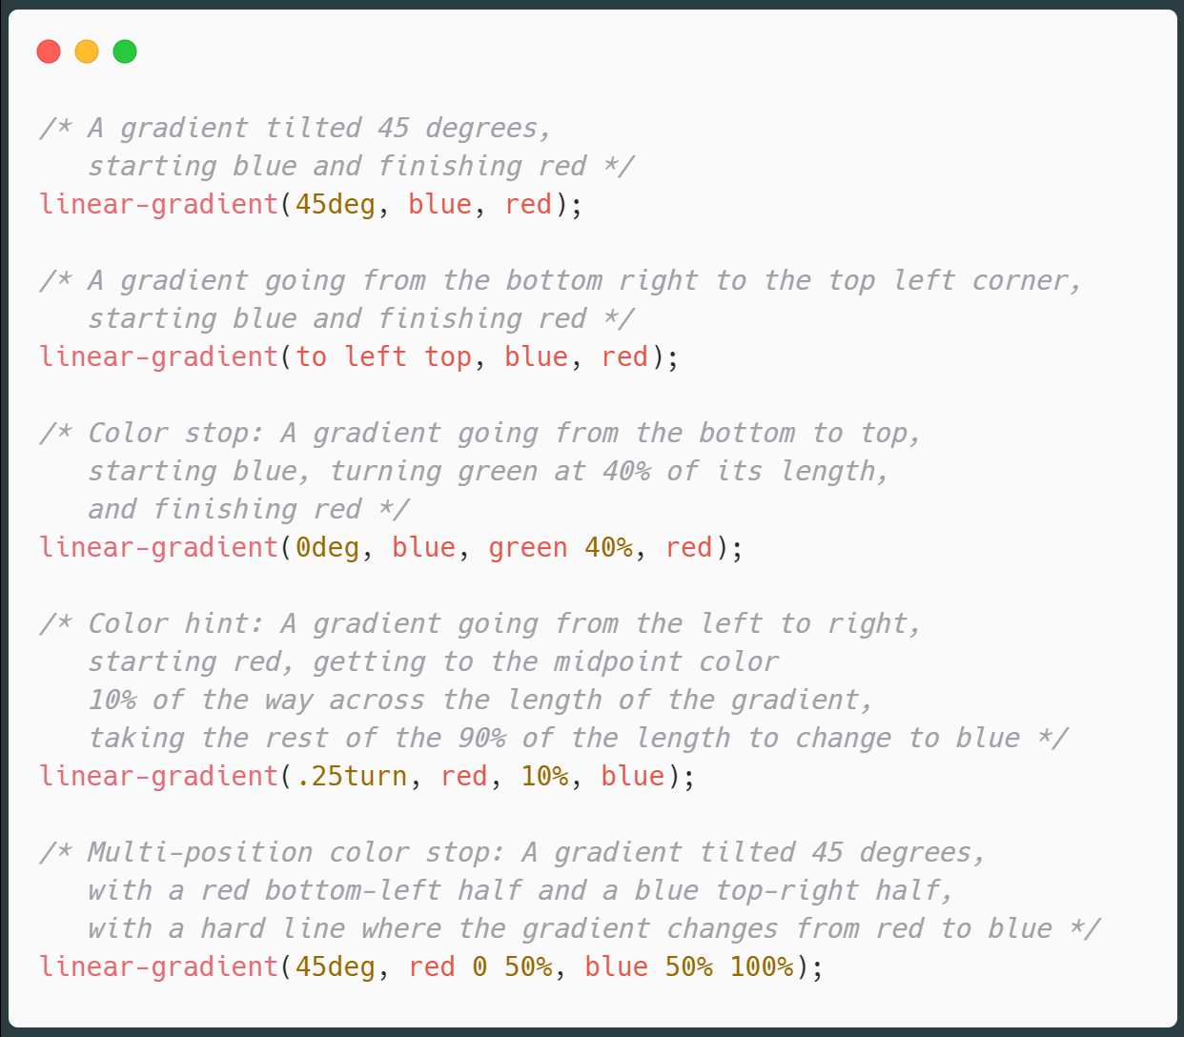
Gradients
Gradient is basically about a color dissolving into one another

Slide 6
SASS
CSS on steroids
A pre processor

