Slide 1

CSS
The make up for webpages

Slide 2
Flexbox
Flexbox is a one-dimensional layout method for laying out items in rows or columns. Items flex to fill additional space and shrink to fit into smaller spaces.
For a long time, the only reliable cross browser-compatible tools available for creating CSS layouts were things like floats and positioning. These are fine, and they work, but in some ways they are also rather limiting and frustrating.

Slide 3
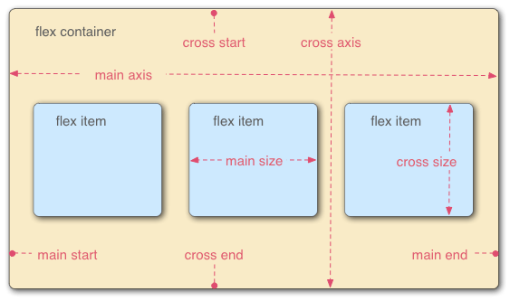
The main axis is the axis running in the direction the flex items are being laid out in (e.g. as rows across the page, or columns down the page.) The start and end of this axis are called the main start and main end.
The cross axis is the axis running perpendicular to the direction the flex items are being laid out in. The start and end of this axis are called the cross start and cross end.
The parent element that has (display: flex) is called the flex container.
The items being laid out as flexible boxes inside the flex container are called flex items.

Slide 4
Display Flex

Slide 5
Flex Direction

Slide 6
Flex Direction

Slide 7
Justify Content

Slide 8
Align Items

Slide 9
Using both

Slide 10
Align Self

Slide 11
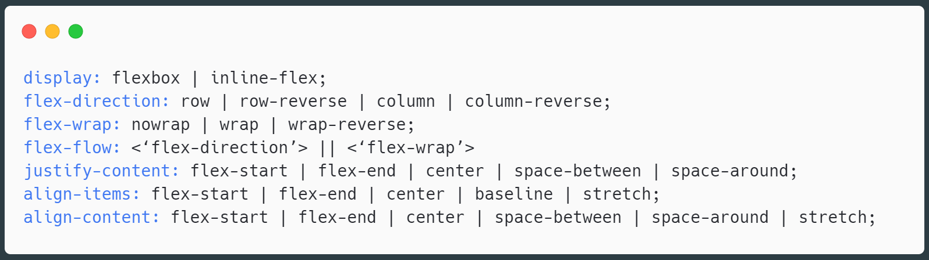
Container Properties

Slide 12
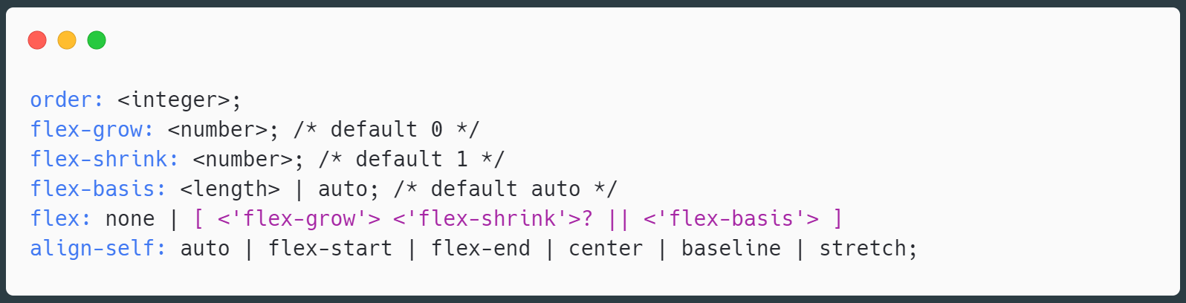
Item Properties (inside flex container)

