Slide 1
TASK 1:SOLVING THE VULNERABILITIES OF XSS LABS AT PORTSWIGGER.
STEPS TO BE FOLLOWED:
STEP 1: OPEN THE VIRTUAL BOX AND LOGIN TO KALI LINUX.
STEP 2:OPEN FIREFOX IN LINUX AND SEARCH PORTSWIGGER.
STEP 3:SIGN UP TO PORTSWIGGER AFTER SIGNING UP SIGN IN TO THE WEBSITE.
STEP 4:OPEN YOUR PROFILE THEN OPEN THE VULNERABILITIES LIST.
STEP 5:NOW CHECK WHETHER THE XSS LAB VULNERABILITIES ARE AVAILABLE OR NOT.
STEP 6:NOW START SOLVING THE VULNERABILITIES OF XSS LABS BY USING PAYLOADS.
STEP 7:PAYLOADS CAN BE DOWNLOADED FROM GITHUB.
STEP 8:SOLVE ANY 5 OF THE GIVEN VULNERABILITIES ,THE TASK IS FINISHED.

Slide 2
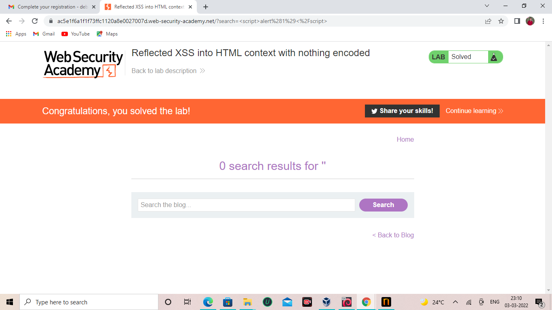

Slide 3
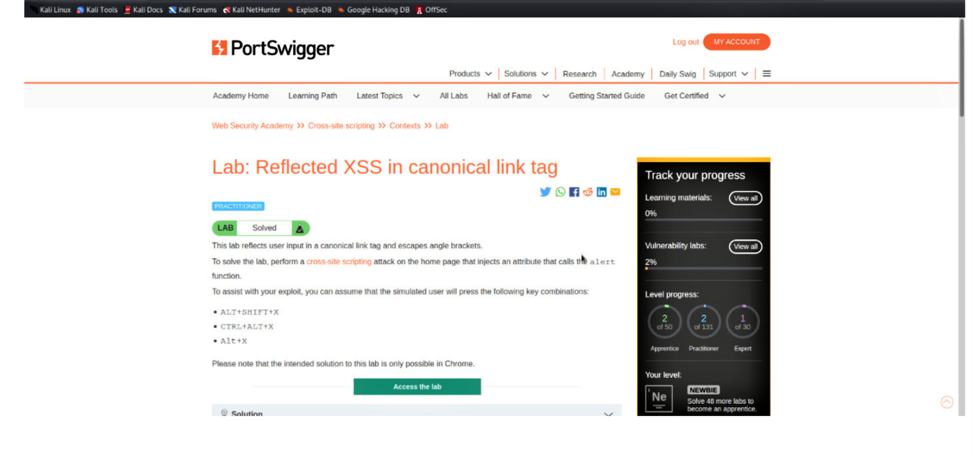

Slide 4
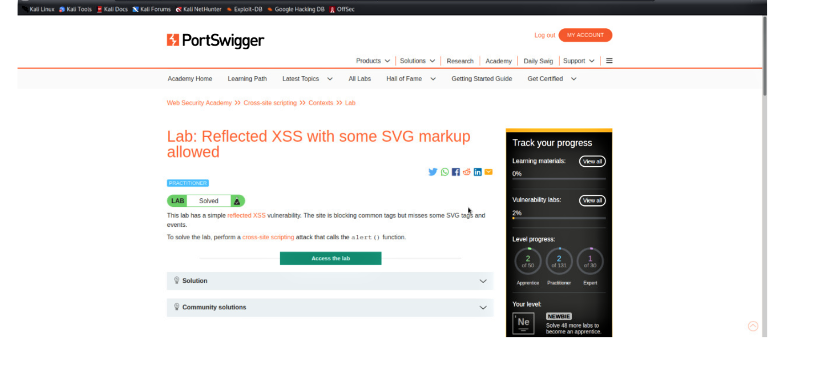

Slide 5
