Slide 1
Task:3
ENTERING/SOLVING A GIVEN WEBSITE USING BURPSUITE

Slide 2
STEPS TO BE FOLLOWED
STEP 1:OPEN VMWARE WORKSTATION AND LOGIN TO KALI LINUX STEP 2: OPEN BURP SUITE CHECK WHETHER THE INTERCEPT IS ON

Slide 3
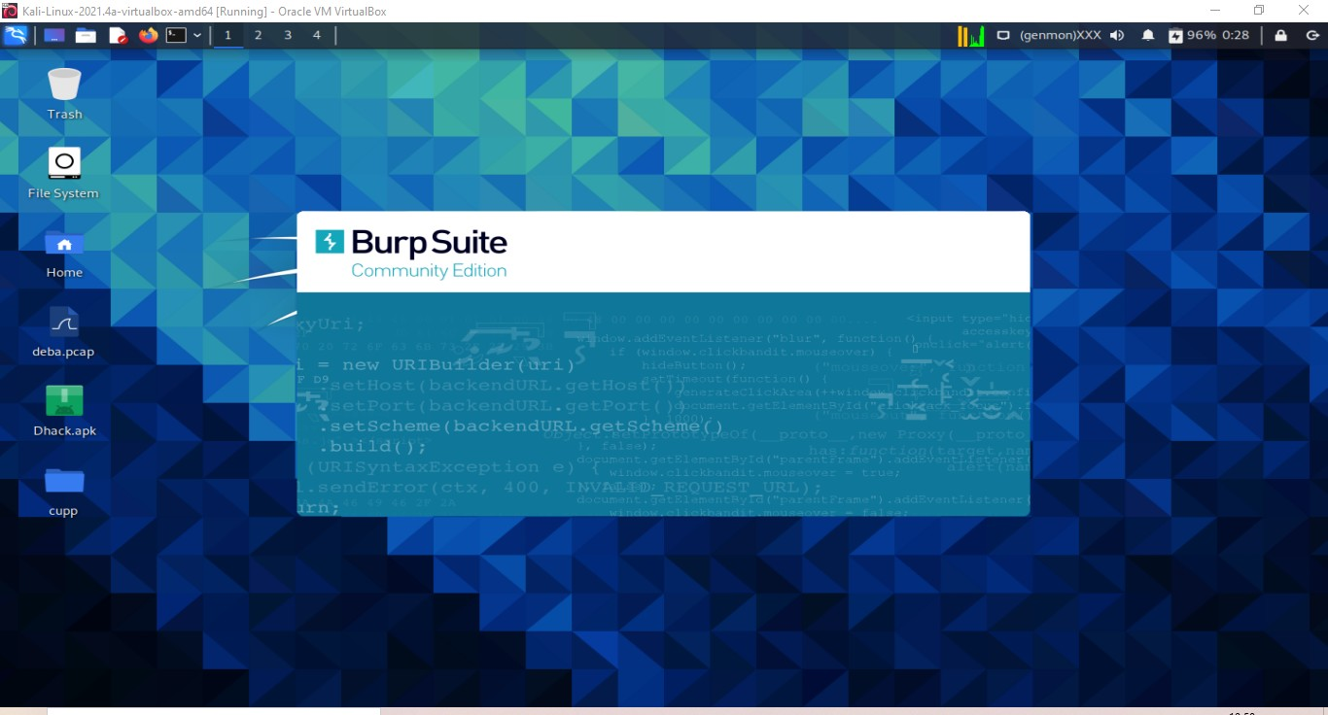

Slide 4
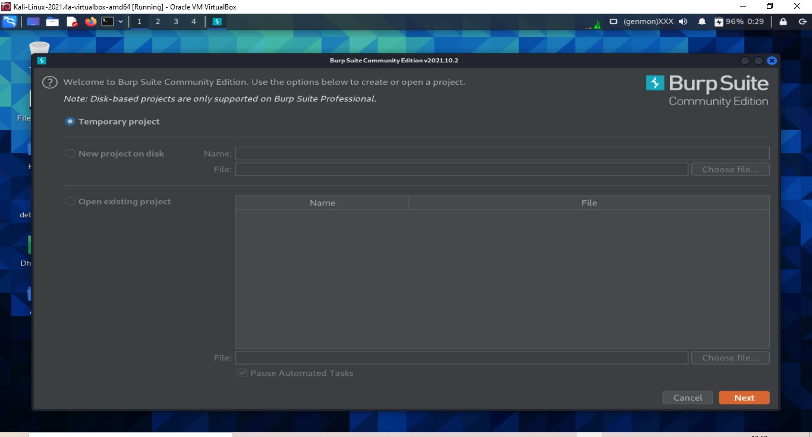

Slide 5
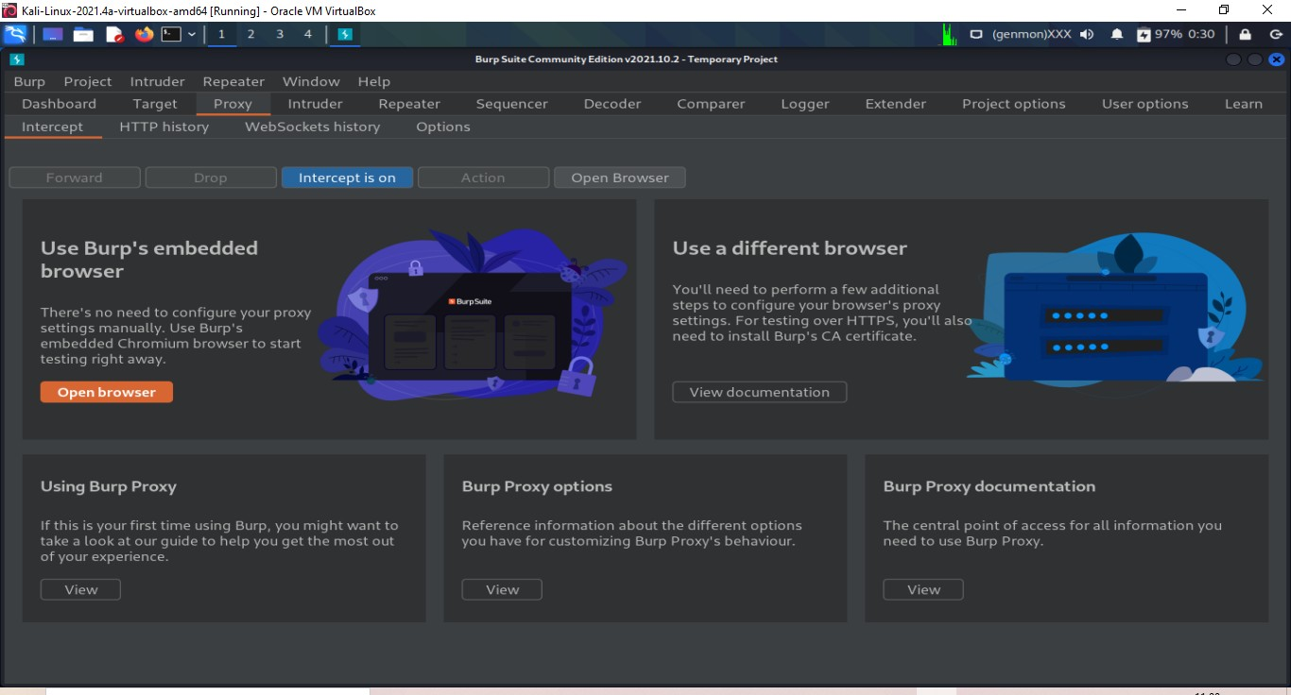

Slide 6
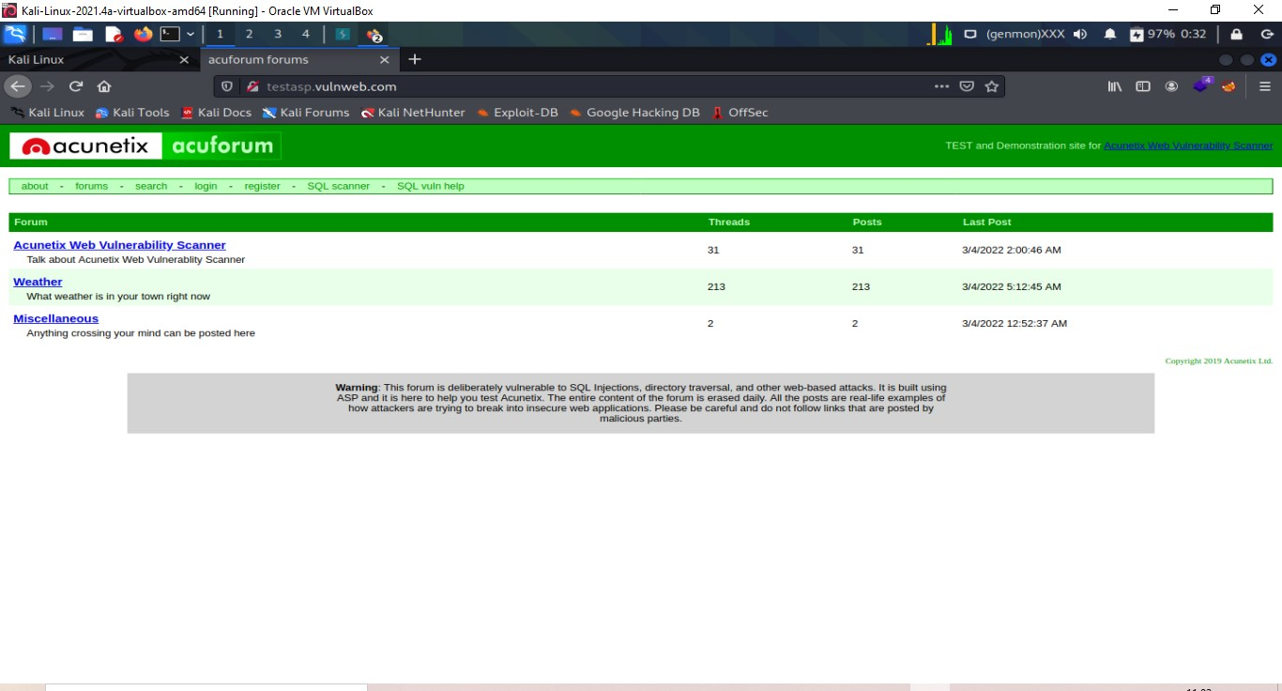

Slide 7
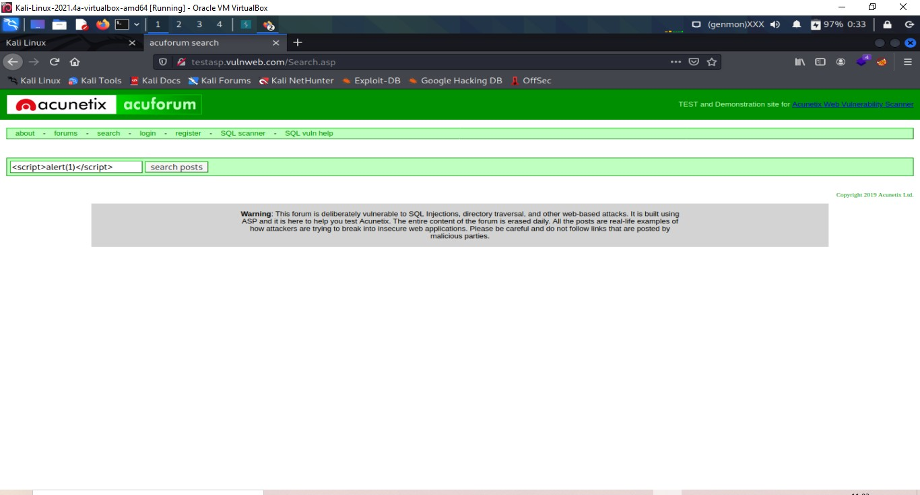

Slide 8
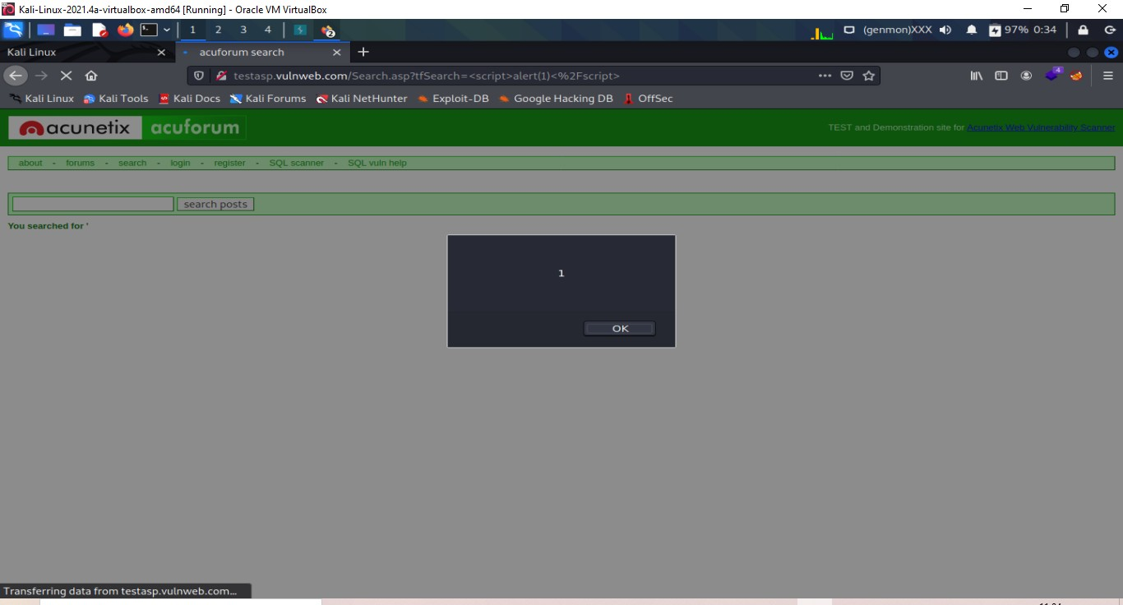

Slide 9
