Slide 1
Goal-driven Context-sensitive Production Processes: A Case Study using BPMN

Slide 2
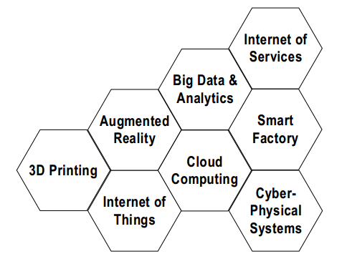
Motivation
Forthcoming Industrial Revolution
Industrie 4.0 (Germany) / Industrial Internet (USA)

Slide 3
Outline
Background
Problem Statement
Requirements
Case Study : CES Realization using BPMN
Existing Approaches & Comparison
Summary & Outlook

Slide 4
Background
Internet of Things (IoT) - Interconnection of everyday objects with ubiquitous intelligence such that they can sense and actuate upon it if required
Cyber-Physical Systems (CPS) - Integrated embedded computers and physical processes where physical processes affect computations and vice versa
Context-sensitive Process - Processing unit that performs processing depending on the available context, i.e., characteristic of an entity or situation
Context Attribute describes a context, e.g., <sensor-name, sensed-value>
Smart Factory - Context-sensitive production environment that can react to changes in real-time using IoT and CPS

Slide 5
Problem Statement
What Customer Wants? | What Manufacturer Wants?
Highly Individualized Products | Simple Supply Chain
Competitive Price | High Profit and Efficiency
How next-generation manufacturers can
adapt to manufacturing intelligence?
integrate technologies like IoT, CPS, etc.?
establish a balance among changeability, cost, time, and quality?

Slide 6
Requirements
IoT Incorporated Process Modeling (R1)
Goal-driven Production Process Execution (R2)
Context-sensitive Production Process Execution (R3)
Optimizable Production Processes (R4)
Prioritization of Goals (R5)
Resilience to Minor Changes (R6)

Slide 7
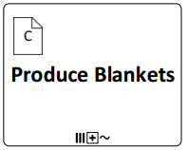
Context-sensitive Adaptive Production Processes (CAPP)
CAPP
facilitates intelligent production processes.
Adapt to the changing business objectives
Flexible to the changing production environment.
leads to innovative modeling of production activities and its know-how.
Context-sensitive Execution Step (CES), a logical sub-process type construct, that encompasses multiple alternative processes executed in runtime.

Slide 8
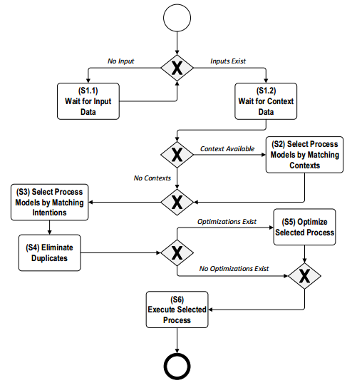
Execution Semantics of a CES

Slide 9
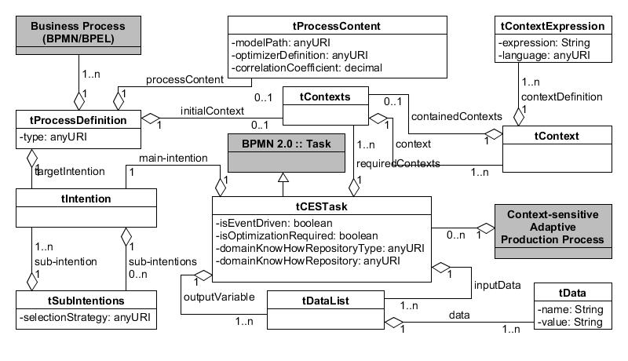
Relation among CES Attributes

Slide 10
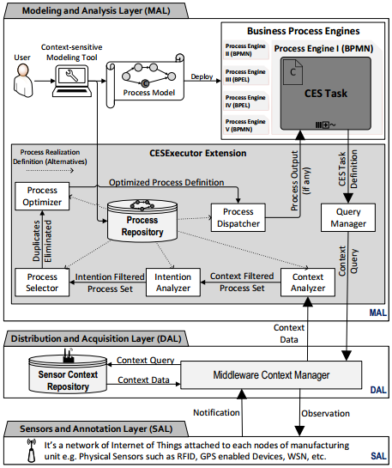
Architecture of CAPP Runtime

Slide 11
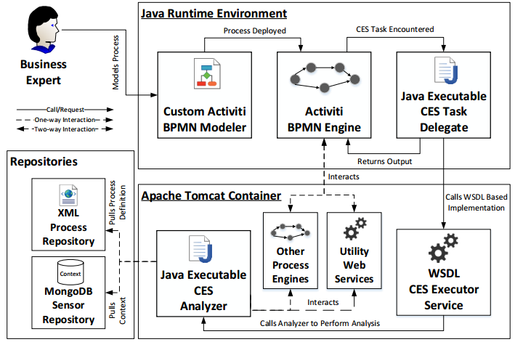
Case Study : CES Realization using BPMN

Slide 12
Case Study : Message-based Integration

Slide 13
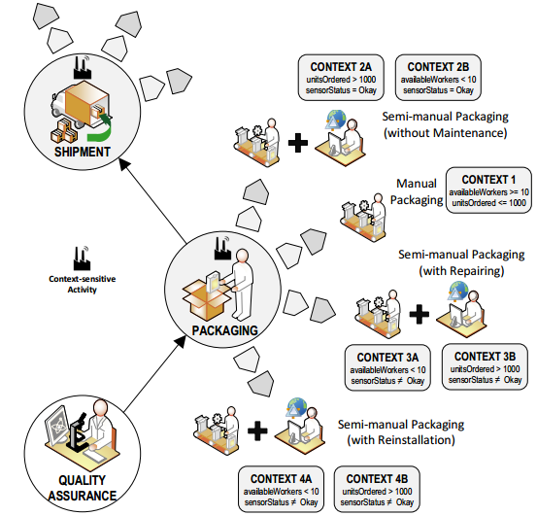
Case Study : Application Scenario

Slide 14
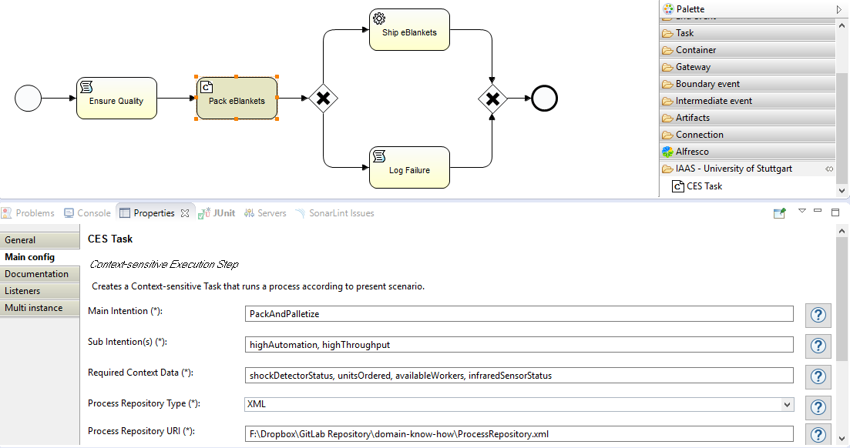
Custom Activiti Designer

Slide 15
Case Study : XML Excerpt of CES Definition
<?xml version="1.0" encoding="UTF-8" standalone="yes"?>
<CESDefinition xmlns="http://www.uni-stuttgart.de/iaas/cmp/v0.1/" xmlns:ns2="http://www.uni-stuttgart.de/iaas/ipsm/v0.2/" xmlns:ns3="http://docs.oasis-open.org/tosca/ns/2011/12" isEventDriven="false" isCommandAction="true" targetNamespace="http://www.uni-stuttgart.de/iaas/cmp/v0.1/">
<Intention name="PackAndPalletize">
<ns2:SubIntentions>
<ns2:SubIntentionRelations>http://www.uni-stuttgart.de/iaas/cmp/weight-based</ns2:SubIntentionRelations>
<ns2:SubIntention name="highAutomation"/>
<ns2:SubIntention name="highThroughput"/>
</ns2:SubIntentions>
</Intention>
<RequiredContexts>
<ns2:Context name="shockDetectorStatus"/>
<ns2:Context name="unitsOrdered"/>
<ns2:Context name="availableWorkers"/>
<ns2:Context name="infraredSensorStatus"/>
</RequiredContexts>
<InputData>
<DataList name="operatorName" value="Wolfgang"/>
<DataList name="supervisorName" value="Frank"/>
<DataList name="orderID" value="DE37464358BY"/>
<DataList name="qualityCheck" value="passed"/>
<DataList name="machinistName" value="Erick"/>
</InputData>
<OutputVariable>
<DataList name="finalStatus" value=""/>
</OutputVariable>
<OptimizationRequired>true</OptimizationRequired>
<DomainKnowHowRepositoryType>xml</DomainKnowHowRepositoryType>
<DomainKnowHowRepository>F:\Dropbox\GitLab Repository\domain-know-how\ProcessRepository.xml</DomainKnowHowRepository>
</CESDefinition>

Slide 16
Case Study : XML Excerpt of Process Repository
<ProcessDefinition processType="http://www.omg.org/spec/BPMN/2.0/" id="PMX001" name="ManualPacking" targetNamespace="http://www.activiti.org/">
<Documentation>This is a dummy Manual Model.</Documentation>
<ProcessContent>
<ManufacturingContent>
<ModelPath>F:\\Dropbox\\GitLab Repository\\domain-know-how\\PMX001.bpmn</ModelPath>
<OptimizerDefinition>POPT01</OptimizerDefinition>
<Weight>0.20</Weight>
</ManufacturingContent>
</ProcessContent>
<TargetIntention name="PackAndPalletize" targetNamespace="http://www.uni-stuttgart.de/iaas/cmp/v1/packaging">
<Documentation>The primary goal/intention is to seal and sort the packets as per the business rule.</Documentation>
<SubIntentions>
<SubIntention name="highHRUtilization" targetNamespace="http://www.uni-stuttgart.de/iaas/cmp/v1/packaging">
<Documentation>Work must be done in such a way that no employees sit idle in the premises of company.</Documentation>
</SubIntention>
</SubIntentions>
</TargetIntention>
<InitialContexts>
<Context name="CON1" targetNamespace="http://www.uni-stuttgart.de/iaas/cmp/v1/packaging">
<Documentation>It depicts a business situation where demand is pretty low and available workers are more.</Documentation>
<ContextDefinition definitionLanguage="http://www.w3.org/TR/xpath">
<DefinitionContent>
<ManufacturingContent>
<Expression>//Context[@name='availableWorkers']/ContextDefinition/DefinitionContent/ManufacturingContent[SenseValue&gt;=10]/SenseValue/text() | //Context[@name='unitsOrdered']/ContextDefinition/DefinitionContent/ManufacturingContent[SenseValue&lt;=1000]/SenseValue/text()</Expression>
</ManufacturingContent>
</DefinitionContent>
</ContextDefinition>
</Context>
</InitialContexts>
</ProcessDefinition>

Slide 17
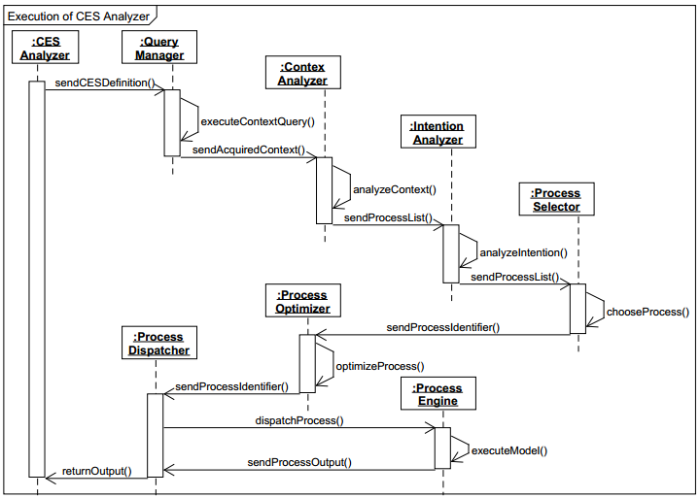
Case Study : Execution Sequence of Sub-components

Slide 18
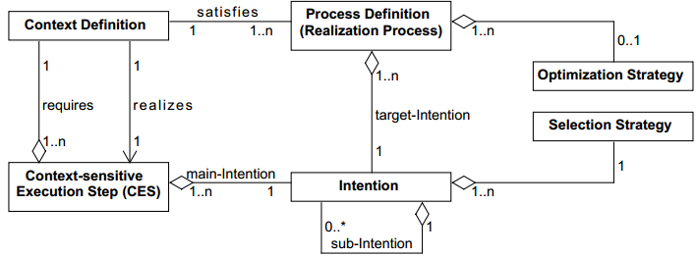
Case Study : CES Meta Model

Slide 19
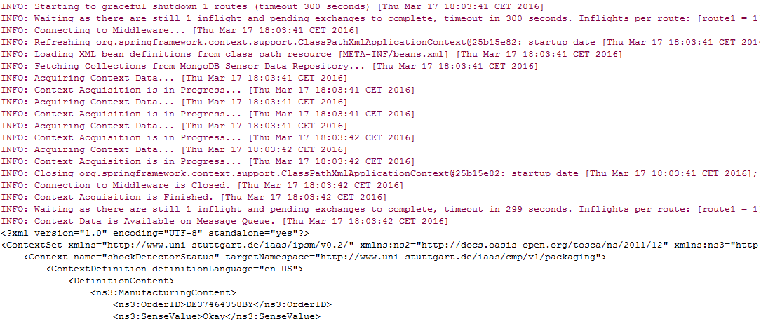
Case Study : Query Manager
“Query Manager prepares context query and pushes the query to the for the underlying sensor based context middleware.”

Slide 20
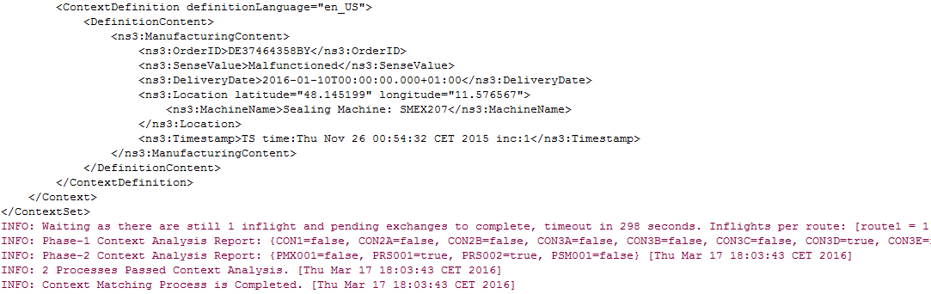
Case Study : Context Analyzer and Intention Analyzer
“Context Analyzer fetches the available process definition inside process repository to nominate the suitable definitions valid for the received contexts.”
“Intention Analyzer analyzes the received process definitions by filtering them
with required main-intention (goals) defined for the specific business scenario.”

Slide 21
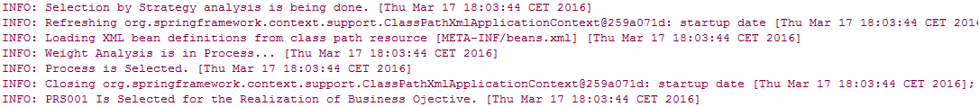
Case Study : Process Selector and Process Optimizer
“Process Selector filters the received process definitions from Intention Analyzer
with a predefined selection strategy (if no strategy -> random strategy).”
“Process Optimizer looks for the process descriptor of any defined optimization model for the process, deploys, and executes the optimization model with the required process engine instance..”

Slide 22
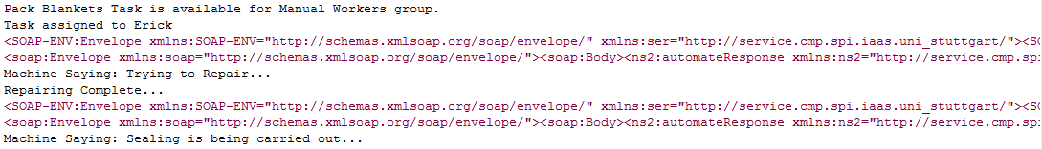
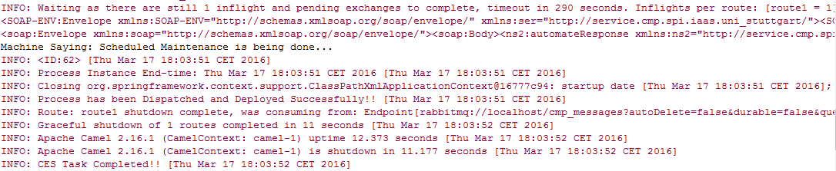
Case Study : Process Dispatcher
“Process Dispatcher deploys the main business process chosen to an underlying process engine. This sub-component is also responsible for executing the complementary business processes.”

Slide 23
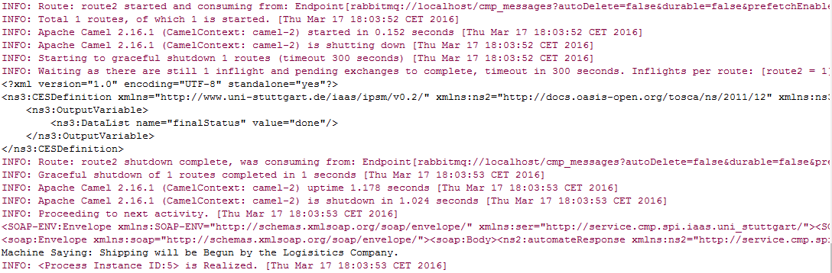
Case Study : Process Output and Final Status

Slide 24
Existing Approaches & Comparison
 | R1 | R2 | R3 | R4 | R5 | R6
Ad-hoc Sub-processes | - | ~ | ~ | - | - | -
Adams et al. | ✓ | ✓ | ✓ | - | - | ✓
Andrikopoulos et al. | ✓ | ✓ | ✓ | - | - | ✓
Bucchiarone et al. | ✓ | ✓ | ✓ | - | - | ✓
Hallerbach et al. | ✓ | - | - | - | - | ✓
Hirmer et al. | ✓ | - | ✓ | - | - | ✓
Marconi et al. | ✓ | - | ✓ | - | - | ✓
Pfeffer et al. | ✓ | ✓ | - | - | - | -
Reichert et al. | ✓ | - | - | - | - | ✓
van der Aalst et al. | ✓ | - | - | - | - | ✓
Wieland et al. | ✓ | - | ✓ | - | - | ✓
Wolf et al. | ✓ | - | ✓ | - | - | -
Sungur et al. (CES) | ✓ | ✓ | ✓ | ✓ | ✓ | ✓

Slide 25
Summary and Outlook
We have
realized CAPP based CES construct using BPMN.
extended Activiti BPMN tool for incorporating CES entity.
integrated business objectives with the production context.
proposed architecture for realizing CAPP based systems.
implemented a real-world scenario using CES construct.
presented the mechanism such that CES remain process language agnostic.
We will like to
realize CES based on CAPP approach using WS-BPEL.
integrate dynamic process optimization schemes.
develop GUI tool for Process Repository modelling.
match goals recursively inside Intention Analyzer.
Thank You for Your Attention!

