Slide 1
Indexing and Slicing for Lists, Tuples, Strings
Presented By
Subham
Supriya
Sachin
Debasish

Slide 2
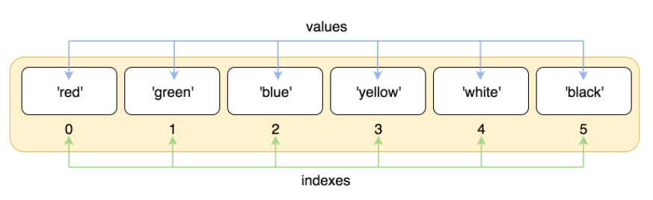
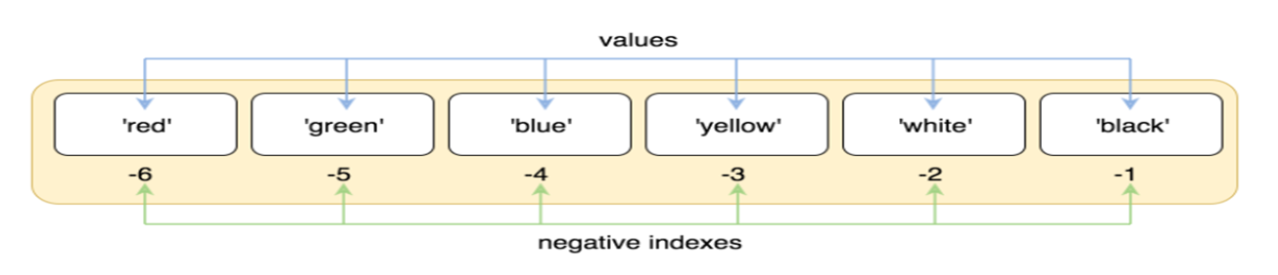
List Indexing and Slicing
Let’s take a simple example:
>>> colors = ['red', 'green', 'blue', 'yellow', 'white', 'black']
Positive indexing:
Eg:
colors[2]=‘blue’
colors[0]=‘red
Negetive Indexing:
Eg:
colors[-4]=‘blue’
colors[-6]=‘red’
colors[-1]=‘black’

Slide 3
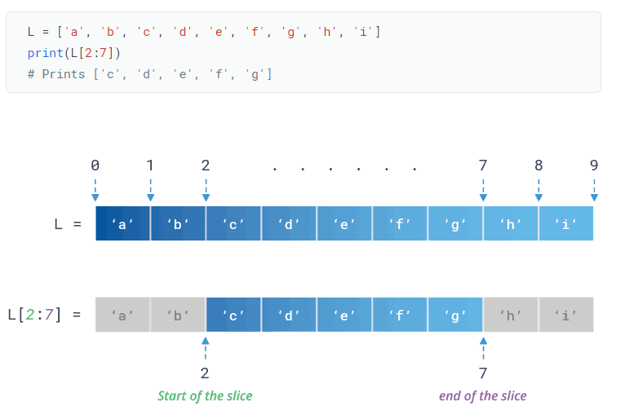
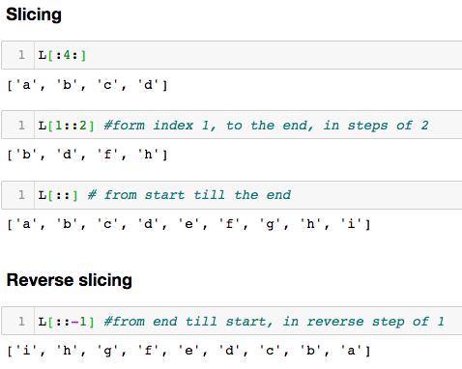
Slicing
If L is a list, the expression L [ start : stop : step ] returns the portion of the list from index start to index stop, at a step size step.

Slide 4
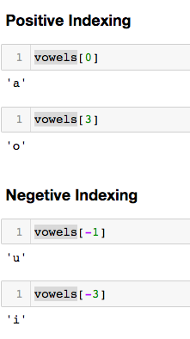
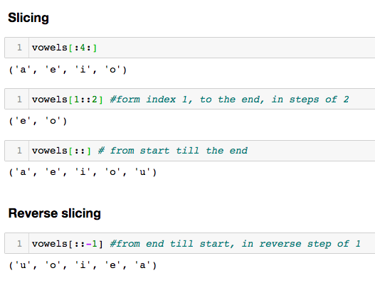
Tuple Indexing and Slicing
Lets take and example:
vowels = ('a','e','i','o','u’)

Slide 5
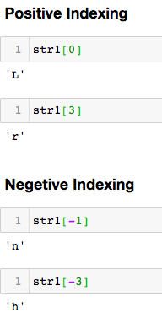
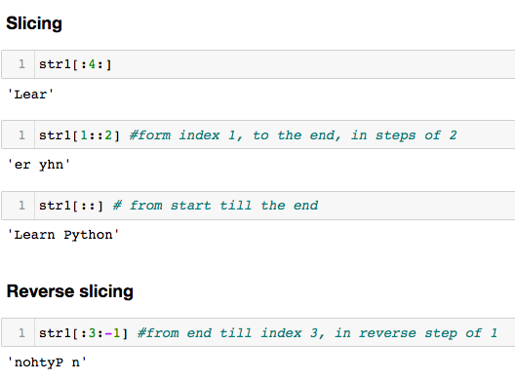
String Indexing and Slicing
Python string method index() determines if string str occurs in string or in a substring of string if starting index ’start’ and ending index ’stop’ are given.
Lets take an example:
str1='Learn Python'

Slide 6
Thank You !!

