Slide 1
NPV
Presented By
Subham
Supriya
Sachin
Debasish

Slide 2
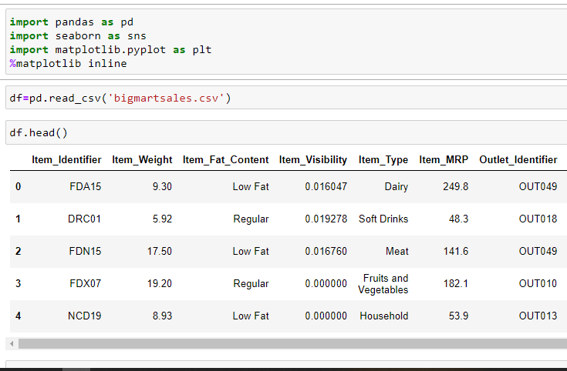
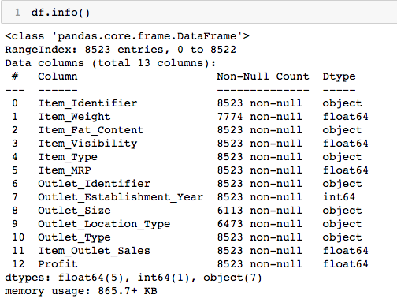
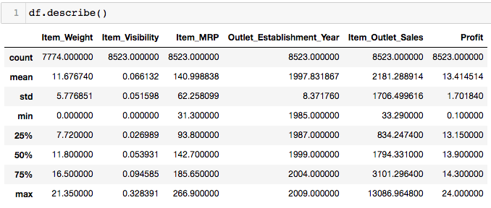
NVP
In this project we’ve used NumPy, and Pandas for data analysis, and matplotlib and seaborn for data visualisation
Here we load a dataset called “Bigmartsales” , using the read_csv syntax.

Slide 3
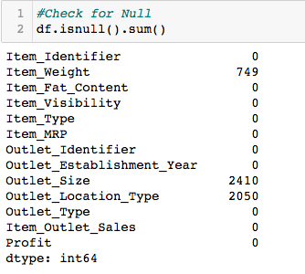

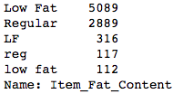
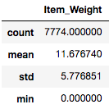
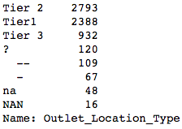
Data to be Cleaned:
df.shape = (8523, 13)
*no data has been dropped*
Outlet Size:
2410 missing/empty data
Item Fat Content:
Not having standardized keywords for the data
Item Weight:
749 missing / empty data
Outlet Location Type:
Not having standardized keywords for the data, and lot of Null values.

Slide 4
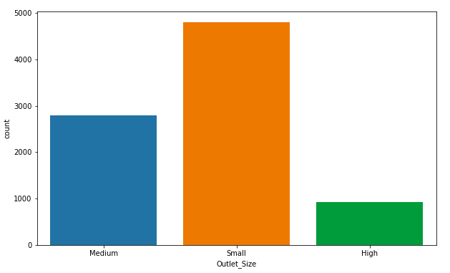
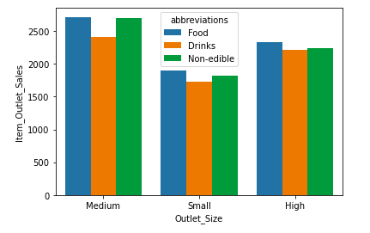
Q1. Compare the count based on the Outlet Size and the Outlet Sales with the same.
Inference:
Even though the number of small stores are more compared to medium and high, the Outlet sales is lesser.
On the other hand, then medium and high stores are less in number, but generates more sales.

Slide 5
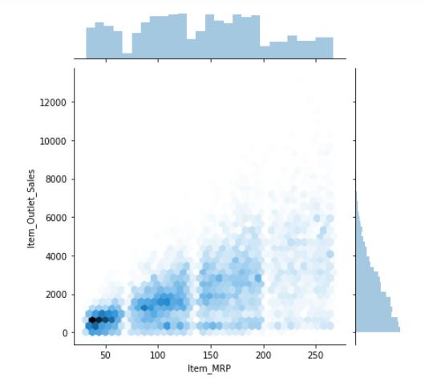
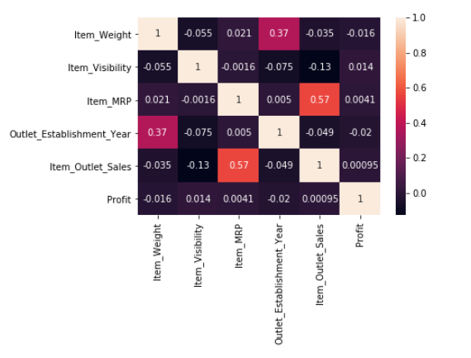
Q2. Effect of MRP on Outlet sales
Q3. Correlate all the Factors in the data.
Inference:
Lesser the MRP, More the Sales of the product
Inference:
The correlation of all the Columns have been calculated and shown in the above heat map.

Slide 6
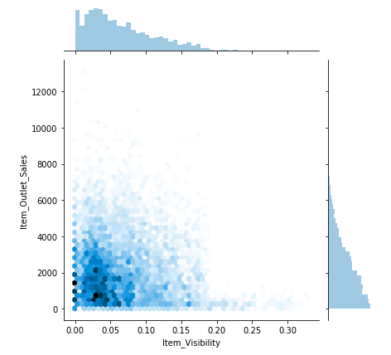
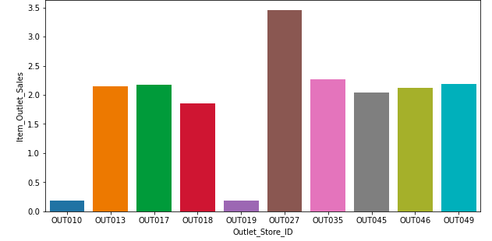
Q4 Effect of Visibility on Outlet Sales
Q5. Determine which outlet has the most Outlet sales comparatively
Inference:
Less the Visibility, More the Outlet Sales
Inference:
OUT027 has the most sales compared to the other outlets.

Slide 7
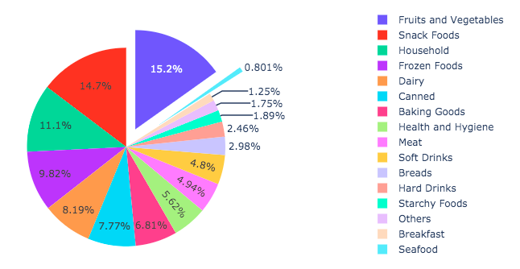
Q6. Find which Item has the most sales along with their percentiles using a Pie Chart. Also mention the maximum and the Minimum values of the percentages
Inference:
Maximum : Fruits and Vegetables(15.2%)
Minimum : Seafood(0.801%)

Slide 8
Thank You !!

