Slide 1
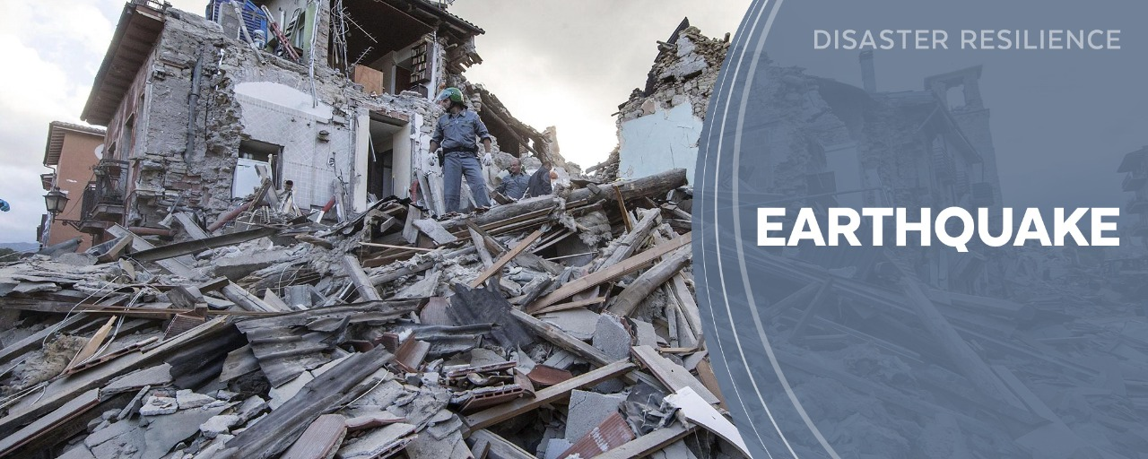
SUBHAM
DEBASISH
SUPRIYA
SACHIN

Slide 2


Slide 3
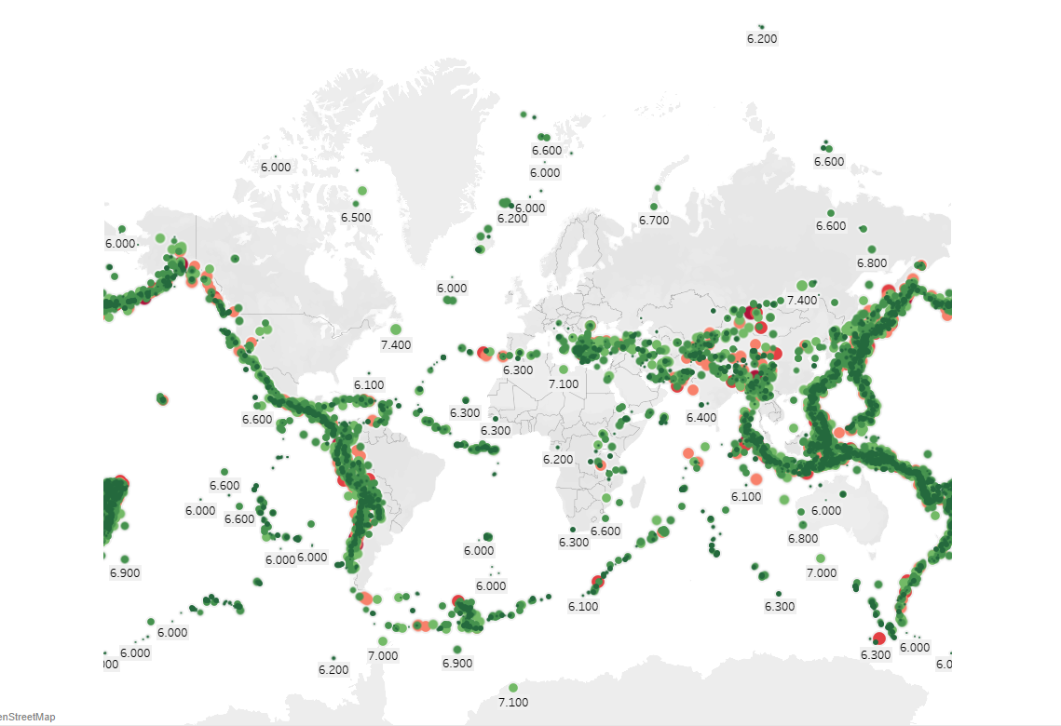
Geographical visualisation of all Earthquakes that occurred on Earth between 1900 and 2013 with Magnitude.
Geographical representation of Earthquakes occurrence with respect to Magnitude .
Classification of Magnitude :
Class | Magnitude
Great | 8 or more
Major | 7-7.9
Strong | 6-6.9
Moderate | 5-5.9
Light | 4-4.9
Minor | 3-3.9

Slide 4
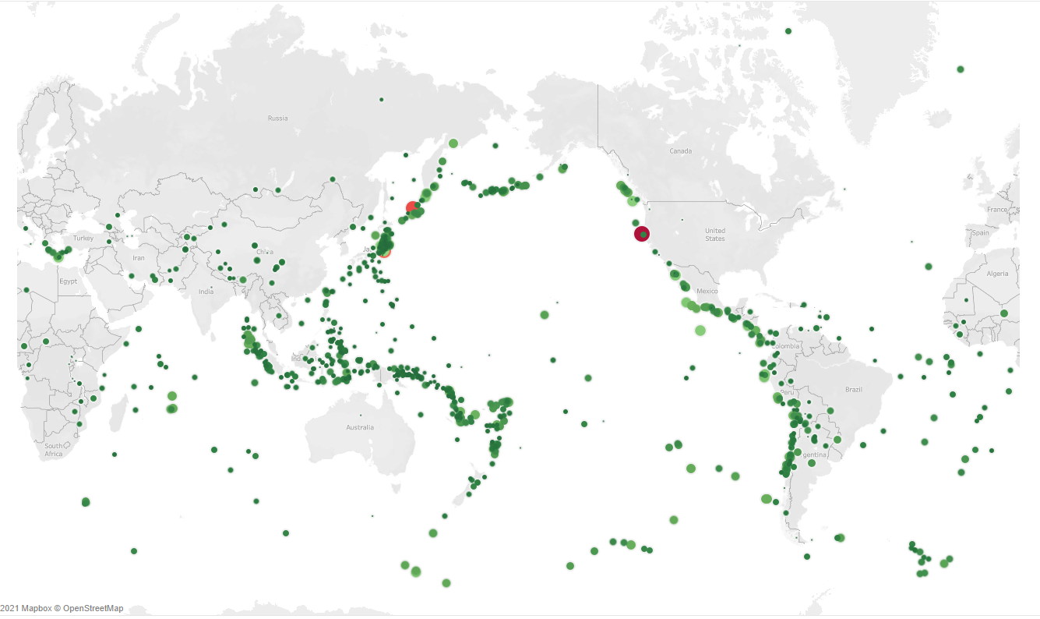
Seismic Gap
A seismic gap is a segment of an active fault known to produce significant earthquakes that has not slipped in an unusually long time, compared with other segments along the same structure.
Magnitude | Earthquake Effects
7-7.9 | Major earthquake with causes Serious damage.
8 or above | a Great earthquake that Can totally destroy communities near the epicenter ,One every 5 to 10 years.

Slide 5
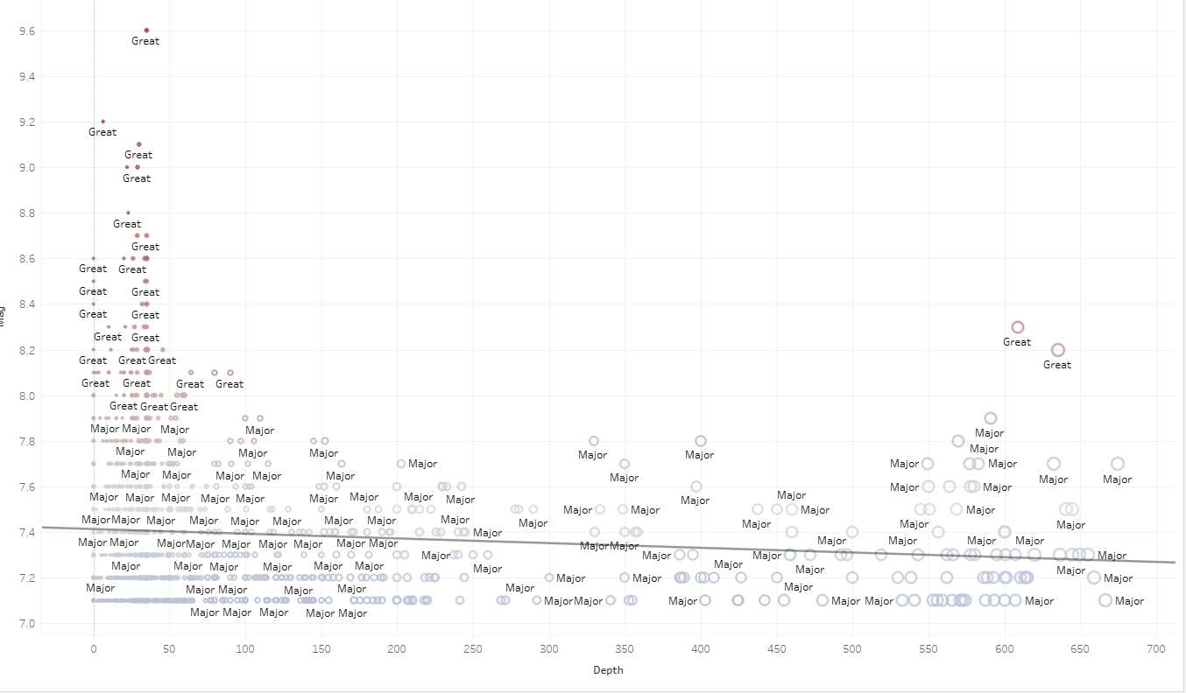
Correlation between Depth and Magnitude variables for occurrences of mega Earthquakes
The largest earthquakes occur at shallower depths in the earth's crust, but smaller earthquakes can and do occur at all depths down to about 700 km.

Slide 6
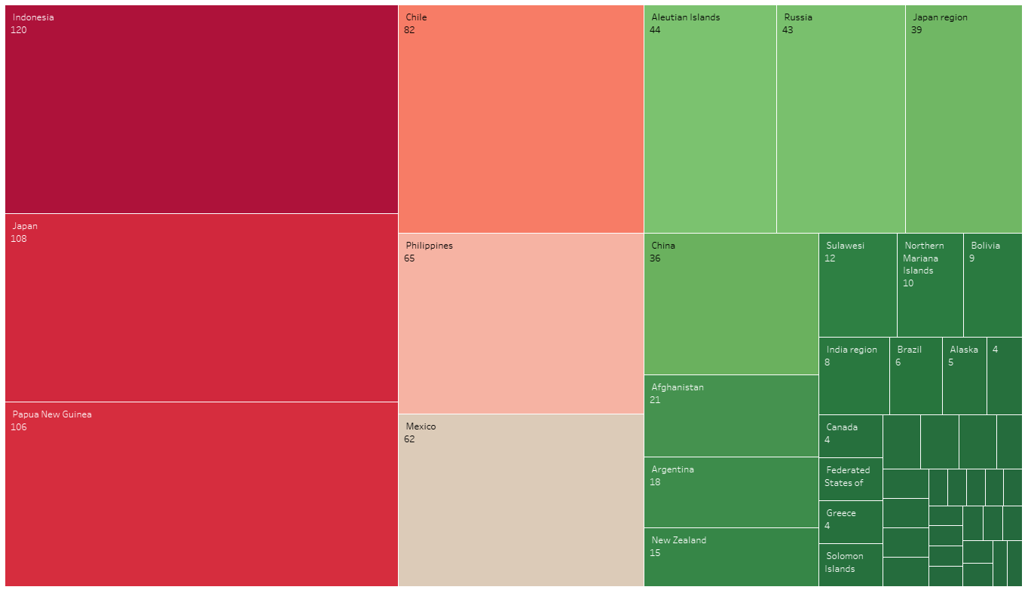
Tree Map Visualisation of country having higher occurrence of Earthquake.
Top countries with highest occurrence of Earthquakes
Indonesia
Japan
Papua New Guinea
Chile
Philippines
Mexico

Slide 7
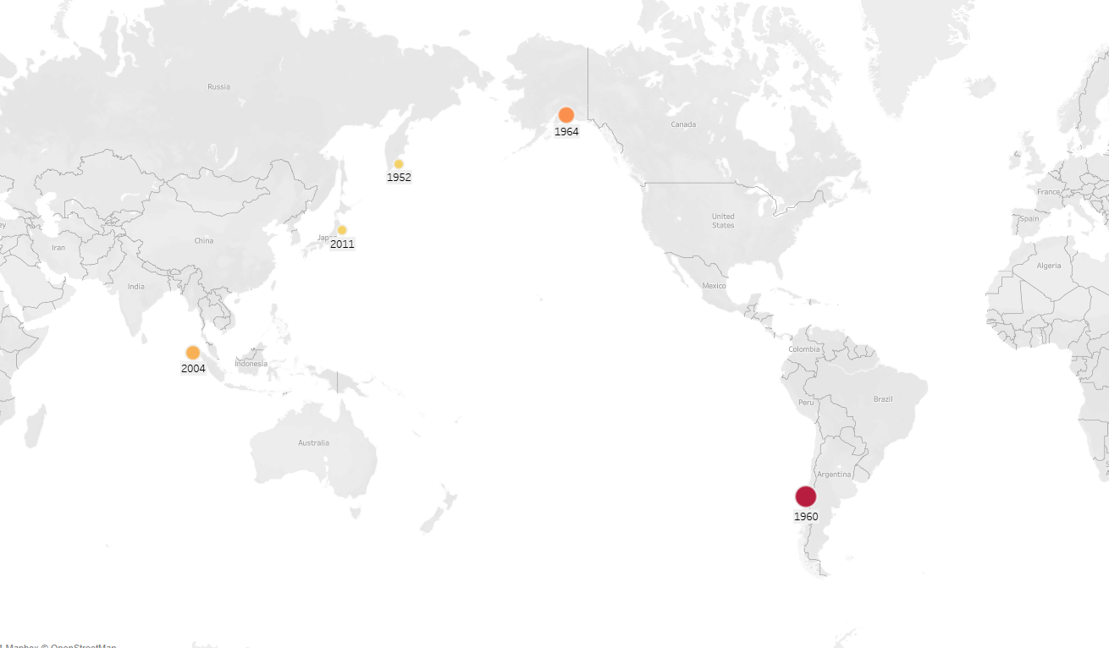
Great Earthquakes ( Magnitude above 9) through the year from 1900 to 2013.
1952 – Russia (9.0)
1960 – Chile (9.4-9.6)
1964 – South of Alaska (9.2)
2004 – Indian Ocean (9.1)
2011 – Japan (9.0)

Slide 8
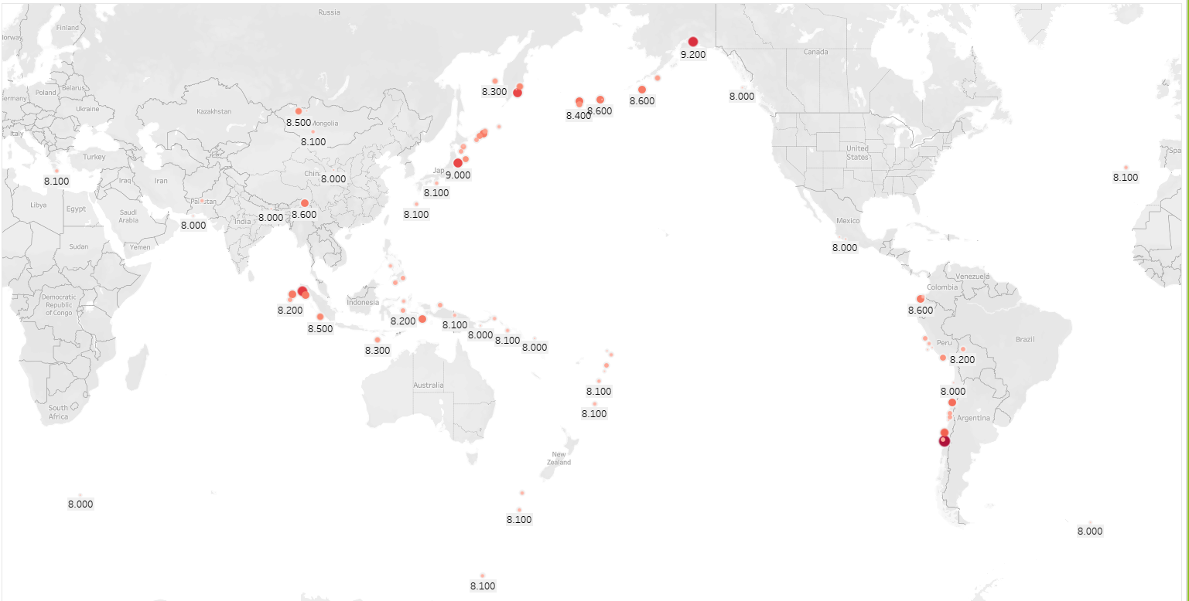
High Rick Areas for an Investment.

Slide 9
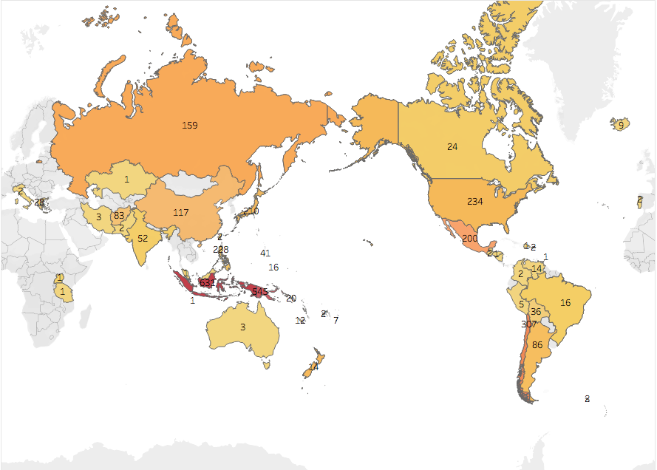
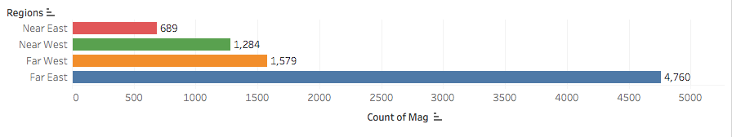
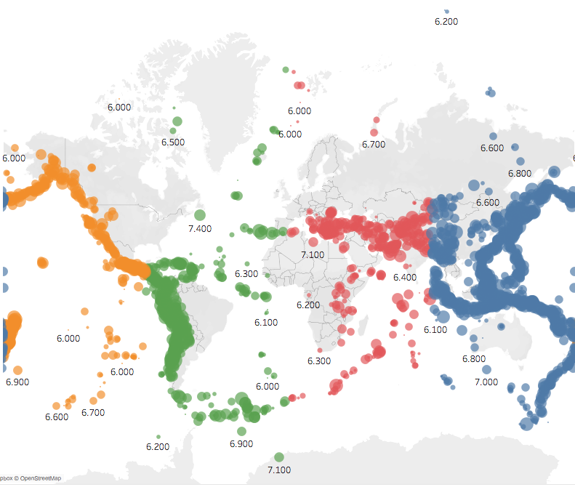
Occurrence of earthquakes Country-wise and Region/wise
Regions | Occurrence (Count)
Near East | 689
Far East | 4760
Near West | 128
Far West | 1579
The “Near East” region is where there are minimum occurrence of earthquakes.
While the “Far East” region is where there is high occurrence of earthquakes.

Slide 10
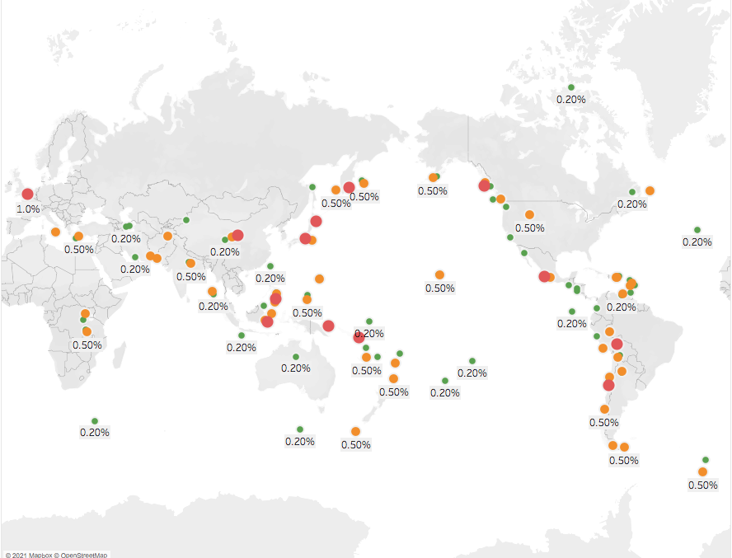

Insurance Premium Distribution
Magnitude Class | Premium Percentage
Great | 1.00%
Major | 0.50%
Strong | 0.20%
Moderate and below | 0.10%

Slide 11

THANK
YOU

