Slide 1
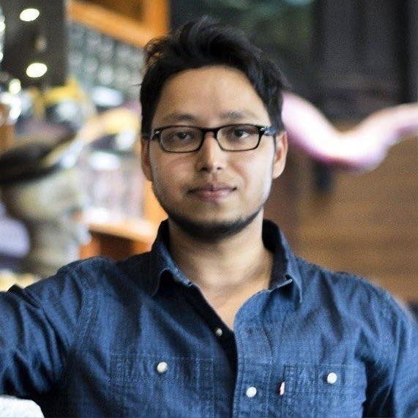
DEBASISH SINGHA
INTEGRATIONS & MAINFRAME TO MICRO FOCUS MIGRATION LEAD
Atlanta, Georgia, USA
Competencies
Summary:
Hands-on Integrations and Mainframe Migration specialist, 15+ years in COBOL, CICS, DB2. Designs and debugs the CDC (Change Data Capture), IBM MQ and TCP socket integration layer of a mainframe-to-Micro Focus migration, and tunes SQL for real-time replication.
Mainframe to Micro Focus migration
Change data capture design
IBM MQ & code page conversion
CICS TCP socket integration
SQL performance tuning
Root cause analysis & debugging
AI-assisted technical analysis
Career Summary
Technology Expertise
15+ years in COBOL, CICS, DB2, IMS, VSAM and SQL on IBM z/OS.
Specialist in integrations & Mainframe to Micro Focus / Rocket Enterprise Server migration.
Owns the CDC, IBM MQ and TCP socket integration layer on the current programme.
SQL performance tuning for near real-time replication into an operational data store.
B.Tech, Electronics & Communication Engineering (2011).
Integrations Lead & Onsite Development Lead, Jul 2025 - Present: CDC, IBM MQ and socket integration for a mainframe-to-cloud migration.
Technical Lead, Jan 2025 - Jun 2025: COBOL development and defect analysis in a Micro Focus UNIX environment.
Technical Lead, Mar 2022 - Dec 2024: converted FOCUS 4GL to SQL and COBOL, and FOCUS screens to CICS screens, Report generation via Easytrieve.
Senior Software Engineer, Jun 2017 - Mar 2022: enhancement, root cause analysis and batch tuning on z/OS.
Software Engineer, Jun 2011 - May 2017: COBOL, DB2 and VSAM development for a brokerage platform.
Replaced the CDC incumbent replication product with a SQL-COBOL-based solution feeding an Oracle ODS over IBM MQ.
Tuned SQL and CDC capture jobs so replication runs in near real time.
Used IBM MQ code page conversion to bridge EBCDIC and ASCII systems.
Debugged CICS TCP sockets calling a Java pricing engine; profiled with Wireshark.
Uses Vertex AI and Claude to speed up performance analysis.
COBOL, CICS, JCL, DB2, IMS, VSAM, SQL
Micro Focus / Rocket ES, z/OS, Linux, GCP
IBM MQ, SQL Server CDC
EZASOKET sockets, Wireshark, Vertex AI, Claude
Industry Certificates
Currently pursuing Claude Certified Professional Architect course and exam.
BluAge L2 Certified
Oracle Certified Java Professional
Industries
Technology & electrical distribution
Transportation, logistics & fleet
Financial services & retail brokerage

