Slide 1
Hindi Speech to English Text Translation System
VOXLING
Debanjan nanda Debayan datta Ayan maity

Slide 2
WHAT?
Speech-to-Text
Text Translation
Fusion of two core components
Hindi Audio to
Hindi Text
Hindi Text to
English Text

Slide 3
WHY?
Language Barrier Reduction: Bridging the gap for non-English speakers and enhancing in real time translation.
Accessibility: Provides an easy way for non-native Hindi speakers to access content available in Hindi.
Common Ground for Communication: Native Hindi speakers often encounter challenges when interacting in non-Hindi-speaking regions.
Automated Translated System: Highly useful in several industries like Tourism, Service Centre and Media.
Research & Development: Given that Hindi is considered a low-resource language compared to English and Mandarin, our project will foster research and development in this area.

Slide 4
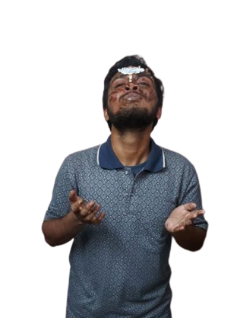
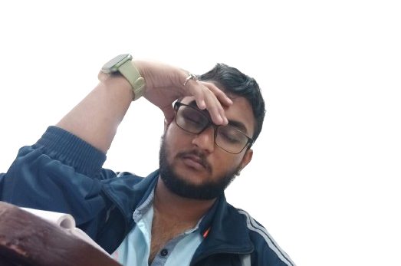
HOW?

Slide 5
Model 1: Hindi Speech → Hindi Text
Dataset 1 (actually contains first 3 columns)
Source: OpenSLR
English Text is manually collected using Google Translate
ID | Hindi Speech | Hindi Text | English Text
- | - | - | -
- | - | - | -

Slide 6
Model 2: Hindi Text → English Text
Hindi Text | English Text
- | -
- | -
Dataset 2
Source: IITB English-Hindi Corpus

Slide 7
ID
HindSpeech
HindText
EngText
MODEL 1
Hindi Audio
Input
Intermediate
Predicted
HindText
comparison
Predicted
EngText
Output
MODEL 2
HindText
EngText

Slide 8
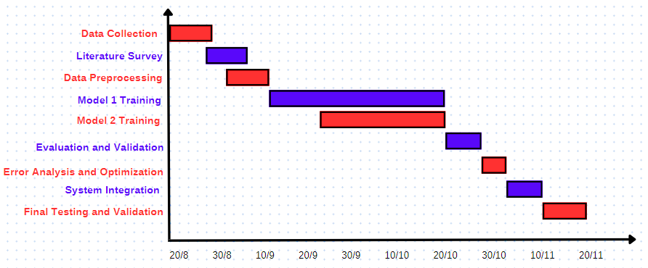
Task | start | finish
Data Collection | 20-08-2024 | 26-08-2024
Literature Survey | 27-08-2024 | 06-09-2024
Data Preprocessing | 01-09-2024 | 11-09-2024
Model 1 Training | 12-09-2024 | 20-10-2024
Model 2 Training | 24-09-2024 | 20-10-2024
Evaluation and Validation | 20-10-2024 | 27-10-2024
Error Analysis and Optimization | 27-10-2024 | 02-11-2024
System Integration | 02-11-2024 | 10-11-2024
Final Testing and Validation | 10-11-2024 | 19-11-2024
WORK PLAN
& TIMELINE

Slide 9
Work Division
We plan on working collaboratively and later we would divide the tasks based on each other's strength and weakness

Slide 10
Thank you

Slide 11
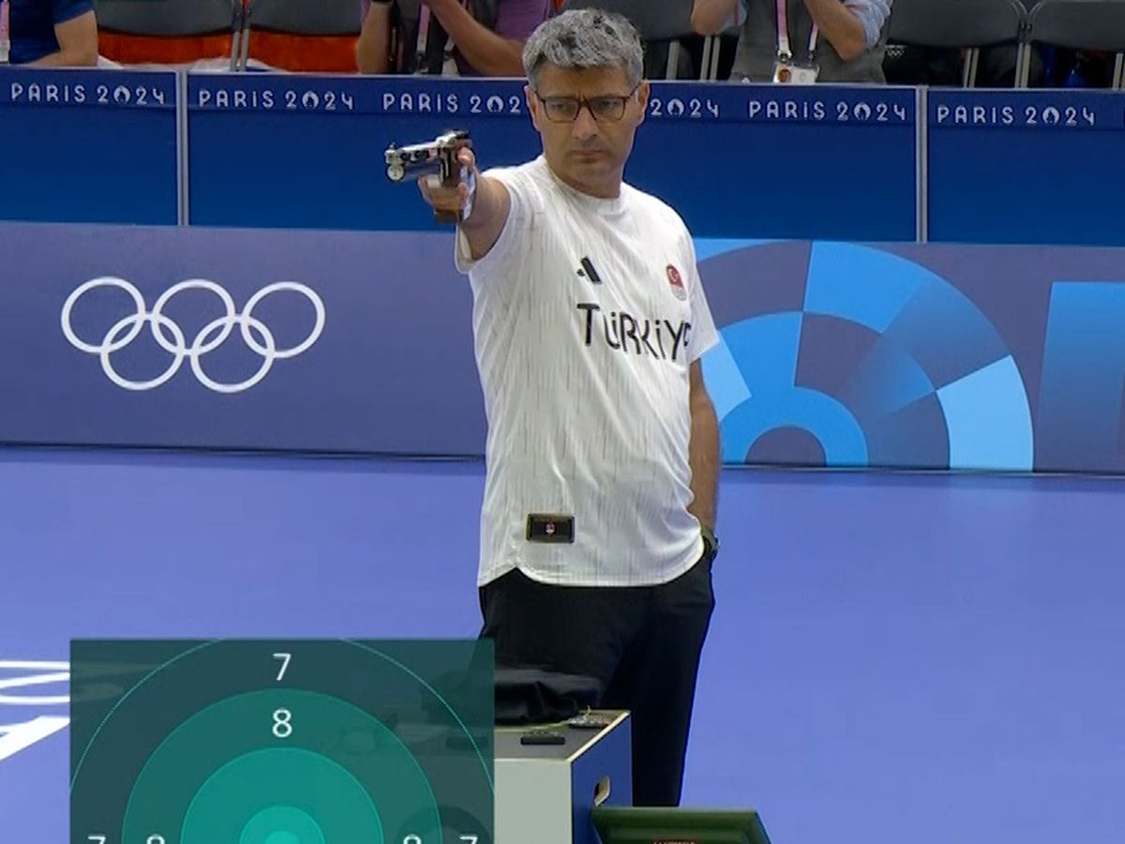
SO ANY QUESTIONS??

