Slide 1
FYND 2019 ML CHALLENGE
- DEBAYAN MITRA
Email - debayanmitra1993@gmail.com
Linkedin - https://www.linkedin.com/in/debayan-mitra-63282398/
Github - https://github.com/debayanmitra1993-data

Slide 2
Table of Contents
Problem statement - Detect Footwear closure type from Images (6 class classification)
Image descriptions
Data processing & insights
Memory & Time optimization hacks
Deep learning Modelling approach – CNN Transfer learning (2 stage)
CNN Modelling Approach 1
CNN Modelling Approach 2
CNN Modelling Approach 3
Hyperparameters used
Final Model Used
Approach to Select best Image view
Model Results and performance metrics
Code repository
Libraries & tools used
Summary, Conclusions & Future work, scope of Improvements
References

Slide 3
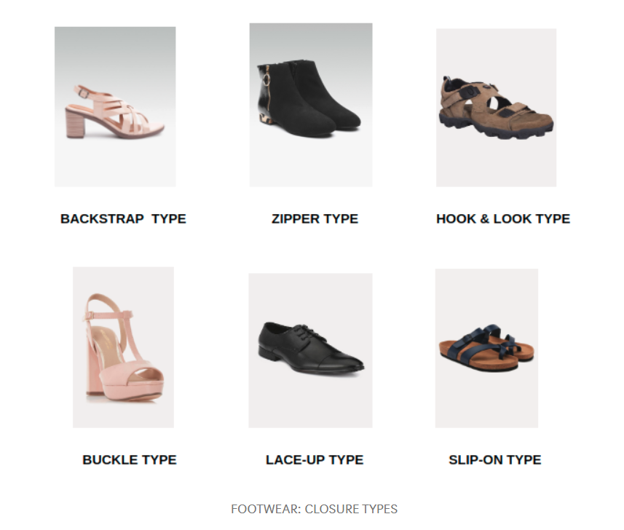
Problem statement
Link to challenge - https://blog.gofynd.com/machine-learning-internship-challenge-2019-6b4e9dddb637
(6 classes – Backstrap, Zipper, Hook & Look, Buckle, Lace, Slip-on)
2156 footwear images (5 image views per footwear)

Slide 4
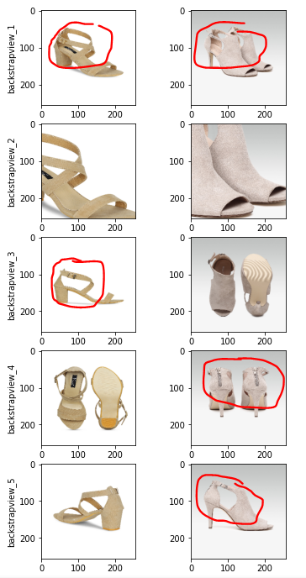
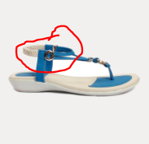
(1) Backstrap – example images
Image Descriptions
A pull strap attached to the top of the backstay of a shoe or boot

Slide 5
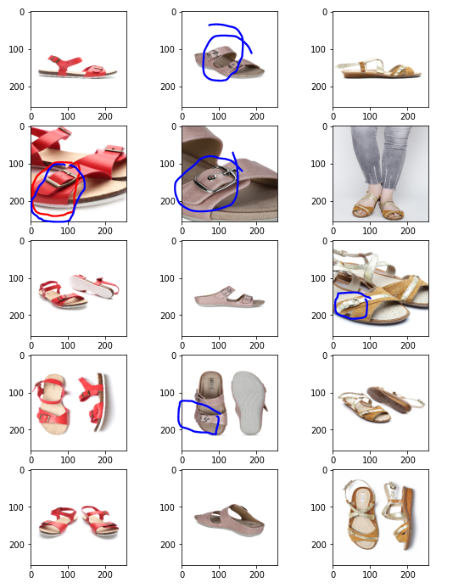
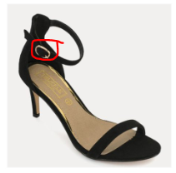
(2) Buckle – example images
To be fastened by a buckle. A buckle is a device used for fastening two loose ends, with one end attached to it and the other held by a catch in a secure but adjustable manner.

Slide 6
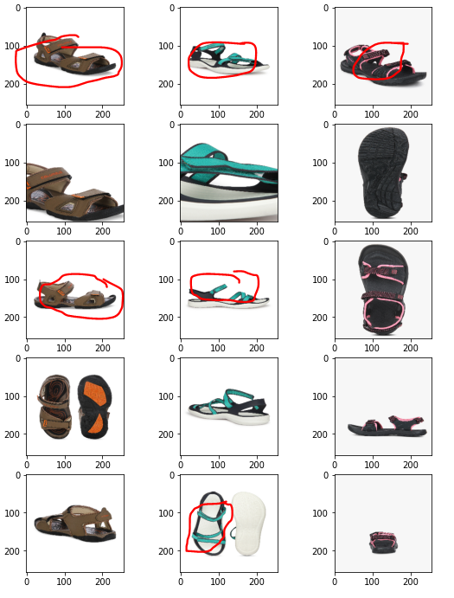
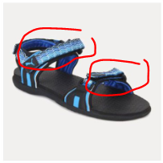
(3) Hook & Look – example images
Hook-and-loop fasteners consist of two components: typically, two lineal fabric strips which are attached to the opposing surfaces to be fastened.

Slide 7
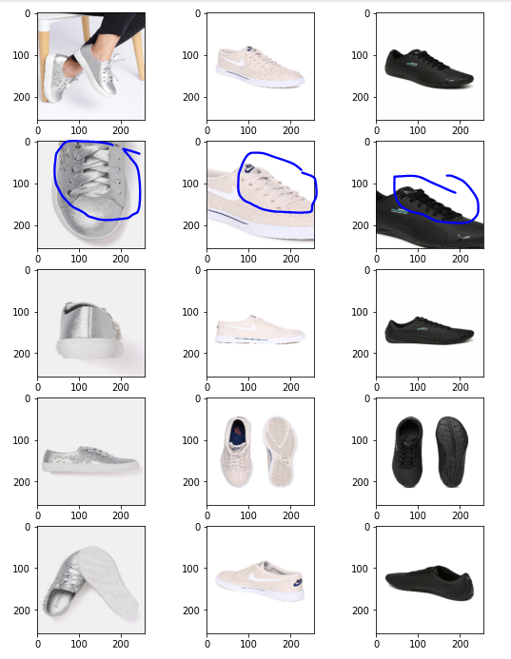
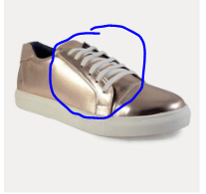
(4) Lace – example images
Lace-up closure means to be fastened by laces. Lace is a cord or leather strip passed through eyelets or hooks on opposite sides of a shoe and then pulled tight and fastened.

Slide 8
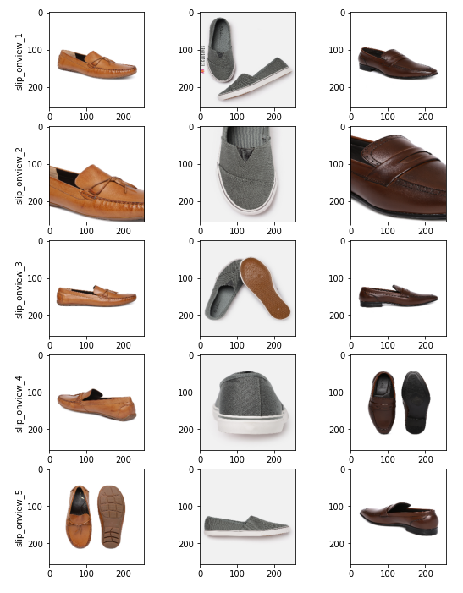
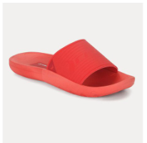
(5) Slip on – example images
Slip on closure means having no fastenings. Therefore able to be put on and taken off quickly.

Slide 9
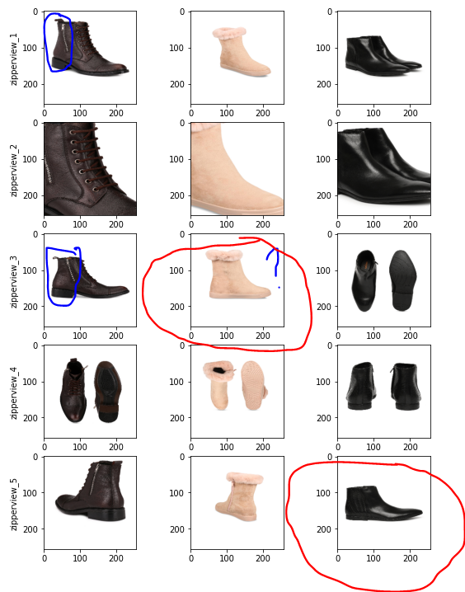
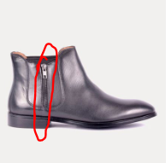
(6) Zipper – example images
A fastening device operating by means of two parallel rows of metal or plastic teeth on either side of a closure that are interlocked by a sliding tab. Also known as a zip.
Challenge – zip sections not clearly visible in many images

Slide 10
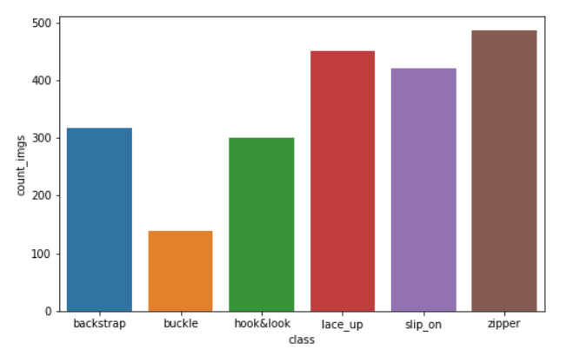
Data processing & insights
Class imbalance observed, Buckle has fewer images than others
Stratified split into train : test (80:20)
Fetch images from Image URLs :
skimage.io -> cv2.resize -> (256,256,3)
Store in numpy.ndarray – 4D matrix
(Batch Size,256,256,3)
Keras ImageDataGenerator to Augment Images
rotation_range = 10
horizontal_flip = True
zoom_range = 1

Slide 11
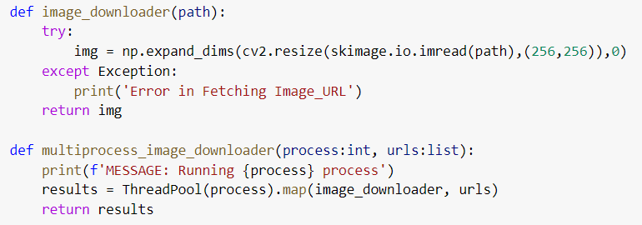
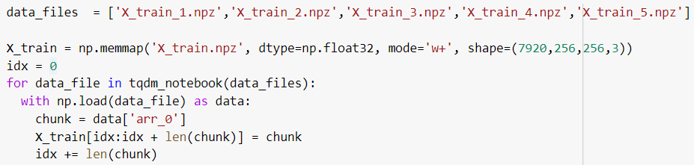
Memory & Time optimization hacks
Fetch 10,780 image URLs to local
Load (10780,256,256,3) np.ndarray into Memory - MemoryError
Server latency (Lag)
Multiprocess Threadpool to fetch Image URLs
2 core CPU parallelization (Colab)
Reduce fetch time by 50%
Increase CPU cores for faster parallelization
numpy.memmap (memory mapped file read)
numpy.savez_compressed() – Limited Google Drive space availability

Slide 12
Memory & Time optimization hacks
Class imbalance observed, Buckle has fewer images than others
Stratified split into train : test (80:20)
Fetch images from Image URLs :
skimage.io -> cv2.resize -> (256,256,3)
Multiprocess Threadpool
(2 core CPU parallelization)
reduce fetch time by 50%
Store in numpy.ndarray – 4D matrix
(Batch Size,256,256,3)
Keras ImageDataGenerator to Augment Images
rotation_range = 10
horizontal_flip = True
zoom_range = 1

Slide 13
Deep learning Modelling approach – CNN Transfer learning (2 stage)
Stage 1 – (Freeze ResNet50, Train Top layers only)
Stage 2 – (Unfreeze ResNet50, Train all layers)
256x256
Input image
ResNet50 Block
Softmax (6)
Dropout (0.3)
Dropout (0.4)
Global Avg Pool 2D
Dense(512)

Slide 14
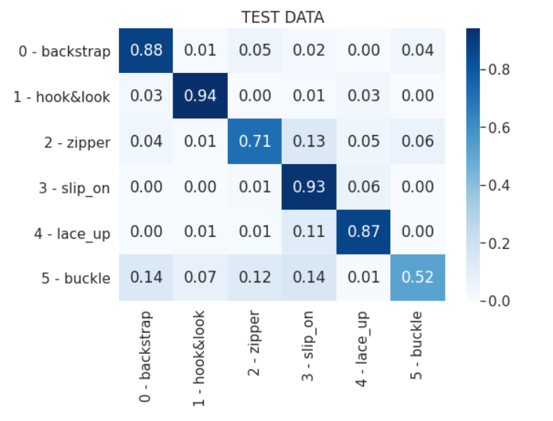
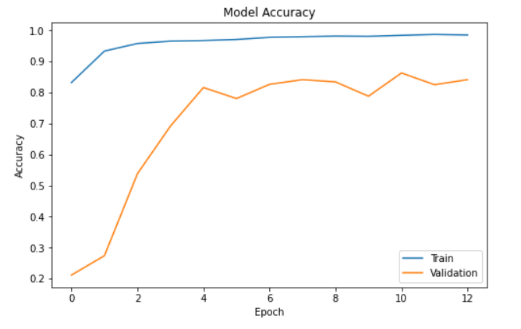
CNN Modelling (Approach 1)
Use each of 5 image views as each row in the training data
For ‘n’ images -> (5 x n) training data
87.5 % Test accuracy
Recall Matrix (Accuracy per class) to evaluate
Buckle, Zipper Confusions

Slide 15
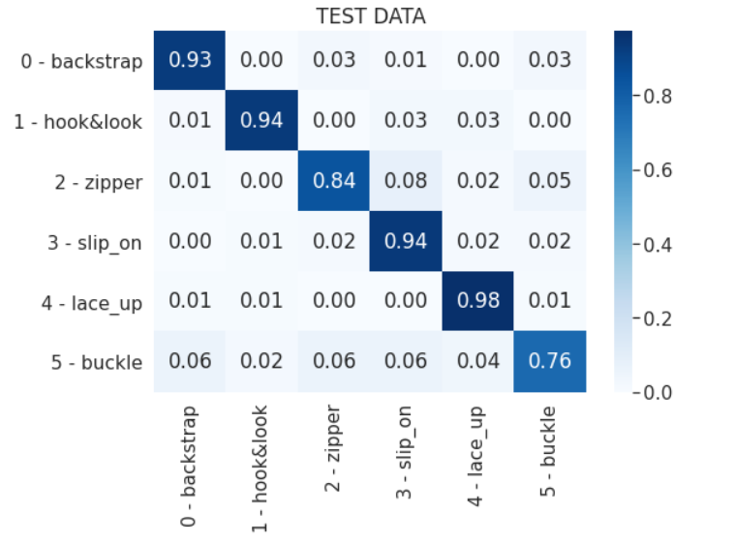
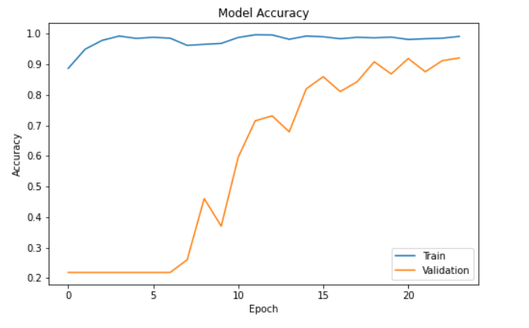
CNN Modelling (Approach 2)
Use only relevant Image views for each class
Take a look at few of the examples for each of the 6 classes and decide which angle view best gives feature prominence
Backstrap, Slip on, Zipper, Hook & Look - (use View 1 only)
Buckle (View 1 & View 2)
Lace (View 2)
90.8% Test accuracy
Zipper & Buckle accuracy improves

Slide 16
CNN Modelling (Approach 3)
Feature Extractor from 5 parallel ResNet50 -> 4x4 MaxPool Blocks for 5 image views
256x256
Input image
ResNet50 Block
4x4 MaxPool
Flatten
256x256
Input image
ResNet50 Block
4x4 MaxPool
Flatten
C0NCATENATE
Dense(512)
Dropout (0.4)
256x256
Input image
ResNet50 Block
4x4 MaxPool
Softmax (6)
Flatten
256x256
Input image
ResNet50 Block
4x4 MaxPool
Flatten
256x256
Input image
ResNet50 Block
4x4 MaxPool
Flatten

Slide 17
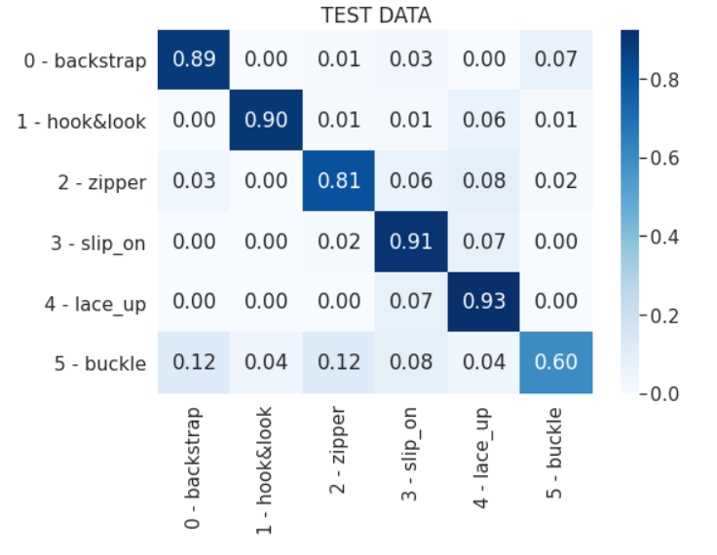
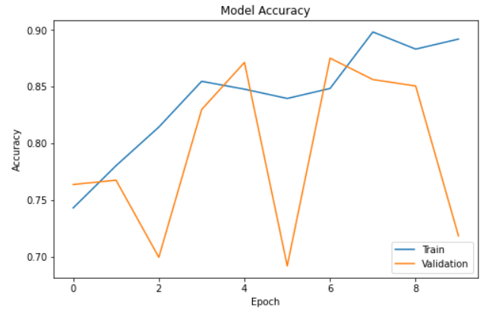
87.1% Test accuracy
60% Recall accuracy for Buckle

Slide 18
Hyperparameters used
Batch size = 8 for Model 3 (for optimum memory usage)
Batch size = 64 for Model 1,2
Adam optimizer (lr = 1e-4)
Image Augmentations (ImageDataGenerator)
Horizontal_flip = True, rotation_range = 20, zoom_range = 1
Not significant improvement in test accuracy observed
ElasticNet regularizer on Final Dense Layer – (L1 = 1e-5, L2 = 1e-4)
+3 % increase in test accuracy, reduced overfit

Slide 19
Final Model Used
Feed each Image view into Model 1, output most common prediction from 5 images
For multi mode -> use prediction(view 1) as output
Prediction View 1 is chosen in the exception block (best Cross Validation accuracy)
93.2 % Test accuracy
Prediction view 1
Image view 1
Prediction view 2
Image view 2
MODEL 1
Prediction view 3
OUTPUT CLASS
Image view 3
Try (Mode) exception (Prediction 1)
Prediction view 4
Image view 4
Prediction view 5
Image view 5

Slide 20
Approach to select best Image view
For each img in Image view – range(1,6):
probabilities.append(model.predict_proba(img))
return probabilities.index[max(probabilities[prediction_class = output_class])]
Softmax view 1
Image view 1
Softmax view 2
Image view 2
MODEL 1
Softmax view 3
If(TRUE) AND (return View having max(softmax))
Image view 3
Return True if (output class = prediction class)
Image view
Softmax view 4
Image view 4
Softmax view 5
Image view 5
OUTPUT CLASS

Slide 21
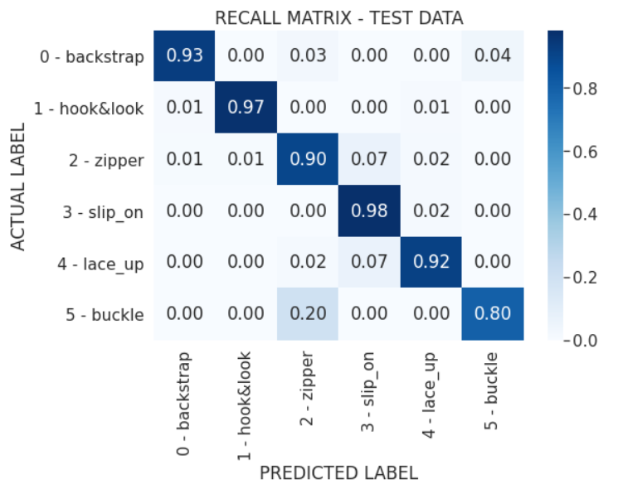
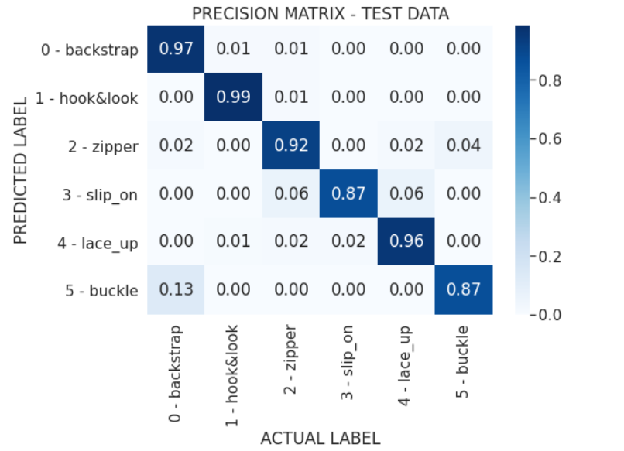
Model results & Performance Metrics
Accuracy – 93.2%
Quadratic weighted Kappa = 0.91
Micro Avg. F1 = 0.93
Macro Avg. F1 = 0.92

Slide 22
Code repository
Github - https://github.com/debayanmitra1993-data/Fynd-2019-ML-Challenge

Slide 23
Libraries & Tools used
Google Colab (GPU accelerator)
Python Libraries
Keras
Pandas
Numpy
OpenCV
Skimage
Multiprocess
Pydrive
sklearn

Slide 24
Summary, Conclusions & Future work, scope of Improvements
Hyperparameter optimizations (to improve generalization ability)
Grid search L1, L2 regularizer on Dense Layer weights (GridSearchCV)
Experiments with Model architectures & Ensembles
InceptionV3, EfficientNetB5 etc.
Scrape web data to obtain clearer Images for Buckle, Zipper images

Slide 25
References used
https://towardsdatascience.com/multi-view-image-classification-427c69720f30
https://medium.com/better-programming/building-an-imagedownloader-with-multiprocessing-in-python-44aee36e0424
https://github.com/dimitreOliveira/APTOS2019BlindnessDetection
https://numpy.org/doc/stable/reference/generated/numpy.memmap.html

