Slide 1
Text Classification
B Deb

Slide 2
Agenda
Classification Problem
Exploratory Data Analysis using LDA
Classification Algorithms
Logistic Regression
Naïve Bayes
Support Vector Machine
Random Forest
XGBoost
Neural Networks
Model Evaluation
Overfitting

Slide 3
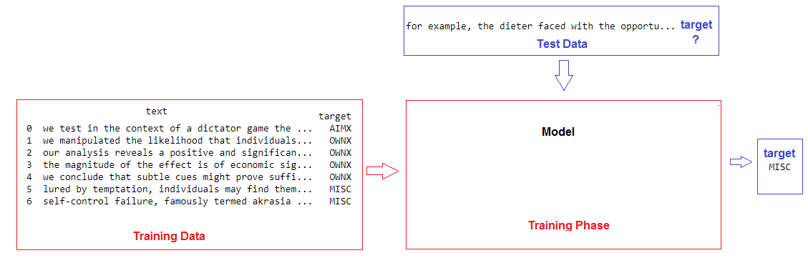
Classification Problem
Ref: [1] A. Chambers. Statistical models for text classification: Applications and analysis, Ph.D., University of California, Irvine (2013). ProQuest Dissertations and Theses.
[2] https://archive.ics.uci.edu/ml/datasets/Sentence+Classification

Slide 4
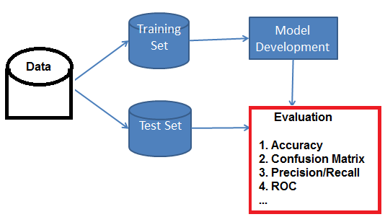
Classification Pipeline

Slide 5
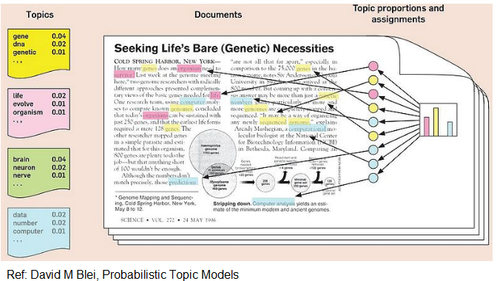
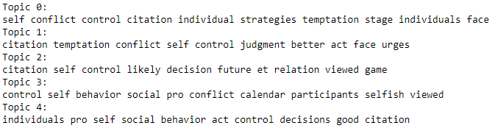
EDA using Latent Dirichlet Allocation

Slide 6
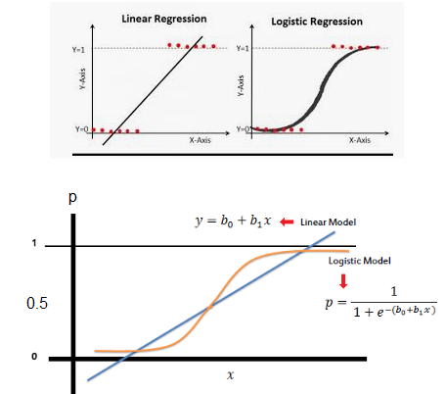
Logistic Regression
Linear regression is not suitable for classification problems
One solution is logistic regression

Slide 7
Logistic Regression
Advantages:
Gives probabilities for the class
Disadvantages:
There should be little or no multicollinearity among independent variables
Independent variables must be linearly related to the log of odds, though it is not mandatory that the dependent and independent variables to be related linearly.
Interpretation of weights difficult
Overfitting

Slide 8
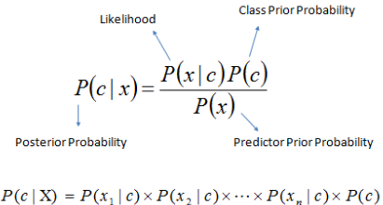
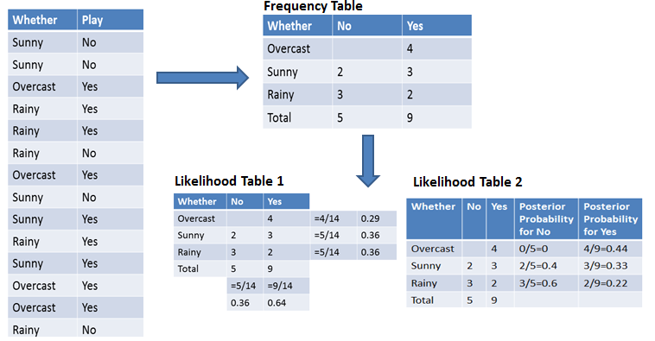
Naïve Bayes
First
P(Yes | Overcast) = P(Overcast | Yes) P(Yes) / P (Overcast)
Find whether
P (Yes | Overcast) is higher than
P (No| Overcast)
Next
P(Yes | Overcast, Mild) = P(Overcast, Mild | Yes) P(Yes)

Slide 9
Naïve Bayes
Advantages:
Efficient on large dataset
Efficient for text classification
Disadvantages:
Assumption of independence may not hold for real data

Slide 10
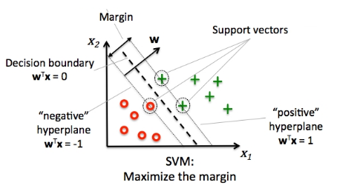
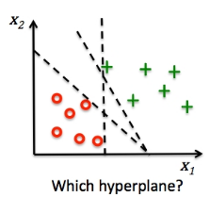
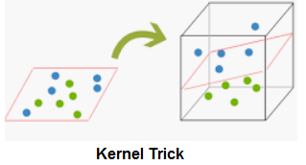
Support Vector Machine

Slide 11
Support Vector Machine
Advantages:
Can handle non-linear data using kernel trick.
Model is stable as a small change in dataset does not usually affect the hyperplane.
Disadvantages:
Longer training time.
Hard to interpret the model
Require feature scaling before modeling
Hard to choose appropriate kernel

Slide 12
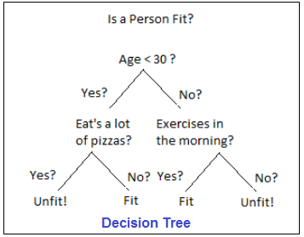
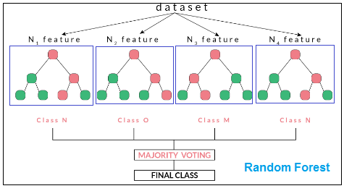
Random Forest

Slide 13
Random Forest
Advantages:
Less chance of overfitting
Not require scaling of data before modeling
Provides satisfactory accuracy even when missing data present
Disadvantages:
Hard to interpret the model

Slide 14
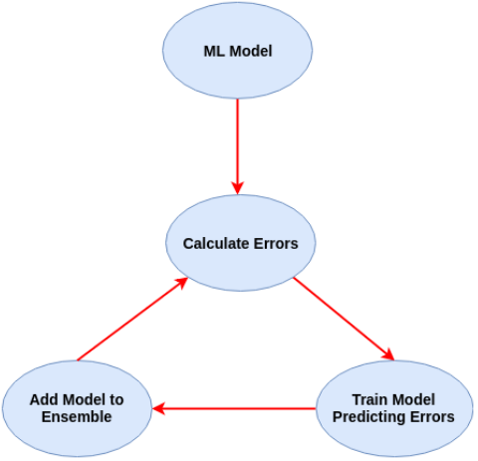
XGBoost

Slide 15
XGBoost
Advantages:
Has inbuilt L1 and L2 regularization to address overfitting
Support parallel processing
Has in-built capability to handle missing values. In case of missing value in a node, both left hand and right hand split is tried and learns the path to higher loss for each node.
Disadvantages:
Must transform categorical variables to some integer encoding

Slide 16
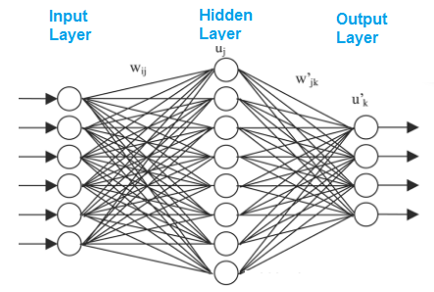
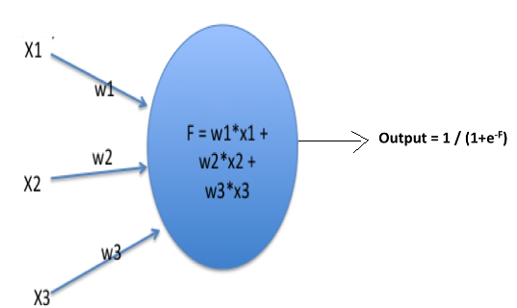
Neural Networks

Slide 17
Neural Networks
Advantages:
Outperform nearly every traditional ML algorithms given large training data
Disadvantages:
Hard to determine the proper network structure
Hard to interpret the weight matrix
Require large training data
Computationally expensive

Slide 18
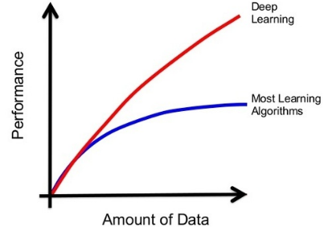
Why Deep Learning

Slide 19
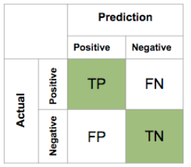
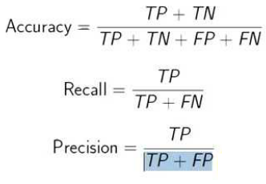
Model Evaluation

Slide 20
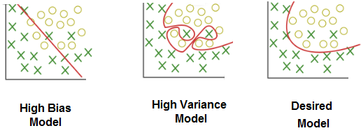
Overfitting

