Slide 1
Chicago Crime Tracker
Debbie Brasier • LA 558 Final Project

Slide 2
Purpose
Map of historical crimes in Chicago, in order to show riskiest areas, in combination with neighborhoods and transit information.

Slide 3
Technology
cityofchicago.org API
Leaflet
Leaflet clusters
Leaflet heatmaps
Awesome markers
jQuery
Bootstrap
JSON
Select2 (typeahead feature for dropdown menus)

Slide 4
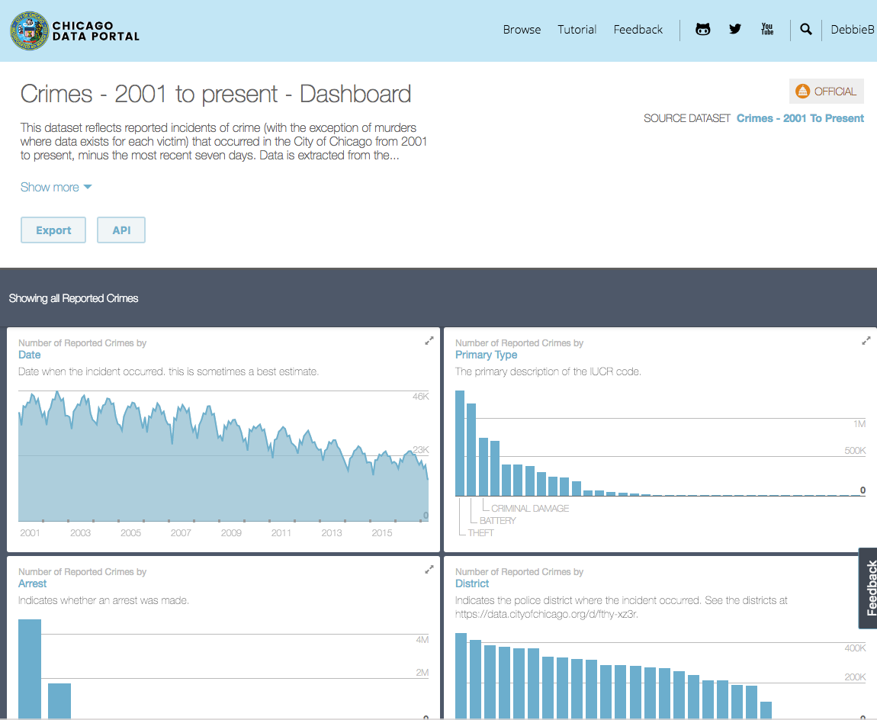
Data Sources
Crimes - 2001 to present
Sex Offenders
Police Stations
Neighborhoods
"L" Stations
Bus Stops

Slide 5
Challenges
My challenges were all regarding the data!
Getting good data is critical for an accurate, meaningful map.

Slide 6
Challenges
My challenges were all regarding the data!
Getting good data is critical for an accurate, meaningful map.
Working with the API for crimes data took a lot of time to figure out.

Slide 7
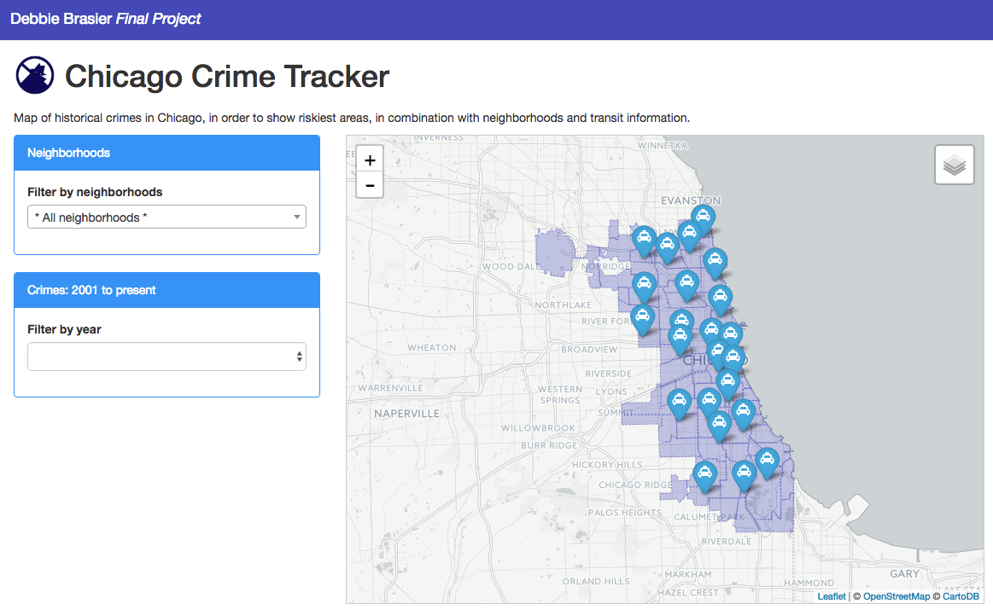
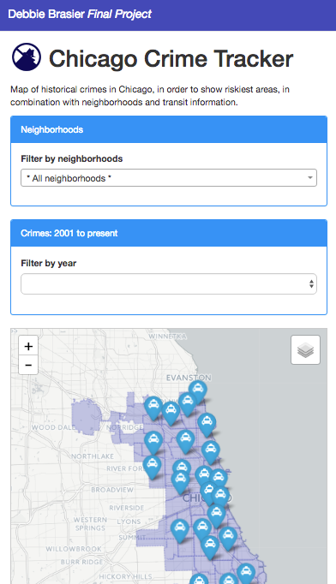
Journal of work: App design
Customized bootstrap theme
Mobile friendly
Panels for user-interactions
Map layers for additional data

Slide 8
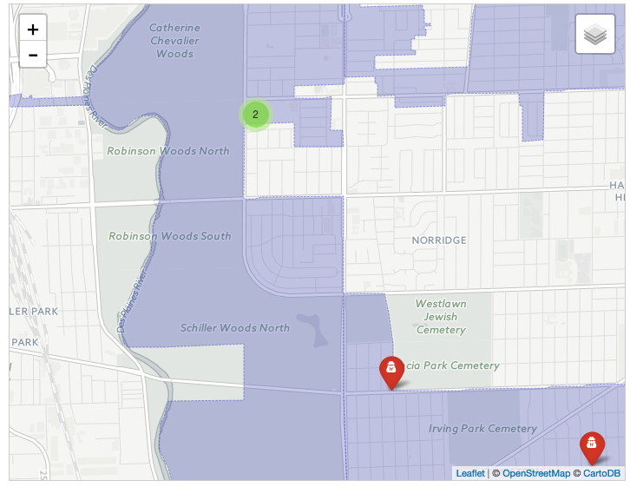
Journal of work: Sex Offender Registry
1248 addresses were masked (054XX W THOMAS ST)
Needed geocoded addresses
Tried freegeocoding.com, but data was incorrect.
Used mapdevelopers.com, which was accurate, but I had to split the data into rows of 100.
There are 3 layers on the map for this data:
Single markers
Clusters
Heat Map

Slide 9
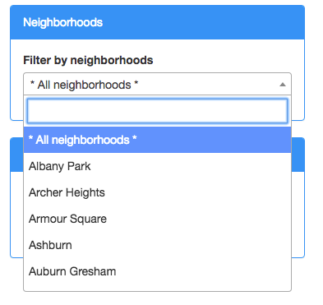
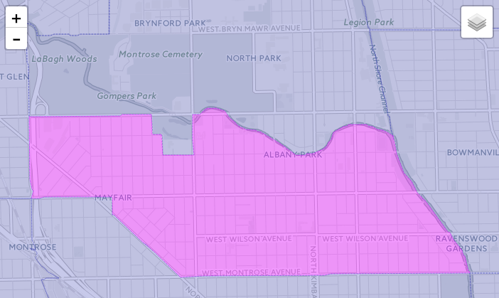
Journal of work: Chicago Neighborhoods
Added shapes as a layer from a geojson file
When the neighborhoods layer is on, there is a Neighborhoods panel with a dropdown menu
I used jquery to alphabetize the neighborhoods in the dropdown menu
I added a library called select2 to the dropdown to allow the user to type or choose a neighborhood.
When a neighborhood is selected, it is highlighted on the map

Slide 10
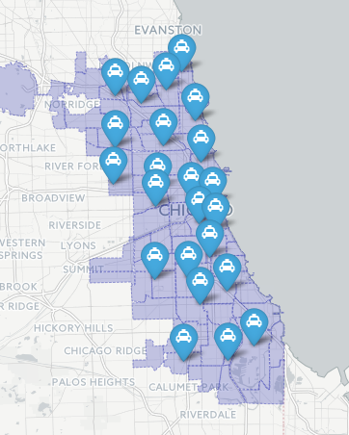
Journal of work: Police Stations
Downloaded a .csv file
Deleted unneeded columns to trim file size
Formatted data into an array using find and replace in Brackets.
Added awesome-markers as a layer on the map for all police stations.

Slide 11
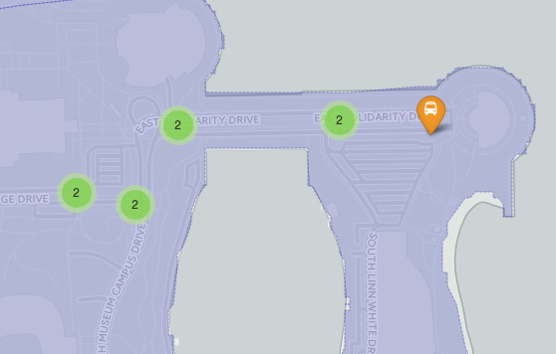
Journal of work: Bus Stops
Downloaded a .csv file
Deleted unneeded columns to trim file size
Formatted data into an array using find and replace in Brackets.
Added awesome-markers as a layer on the map for all bus stops.
This also displays on the map as marker clusters

Slide 12
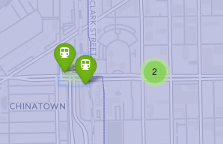
Journal of work: “L” Stations
Downloaded a .csv file
Deleted unneeded columns to trim file size
Formatted data into an array using find and replace in Brackets.
Added awesome-markers as a layer on the map for all “L” Stations.
This also displays on the map as marker clusters

Slide 13
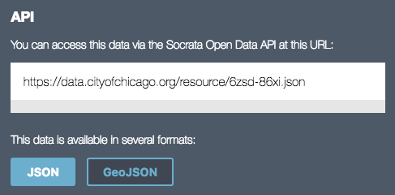
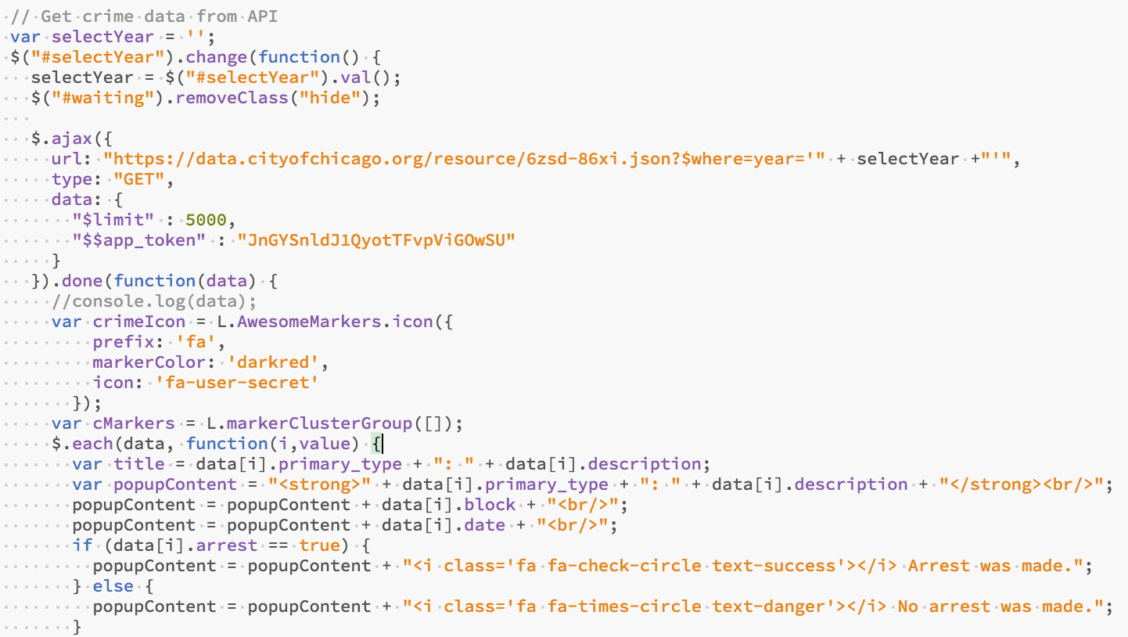
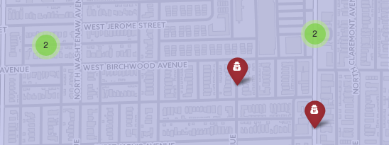
Journal of work: Crimes
This was a disaster: 790,000 rows of data!
Really slow and crashy to work with files.
Used the API as a last resort. I fought with it quite a bit to get it working. In the geojson file, latitude and longitude were missing, so I had to switch to json.
I only bring back 5K rows of data to keep the app fast, but it could easily be set to 500K.
Because of the wait for the API data, I added a waiting message in the UI while it loads.
I also show this data as clusters.

Slide 14
Final Product
Useful map with interesting user interactions
Could be enhanced with bringing back more data from the crime API.

