Slide 1
Deterministic Finite State Machine (FSM)
Debbie Cohen

Slide 2
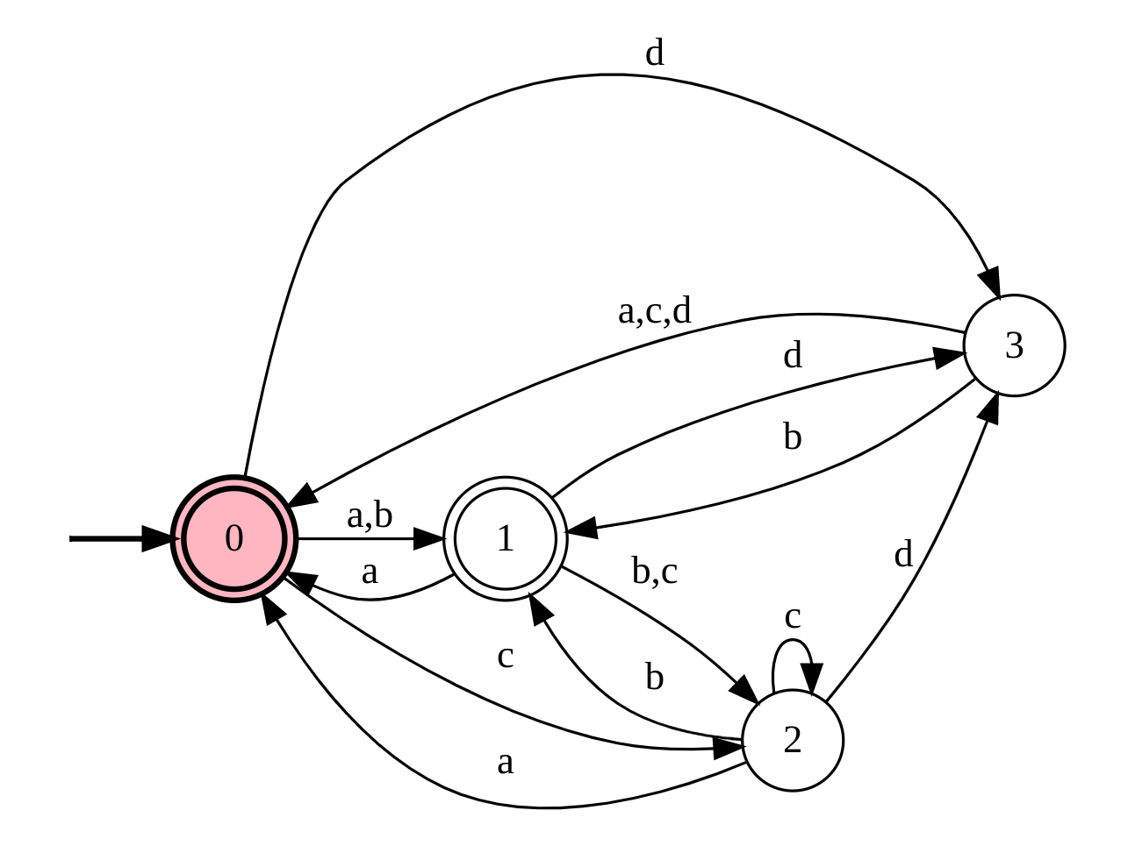
What is it?
Is a machine that accepts or rejects a given string of symbols by running through a state sequence uniquely determined by the string.
Since it is deterministic it means that only one input can move the machine from one state to another

Slide 3



FSM definition
Inputs
Name of file: test1.fsm
Name of file: test1.inputs
Current state
0:a>1
0:b>1
0:c>2
0:d>3
1:a>0
1:b>2
1:c>2
1:d>3
2:a>0
2:b>1
2:c>2
2:d>3
3:a>0
3:b>1
3:c>0
3:d>0
Next state
a
a
a
a
b
c
b
c
Input needed for transition

Slide 4
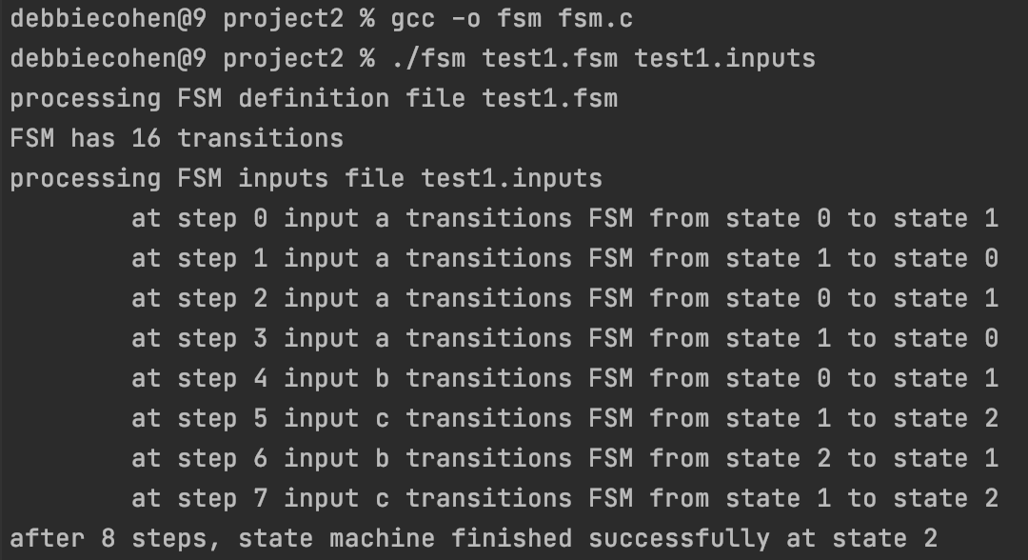
Output

Slide 5
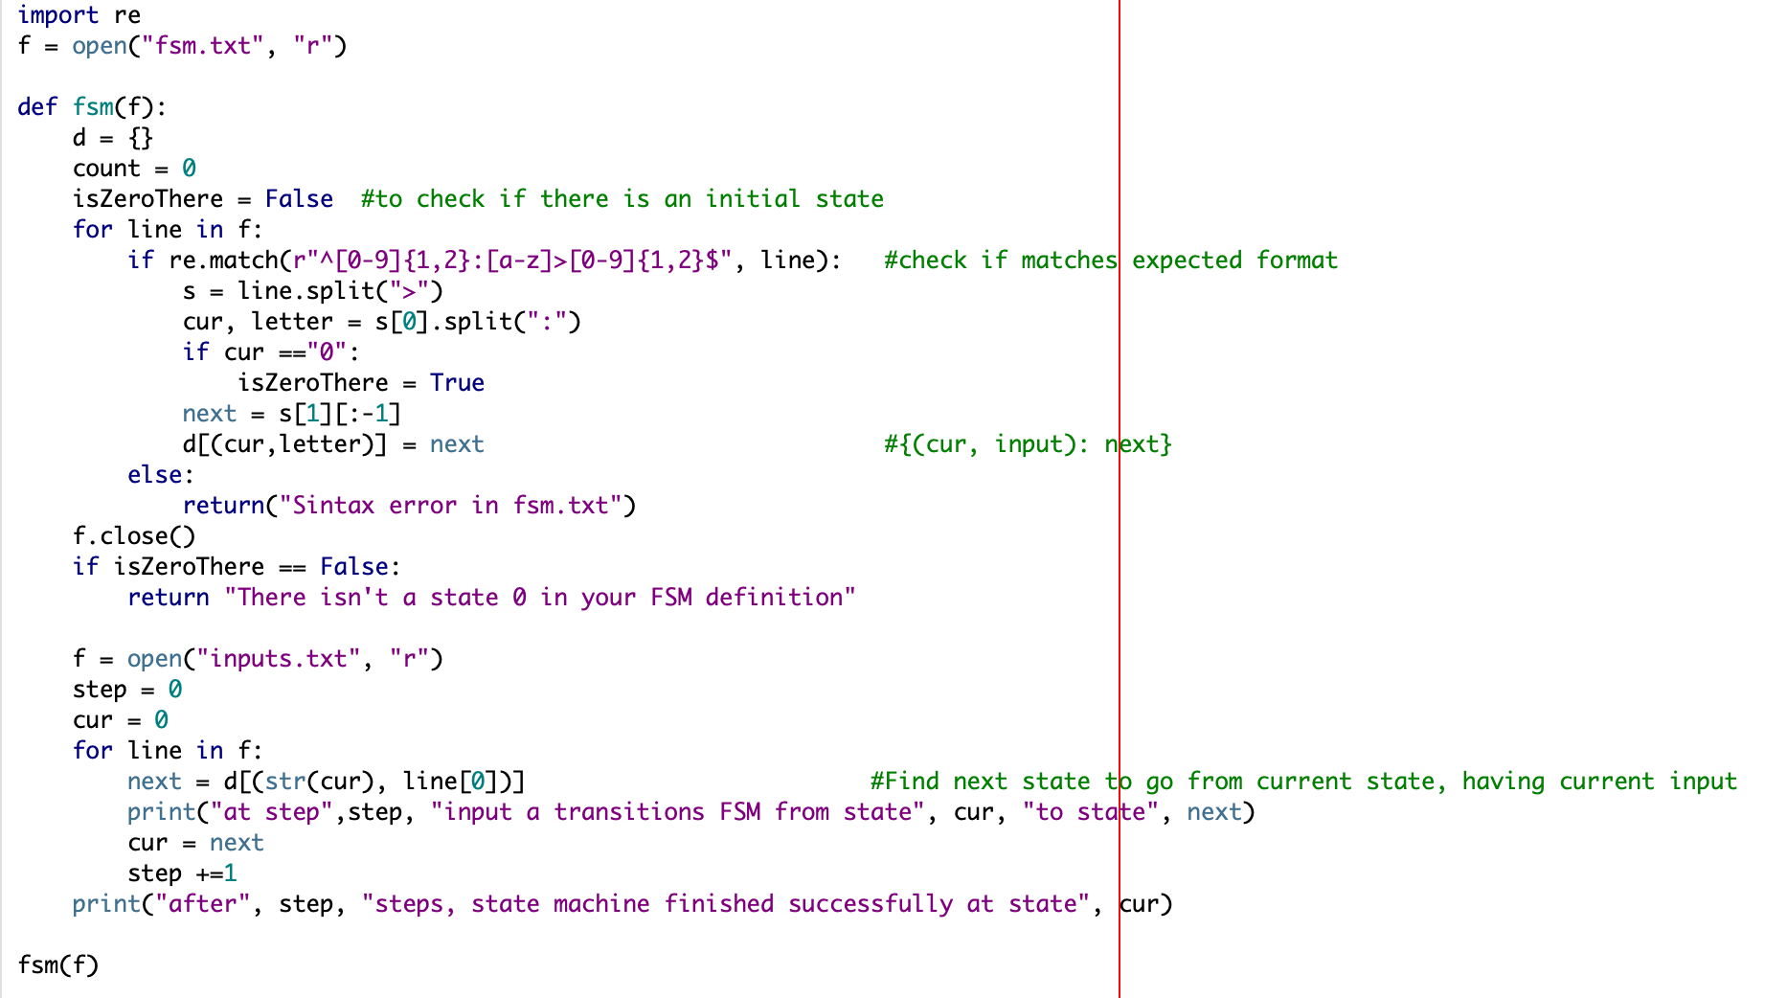
How did I start?... Python!

Slide 6
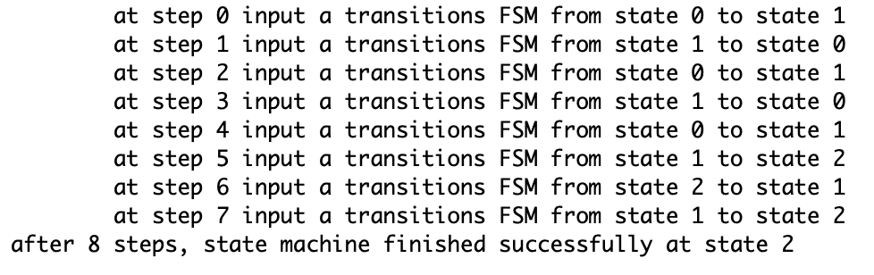

And it worked!

Slide 7

And then… C code!!!
3 functions:
CountLines
LoadDataFromFSMDef
ExecuteSteps
Main()

Slide 8
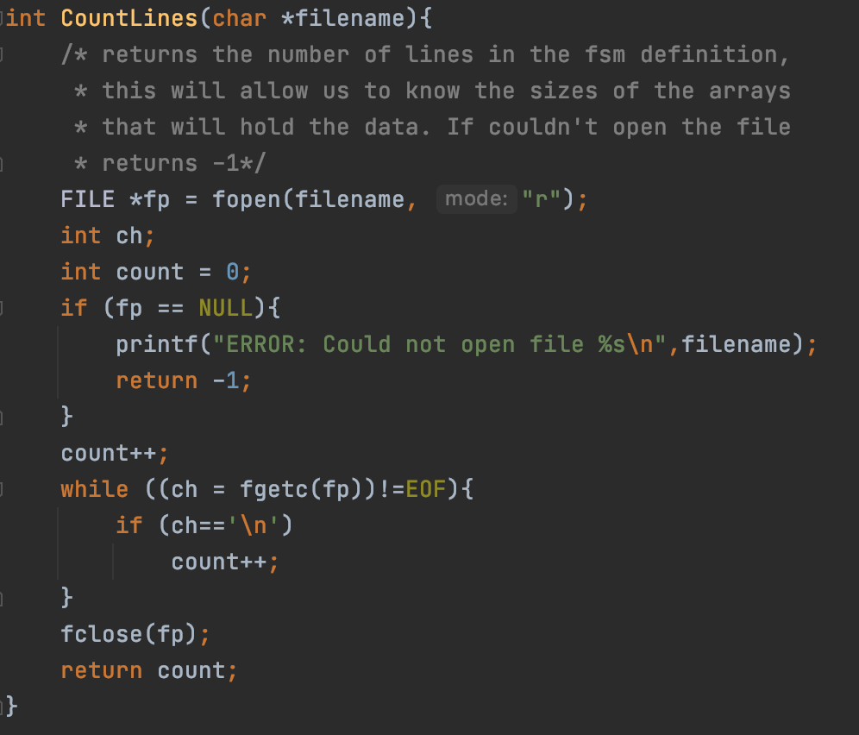
CountLines(char *filename)
Will be used to know the size of the arrays that will store the data in the FSM definition.

Slide 9
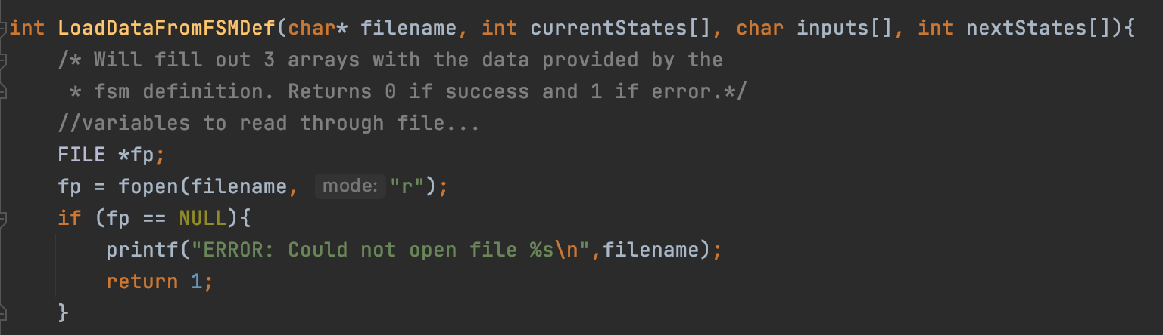
LoadDataFromFSMDef(char* filename, int currentStates[], char inputs[], int nextStates[])
Will return an int representing success(0) or failure (1)
Will return 3 arrays with the data provided by the fsm definition

Slide 10
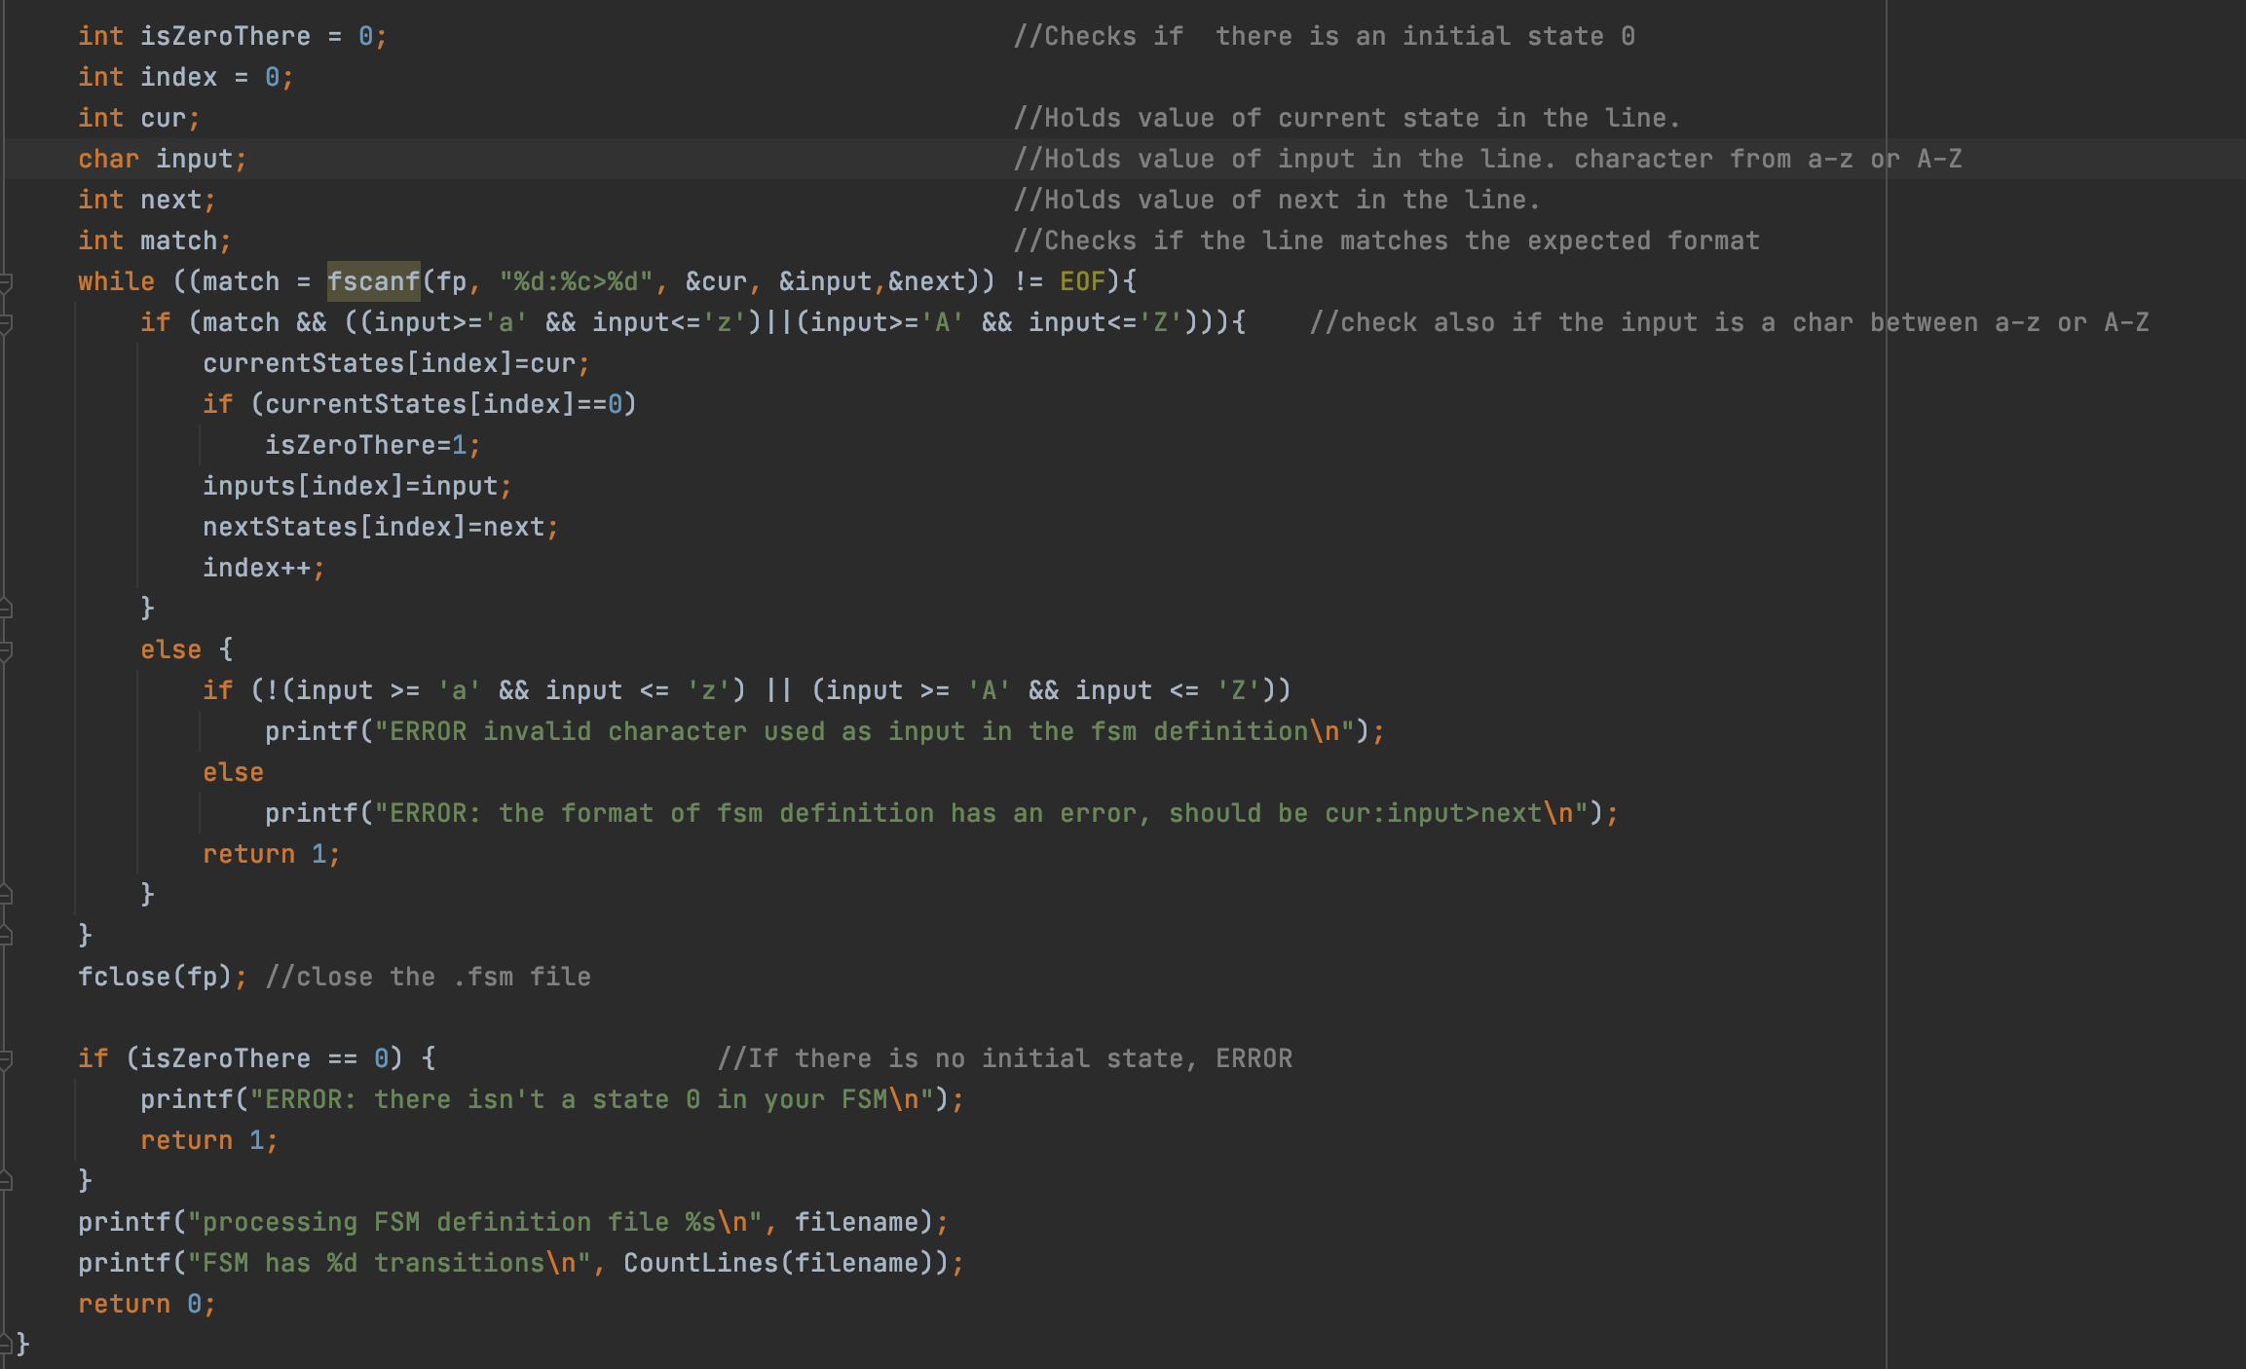
LoadDataFromFSMDef(char* filename, int currentStates[], char inputs[], int nextStates[])
fscanf functions shall return the number of successfully matched and assigned input items

Slide 11
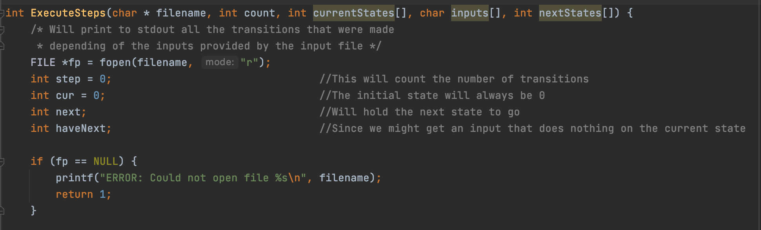
ExecuteSteps(char * filename, int count, int currentStates[], char inputs[], int nextStates[])
Will return an int representing success(0) or failure(1)

Slide 12
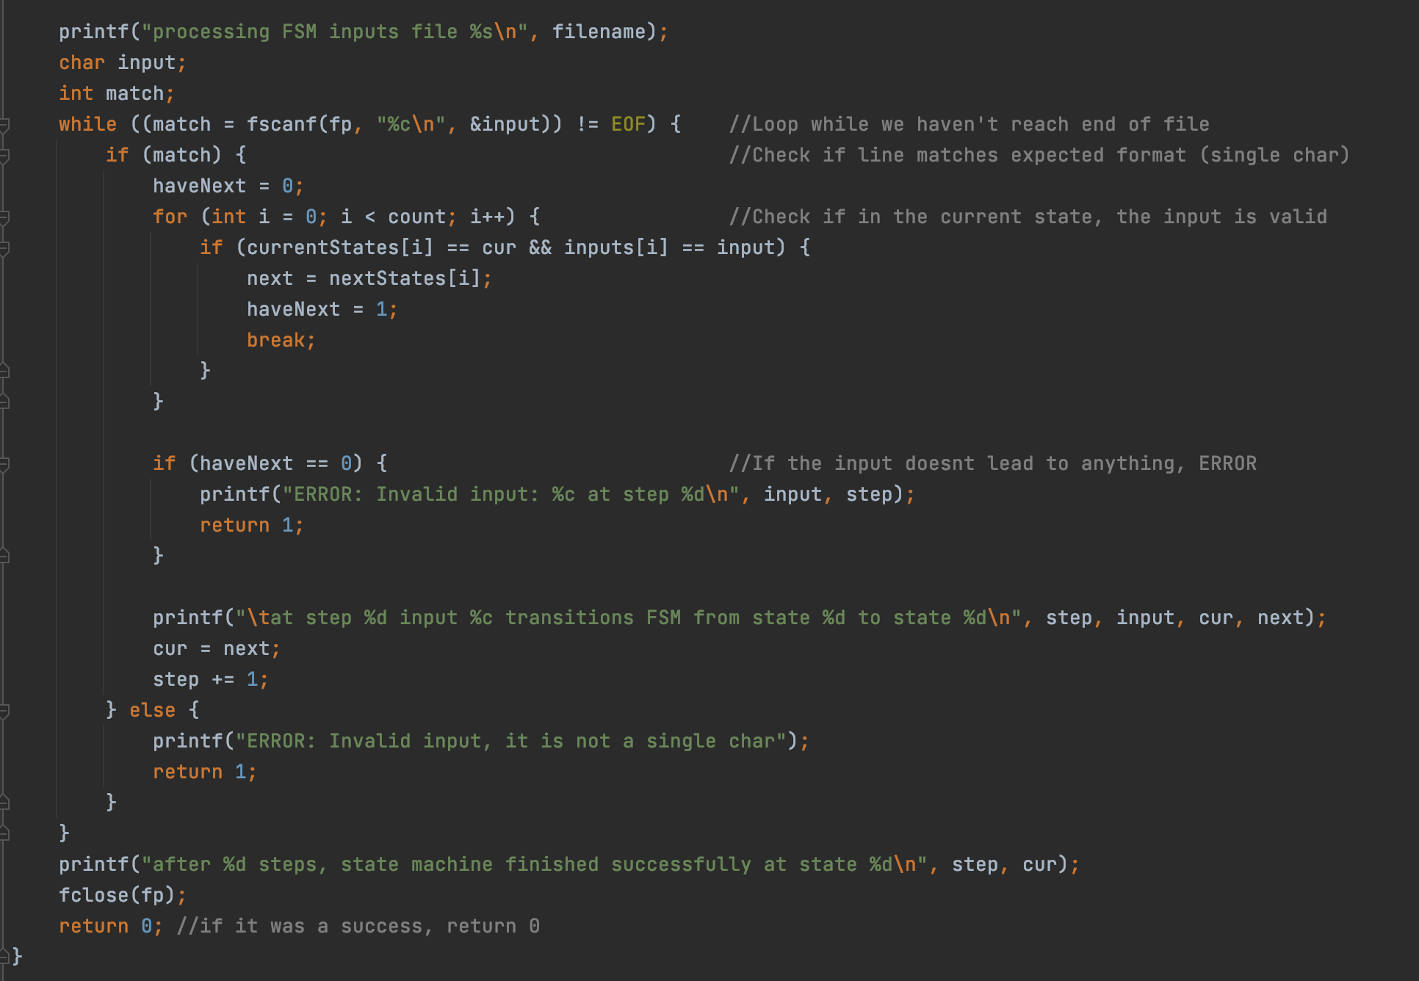
ExecuteSteps(char * filename, int count, int currentStates[], char inputs[], int nextStates[])

Slide 13
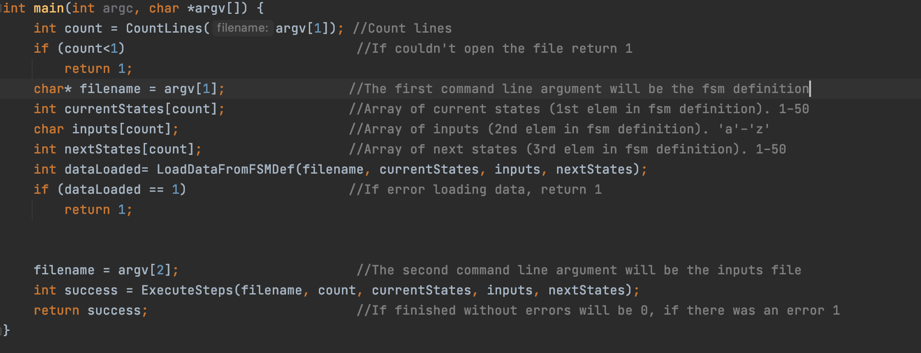
Putting all together in … main()
Will return an int representing success(0) or failure(1)
argv[1] → fsm definition filename
argv[2] → inputs file name

Slide 14
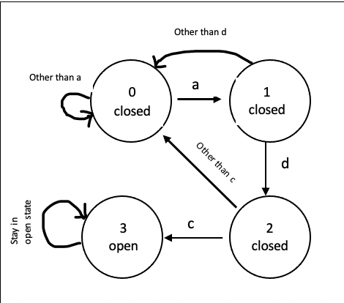
Example of a 3 characters combination lock
In this simple case we want to check if a 3 digit combination is the correct password for the lock. In this specific example, once the lock is open, it will stay open.
Password: adc
0 ==> locked
1 ==> locked (1st letter is right, a)
2 ==> locked (2nd letter is right, d)
3 ==> open (3rd letter is right, c)

Slide 15
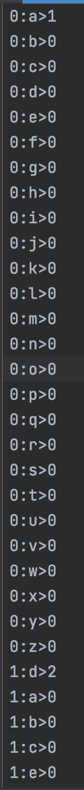
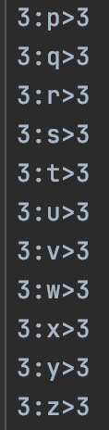
combinationLock.fsm

Slide 16
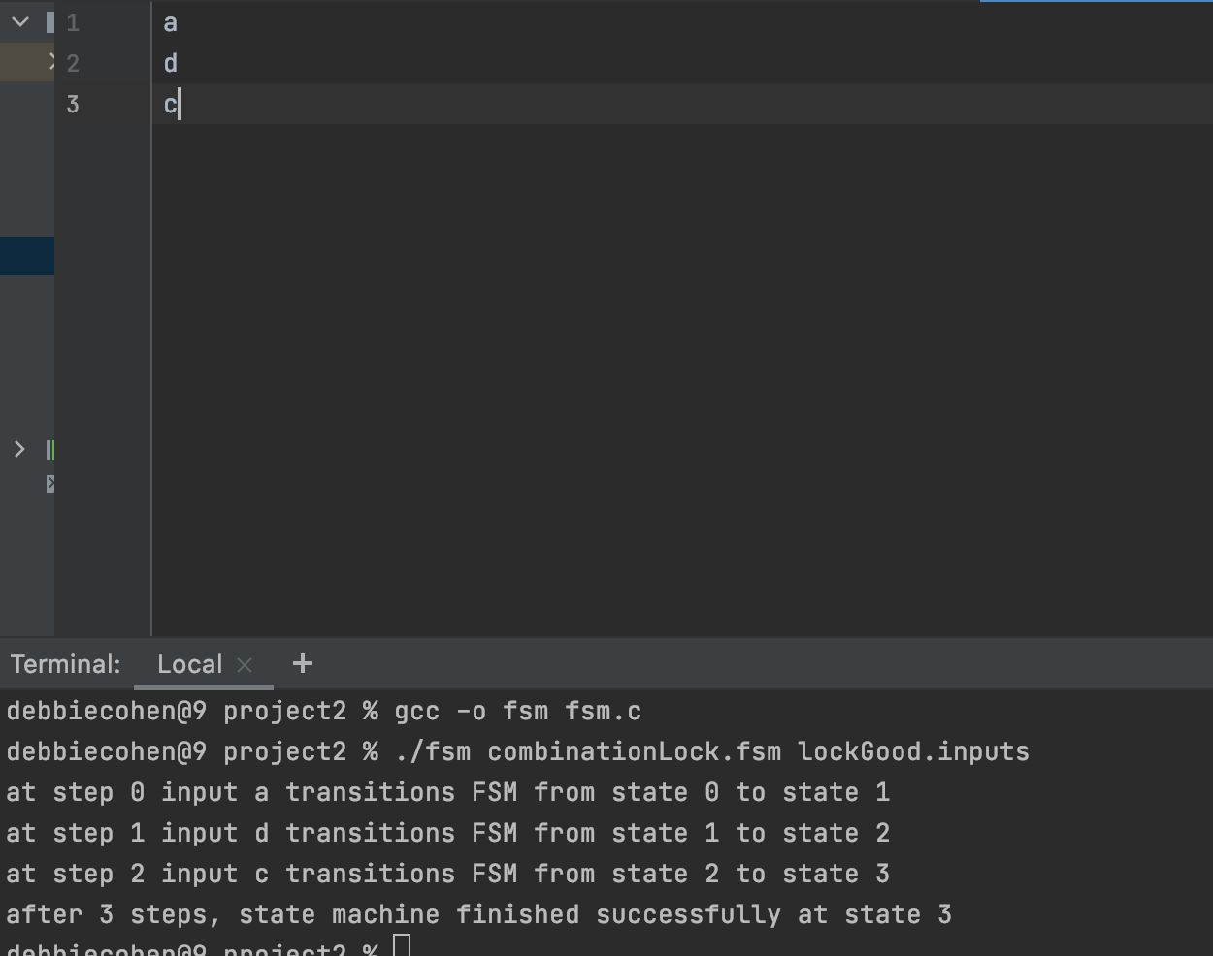
Showing execution when user enters the correct password
If the input password is correct, the machine will finish at state 3 (open)

Slide 17
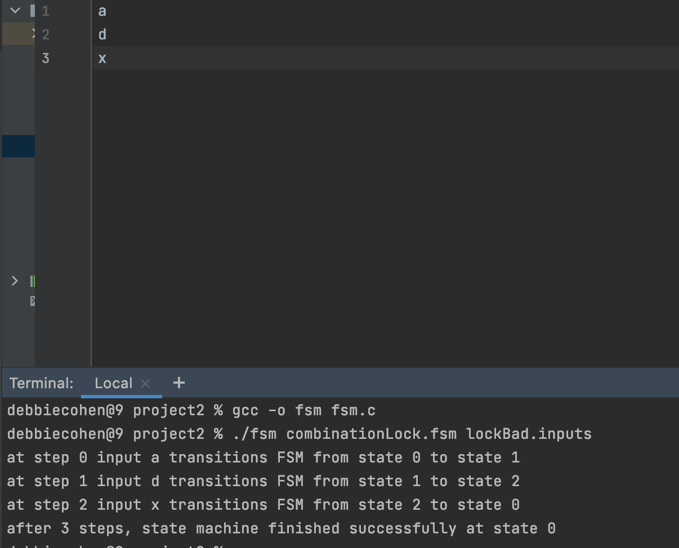
Showing execution when user enters the incorrect password
If the input password is incorrect, the machine will finish at state 0 (locked)

Slide 18
TESTS

Slide 19
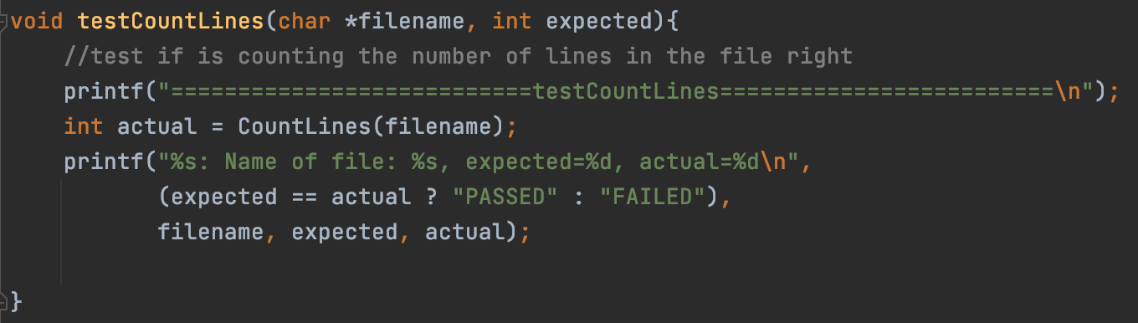
Testing CountLines(char *filename)
Note: CountLines returns either the number of lines in the file or -1 if there is an error.

Slide 20
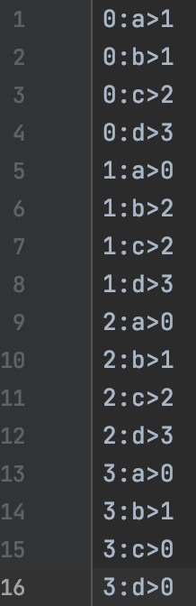
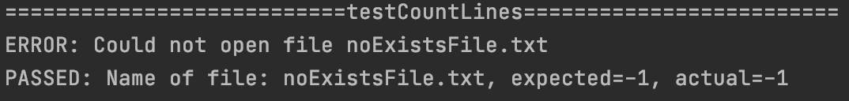
Test 1: Counting lines of existent file
Filename: test1.fsm
Test 2: Counting lines of no existent file

Slide 21
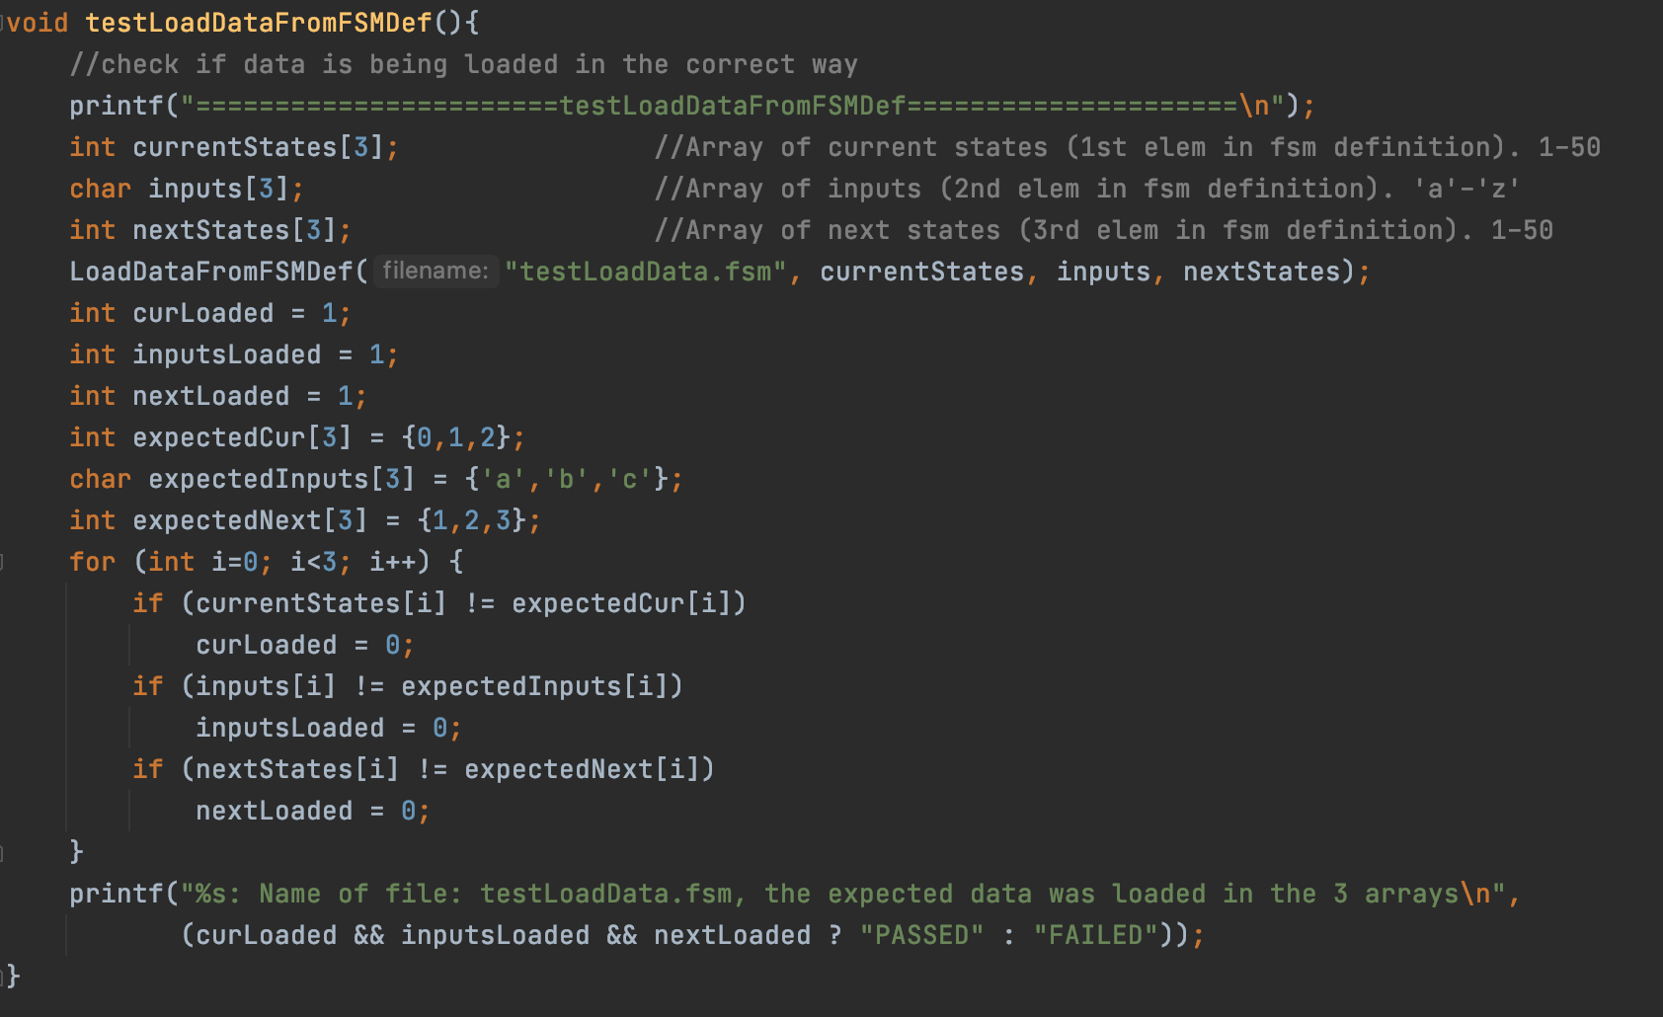
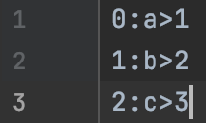
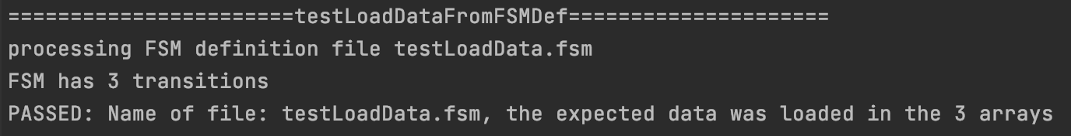
Testing if the data from the FSM definition is being Loaded in the 3 arrays
Filename: testLoadData.fsm

Slide 22
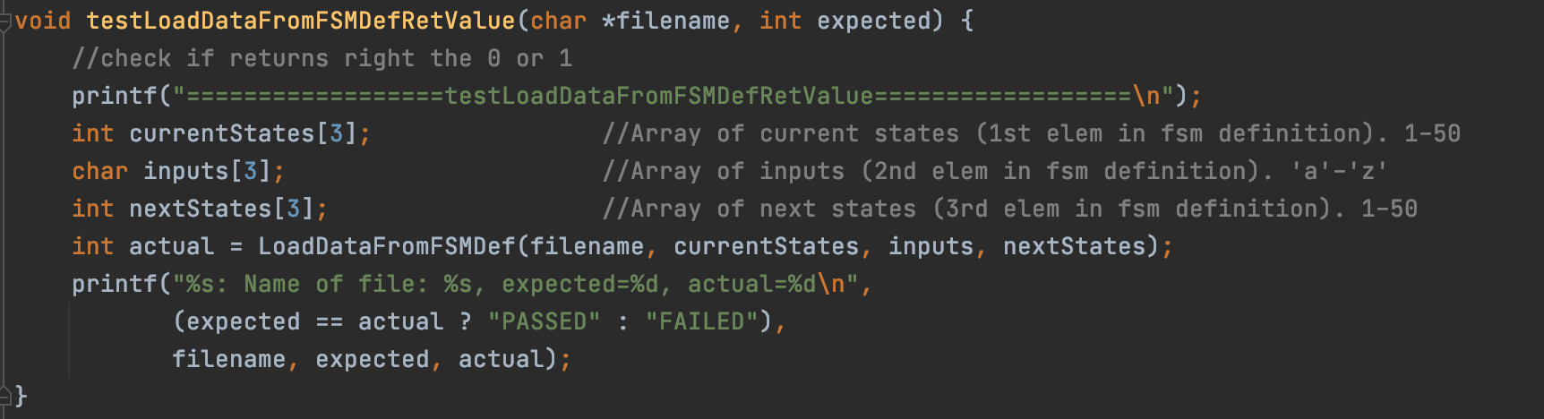
Testing if the 0 or 1 returned from LoadDataFromFSM()
Note: LoadDataFromFSM loads the arrays with the data and returns 0 if success and 1 if failure

Slide 23
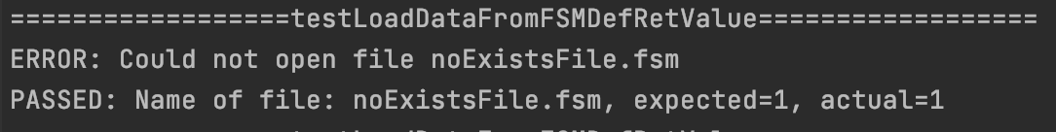
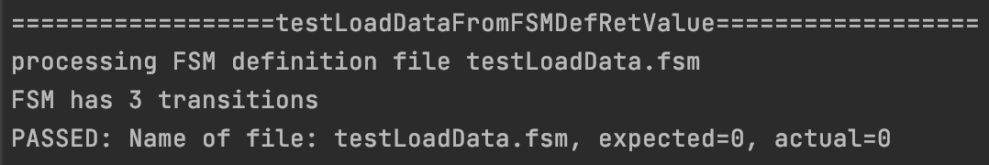
Test 1: Load data from no existent file
Should return 1 because the file doesn’t exist
Test 2: Load data from existent file

Slide 24
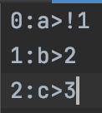
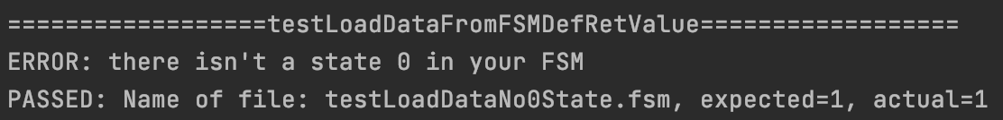
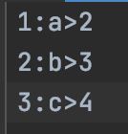
Test 3: Load data from file with error in format
Filename: testLoadDataFormatError.fsm
Test 4: Load data from file without initial state
Filename:
testLoadDataNo0State.fsm

Slide 25

Test 5: Load data from file invalid character on input
Filename:
testLoadDataInputError.fsm

Slide 26
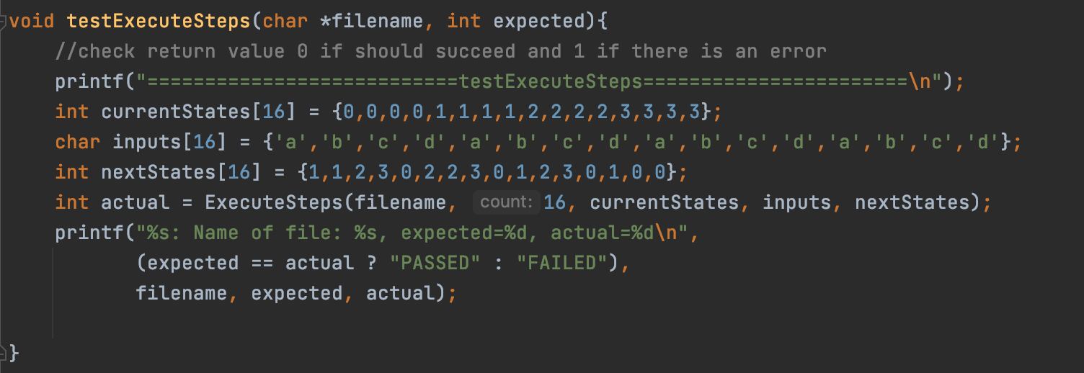
Testing the 0 or 1 returned from ExecuteSteps()
The 3 arrays are how they should look like after loading the data from the test1.fsm file
Note: ExecuteSteps returns 0 if success and 1 if failure

Slide 27
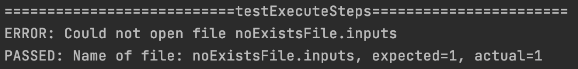

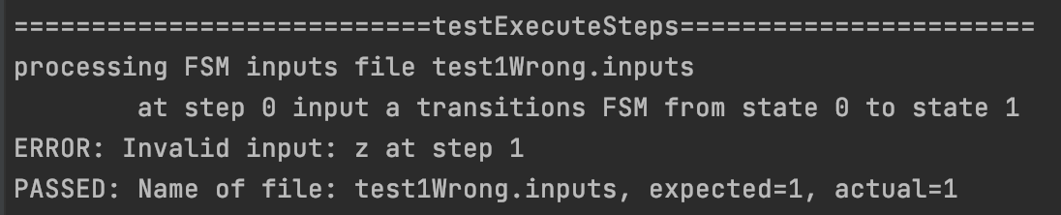
Test 1: Execute steps from no existent inputs file
Test 2: Throw error if input character doesn’t lead to any state
Filename:
test1Wrong.inputs

Slide 28

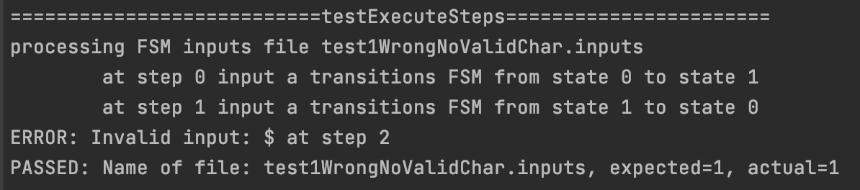
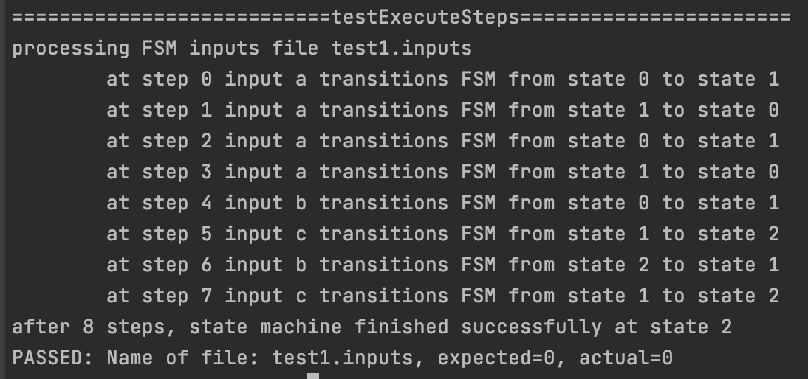
Test 3: Throw error if input character in not a character from a-z or A-Z
Filename:
test1WrongNoValidChar.inputs
Test 4: Regular execution of steps

Slide 29
Challenges
1- Oh no!! No dictionaries in C!!!
2- fgets() + regex + strtok VS fscanf

Slide 30
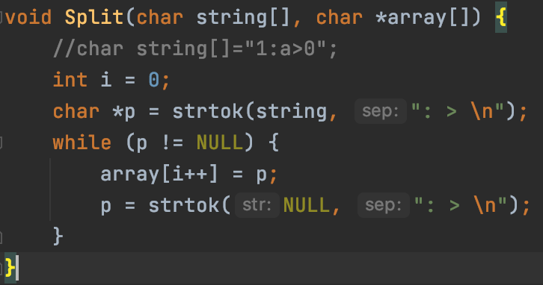
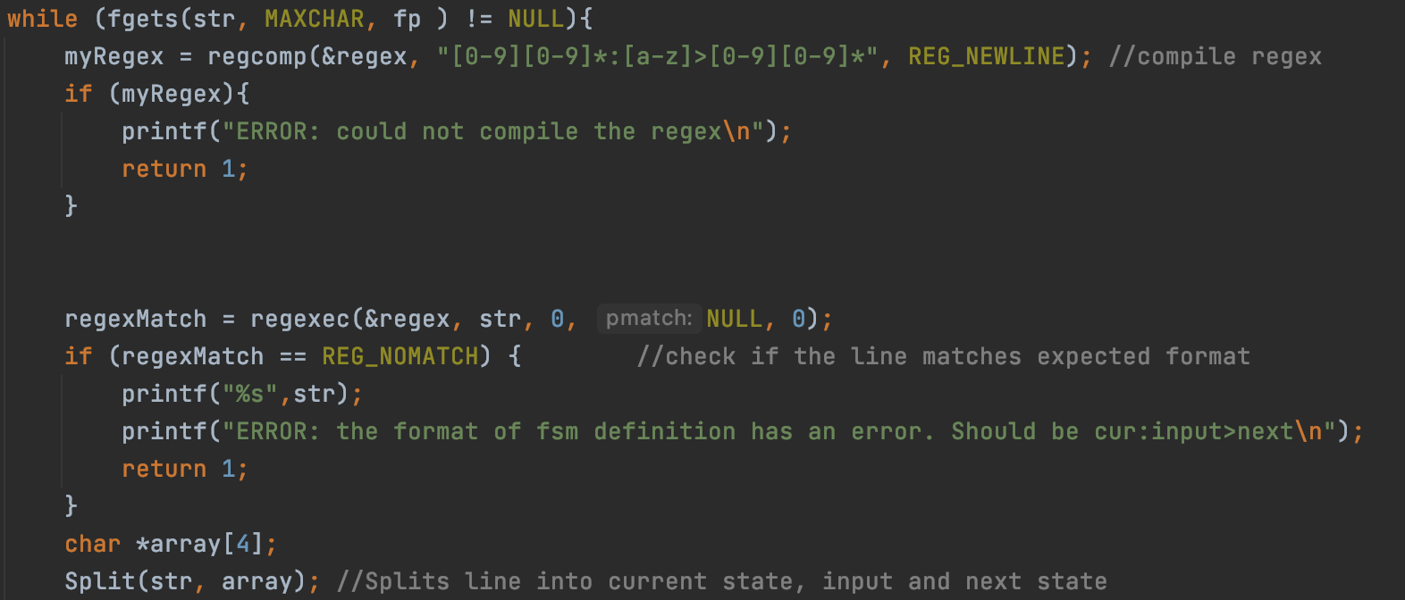
Before knowing about fscanf…

Slide 31
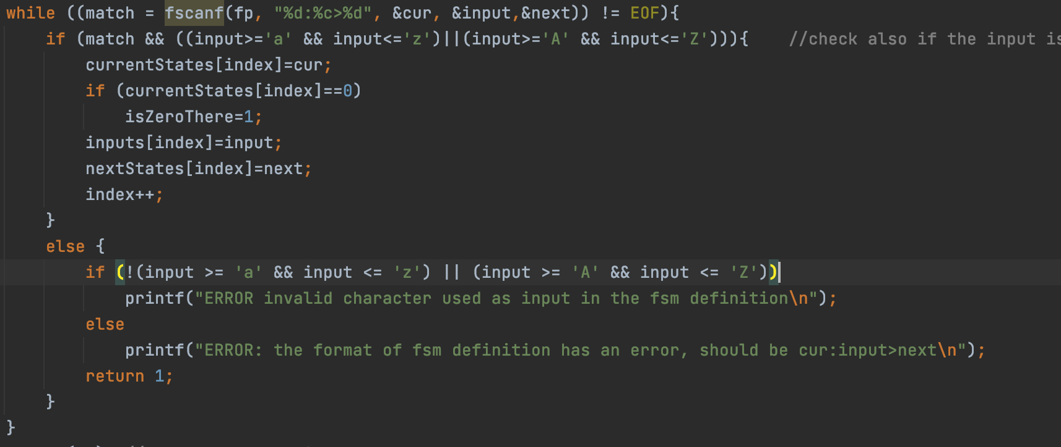
After…

Slide 32
Reflection
Really fun project to do
Real life examples
Python vs C
Many ways to do the same thing.

Slide 33

GitHub repository link
https://github.com/debbiecohen/finiteStateMachine.git

Slide 34
THANK YOU!!!
Computer Systems, Fall 2020

