Slide 1
PREDICTING CRIME IN DC
Debbie Yu | General Assembly | DAT7

Slide 2
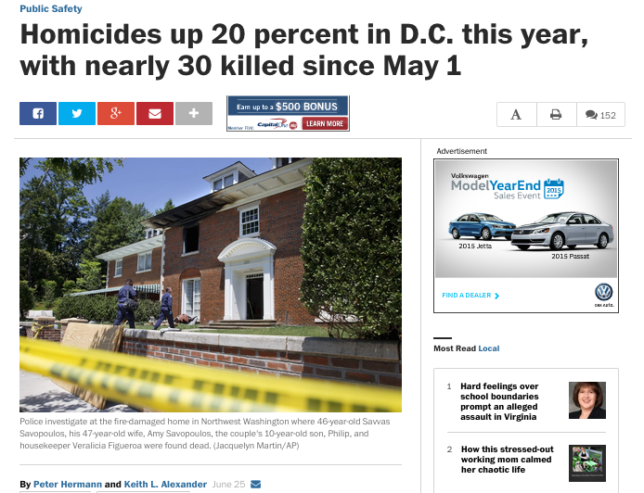
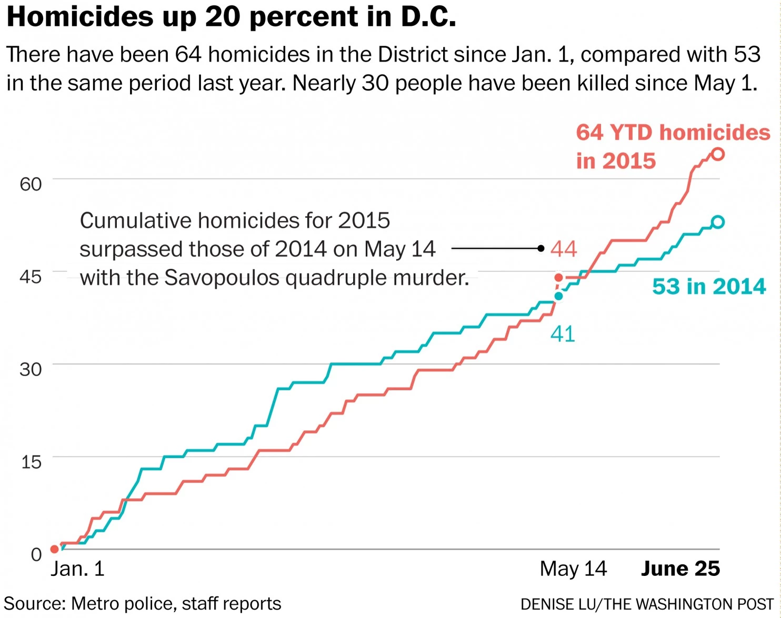
PROBLEM
While crime rates in DC have steadily decreased over the past 20 years, DC still struggles with relatively high crime rates like most major US cities.
Washington Post article from June 25, 2015:
SOURCE: http://www.washingtonpost.com/local/crime/dc-homicides-jump-20-percent-amid-a-surge-in-may-june/2015/06/25/2effd93c-1b37-11e5-93b7-5eddc056ad8a_story.html

Slide 3
QUESTION
Can I predict the types of crimes occurring in DC?
Particularly, with a focus on location in DC (e.g. neighborhood), and time of year (e.g season and months)
Data sources:
DC Crime data for 2014
DC Neighborhood data
DC Weather for 2014

Slide 4
DATA SOURCES
2014 DC Crime data
Source: DC Government Open Data portal
Shape: (38388, 21)
Rows: Crime incidents for all of 2014
21 Columns:
ccn
reportdatetime
policeshift
offense
method
lastmodifieddate
blocksiteaddress
blockxcoord
blockycoord
ward
anc
district
psa
neighborhoodcluster
businessimprovementdistrict
block_group
census_tract
voting_precinct
start_date
end_date
esri_oid
Notes:
Pretty clean

Slide 5
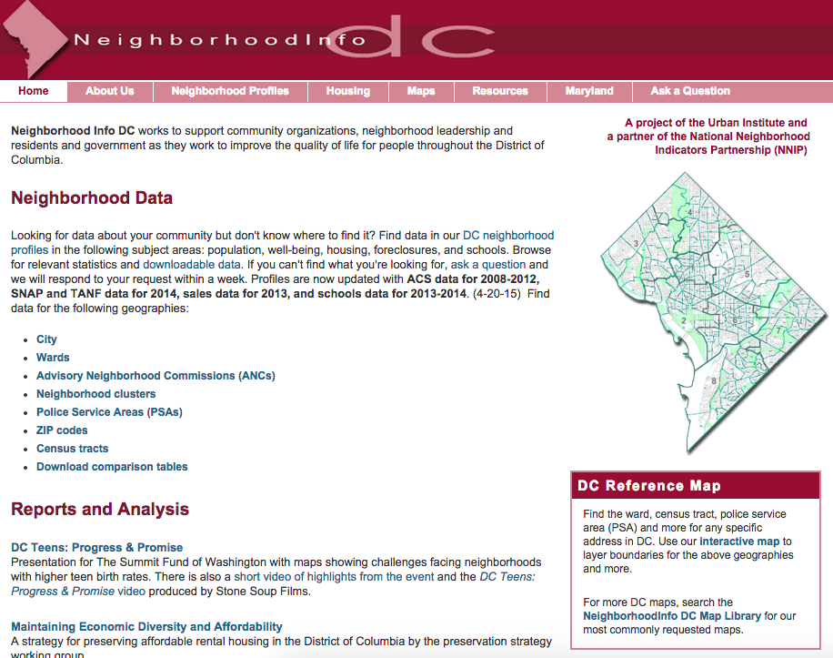
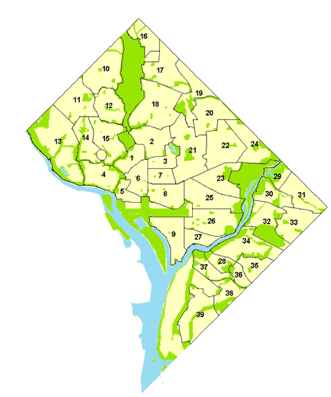
DATA SOURCES
Neighborhood Data
Data is organized by “neighborhood cluster” (groupings of 3-5 neighborhoods throughout DC)
Examples:
Cluster 8: Downtown, Chinatown, Penn Quarter, Mt. Vernon Sq, North Capitol
Cluster 26: Capitol Hill, Lincoln Park
Notes:
ABOUT THE SITE
Built by a collaboration between the Urban Institute and National Neighborhood Indicators Partnership
NNIP is a peer network that is dedicated to promoting the “democratization and use of local data for community building and decision making”
Members of this network belong to over 40 US cities
Networking members and partners have built information systems (e.g. websites, data portals, etc..) to keep updated information on neighborhood-level data in cities
Their focus is to enable city and community leaders with information about their neighborhood-level data, whic
PURPOSE OF THE SITE
Clean and store data files from DC Office of Planning, Metropolitan Police Department, Office of the CTO, Department of Human Services, Office of Income Maintenance
create indicators in standardized geographies
You can see data by Council Ward, ANC (Advisory Neighborhood Commissions – sub-divisions within wards), and Neighborhood Cluster
Neighborhood clusters – groupings of 3-5 neighborhoods throughout the city, and there 39 groupings. Clusters are used by the DC government for budgeting, planning, service delivery and analysis
Single neighborhoods aren’t used as a geographic unit because there’s a lot of debate about the boundaries of neighborhoods and those boundaries tend to change over time. While the boundaries of the clusters may move over time, these are designated by the distfct and all boundaries and changes are publicly available.

Slide 6
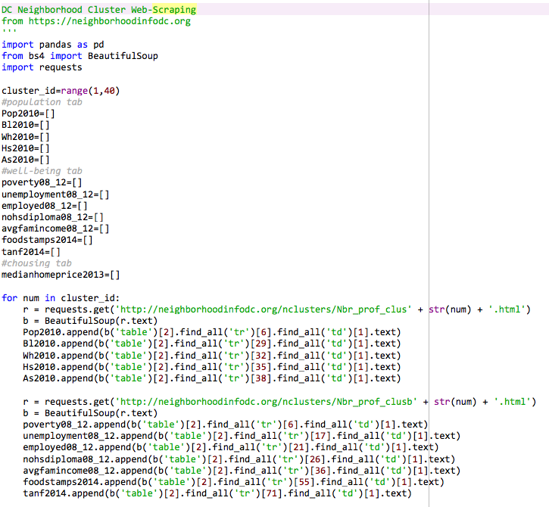
DATA SOURCES
Neighborhood Data Web Scraper
Features Scraped for each neighborhood cluster:
population 2010
%African American
%white
%hispanic
%asian
poverty_rate 2008-2012
unemployment rate 2008-2012
employment rate 2008-2012
no high school diploma 2008-2012
average family income 2008-2012
% receiving food stamps 2014
% receiving TANF 2014
Notes:
TANF: https://en.wikipedia.org/wiki/Temporary_Assistance_for_Needy_Families

Slide 7
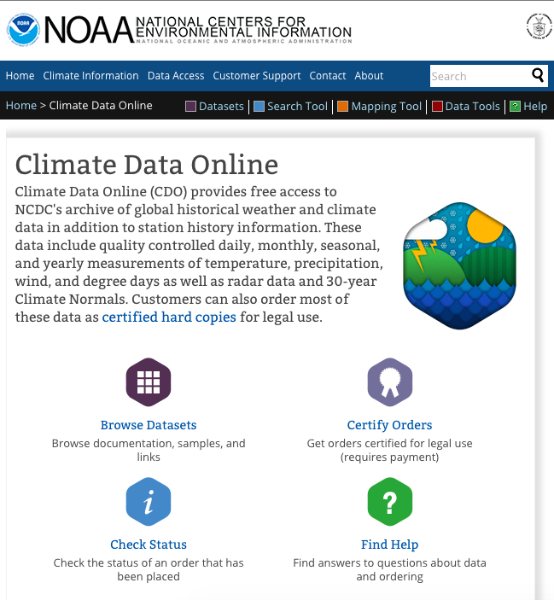
DATA SOURCES
DC Weather for 2014 from NOAA
Retrieved csv file of daily temperature recordings for DC weather stations in 2014
Reagan National Airport weather station
Features:
Date
Max Temp
Min Temp
Snow
Rain
Notes:
TANF: https://en.wikipedia.org/wiki/Temporary_Assistance_for_Needy_Families

Slide 8
DATA EXPLORATION
Accomplishments:
Data cleaned for DC Government Data
File was relatively complete; with 38k rows there were 500 missing rows
Converted all datatypes/formatting
Data cleaned for web-scraped data
Learned how to scrape data from tables on different pages
Very few missing values for neighborhoods
Converted all datatypes
2 dataframes have been merged (crime data and neighborhood info)
Rudimentary data visualization
Some challenges with visualization; issues with seaborn,
Seemingly simple visualizations seem to require many lines of code in matplotlib
Notes:
TANF: https://en.wikipedia.org/wiki/Temporary_Assistance_for_Needy_Families

Slide 9
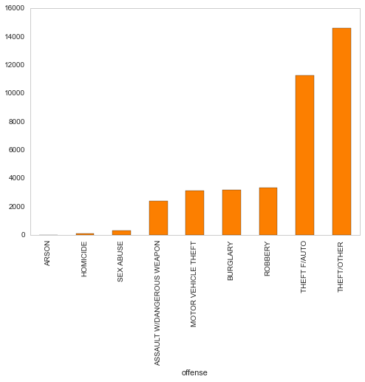
DISTRIBUTION OF CRIME TYPES IN DC
Crime Type | Count
Theft/Other | 14628
Theft F/Auto | 11286
Robbery | 3333
Buglary | 3184
Motor Vehicle Theft | 3118
Assault w/Dangerous Weapon | 2398
Sex Abuse | 309
Homicide | 106
Arson | 26
Notes:
Theft/Other: A broad inclusion of Theft offenses including embezzlement, theft of services and fraud/false pretenses. The Theft/Other category excludes theft of items from a motor vehicle or the motor vehicle itself.
Would be interesting to remove theft/other
Would I need separate models for violent crimes (exclusing theft/other)

Slide 10
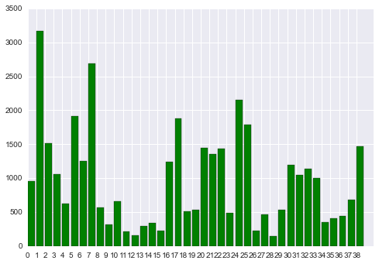
TOTAL # OF OFFENSES BY NEIGHBORHOOD CLUSTER
Notes:
Will be interesting how this will be relative to the size of the neighborhood clusters & population density

Slide 11
DATA EXPLORATION
Next steps:
Need to clean weather data/get temp question answered
Some basic visualization completed; need more
Exploring time series data
Prioritizing features to include in the model
Not sure if I have time to include other features
Prioritizing types of visualizations
Time series
Maps
Modeling! (not started yet)

