Slide 1




Case Study: Fashion E-Commerce Digital
Marketing Analysis
Presented by:
Email:
Dsarea Data Analytics & Visualization
Debby R. Malik
debbymalik21@gmail.com

Slide 2
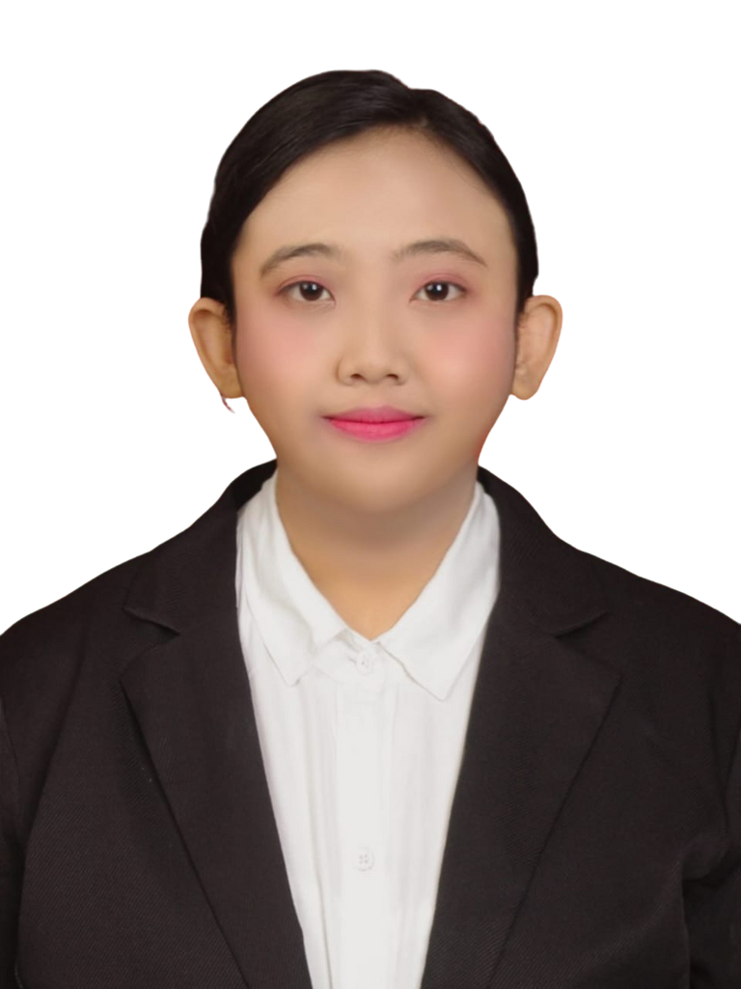



DEBBY ROFIKO MALIK
Data Enthusiast
A highly adaptable Biomedical Engineering graduate from Universitas Indonesia with strong analytical skills and solid problem-solving abilities. Experienced in turning raw data into clear, actionable insights using Excel, SQL, and Looker Studio. A fast learner with a firm belief in the value of data for informed decision-making and sustainable growth, committed to continuous learning and delivering effective data-driven solutions.
West Jakarta
debbymalik21@gmail.com
Debby Rofiko Malik

Slide 3



Courses & Certifications
Data Analytics & Visualization
Bootcamp
| Link Certificate
(November, 2025)
Data Science & Data Analysis
| Link Certificate
(October, 2025)
Machine Learning with Python
| Link Certificate
(June, 2024)

Slide 4
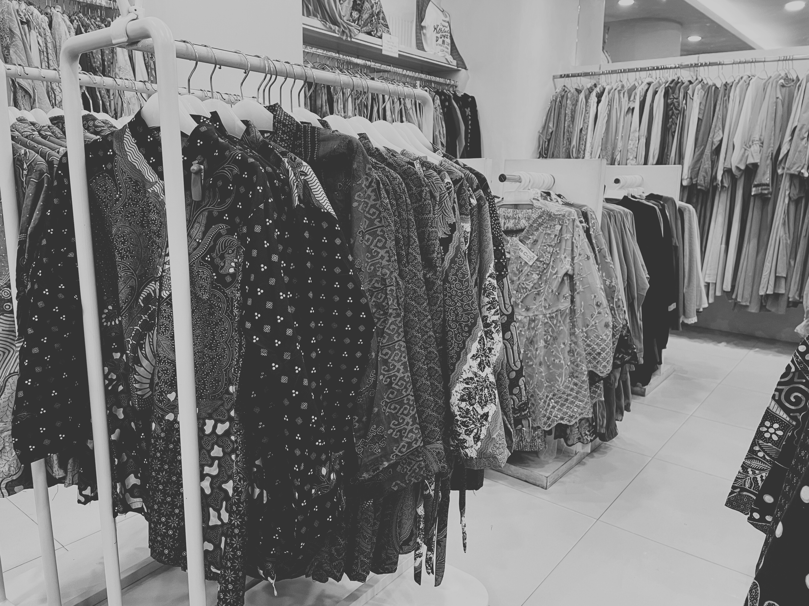
Case Study: Background
This month, the Conversion Rate (CR) on the website and digital platforms of XYZ, a fashion e-commerce company, declined by 2% compared to the previous month. This drop raises concerns as it may reduce revenue and weaken the effectiveness of ongoing marketing campaigns.
At the request of the executive team, the marketing team needs to analyze the root causes of this decline and design strategies to increase the conversion rate by 3% within the next three months, focusing on website user experience optimization, social media engagement, and the effectiveness of digital advertising.

Slide 5
Main Objective Questions
Objectives
1
Which marketing factors or channels contributed most to the decline in Conversion Rate (CR)?
1
Increase the Conversion Rate (CR) by 3% within three months.
2
How does user behavior on the website and social media influence their purchase decisions?
2
Identify the key factors and marketing channels influencing CR.
3
What strategies or optimizations can be implemented to increase the CR in the next three months?
3
Understand visitor behavior across the website and social media platforms.

Slide 6
Data Definition
Column Name | Definition
User_ID | Unique ID of the visitor
Location | City or province of the visitor
Visit | Number of visits to the website
Session_Duration | Duration of the website session (in minutes)
Product_Category | Product category viewed

Slide 7
Data Definition
Column Name | Definition
Product_Page_Views | Number of product pages viewed
Ads_Name | Name of the advertisement or ad campaign
Transaction_date | Date the customer made a purchase
Impressions | Number of ad impressions
Clicks | Number of ad clicks

Slide 8
Data Definition
Column Name | Definition
Engagement | Number of interactions (likes + comments + shares)
Purchase | Purchase status (Yes/No)
Transaction_Amount | Transaction value (in currency)
Repeat_Customer | Returning customer status (Yes/No)
Awareness: Impressions, Reach Rate
Interest: Session_Duration, Engagement, CTR
Desire: Product_Page_Views
Action: Conversion_Rate, Transaction_Amount (AOV)

Slide 9
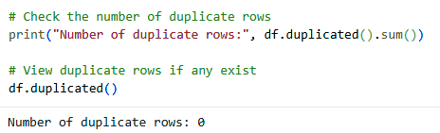
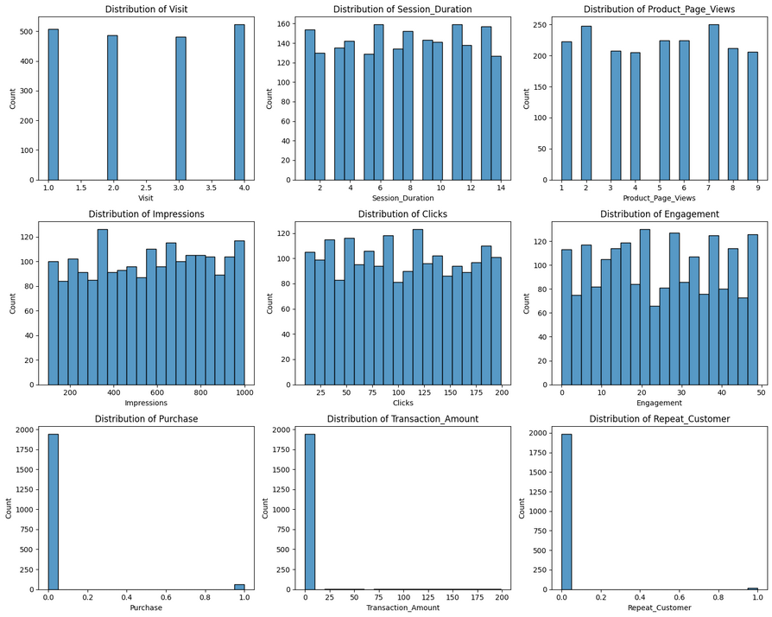
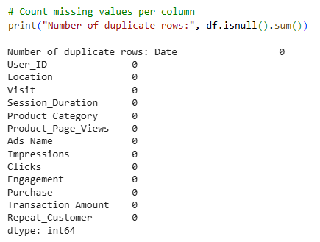
Data Sanity Check
Q1: Are there any duplicates or missing values?
Q2: Are there any unreasonable data distributions?
Tools: Python
The distribution of key behavioral metrics (Visit, Session Duration, Product Page Views, Impressions, Clicks, and Engagement) appears stable and well-balanced across realistic value ranges, indicating consistent data capture with no visible anomalies such as extreme spikes, gaps, or distorted patterns.
Purchase and Repeat_Customer appropriately show a strong dominance of non-conversion values (0), which aligns with typical e-commerce behavior where only a smaller portion of users actually convert or return.
Meanwhile, Transaction_Amount exhibits a right-skewed pattern, reflecting the natural tendency for most transactions to occur at lower values, with fewer high-value purchases.
Overall, the dataset is ready for the next analytical stage.
NO DUPLICATE
NO MISSING VALUES

Slide 10
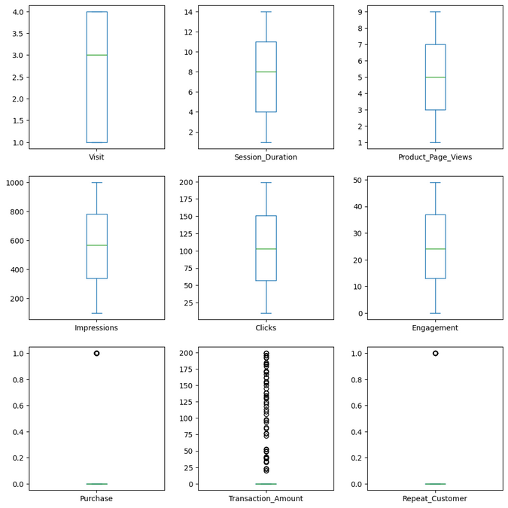
Data Sanity Check
Q3: Are there any outliers?
Tools: Python
The boxplots for the main behavioral metrics (Session Duration, Product Page Views, Impressions, Clicks, and Engagement) show no visible outliers.
Transaction_Amount is the only variable that displays several high-end outliers. This pattern is expected in an e-commerce context, where a small proportion of customers accounts for disproportionately high transaction values. These extreme observations are therefore informative rather than problematic, as they may be linked to high-impact campaigns, premium customer segments, or bulk purchases. Removing them would risk eliminating meaningful business insights.
The binary variables (Purchase and Repeat_Customer) show a strong class imbalance dominated by the value 0. This distribution accurately reflects a realistic business/marketing funnel, in which most visitors do not convert or become repeat customers. The isolated values of 1 in the boxplot are not anomalies but represent successful conversion and retention events, making these variables critical indicators of campaign effectiveness and overall customer journey performance.

Slide 11
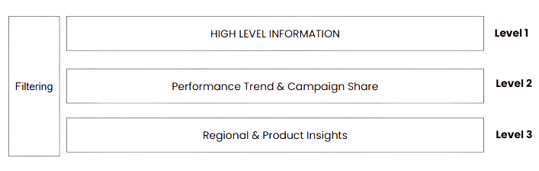
Dashboard Layout Design
Stakeholder: Executive Management

Slide 12
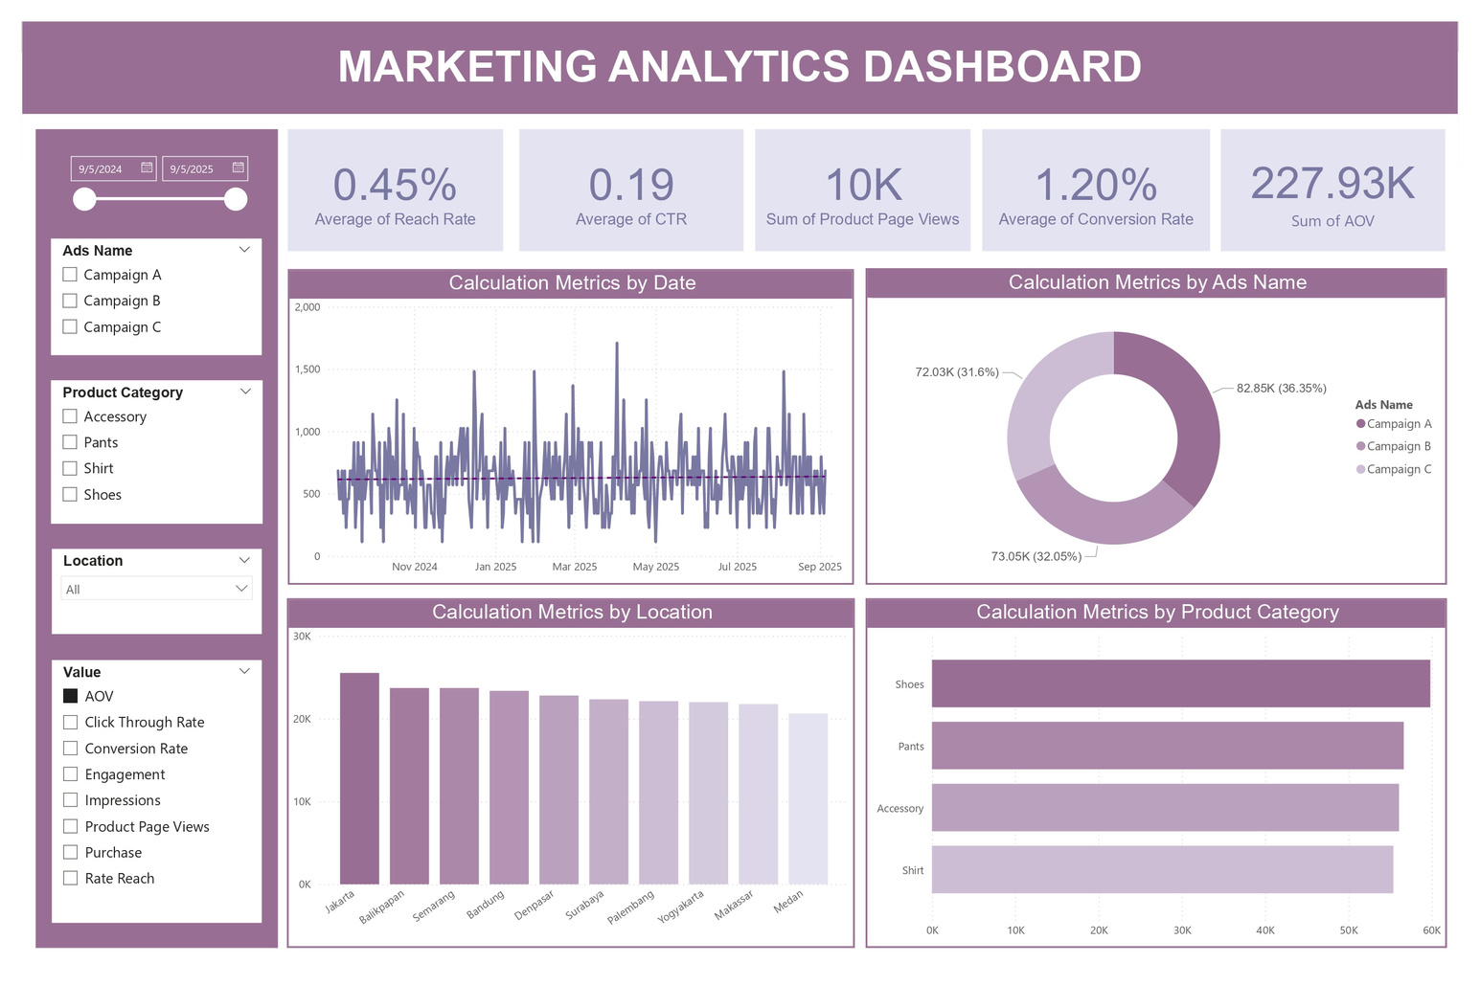
Marketing Analytics Dashboard
Tools: Power BI

Slide 13

Q1: Which marketing factors or channels contributed most to the decline in Conversion Rate (CR)?

Slide 14
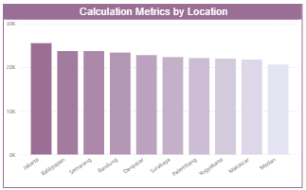
Q1: Which marketing factors or channels contributed most to the decline in Conversion Rate (CR)?
1
Deep Analysis - Location
Location | Reach Rate | CTR | Engage- ment | Impres- sion | Product Page View | Conver. Rate | AOV | Purchase
Balikpapan | 0.44 | 17.95 | 24.35 | 5.06K | 4.68 | 0.78 | 23.70K | 208
Bandung | 0.45 | 18.81 | 24.18 | 4.96K | 4.68 | 0.19 | 23.36K | 205
Jakarta | 0.46 | 18.99 | 24.37 | 5.46K | 4.88 | 1.56 | 25.53K | 224
Makassar | 0.42 | 18.13 | 25.30 | 4.83K | 5.13 | 1.50 | 21.76K | 191
Medan | 0.42 | 18.31 | 23.70 | 4.29K | 5.19 | 1.39 | 20.67K | 181
Palembang | 0.45 | 19.14 | 24.35 | 4.72K | 5.12 | 1.84 | 22.10K | 194

Slide 15
Location | Reach Rate | CTR | Engage- ment | Impres- sion | Product Page View | Conver. Rate | AOV | Purchase
Semarang | 0.49 | 18.47 | 26.15 | 5.44K | 5.16 | 0.57 | 23.70K | 208
Surabaya | 0.46 | 19.22 | 25.23 | 4.95K | 5.11 | 2.17 | 22.33K | 196
Yogyakarta | 0.47 | 18.66 | 24.24 | 4.68K | 4.70 | 1.25 | 21.99K | 193
Denpasar | 0.43 | 17.69 | 22.82 | 4.56K | 5.04 | 0.77 | 22.79K | 200
Reach Rate: The averages in Denpasar (0.43), Makassar (0.42), and Medan (0.42) are the lowest.
Engagement: Denpasar’s average (22.82) is the lowest compared to the other cities (24).
CTR: The averages in Balikpapan (17.95%) and Denpasar (17.69%) are the lowest.
Impression: Medan (4.29k) has the lowest number
Product Page View: The averages in Yogyakarta (4.70), Balikpapan (4.68), and Bandung (4.68) are the lowest.
Purchase: Medan (181) has the lowest number.
AOV: Medan (20.67K) is the lowest.
Conversion Rate: The averages in Balikpapan (0.78%), Denpasar (0.77%), Semarang (0.57%), and Bandung (0.19%) are the lowest.

Slide 16
Summary
Several cities show low performance across almost all metrics, particularly Medan (Reach Rate, Impressions, Purchase, and AOV) and Denpasar (Reach Rate, Engagement, CTR, and Conversion Rate). Other cities, such as Bandung and Balikpapan, also show low scores in Product Page Views and Conversion Rate.
Recommendation
Makassar and Medan: Run bundling and discount offers to increase purchase intent, launch awareness campaigns to drive initial traffic, provide product education (such as short-form videos) to encourage clicks to product pages, and activate seasonal promotions to accelerate purchases.
Denpasar: Increase engagement through creative content and loyalty programs. You may also implement bundling, discounts, and awareness campaigns to broaden traffic reach.
Bandung, Balikpapan, Yogyakarta: Optimize product pages (images, descriptions, ratings, trust badges), offer limited-time promotions to encourage purchases, and enhance product recommendations.
Balikpapan and Denpasar: Conduct retargeting and A/B testing on ads to improve CTR.

Slide 17
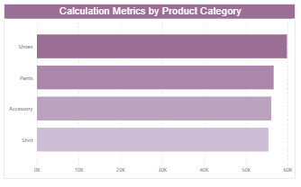
Q1: Which marketing factors or channels contributed most to the decline in Conversion Rate (CR)?
2
Deep Analysis - Product
Location | Reach Rate | CTR | Engage- ment | Impres- sion | Product Page View | Conver. Rate | AOV | Purchase
Shoes | 0.45 | 18.14 | 24.27 | 12.74K | 5.02 | 1.27 | 59.83K | 525
Pants | 0.45 | 19.40 | 24.60 | 12.23K | 4.90 | 1.14 | 56.64K | 497
Accessory | 0.43 | 17.84 | 24.35 | 11.98K | 4.99 | 1.13 | 56.07K | 492
Shirt | 0.46 | 18.84 | 24.69 | 12.00K | 4.93 | 1.24 | 55.38K | 486

Slide 18
Reach Rate: Accessories have the lowest average (0.43).
Engagement: Shoes have the lowest average (24.27).
CTR: Accessories (17.84%) and Shoes (18.14%) show the lowest averages.
Impression: Accessories (11.98K) and Shirts (12.00K) are the lowest.
Product Page View: Shirts and Pants have the lowest average (4.9).
Purchase: Shirts have the lowest purchase count (486).
AOV: Shirts have the lowest average order value (55.38K).
Conversion Rate: Pants (1.14%) and Accessories (1.13%) show the lowest averages.
Summary
Several product categories show low performance across multiple metrics. Accessories have low reach rate and CTR, Shoes have low engagement and CTR, Shirts have low impressions, product page views, purchases, and AOV, while Pants and Accessories have low conversion rates.
Recommendation
Accessories: Run awareness campaigns to increase visibility, implement bunding or special discounts to attract initial interest, and improve CTR through retargeting and more compelling ad creatives.
Shirts: Launch awareness campaigns and discount-based promotions to boost traffic, optimize product pages (images, description, ratings, trust elements), apply sales strategies such as upselling, cross-selling, or limited-time promotions to drive conversion.
Shoes: Increase engagement through interactive content, user reviews, and loyalty programs, as well as retargeting and creative ad variations to reach more qualified audiences.
Pants: Focus on product page optimization to address low conversion and apply sales-driving strategies such as limited-time offers, upselling, or product recommendations.

Slide 19
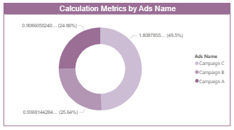
Q1: Which marketing factors or channels contributed most to the decline in Conversion Rate (CR)?
3
Deep Analysis - Ads
Accessory
CTR: Campaign A (32.08%) , Campaign B (36.4%), dan Campaign C (31.52%)
Rate Reach: Campaign A (33.94%) , Campaign B (33.41%), dan Campaign C (32.64%)
Pants
CTR: Campaign A (34.91%) , Campaign B (34.15%), dan Campaign C (30.94%)
Rate Reach: Campaign A (35.99%) , Campaign B (33.41%), dan Campaign C (30.6%)
Shirt
CTR: Campaign A (34.92%) , Campaign B (31.48%), dan Campaign C (33.61%)
Rate Reach: Campaign A (33.06%) , Campaign B (34.3%), dan Campaign C (32.63%)
Shoes
CTR: Campaign A (32.5%) , Campaign B (33.54%), dan Campaign C (33.96%)
Rate Reach: Campaign A (32.89%) , Campaign B (33.57%), dan Campaign C (33.54%)

Slide 20
Summary
Overall, Campaigns B and C show lower CTR and Reach Rate compared to Campaign A in several categories. Campaign C performs the lowest in Accessories and Pants, while Campaign B underperforms in Shirts. Meanwhile, Shoes remain stable, indicating consistent ad performance.
Recommendation
Campaign C (Accessories & Pants): Implement bundling offers or flash sales to boost conversions.
Campaign B (Shirts): Strengthen targeting and enhance creative content.
Campaign Shoes: Maintain the current strategy and focus on customer loyalty.
Low CTR: Use exclusive promotions or apply retargeting strategies.

Slide 21
Q2: How does user behavior on the website and social media influence their purchase decisions?

Slide 22
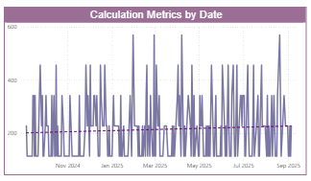
Q1: How does user behavior on the website and social media influence their purchase decisions?
4
Deep Analysis - Trend Line
Location | CTR | Purchase | Product Page View
Balikpapan | Menurun | Flat | Meningkat
Bandung | Flat | Flat | Meningkat
Denpasar | Meningkat | Meningkat | Flat
Jakarta | Meningkat | Menurun | Meningkat
Makassar | Meningkat | Flat | Menurun
Medan | Meningkat | Flat | Menurun

Slide 23
Location | CTR | Purchase | Product Page View
Palembang | Menurun | Meningkat | Meningkat
Semarang | Menurun | Meningkat | Meningkat
Surabaya | Flat | Menurun | Flat
Yogyakarta | Meningkat | Menurun | Menurun
Summary
Based on the data by location, the trends vary across regions. Denpasar shows positive performance with increases in CTR and Purchases. In Jakarta, clicks and page views are rising, but Purchases are declining, indicating possible issues during checkout or pricing. Balikpapan and Bandung show high interest, yet Purchases remain stagnant. Makassar and Medan see an increase in clicks but a decrease in page views. Palembang and Semarang experience rising Purchases despite lower CTR, while Surabaya and Yogyakarta show a downward trend in Purchases.
Recommendation
Balikpapan, Bandung, Makassar, Medan: Improve conversion by optimizing the checkout process, offering product bundles, running limited-time promotions, and enhancing product page quality.
Jakarta: Review pricing, implement strategic discounts or time-limited promotions, and improve the user experience on the checkout page to turn clicks into purchases.

Slide 24
Q3: What strategies or optimizations can be implemented to increase the CR in the next three months?

Slide 25
Q3: What strategies or optimizations can be implemented to increase the CR in the next three months?
Target: Increase the conversion rate by +3% (e.g., from 2% to 5%)
The approach combines technical funnel improvements, segmented marketing campaigns, and A/B testing experiments, with strategies prioritized based on effort versus impact.
Priority Actions
1
Product Page Optimization (+1.0% CR)
3
Retargeting & Creative Ads (+0.5% CR)
Focus on Shirt, Pants, and Accessory products. Improvements include larger product photos, bullet-point benefits, customer reviews, stock/limited-time urgency cues, clear purchase buttons, and cross-sell modules. Conduct A/B testing with trust badges and one-click buy to measure their effect on conversion from product page to checkout.
Focus on Campaign B (Shirt) and Campaign C (Accessory & Pants). Use dynamic retargeting, creative testing (video vs carousel), tailored CTAs, and email nurture for abandoned carts. Key metric: conversion rate from retargeted traffic vs control.
4
Bundling / Limited-Time Promos & Flash Sales (+0.4% CR)
2
Checkout & Friction Removal (+0.8% CR)
Focus on Jakarta, where clicks are high but purchases are declining. Improvements include simplifying forms, enabling guest checkout, adding a progress bar, auto-fill features, improved error messages, and real-time validation. Run A/B tests comparing the old checkout flow vs the optimized version. Key metrics: checkout conversion and cart abandonment rate.
Apply bundling for Accessories and Shirts, and run flash sales in Medan, Makassar, and Denpasar. This strategy increases AOV while simultaneously boosting conversions by enhancing perceived value.
5
Content & Social Engagement (+0.3% CR)
Focus on Denpasar and the Shoes category. Create interactive content such as user-created posts and review videos, and offer loyalty perks. These efforts are expected to increase engagement, improve click-through rates, and ultimately contribute to higher conversions.

Slide 26
Q3: What strategies or optimizations can be implemented to increase the CR in the next three months?
3-Month Plan
Month 1
Optimize the product page and checkout flow, and set up retargeting audiences.
Month 3
Scale the most effective channels, run final A/B tests on pricing or discounts, and compile the overall results.
01
03
Month 0 (Week 1)
Conduct a funnel audit, set up tracking, and run CTA and guest checkout experiments.
Month 2
Evaluate and scale winning A/B tests, launch bundling and flash sale initiatives, and intensify retargeting efforts.
00
02

Slide 27
Q3: What strategies or optimizations can be implemented to increase the CR in the next three months?
Experiment & Measurement
Hypothesis: Adding reviews and a trust badge will increase the conversion rate from the product page to checkout by 20%.
Unit: Organic visitors and paid traffic
Metric: Conversion rate from the product page to checkout.
Duration: At least 2 weeks, with a stop rule of p < 0.05 and a minimum of 7 days to account for weekday and weekend cycles.
Funnel Metrics: impressions → CTR → page view → add to cart → checkout → purchase.
Attribution: measured using UTM parameters combined with a last-non-direct attribution model, along with a pre/post cohort analysis
Technical Quick Wins
1
Improve Page Speed to Under 3 Seconds
2
Optimize Mobile UX (CTA Thumb Reach, Sticky Add-to-Cart)
3
Enable One-Click Guest Checkout
Ensure the website or product page loads quickly, especially on mobile.
Slow pages cause visitors to leave the site, which leads to lower conversion rates.
The “Buy” button or any CTA should be easy to reach with the thumb on mobile screens.
“Sticky add-to-cart” means the purchase button stays visible even while scrolling down the page.
Visitors should be able to purchase without creating an account.
This reduces checkout friction and increases the number of completed purchases.

Slide 28
Technical Quick Wins
4
Set Up an Abandoned Cart Email Sequence
5
Retargeting Dynamic Ads
6
Tweak Creatives for Campaigns B & C
Send automated emails when visitors add a product to the cart but do not complete the purchase.
Emails can be sent after 1 hour, 24 hours, and 72 hours to remind them to finish the checkout.
Ads that reappear for visitors who viewed a product but did not buy.
These ads can show the same product or similar recommendations to increase the chance of conversion.
Adjust ad content (images, videos, CTAs) or audience targeting to improve CTR and conversion rate.

Slide 29
Q3: What strategies or optimizations can be implemented to increase the CR in the next three months?
Monitoring & Interim Targets
Monitor the weekly delta in conversion rate both overall and by city. The interim targets are: +1% by the end of Month 1, +2% by Month 2, and +3% by Month 3. If the targets are not met, scale up the channels that deliver the highest lift.
Specific Recommendations
Medan & Makassar: Implement flash sales and retargeting campaigns.
Denpasar: Use interactive content and loyalty initiatives.
Jakarta: Conduct a pricing and checkout audit.
Accessories & Shirts: Focus on awareness campaigns, bundling offers, and product page optimization.
Campaign C: Bundle Accessories & Pants and measure the post-promo conversion rate.

Slide 30
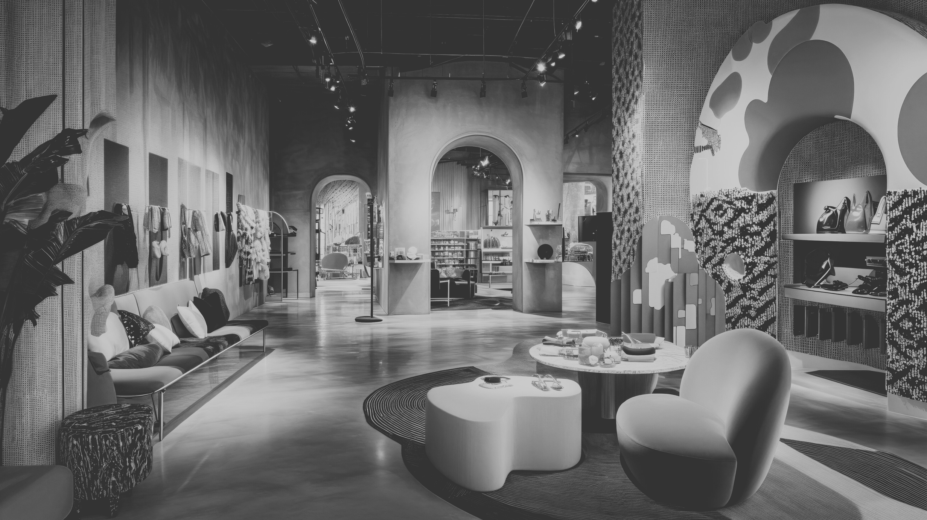


Thank You!
Github
Power BI

