Slide 1
Ensembling Downstream Image Classification Models Pretrained on Self-Supervised Models
Bradley Wheeler, Debdas Ghosh, Lingrui Ouyang

Slide 2
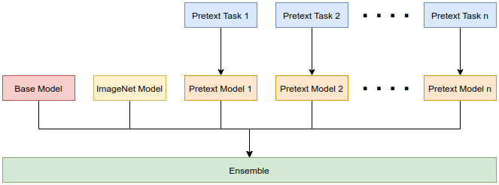
Refresher
Pretext Training
Rotation
Relative position
Jigsaw puzzle
Downstream training
Baseline model
Pretrained: ImageNet
Pretrained: Pretext
Ensembling
Majority voting
Softmax weighting

Slide 3




Pretext Training

Slide 4
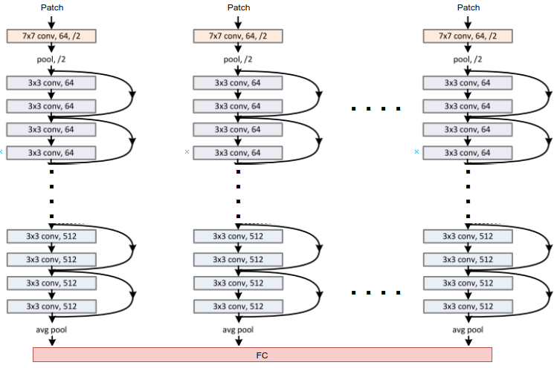
Pretext Architecture

Slide 5
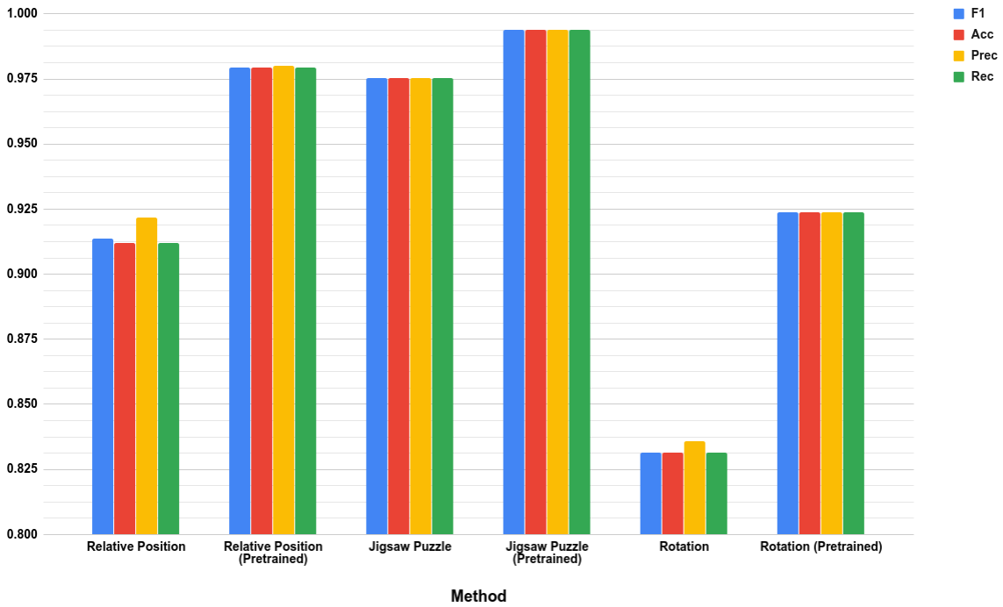
Pretext Performance
Three Pretext tasks (i.e. Relative Position, Jigsaw Puzzle and Rotation) are trained two times each:
With ImageNet pretrained weights
Without any pretraining
Total 6 Pretext Models

Slide 6
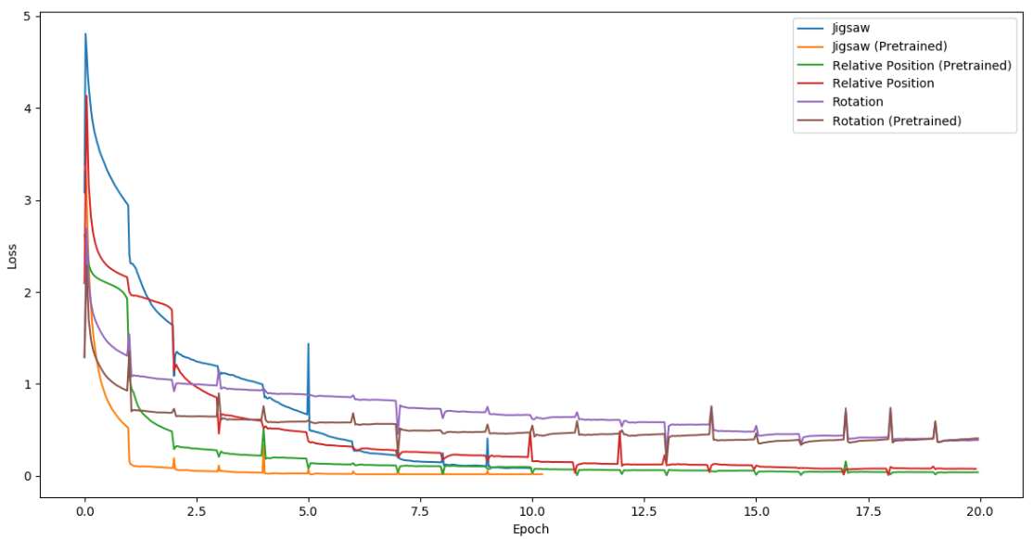
Pretext Loss

Slide 7
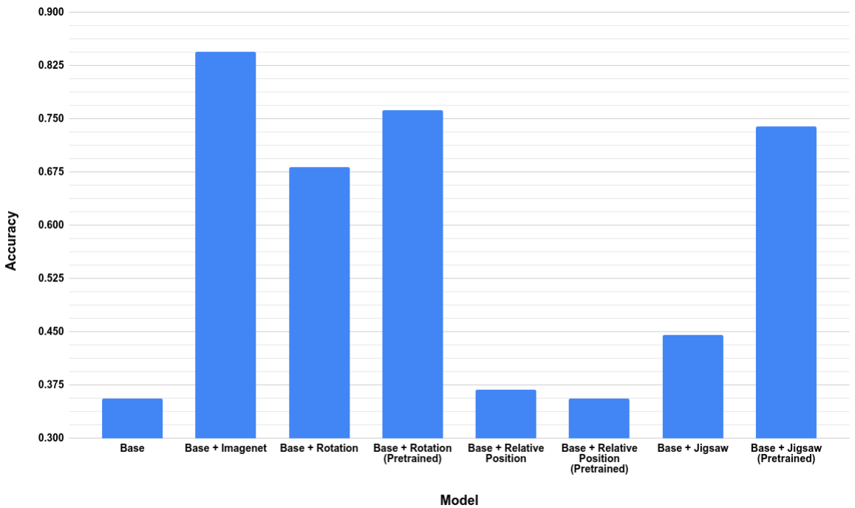
Downstream Classification Performance (NEW)
Base Classification Model is ResNet50.
Vanilla ResNet50 Classification Model has accuracy 0.8449 with ImageNet pretraining and has accuracy 0.3556 without pretraining on CIFAR10 dataset. (2 Models)
Code Snippet for Downstream Tasks with Pretext weights (6 Models):
res_net = models.resnet50(pretrained=False)
res_net.fc = nn.Linear(XXXX, XX)
state_dict = torch.load(PretextModelWeight.pth) #6 different PretextModelWeight.pth
res_net.load_state_dict(state_dict['state_dict'])
res_net.fc = nn.Linear(XXXX, len(classes))
Total 2+6=8 Downstream Models

Slide 8
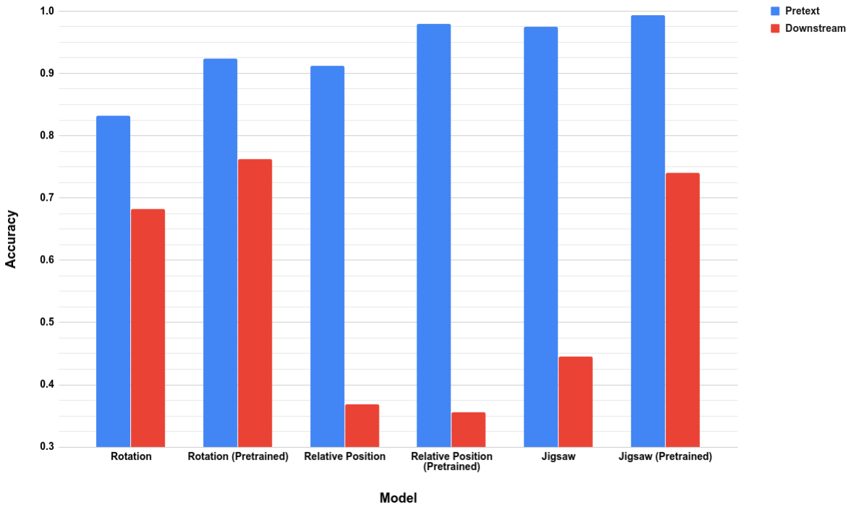
Pretext vs. Downstream Performance (NEW)
Downstream Models are Classification Models using Pretext Model’s weights.
Whereas Pretext Models are specific to each Pretext Tasks (i.e. Rotation, Relative Position and Jigsaw)

Slide 9
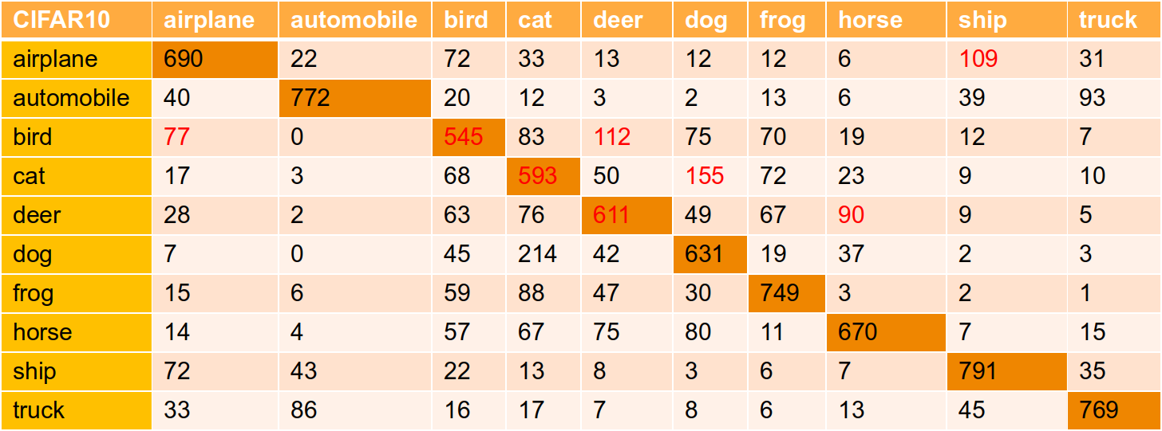
Confusion Matrix of Rotation Downstream

Slide 10
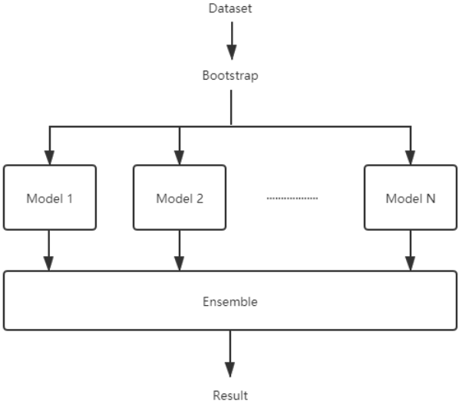
Ensemble Learning: Bagging

Slide 11
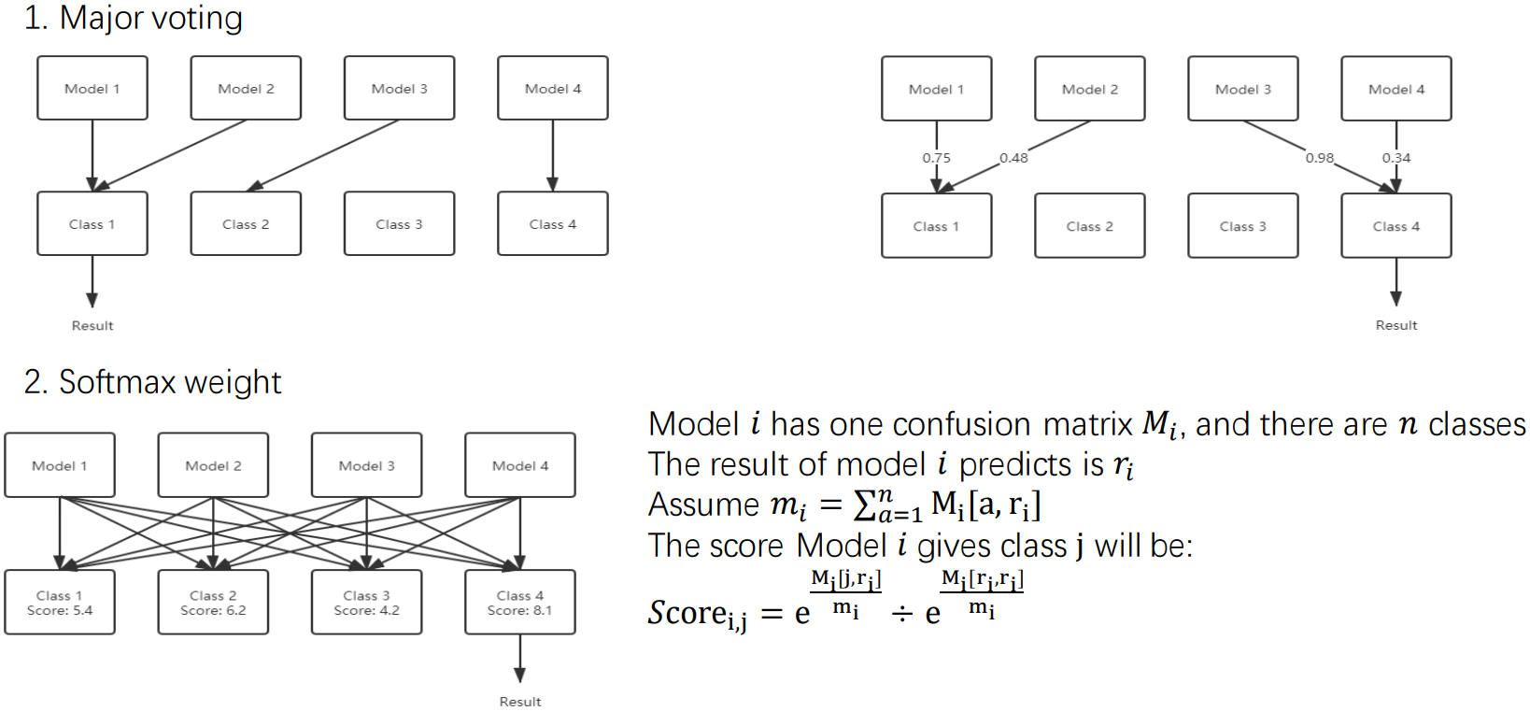
Ensemble Method

Slide 12
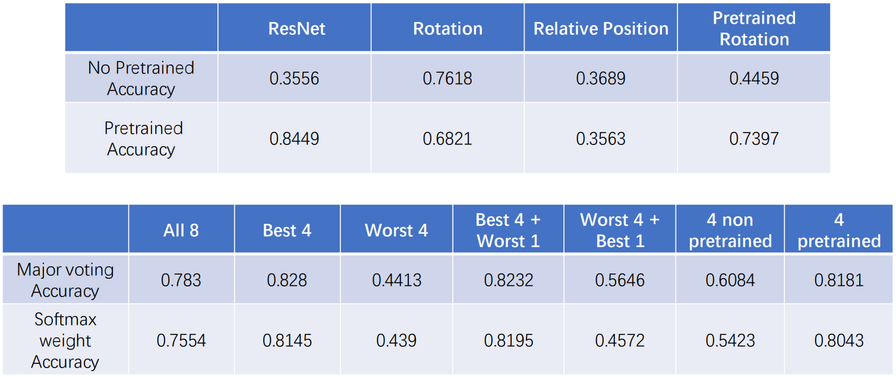
Ensemble Performance

Slide 13
Future Work
Different pretext models: color, textures, other info
Train with different datasets
Ensembling with stacking

Slide 14
Thank you!

