Slide 1
Fundraising Campaign Analysis
Insights and Recommendations

Slide 2


Executive Summary
Background
Campaigns were delivered to 270 contacts across NSW, VIC and QLD out of which 30 donations were received.
NSW and VIC drive income with $50 medians, whilst QLD has a smaller base and $20 median with the highest unmatched rate.
By age, 70+ records the highest mean gift (small base), whereas 30–39 skews lower.
Campaign KPIs
To preserve financial accuracy and performance clarity, we report both raw receipts and campaign-attributed gifts. The campaign recorded 30 receipts in total; 28 are attributed to the mailing (strict URN plus high-confidence fuzzy), and 2 receipts totalling $70 remain off-file/unattributed—income received but not yet linked to a contact record.
Overall
Attributed
All receipts: 30 gifts
Attributed receipts: 28 gifts
Response rate: 11.11%
Response rate: 10.37%
Average gift: $44.00
Average gift: $44.64
Gross income: $1,320
Gross income: $1,250
Cost: $810
Cost: $810
Net income: $510
Net income: $440

Slide 3
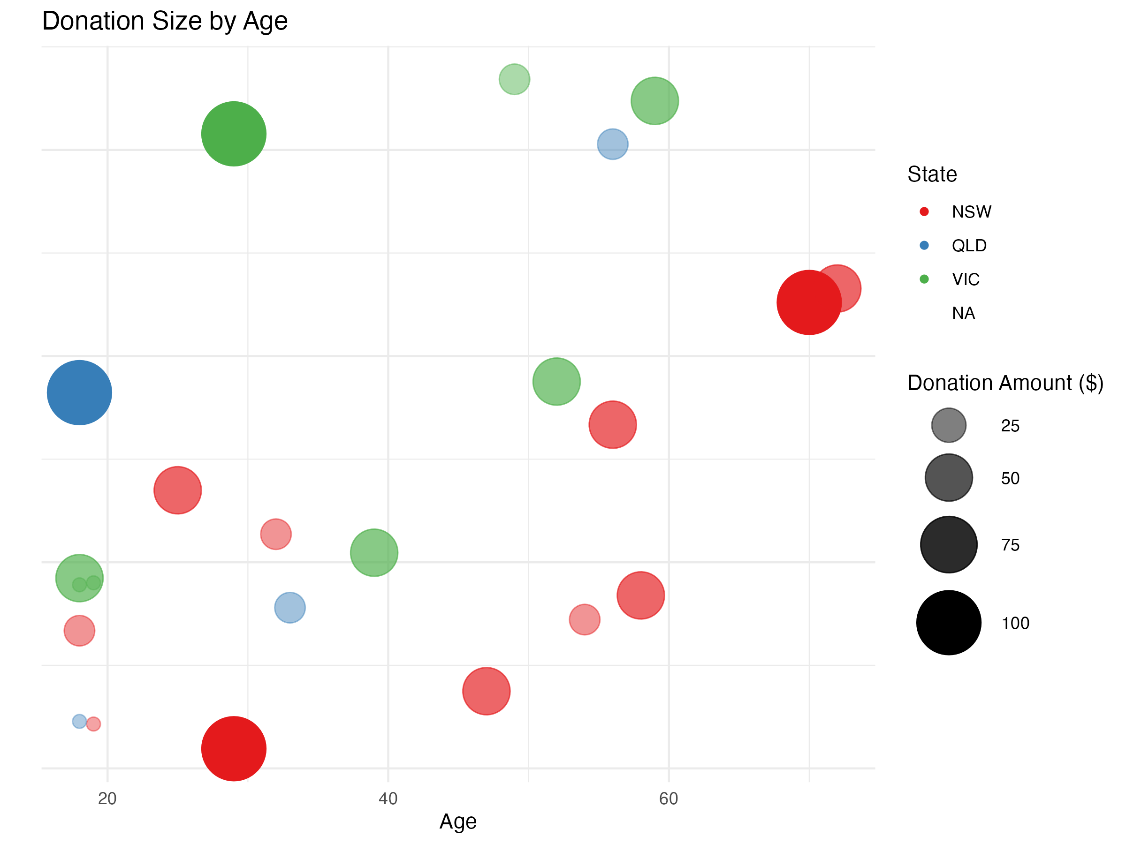
High-value gifts are distributed across 18–30 and 55–70 age groups
Unlocking high-value donations
Larger bubbles (donations) spread among the 18-30 and 51-70 age groups. The largest share of ≥ $60 gifts comes from ages 18–30 (31%)
Gift distribution by age groups:
18–30: 13 gifts, 4 ≥ $60 → 30.8% (includes two $100 gifts at age 29).
31–50: 5 gifts, 0 ≥ $60 → 0%.
51–70: 8 gifts, 1 ≥ $60 → 12.5% (one $100 at age 70).
70+: 2 gifts, 0 ≥ $60 → 0%.
Please note there are multiple bubbles overlapping in the chart.

Slide 4
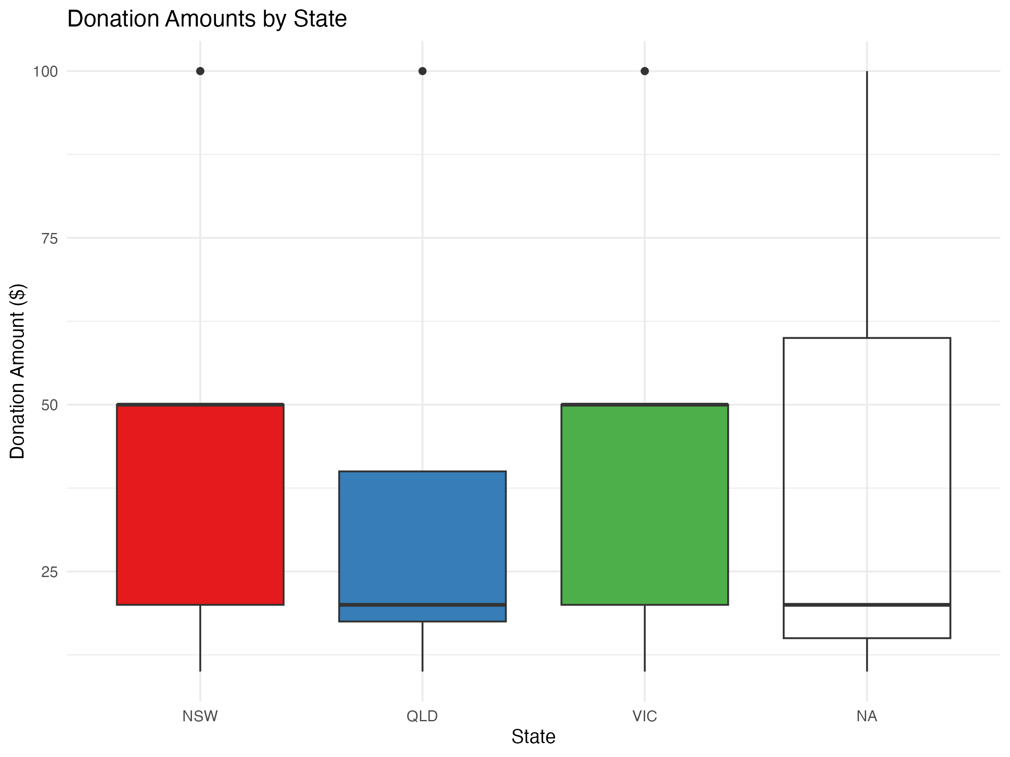
NSW and VIC drive revenue and stability; QLD warrants targeted growth before major-gift scaling
Maximizing Revenue Potential
The typical gift (median) is $50 in both NSW and VIC, and $20 in QLD.
The middle fifty per cent (IQR) lies between $20 and $50 for NSW and VIC, and between $18 and $40 for QLD, indicating a lower and slightly narrower distribution in QLD.
The high-gift tail (≥$60) comprises 15.4% in NSW (2 of 13), 30.0% in VIC (3 of 10), and 14.3% in QLD (1 of 7). The apparently higher share in QLD is based on a very small base and should be interpreted with caution rather than as evidence of leadership.
NSW and VIC are the primary drivers of income.
Median = 50
Median = 50
Median = 20

Slide 5
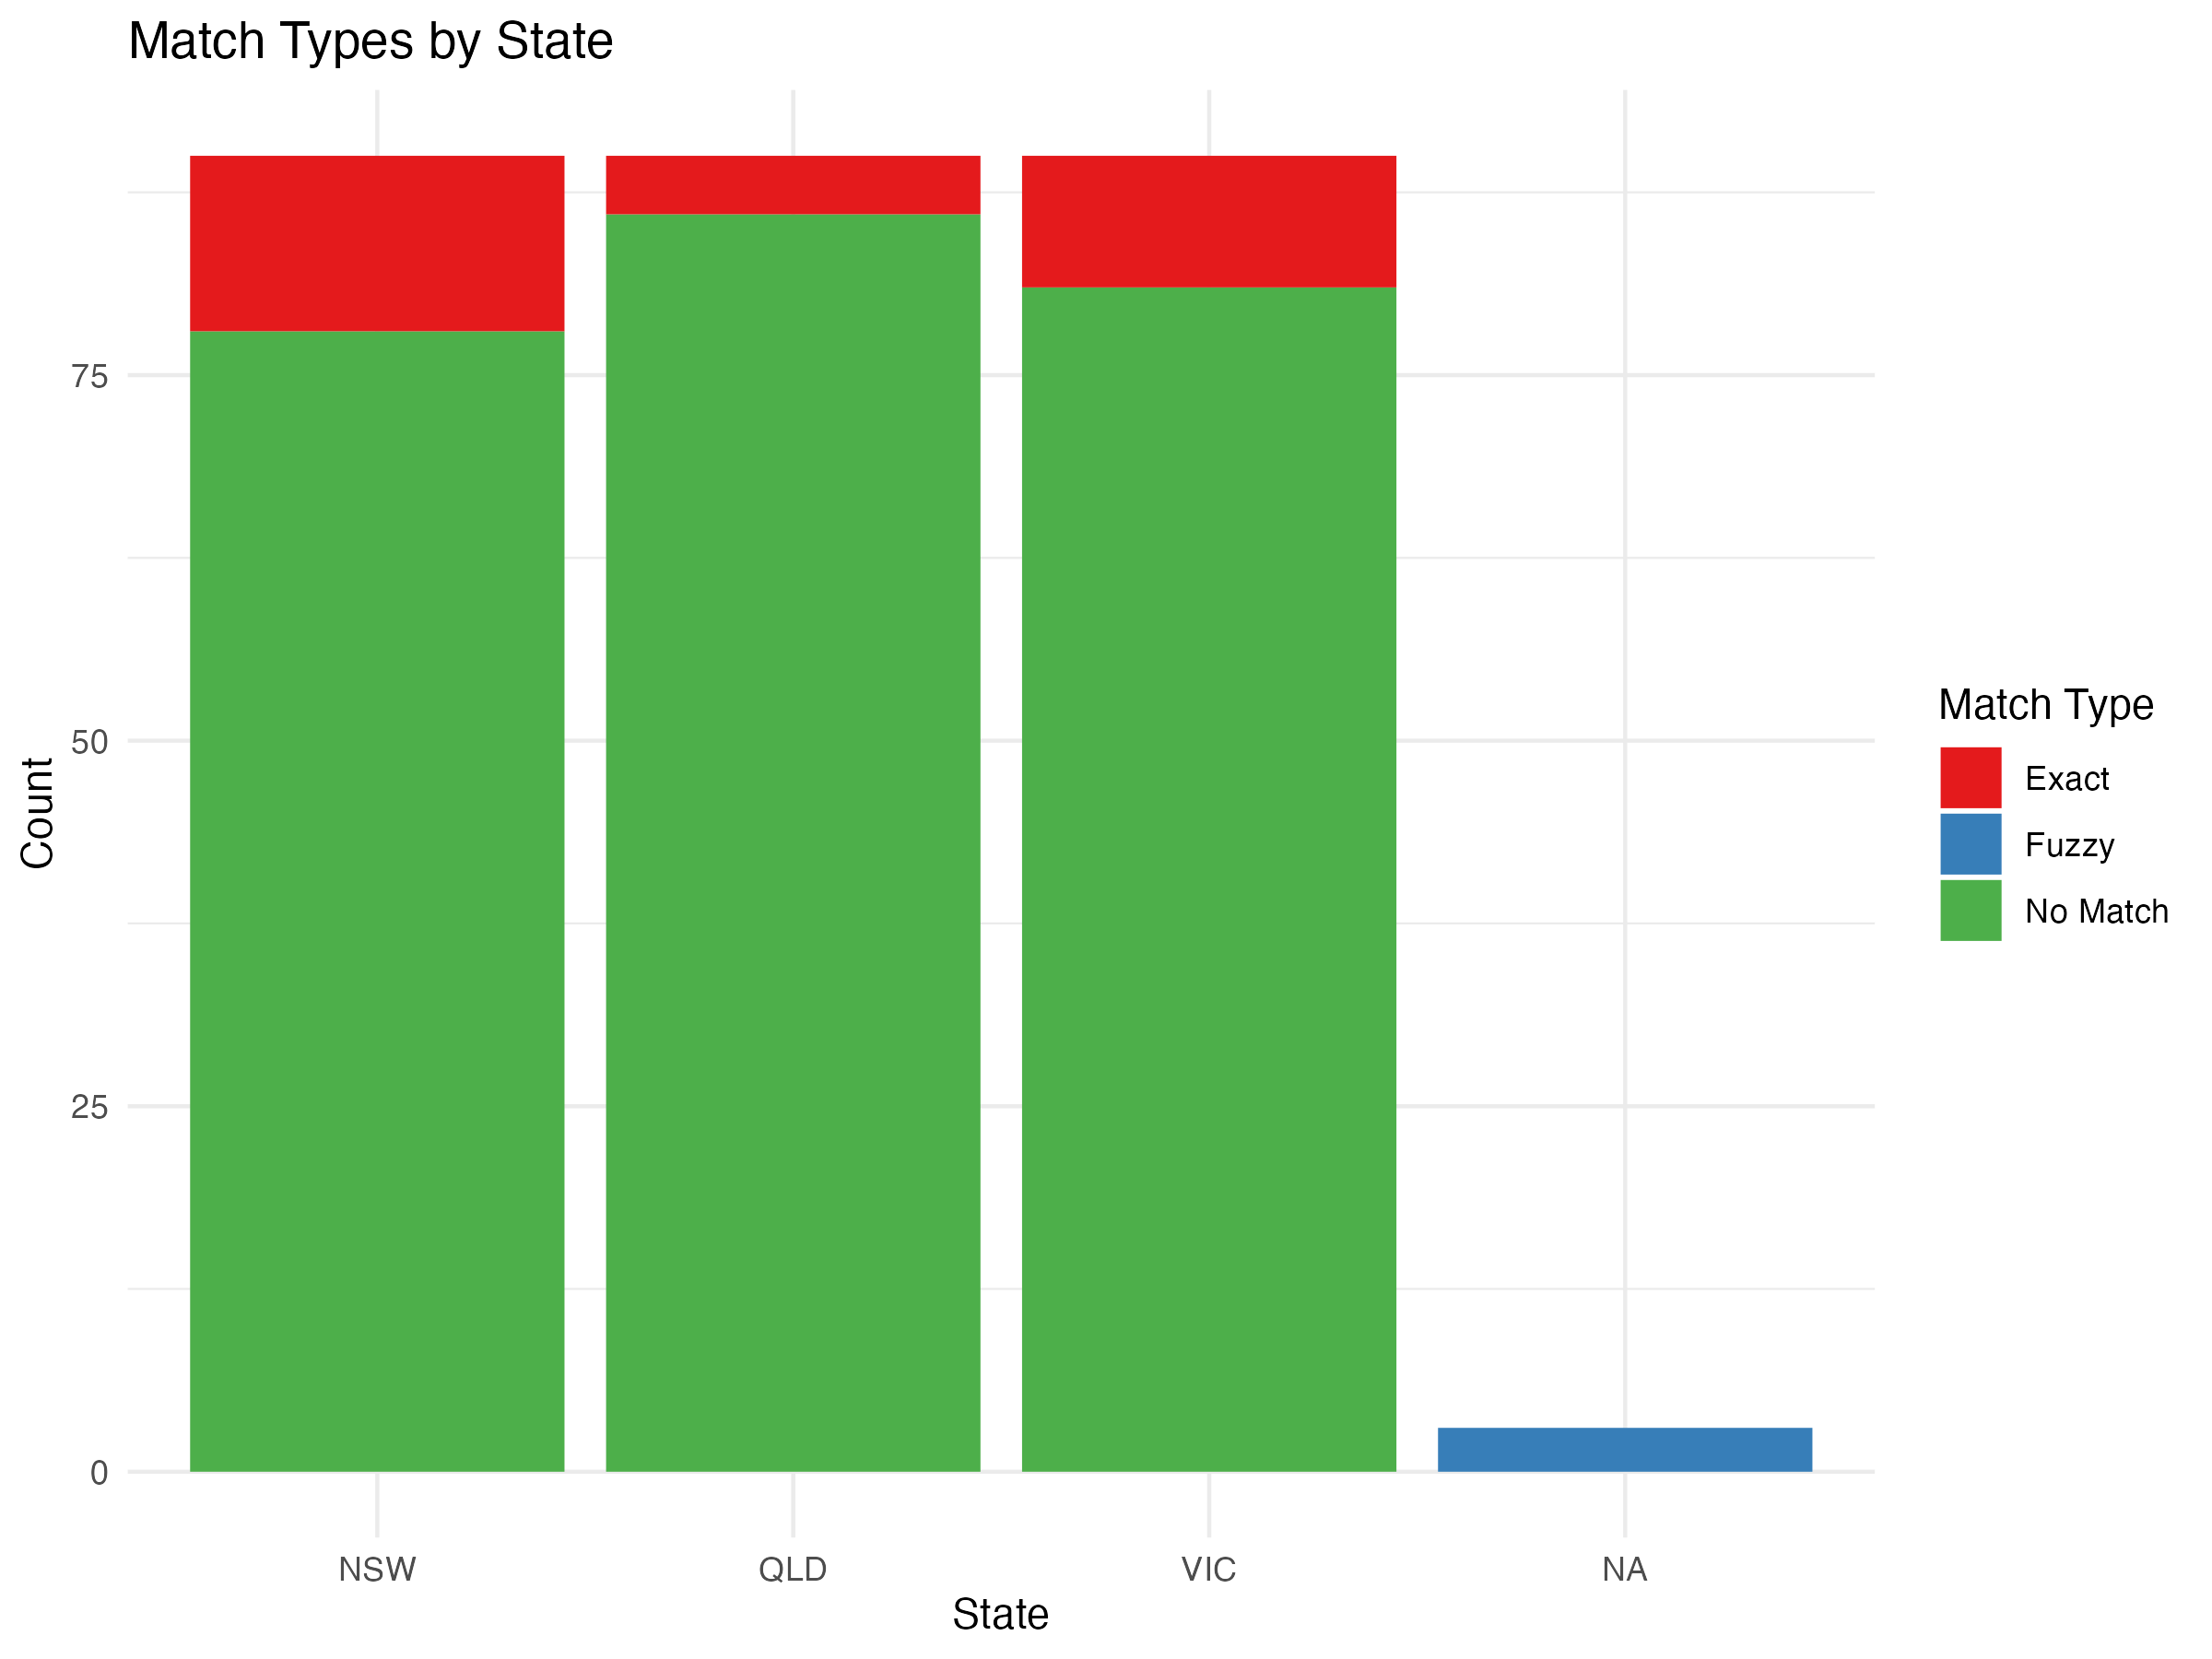
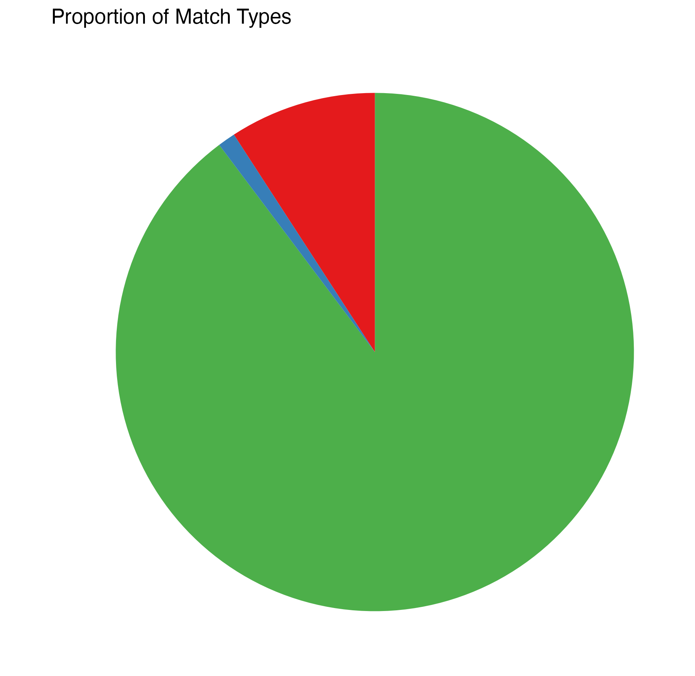
Strengthening Data Integrity: NSW Excels in Exact Matches, QLD Unmatched Records Demand CRM Action
NSW shows the strongest linkage (highest exact, lowest no-match), QLD the weakest, and VIC sits between them.
Operational Readiness by State
Distribution of Match Status

Slide 6
How can we optimise donor targeting and data quality to increase response rate to 15% and ROI to 70-80%?
Maximise immediate revenue by enhancing NSW and VIC performance, strategically grow QLD’s donor base, and strengthen CRM linkage for repeatable, auditable results.
A
B
C
Revenue and Targeting Optimisation
Offer, Channel, and Data Integrity
Measurement and 90-Day Execution
NSW and VIC (Core Revenue Streams): Secure the $50 median and boost the $60+ share with a structured donation escalation ($50 to $60/$75) and targeted messaging. Focus on the 45–60 year old cohort and the 18–30year old segment.
QLD (Growth Opportunity): Prioritise base expansion via reactivation and look-alike acquisition, launching a targeted high-value pilot (10–15 $100-donor profiles) before scaling.
Condition: Scale only with ≥30 active donors.
Maintain the $50 anchor in mail, introduce $60/$75 options, and design a youth-friendly variant (targeted to 18–30-year-olds) with QR/mobile payments. Test relevance messaging for 31–50 cohort (impact, convenience).
Enhance data quality by standardising addresses/URNs, conducting deterministic + governed fuzzy matching (name/suburb), and embedding unique IDs (URN/QR) in future mail.
Target: ≥95% matched, ≤3% fuzzy-under-review, ≤2% unmatched.
Track KPIs on the attributed 28 gifts (exact + fuzzy), with a reconciliation bridge to 30 receipts. Monitor weekly by state/age (response, median, $60+ share, match breakdown).
Rule: Scale only if tests beat control (e.g., p<0.1).

Slide 7
Next Steps for Revenue Growth: Critical to divide and conquer, monitor progress, and refine
Brief Plan: Weeks 1–2: Clean data, set KPIs; Weeks 3–6: Run NSW/VIC tests, QLD pilot, fix gaps; Weeks 7–12: Scale winners, refine 31–50 creative, resolve unmatched, report ROI/CTR(Cost to Raise).
Assign Ownership
Start Small
Track Progress
IT Team: Lead data cleansing and CRM linkage enhancements (standardise URNs, implement fuzzy matching protocols) by Week 2.
Marketing Department: Oversee NSW/VIC $60/$75 test launches and QLD pilot design, initiating by Week 3.
Finance Lead: Validate ROI/CTR metrics and reconcile 28 attributed gifts with 30 receipts, reporting by Week 7.
Launch a controlled pilot: Test the $50→$60/$75 ask ladder in NSW/VIC (100 contacts) and a high-value probe in QLD (10–15 prospects) to validate uplift potential.
Limit initial scale to minimise risk, scaling only if response exceeds 12% (p<0.1 vs 10.37% control)
Monitor weekly KPIs by state and age band (response rate, median donation, $60+ share) via a shared dashboard, updated by the IT team.
Conduct a formal review at Week 6 to assess pilot outcomes, with a final post-mortem by Week 12 delivering ROI and CTR insights.

Slide 8
Thank You!

