Slide 1

Color Vision Assistive Technology Using Retinal Display and AR/VR
M22AI845

Slide 2
Introduction and Basic Understanding
What is color Blindness?
Definition: Inability to perceive certain colors.
Causes: Genetic factors, eye damage, exposure to chemicals.
Rods and Cones are two important cells in human eyes .
The cone cells are responsible for color vision, and there are three types:
1) S-cones (sensitive to short wavelengths, or blue light),
2) M-cones (sensitive to medium wavelengths, or green light),
3) L-cones (sensitive to long wavelengths, or red light).
Rods are responsible for detecting the brightness of light or intensity of light works to detect low intensity of light.
The most common cause of color blindness is an inherited problem or variation in the functionality of one or more of the three classes(s,m,l) of cone cells in the retina.
Notes:
Source : https://www.britannica.com/science/color/The-visible-spectrum

Slide 3
Types and Causes
Protanopia: Affects red and green; caused by lack of long-wavelength cones.
Deuteranopia: Affects red and green; caused by lack of medium-wavelength cones.
Tritanopia: Affects blue and yellow; caused by lack of short-wavelength cones.
Achromatopsia: Affects all colors; caused by lack of all types of cones.
Genetic Factors: X-linked recessive gene.
Environmental Factors: Chemical exposure, aging, eye diseases.

Slide 4
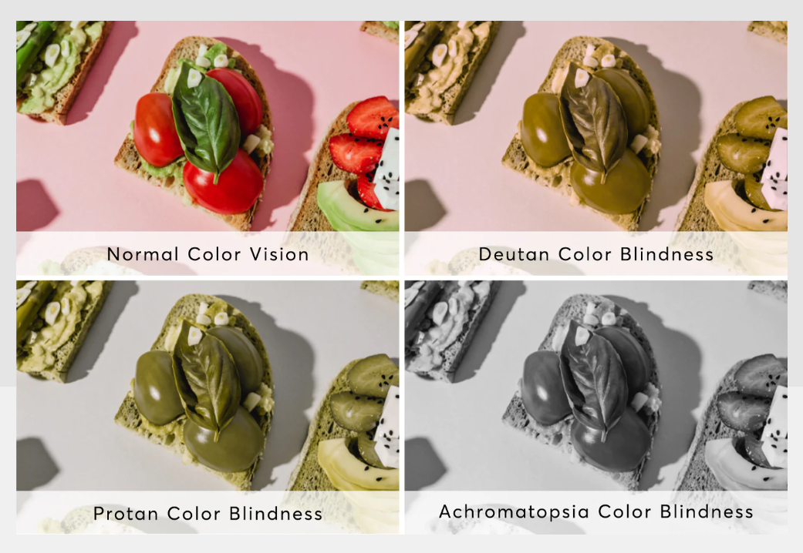
How colour blind people sees the world
Notes:
Source : https://enchroma.com/blogs/beyond-color/how-color-blind-see#:~:text=It%20is%20estimated%20that%20a,%25%20of%20the%20normal%20range).

Slide 5
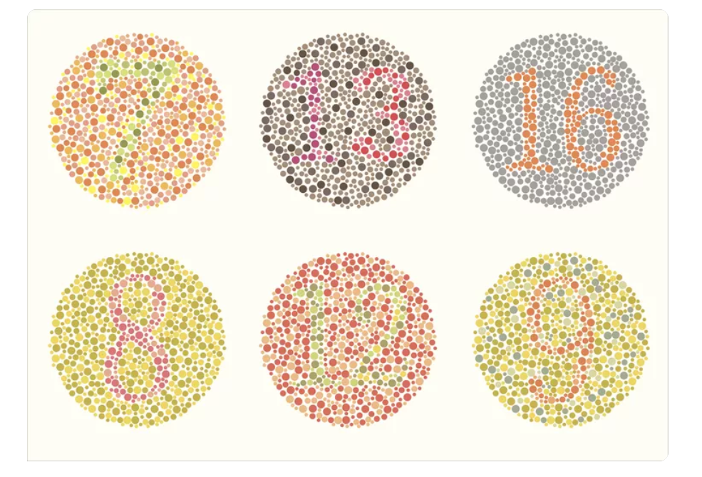
Ishihara Test
Ishihara Test: This is a color vision test that uses a series of plates, each with a number or a shape made of colored dots. The test can detect if you have problems with seeing red and green colors. You have to look at each plate and say what number or shape you see, or if you see nothing.
Notes:
Source : What Is a Red-Green Color Blind Test? (verywellhealth.com)

Slide 6
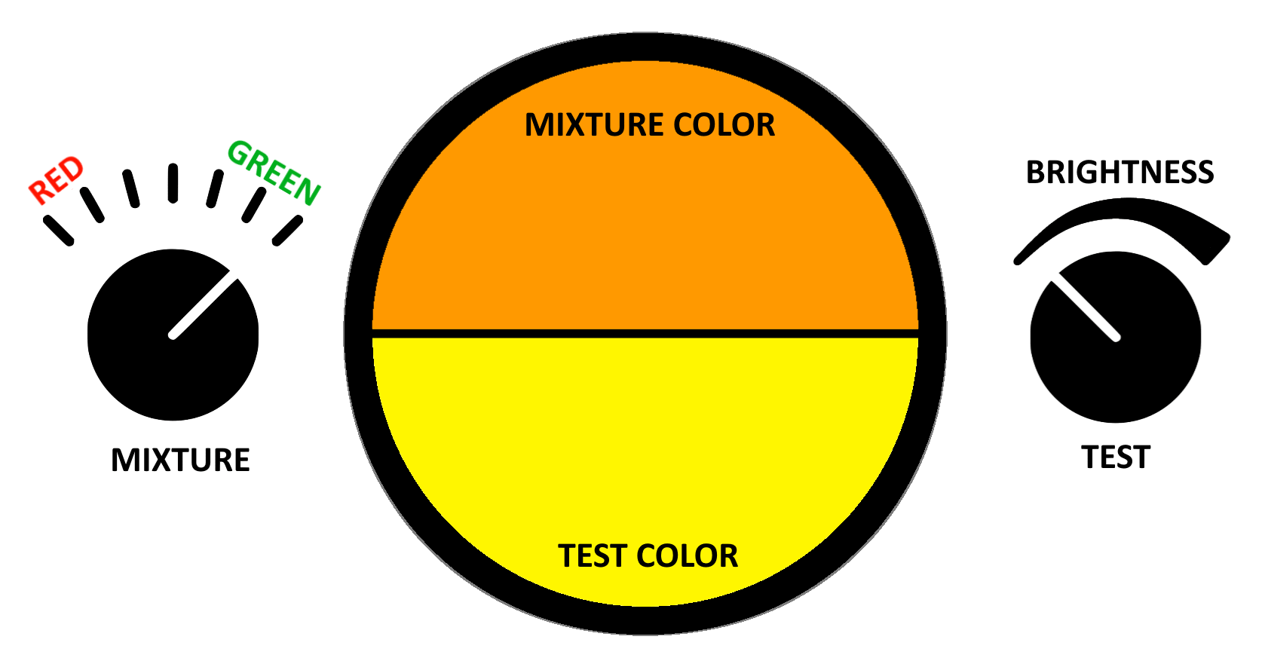
Anomaloscope
Anomaloscope: This is another color vision test that uses a device that shows two different lights. One light is yellow and you can change its brightness. The other light is a mix of red and green and you can change the proportion of the colors. You have to adjust the two lights until they look the same to you. The test can measure how well you can see different hues and how severe your color vision deficiency is.
Notes:
We are going to use a anomaloscope for detecting the colour blindness level as the retinoscopy display will be doing the color correction based upon this test.
Like the level of intensity of different light to properly colourise the image etc.
Source : Wikipedia

Slide 7
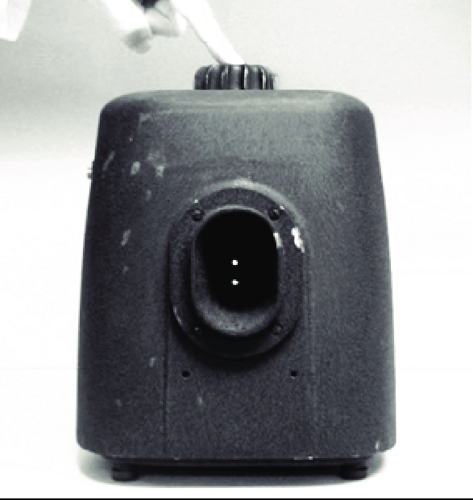
Farnsworth Lantern Test
Farnsworth Lantern Test: This is a color vision test that uses a lantern that shows pairs of lights in red, green, or yellow-white colors. The test can check if you can identify the colors of maritime and aviation signal lights at night. You have to say the two colors that you see in each pair, or if they are the same. The test can screen for red-green color blindness, but not blue color blindness.
Notes:
Source : In the Farnsworth Lantern test, the patient must identify the color to... | Download Scientific Diagram (researchgate.net)

Slide 8
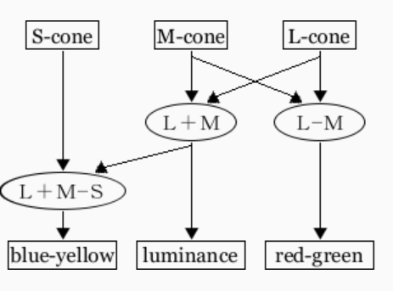
Opponent Process Theory
Opponent Process Theory:
Opponent process theory is a psychological and neurological model that explains how we perceive colors, emotions, and other phenomena by processing signals from different types of receptors in an antagonistic manner. This means that the activation of one type of receptor inhibits the activation of another type of receptor, creating a contrast effect. For example, when we see red, the receptors that are sensitive to red wavelengths are excited, while the receptors that are sensitive to green wavelengths are suppressed. This creates an opponent process between red and green, which are complementary colors.
Notes:
Opponet process theory is important we through diagnostic test we see , above we can estimate which part of color is dominant in patients eye we can define the color filter / color space based upon the diagnostic.
Image source : Visolve - Color vision mechanism (ryobi.co.jp)

Slide 9
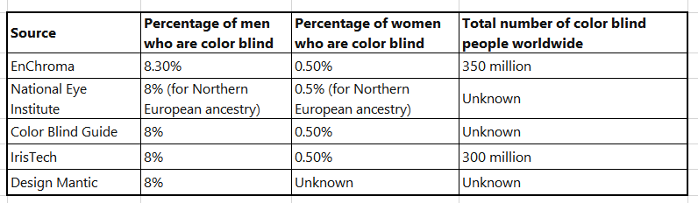
Statistics on colour blindness.

Slide 10
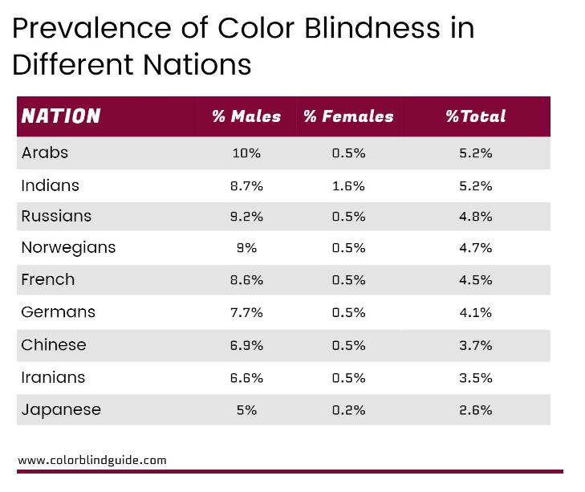
Statistics on colour blindness.
Notes:
https://www.colorblindguide.com/post/colorblind-people-population-live-counter

Slide 11
Assistive Tech for colour blindness Hardware Solutions
Hardware Solutions
1. EnChroma Glasses
Function: These glasses use a patented lens technology to filter out specific wavelengths of light, enhancing the vibrancy and saturation of certain colors.
Technology: Multi-notch filtering cuts out sharp wavelengths of light to enhance specific colors.
Commonality: Optical lens technology.
Use Case: Ideal for outdoor use and can also be customized for indoor settings.
2. Colorlite Glasses
Function: These glasses offer customized lenses tailored to an individual's specific type of color blindness.
Technology: Dichroic filter technology.
Commonality: Optical lens technology.
Use Case: Suitable for both indoor and outdoor activities, including driving.
3. Oxy-Iso Glasses
Function: Specifically designed to enhance red-green color perception.
Technology: Hyper-spectral technology.
Commonality: Optical lens technology.
Use Case: Primarily used in medical fields for identifying veins but can be used in daily life.

Slide 12
Software Solutions
1. Color Oracle
Function: A color blindness simulator that allows designers to see how their work appears to those with color vision impairments.
Technology: Algorithmic color transformation.
Commonality: Software-based color correction.
Use Case: Used by graphic designers and web developers to create accessible designs.
Usage | Color Oracle
2. Visolve
Function: This software uses computer algorithms to transform colors on the computer display into discriminable
colors for various people, including those with color blindness. Commonality: Software-based color transformation.
Visolve - the assistive software for people with color blindness (ryobi.co.jp)
3. Dalton
Function: A Chrome extension that adjusts the colors of web pages for better visibility.
Technology: CSS manipulation.
Commonality: Browser-based color adjustment.
Use Case: Browsing the internet.
Colorblind - Dalton for Google Chrome - Chrome Web Store

Slide 13
Mobile Apps
Color Blind Pal
Function: Helps people who are color blind see the colors around them. It also lets people with normal vision see what it’s like to be color blind.
Technology: Real-time color transformation algorithms.
Commonality: Mobile-based color transformation.
Use Case: Everyday mobile usage, identifying colors, reading color-coded maps, charts, or graphs, and passing a color vision test.
DanKam
Function: An augmented reality app that turns the vague hues that 1 percent of the population with color-blindness sees into the “true” colors as everyone else sees them.
Technology: Augmented Reality (AR).
Commonality: Mobile-based augmented reality.
Use Case: Identifying colors in the environment.
Eye-D
Function: Helps visually impaired people achieve independence in learning, identification, and navigation. It can also identify colors through the mobile camera.
Technology: Machine Learning algorithms for color identification.
Commonality: Mobile-based real-time identification.
Use Case: Shopping, cooking, and other activities requiring color identification, as well as reading text offline and navigating to nearby places of interest.

Slide 14
VR/AR Technology for Colour Blindness Notable Papers
“Virtual Reality Technology for Blind and Visual Impaired People: Reviews and Recent Advances” - Neveen I. Ghali, Omar Soluiman, Nashwa El-Bendary, Tamer M. Nassef, Sara A. Ahmed, Yomna M. Elbarawy & Aboul Ella Hassanien.
“Bringing virtual reality to people who are blind with an immersive sensory-based system” - Ed Cutrell and Eyal Ofek from Microsoft Research.
“Current and Potential Uses of AR/VR for Equity and Inclusion” - The author is Ellysse Dick.
“Augmented Reality in Ophthalmology: Applications and Challenges” - Tongkeng Li, Chenghao Li, Xiayin Zhang, Wenting Liang, Yongxin Chen, Yunpeng Ye, and Haotian Lin.
“An Assistive Model for ICT Applications for Color Blindness” - Wafa Qaiser Khan, Reema Qaiser Khan, Muhammad Sarim, Abdul Basit Shaikh, and Sheikh Kashif Raffat.
Notes:
Yet to read all these paper, currently going through these papers.

Slide 15
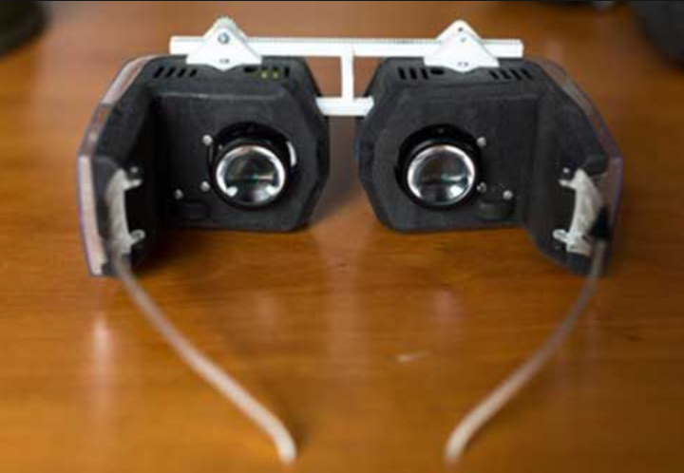
Project proposed Solution
Retinal Display
Notes:
Image source Virtual Retinal Display (engineersgarage.com)

Slide 16
Retinal Display
Retinal display technology, also known as retinal projection or retinal imaging, is a display technology that projects images directly onto the retina of the eye. Unlike traditional displays that require external screens, retinal displays create images that are perceived by the viewer as existing in the external world. This technology has the potential to revolutionize various fields, including virtual reality (VR), by solving the problem of bulkiness associated with current VR headsets.

Slide 17
Working of Retinal Display
Light Source: A low-powered light source, often a laser or LED, generates the initial image.
Modulation: The light passes through an optical modulator, which adjusts the intensity and color of the light to form an image.
Projection: A series of lenses or a micro-mirror array focuses the modulated light and projects it directly onto the retina.
Perception: The eye's natural optics focus the light on the retina, where photoreceptor cells translate it into electrical signals sent to the brain.

Slide 18
Advantages
High Resolution: As the image is directly projected onto the retina, the perceived resolution is extremely high.
Low Power Consumption: Requires less power compared to traditional displays.
Compactness: Eliminates the need for a physical screen, making the device smaller and lighter.
Immersive Experience: Creates a more natural and immersive visual experience.
Notes:
The Virtual Retinal Display (VRD) technology is known for its high-resolution screenless display with excellent color gamut and brightness, far better than the best television technologies. The light from the VRD is coherent (colors in phase with each other) and narrow band in wavelength producing crisp and accurate color reproduction. Unlike pixels, retinels can overlap with each other to form a smoother image and reduce separation of image and higher resolution. This results in a high-quality, accurate color image.

Slide 19
Form Factor Advantage
Elimination of Screens: Traditional VR headsets require bulky screens and optics. Retinal displays eliminate this need.
Weight Reduction: The absence of heavy components allows for a much lighter device.
Form Factor: Enables the development of compact, eyeglass-like VR headsets.
Notes:
Planning to read more on the retinal displays

Slide 20
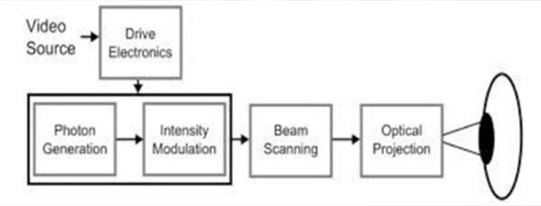
Working of VRD

Slide 21
Challenges VRD
Disadvantages:
Limited Area Covered by the Screen: The area covered by the screen is limited.
Focus Depth: The image would appear focused only if the user was focusing at a particular "depth".
Availability and Cost: VRD is not yet available in significant numbers, and the cost per unit is high.

Slide 22
Proposed solution to challenges
High Weight of Projection System: The weight of the projection system could be reduced by using lighter materials and miniaturizing components. Advances in technology often lead to smaller, more efficient components.
Focus Depth: Improvements in eye-tracking technology could allow the system to adjust the focus depth based on where the user is looking. This would make the image appear focused at all times.
Availability and Cost: As with any new technology, availability will increase and costs will decrease as the technology matures and economies of scale are realized. Increased competition in the market can also lead to lower prices.

Slide 23
Thank you.

