Slide 1
World Economic Indicator
How a country can attain sustainable growth ?

Slide 2


Business Problem How a country can attain sustainable growth ?
Solution
The approach is to improve GDP per capita which is GDP/ population by finding the factors that have:
A strong positive correlation with the GDP
A strong negative correlation with the Population

Slide 3
Data Used
The World Economic Indicator Dataset contains data of 12 years and encompasses diverse countries and regions spanning Africa, Asia, Europe, the Middle East, Oceania, and The Americas. Within this dataset, a comprehensive range of factors are presented, each potentially impacting on GDP per capita.
Within this dataset is a collection of vital information, such as:
1. Energy Usage: The utilization of energy resources within each country or region, which can substantially impact economic performance.
2. Tourism: The influx of visitors and the associated activities can contribute to the overall economic output.
3. Human Resource: Investigating factors like population demographics, education, and skills, which collectively shape the labor force's influence on the economic landscape.
4. Business: The business aspect is explored, capturing indices such as ease of doing business, tax rates, and other factors that shape the entrepreneurial environment and consequently, the economic output.
This rich assortment of factors across the regions provides a comprehensive view of the dynamic interplay between these variables and their potential impact on GDP per capita.

Slide 4
Executive summary
Factors that have a strong positive correlation with the GDP
The relationship between Energy Usage and GDP exhibits the most pronounced correlation coefficient among all the listed factors. This signifies a robust and positive connection between these two variables.
CO2 Emissions display the second-highest correlation coefficient with GDP, implying that nations with greater economic productivity tend to generate increased CO2 emissions.
There exists a substantial positive correlation coefficient between Inbound Tourism and GDP. This implies that countries witnessing a higher influx of international tourists tend to enjoy elevated economic outputs.
Health exp/capita exhibit a stronger correlation coefficient with GDP compared to health expenditures as a percentage of GDP. This indicates that the monetary resources allocated per individual for healthcare serve as a more effective predictor of a nation's economic output than the proportion of GDP allocated towards healthcare.

Slide 5
Executive summary
Other factors that have an impact on GDP
Population Total and Population 65+ demonstrate a moderate positive correlation with GDP, implying that nations with larger overall populations and a higher proportion of elderly residents often experience greater economic outputs.
On the other hand, Birth Rate, Infant Mortality Rate, Population 0-14, and Population 15-64 exhibit either negative or weak correlation coefficients with GDP. This suggests a limited or negative association with economic output.
Lending Interest, Business Tax Rate, Days to Start Business, Ease of Business, and Mobile Phone Usage showcase low correlation coefficients with GDP, indicating a weak or marginal relationship with economic output.
Internet Usage displays a moderate positive correlation coefficient with GDP, indicating that countries with elevated levels of internet usage typically boast higher economic outputs

Slide 6
Detailed analysis
 | Factors | Correlation with GDP | Correlation with Population
GDP | Health Exp / GDP | 0.3015249179 | 0.008820746366
 | Health Exp/Capita | 0.4513468859 | 0.008410515444
 | Lending Interest | -0.05888452674 | 0.007037956295
ENERGY | Energy Usage | 0.8288552336 | 0.6533879594
 | CO2 Emissions | 0.7421813119 | 0.6601708246
HUMAN RESOURCES | Birth Rate | -0.15440759 | -0.03317292417
 | Infant Mortality Rate | -0.1462833251 | 0.03133024953
 | Life Expectancy Female | 0.1480584792 | 0.0528316649
 | Life Expectancy Male | 0.1499396537 | 0.06228391092
 | Population 0-14 | -0.1348482207 | 0.0001482861977
 | Population 15-64 | 0.1183047111 | 0.1035152422
 | Population 65+ | 0.2775645314 | 0.03206309061
 | Population Total | 0.3798868354 | N/A
 | Population Urban | 0.1664623032 | -0.06078463614
TOURISM | Tourism Outbound | 0.8745068426 | 0.3042371085
 | Tourism Inbound | 0.5366005793 | 0.2760655761
BUSINESS | Business Tax Rate | 0.05365346421 | 0.06668135728
 | Days to Start Business | -0.03374512587 | 0.02761225579
 | Ease of Business | -0.01105172223 | 0.01563522448
 | Hours to do Tax | 0.06423362333 | 0.1232159421
 | Internet Usage | 0.268267806 | -0.03065886324
 | Mobile Phone Usage | 0.1321793019 | -0.04017416143

Slide 7
Region | AVERAGE of GDP (If missing) | AVERAGE of Population Total | AVERAGE of GDP/ Capita
Africa | 23302954884 | 17665922.03 | 1838.251255
Asia | 360720369027 | 108212254.3 | 6812.676121
Europe | 345180690163 | 16701733.42 | 25670.47596
Middle East | 110653042490 | 14852352.28 | 17247.22948
Oceania | 62657445766 | 2265297.908 | 5793.693971
The Americas | 413004047861 | 20426273.35 | 9745.528932
Grand Total | 244535032021 | 31608742.96 | 11116.73341
The region of The Americas displays the most elevated mean GDP per capita compared to all the listed regions, signifying a superior quality of life within this area.
Europe has the second highest GDP across all the regions listed, signaling a superior overall economic productivity in this particular region.
In contrast, Africa exhibits the least average GDP per capita among the regions listed, pointing to a comparatively lower standard of living within this geographic area.
Even though Africa maintains a relatively lower GDP per capita, it boasts the highest population when compared to all the regions mentioned. This could potentially hint at future growth possibilities as the economy undergoes development.

Slide 8
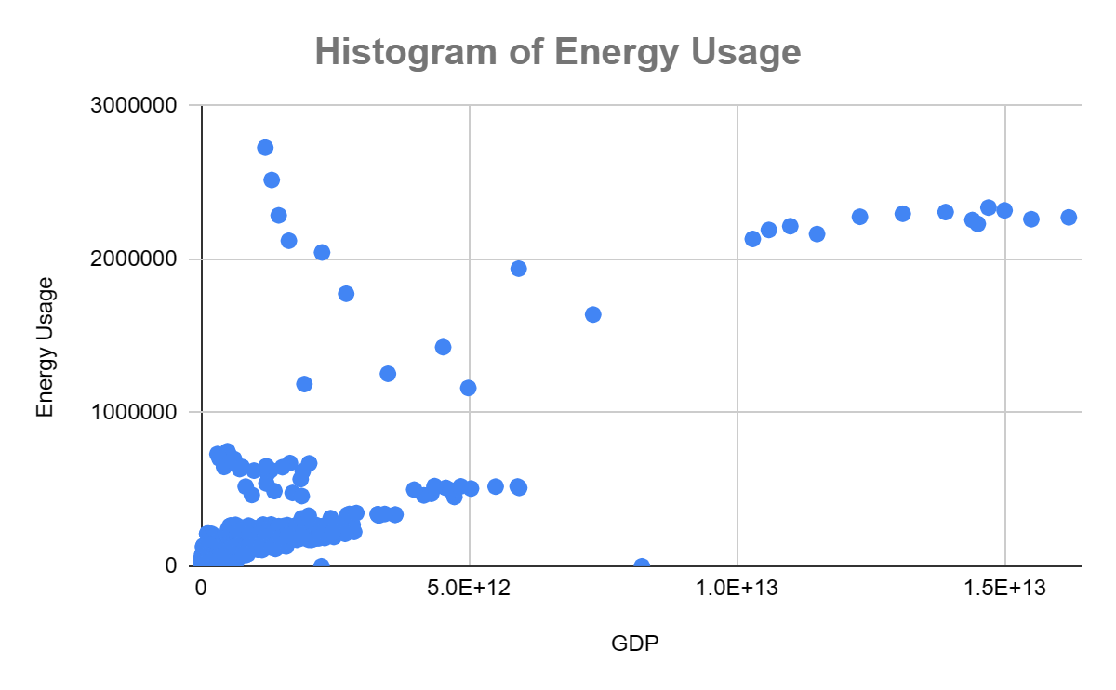

Slide 9
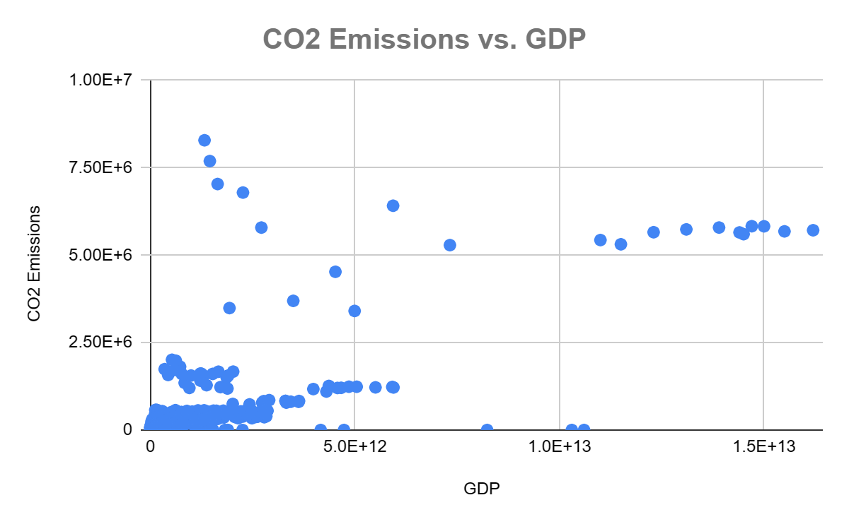

Slide 10
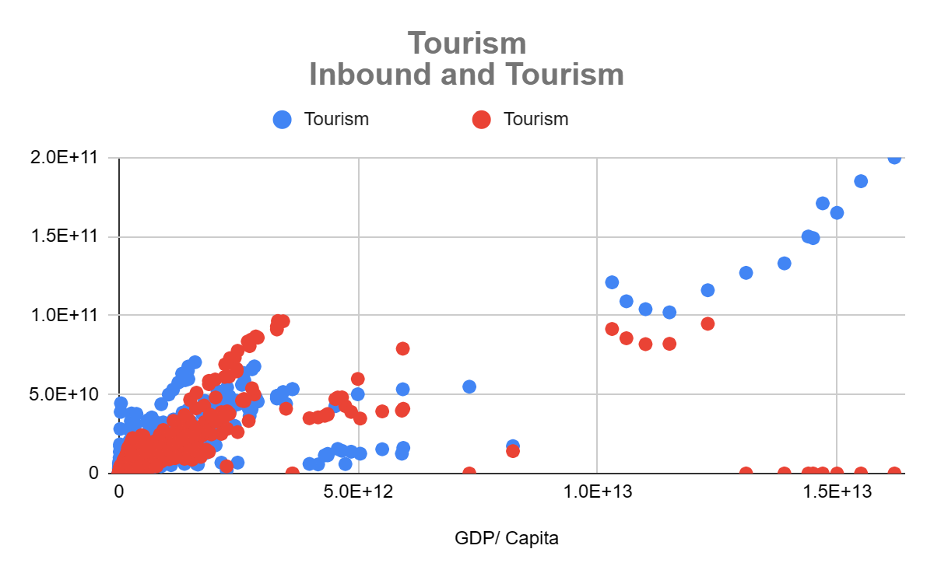
Blank slide

Slide 11
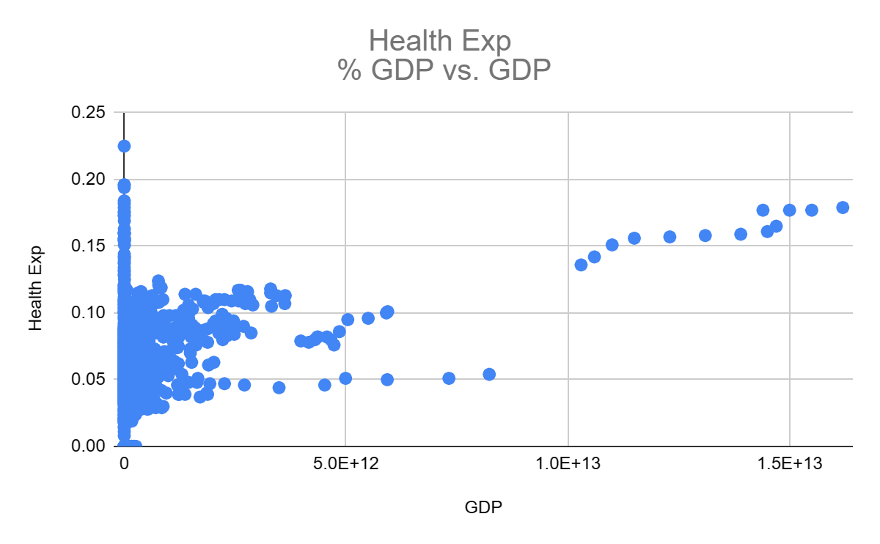
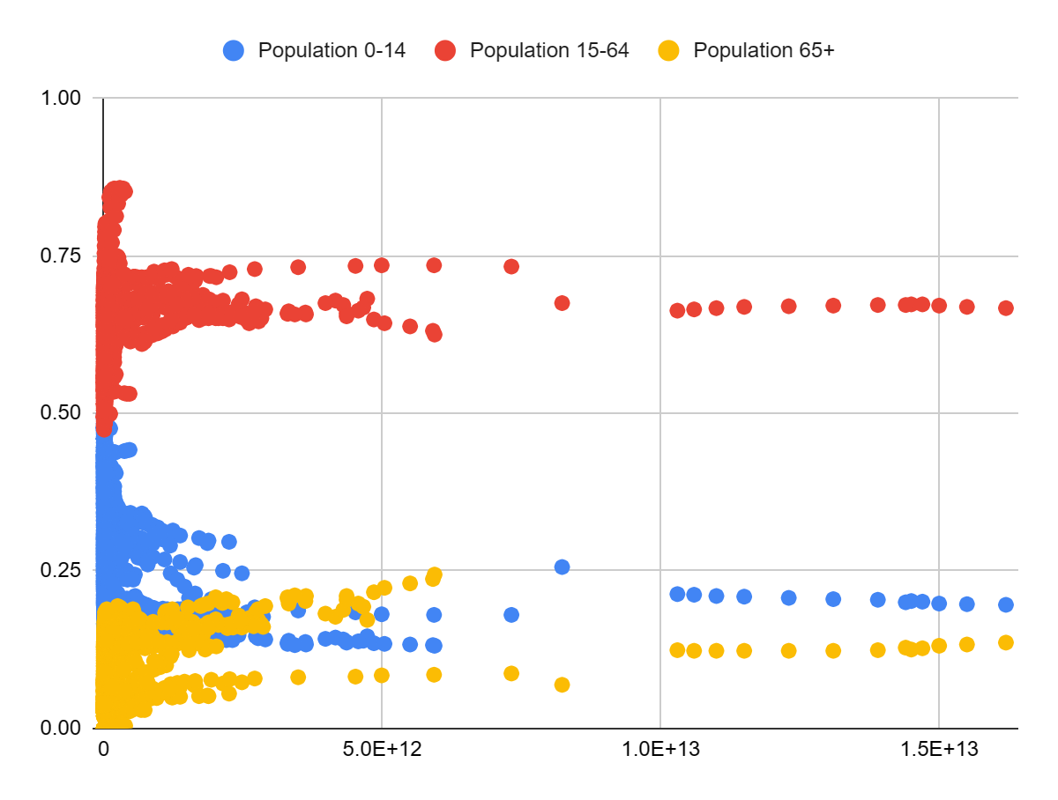

Slide 12
