Slide 1
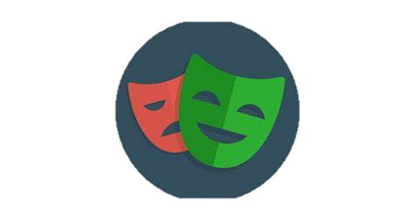
Playwright Automation Tool
Presented By –Debdutta Chatterjee

Slide 2
Contents
Why Playwright?
Playwright Features
Compatibility
Comparison with Selenium
Playwright Architecture
Auto Waiting
Assertions
Locators
Trace Viewer
Events
Isolation
Installation

Slide 3
Why Playwright?
Playwright addresses the common problems faced during test automation
Faster execution
Support for all major browsers
Reliable, Non Flaky
Powerful tools – code gen, trace viewer, playwright inspector
Advanced Locator strategies
Network interception
Support for events
AI integration(Zero step) Performance (using artillery) CICD as service(Playwright testing service)
Managed by Microsoft

Slide 4
Playwright Features
Record & playback using code gen
Trace Viewer
Auto-Waiting
Assertions
Visual testing(pixel match library)
Emulations
Integration with Selenium Grid(4.X)
API Testing
Authentication. Interception of request & response, Signed in state
Events
Custom Selector engine
Record video of test execution

Slide 5
Compatibility
Playwright supports all modern rendering engines including Chromium, WebKit, and Firefox.
OS -Windows, Linux, and macOS
Can be integrated with CICD tools, Docker, Selenium Grid
Native mobile emulation of Google Chrome for Android and Mobile Safari
Languages – Python, Java, C#(.NET), Java script/TypeScript

Slide 6
Comparison with Selenium
Feature | Playwright | Selenium
Speed | Faster | Slower
Auto Waiting | Yes | No
Supported Browsers | Chromium(Chrome, Edge),Firefox, WebKit(Safari) | Chrome, Firefox, IE, Edge, Opera, Safari
Supported OS | Windows, Linux, Mac | Windows, Solaris, Linux,Mac
Mobile device execution | Only emulations | Yes
Language Support | Java script/Ty[pe script, Python, C# .NET, Java | Java, python, C#, Ruby, Perl, PHP, Java script
Support. Documentation & community | Less, As it is comparatively new | More
Opensource | Yes | Yes
Reports | Video, HTML report, traces | No
Web element interactions | Reliable | Can be flaky

Slide 7
Playwright Architecture
Communicates through web socket connection
Web socket connection is stateful & remain alive till either client/server closes it
Two way interactive communication(Live trading/Gaming apps)
Web socket is a bidirectional communication protocol that can send the data from the client to the server or from the server to the client by reusing the established connection channel
Request
Client
Request
Client
Server
Server
Hand shake
Response
Web Scoket
Connection Terminated
HTTP connection
Web Socket connection

Slide 8
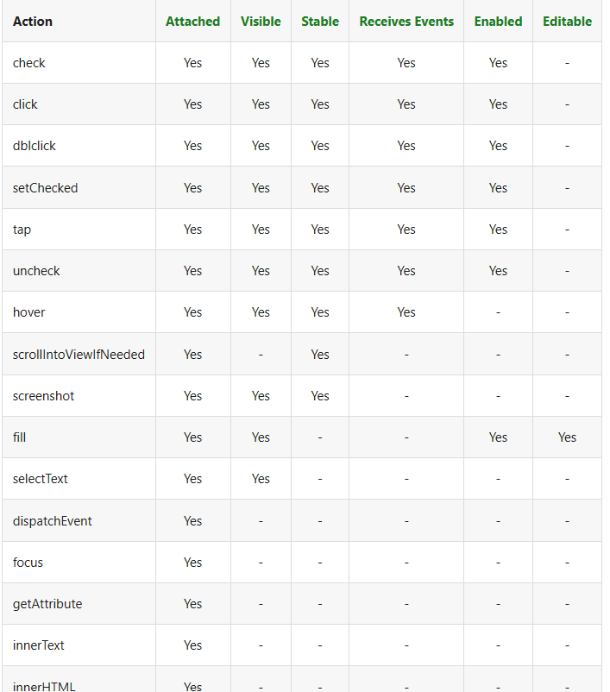
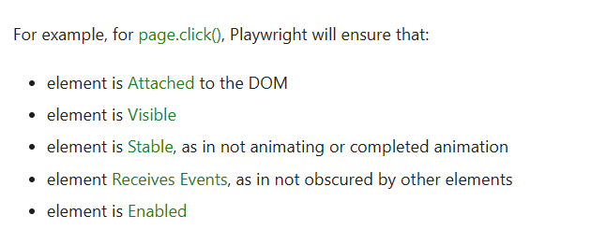
Auto Waiting
Playwright performs some checks using its intelligence before performing actions
It auto-waits for the relevant checks to pass and only then performs the requested action
Throws TimeoutError on failure after stipulated time
Some actions like page.click() support force option that disables non-essential actionability checks
Not all actions are having checks – allTextContents()

Slide 9
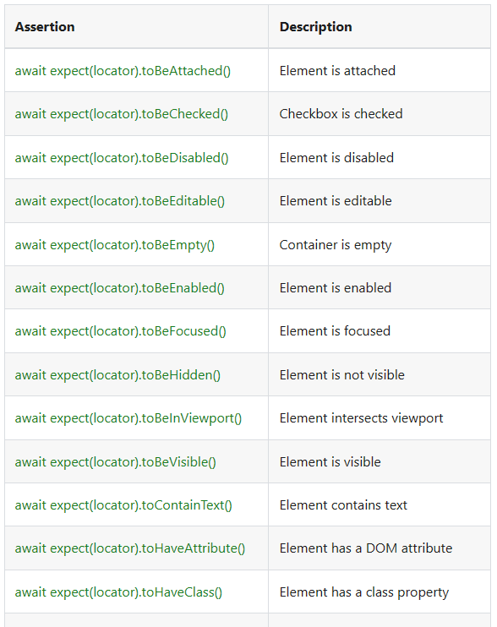
Assertions
Inbuilt assertions methods in ’expect’ library
Soft asserts
Polling
Retrying & Non retrying asserts
Readily available , commonly used assertions
Support screenshot, api assertions
Inbuilt intelligence in assert methods to avoid test failures due to flakiness

Slide 10
Locators
Built in locators
Locate element in shadow DOM
Locate using CSS or Xpath
Loctae by test, substring, exact string or regexp
Support pseudo classes like :visible, :text & more
Filtering locators
Selecting element based on layout – right, left, above
Parent selector(..) Chaining selectors(>>)

Slide 11
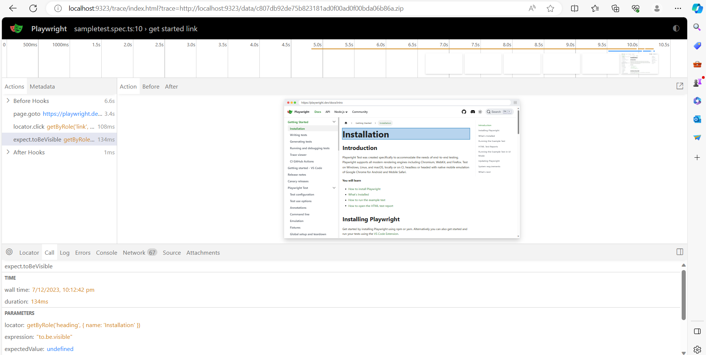
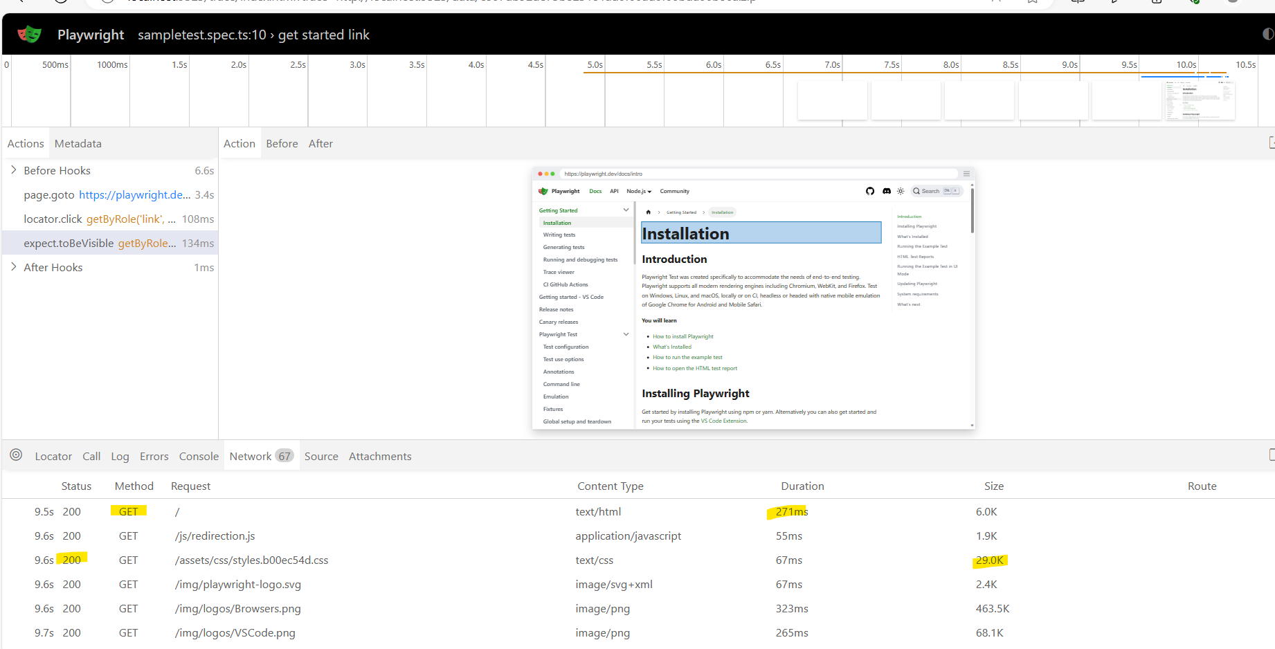
Trace Viewer
GUI tool to view the traces of execution
Entire execution history is recorded in a storyline
Console, HTTP request, response, payload, status are captured
Helps in debugging and adding better evidences for bug reporting

Slide 12
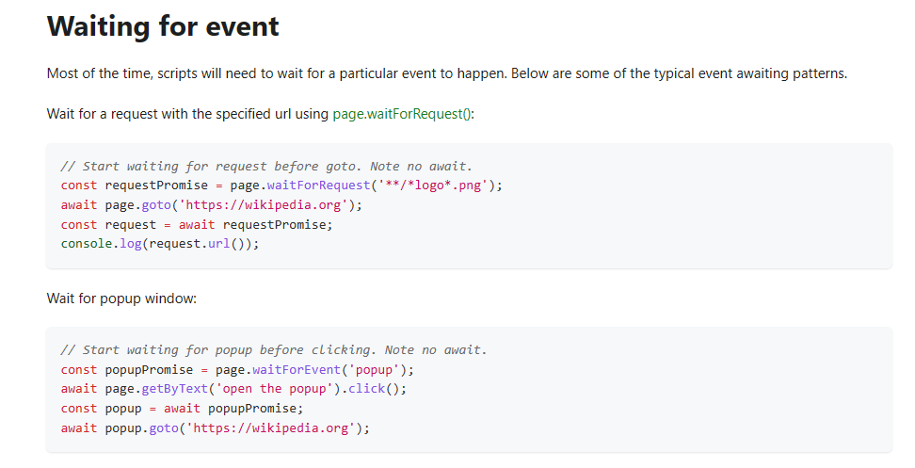
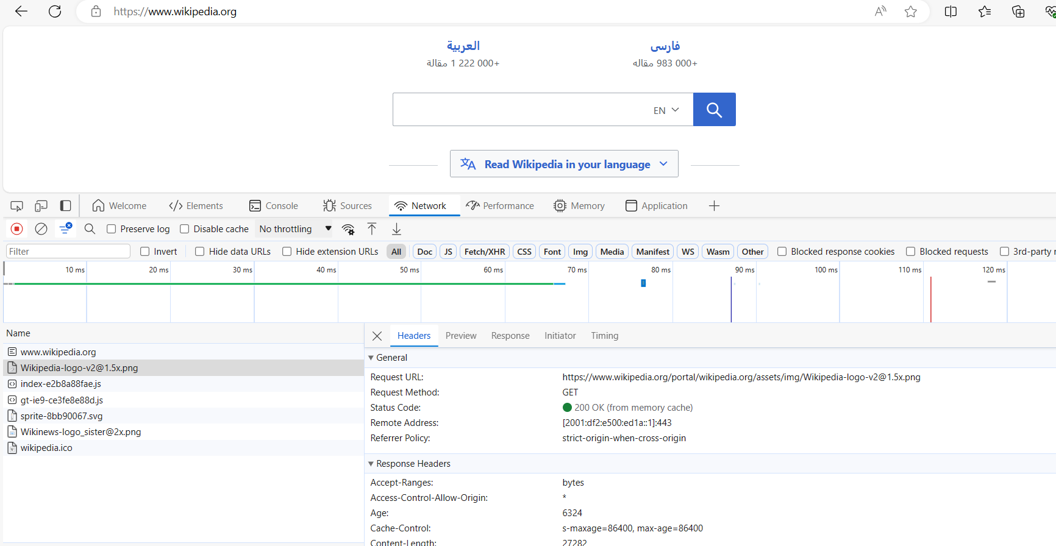
Events
Sometimes, events happen in random time & instead of waiting for them , they need to be handled
Playwright allows listening to various types of events happening on the web page, such as network requests, creation of child pages, dedicated workers etc. There are several ways to subscribe to such events such as waiting for events or adding or removing event listeners.
It is common requirement to wait for a particular event to complete, start etc. Those scenarios can be handled easily with playwright

Slide 13
Isolation
Playwright executes in isolated clean-slate environments called browser contexts (incognito like profiles)
Playwright can create multiple browser contexts within a single scenario. This is useful when you want to test multi-user functionality
Contexts can be customized to start with additional plugins/extensions/profiles (similar to chrome options)

Slide 14
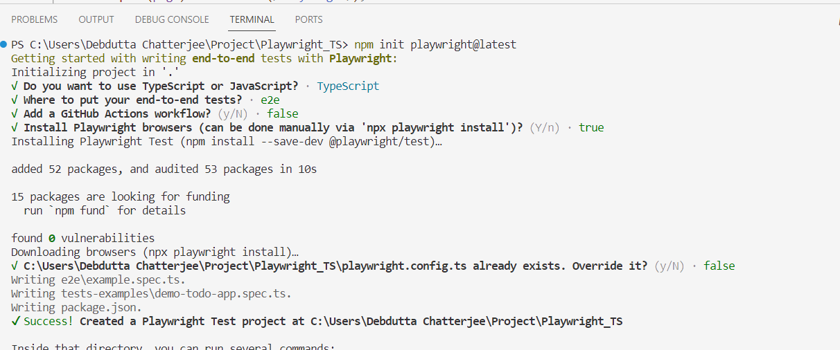
Installation
System Requirement
Node.js 16+
Windows 10+, Windows Server 2016+ or Windows Subsystem for Linux (WSL).
MacOS 12 Monterey or MacOS 13 Ventura.
Debian 11, Debian 12, Ubuntu 20.04 or Ubuntu 22.04, with x86-64 or arm64 architecture.
Installation command -> npm init playwright@latest
Choose between TypeScript or JavaScript (default is TypeScript)
Name of your Tests folder (default is tests or e2e if you already have a tests folder in your project)
Add a GitHub Actions workflow to easily run tests on CI
Install Playwright browsers (default is true)

