Slide 1
Optimal Equity Injection
for Banking Networks
Risk Management on Financial Markets
Based on: Bayraktar, Guo, Tang, Zhang (2025)
"Systemic robustness: a mean-field particle system approach"
Progress Presentation — March 13, 2026

Slide 2
Outline
1. Motivation & Context
2. Problem Formulation
3. Objectives (U and V)
4. Dynamic Programming Principle
5. Curse of Dimensionality
6. Numerical Method: Regression-Based DP
7. Ridge Regression
8. Default Cascades (Case 2)
9. Numerical Results
10. Socialistic Policy & Conclusions
Optimal Equity Injection
2 / 14

Slide 3
1. Motivation & Context
The 2008 Financial Crisis
Banks are interconnected through interbank lending. When one fails,
losses cascade through the system — systemic risk.
The Central Question
A regulator has a limited bailout budget c > 0.
How should it be distributed across N banks over T periods
to maximize the stability of the financial system?
Two Scenarios
Case 1: Banks are independent (isolated failures)
Case 2: Banks are interconnected (default cascades)
Optimal Equity Injection
3 / 14

Slide 4
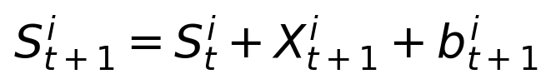
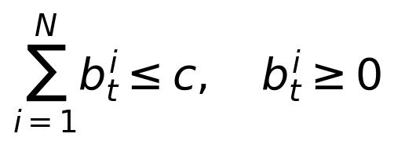
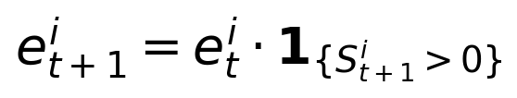


2. Problem Formulation
N homogeneous banks, discrete time t = 0, 1, ..., T
Capital dynamics:
Budget constraint:
Survival update:
State space:
Predictability:
Hybrid: continuous (capitals) + discrete (alive/dead)
Optimal Equity Injection
4 / 14

Slide 5
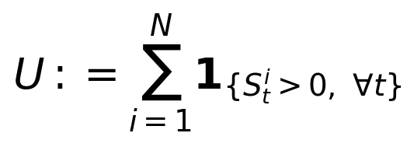
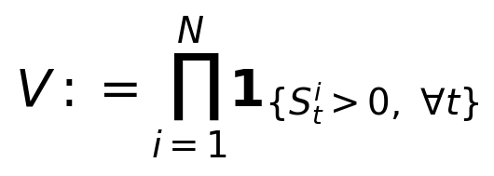
3. Objective Functions
Objective U
Objective V
Objective U
Expected number of banks
surviving to time T
Probability that ALL banks
survive to time T
Rewards saving any bank
Losing even one bank → zero reward
Optimal Equity Injection
5 / 14

Slide 6
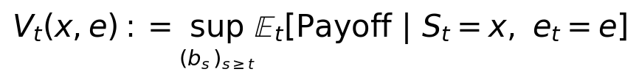
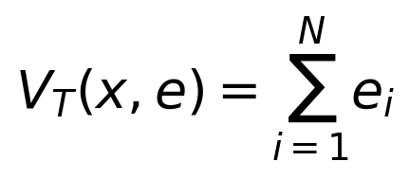
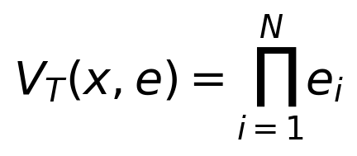
4. Dynamic Programming Principle
Value function:
Terminal conditions
Bellman equation:
Proof idea (Bellman’s principle of optimality):
1. Tower property: ℥ₜ[Payoff] = ℥ₜ[℥ₜ₊₁[Payoff]]
2. Decompose: sup over (bₜ,...,bₜ) = sup(bₜ) sup(bₜ₊₁,...,bₜ)
3. Inner sup = Vₜ₊₁ by definition ⇒ Bellman equation
Optimal Equity Injection
6 / 14

Slide 7
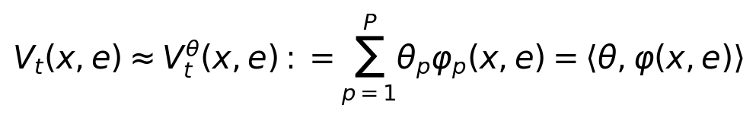
5. Why Exact Solution Is Impossible
Curse of Dimensionality
Grid-based solution requires Kⁿ × 2ⁿ states.
For N=10, K=100: ≈ 10²³ states — impossible!
Solution: Function Approximation
Approximate the value function with a linear combination of features:
P parameters
instead of
Kⁿ states
Optimal Equity Injection
7 / 14

Slide 8
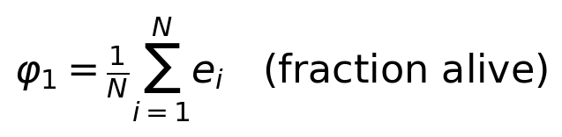
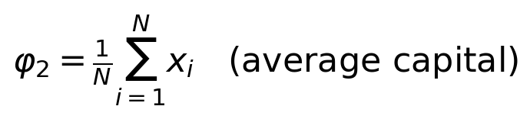
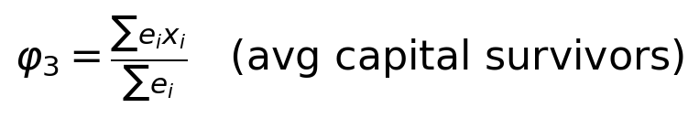
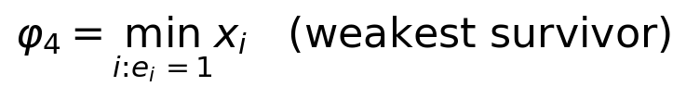
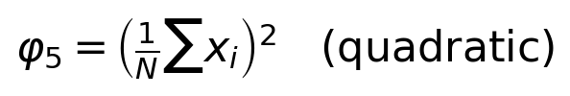

6. Feature Functions (Basis Functions)
Exploit permutation symmetry: all banks are identical ⇒ use aggregate statistics
Why these features?
Symmetric (permutation invariant)
Capture level, spread, extremes
Nonlinear (quadratic, interactions)
Linearly independent
⇒ Convex optimization
with closed-form solution!
Optimal Equity Injection
8 / 14

Slide 9
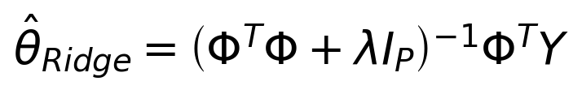
7. The Algorithm: Regression-Based DP
Step 0 (Terminal): Fit θₜ at t=T via ridge regression on terminal payoffs
Backward loop for t = T−1 down to 0:
Step 1 — Generate training states: Simulate N_train paths to time t using rollout policy
Step 2 — Compute targets (Monte Carlo): For each state and action,
sample M shocks, estimate Q(a), take Y = max Q(a)
Step 3 — Ridge regression: Solve for θₜ
Connections
Longstaff-Schwartz
(American option pricing)
Fitted Value Iteration
(approximate DP)
LSTD Learning
(reinforcement learning)
Optimal Equity Injection
9 / 14

Slide 10
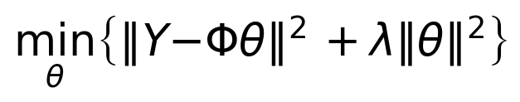
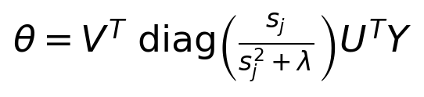
8. Ridge Regression
Why not OLS? Overfitting + ill-conditioning when P is large relative to N_train
Ridge objective:
Key Properties
✅ Always invertible
(ΦᵀΦ + λI is positive definite)
✅ Shrinkage: ||θ_Ridge|| < ||θ_OLS||
✅ Bias-variance tradeoff
λ↑ ⇒ Bias↑, Variance↓
Optimal λ minimizes total MSE
Solution:
SVD implementation (numerical stability):
Optimal Equity Injection
10 / 14

Slide 11
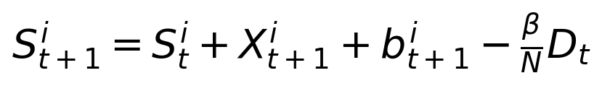
9. Default Cascades (Case 2)
When bank i defaults, every survivor loses β/N:
Cascade Algorithm:
Key Insight
One default can bring down the entire system!
Preventing ANY default prevents the cascade.
⇒ Socialistic policy is
especially important
1. Update capitals with shocks + injections
2. Find newly defaulted banks
3. Count new defaults D. If D = 0 → STOP
4. Each survivor loses β·D/N
5. Go to step 2 (fixed-point iteration)
Optimal Equity Injection
11 / 14

Slide 12
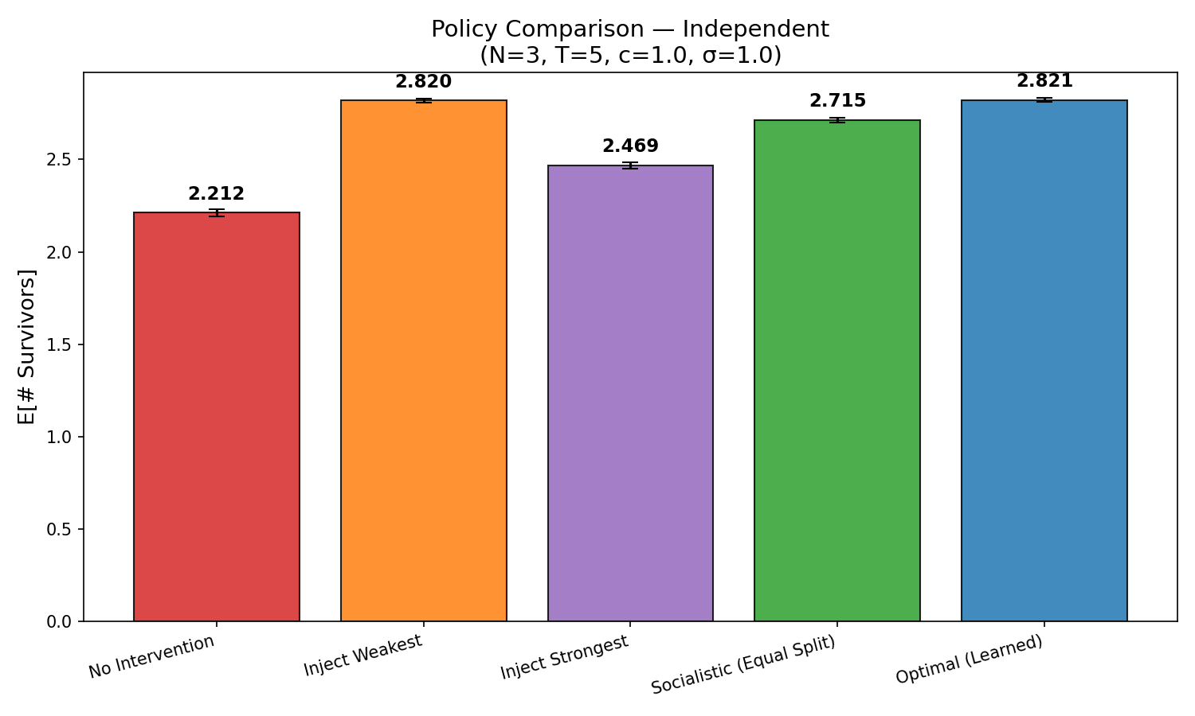
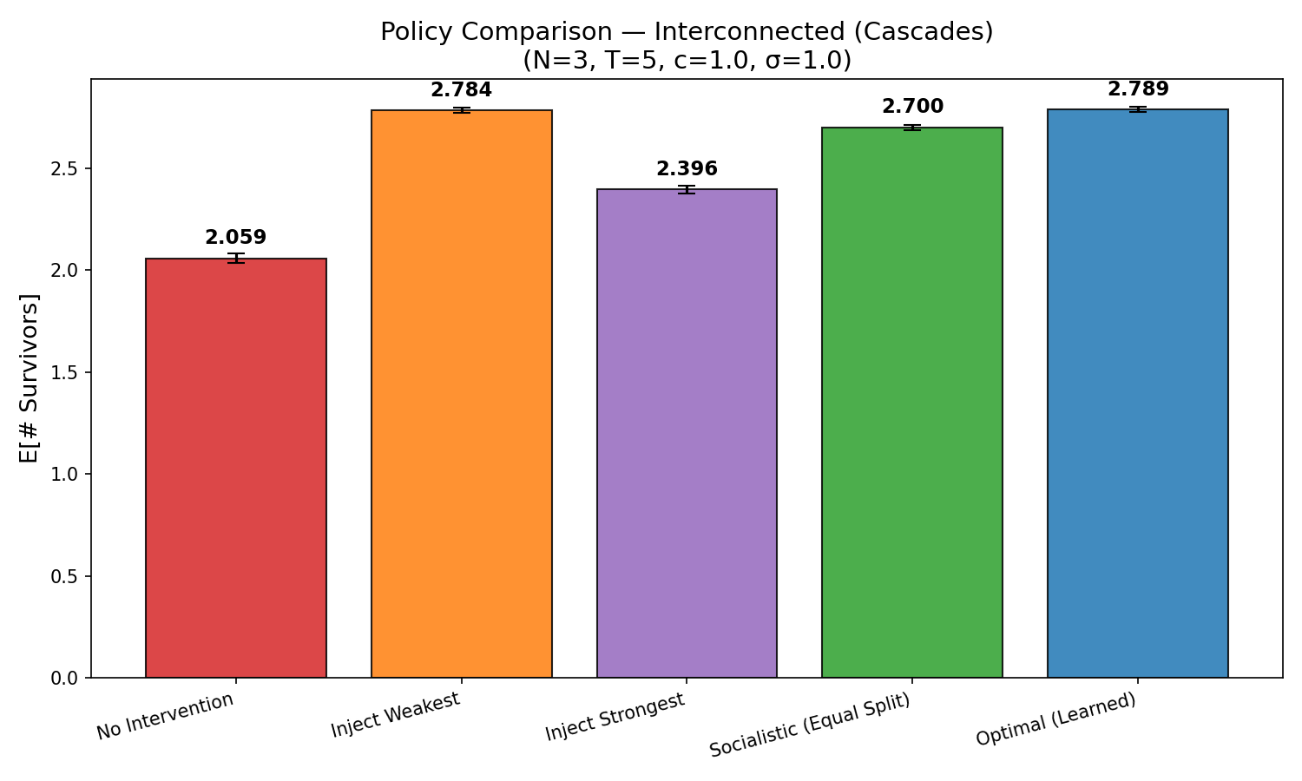
10. Results: Policy Comparison
N=3 banks, T=5, budget c=1.0, shocks ~ N(0,1), β=1.5 (Case 2)
Case 1: Independent
Case 2: Cascades
Optimal ≈ Inject Weakest >> Socialistic >> Inject Strongest >> Nothing
Optimal Equity Injection
12 / 14

Slide 13
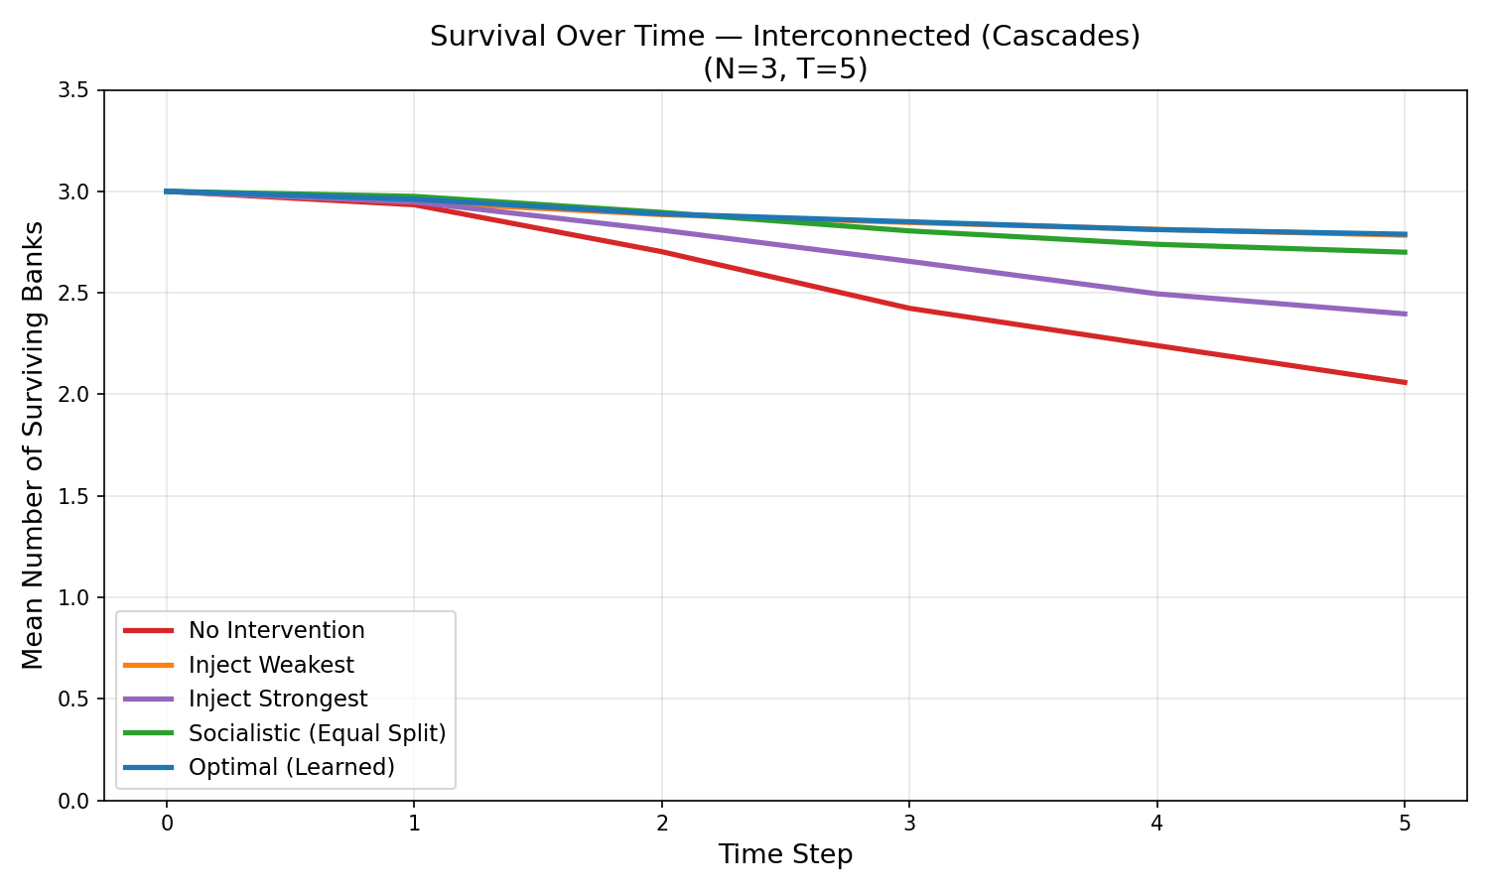
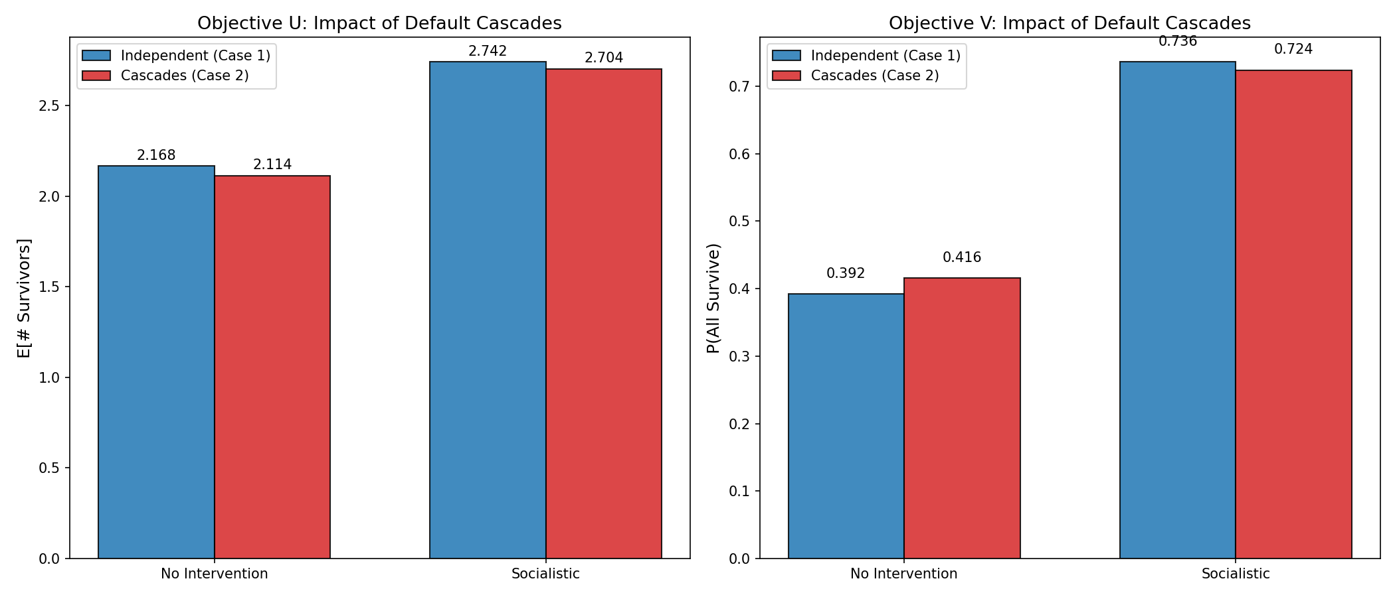
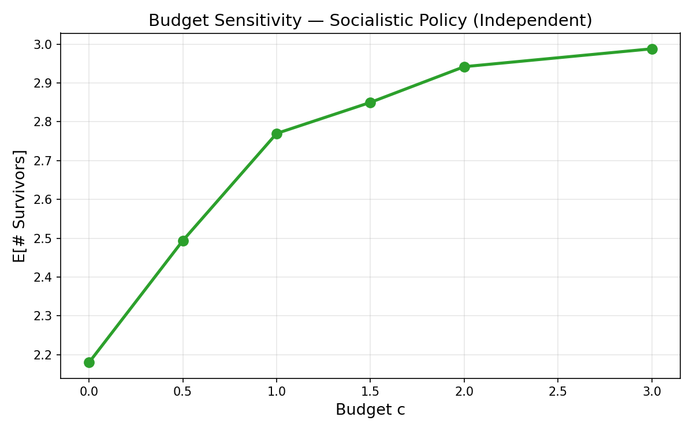
11. Survival Over Time & Cascade Effect
R² = 0.97–0.99 at all interior time steps → excellent fit
Optimal Equity Injection
13 / 14

Slide 14
12. Key Findings & Next Steps
Key Findings
Next Steps
✅ Socialistic policy achieves ~96% of optimal
✅ Inject weakest ≈ Optimal policy
✅ Default cascades increase the value of intervention
✅ Budget has diminishing marginal returns
✅ Regression fit is excellent (R² > 0.97)
▶ Scale to larger N (10, 50, 100)
▶ Test more feature functions
▶ Cross-validation for λ selection
▶ Compare objectives U vs V in depth
▶ Explore mean-field limit (N → ∞)
Optimal Equity Injection
14 / 14

