Slide 1
DDICA

Slide 2
Title : Deep Deterministic Independent Component Analysis for Hyperspectral Unmixing
Authors : Hongming Li, Shujian Yu, José C. Príncipe
Year : Feb 2022
Publication : IEEE

Slide 3
Introduction
Objective: Introduce the novel neural network-based independent component analysis (ICA) method designed for hyperspectral unmixing (HU).
Key Contributions:
Development of the DDICA method.
Challenging the notion that "ICA does not play a role in unmixing hyperspectral data".
Demonstration of superior performance compared to traditional ICA and deep ICA methods.

Slide 4
ICA
Independent Component Analysis (ICA) is a statistical and computational technique used in machine learning to separate a multivariate signal into its independent non-Gaussian components.
The goal of ICA is to find a linear transformation of the data such that the transformed data is as close to being statistically independent as possible.
The heart of ICA lies in the principle of statistical independence.
ICA identify components within mixed signals that are statistically independent of each other.

Slide 5
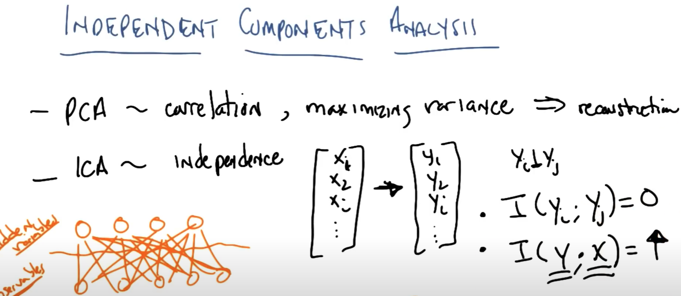
Given a set of features ,
The goal of ICA is to transform the feature space to another feature space such that the features generated in the new space are independent

Slide 6
Criticisms faced by ICA
. However, ICAbased approaches are not popular for HU mainly for two criticisms:
The sources are sometimes mixed in a nonlinear manner, whereas most existing ICA methods assume either a linear mixing matrix or the equivalence between the number of sources and the number of observations
The HU itself is not a strict ICA problem, because the sum of abundances are required to be 1. Due to these limitations, claims that “ICA does not play a competitive role in unmixing hyperspectral data”.

Slide 7
Improvements and answers to criticisms
In this paper, we challenge this point of view by developing a new deep neural network (DNN) based ICA.
We argue that,
for C1 , the nonlinear activation functions, such as ReLU, in DNNs naturally introduce nonlinearity in a hierarchical manner.
for C2, it can be simply addressed by introducing a softmax layer before the network output.

Slide 8
Deep Deterministic ICA
we use a DNN gθ, parameterized by θ, as the nonlinear unmixing function.
Our goal is to minimize the total dependence amongst all predicted sources [˜s1, s˜2, · · · , s˜p].
One popular way to define the total dependence for [˜s1, s˜2, · · · , s˜p] can be expressed as the Kullback–Leibler (KL) divergence from the joint distribution P(˜s1, s˜2, · · · , s˜p) to the product of marginal distributions P(˜s1)P(˜s2)· · · P(˜sp):

Slide 9
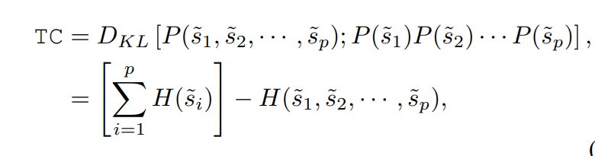
H(˜si)is the entropy of the i-th source, H(˜s1, s˜2, · · · , s˜p) is the joint entropy for [˜s1, s˜2, · · · , s˜p]
The below equation is also called also called the total correlation (TC)

Slide 10
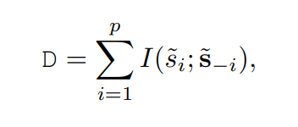
Alternate way
An alternative way to define the total dependence is by the following formula:
I denotes mutual information and ˜s−i refers to the set of all sources except the i-th source

Slide 11
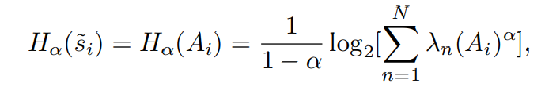
Matrix-based Renyi’s ´ α-order total correlation
A Gram matrix Ki ∈ RN×N can be obtained by computing Ki(n, m) = κ(˜s n i , s˜ m i )
where κ is a infinite divisible kernel which is usually assumed to be Gaussian
The entropy of s˜i can be expressed by:

Slide 12
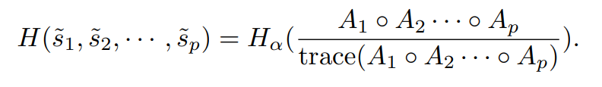
Joint representation
Further, the joint entropy for {s˜i} p i=1 is defined as
where Ai = Ki/ trace(Ki) is the normalized Gram matrix and λn(Ai) denotes n-th eigenvalue of Ai .
In this sense, our DDICA enjoys a simple and tractable objective min TC, which can be directly trained with SGD or its variants.

Slide 13
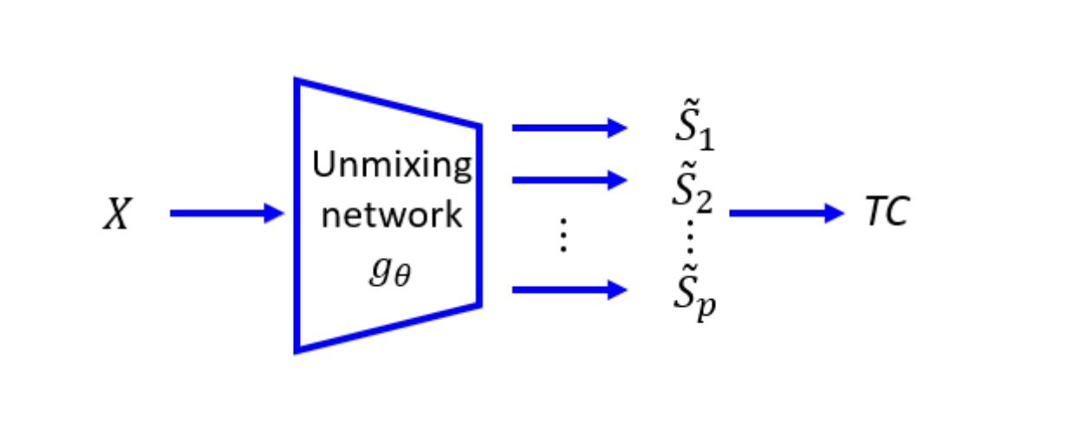
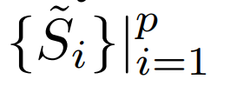
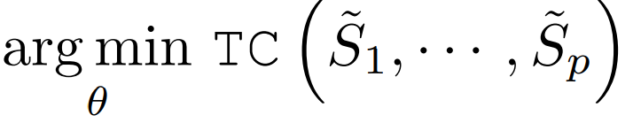
The architecture
Architecture of our proposed deep deterministic independent component analysis (DDICA). We directly minimize the total dependence of all predicted sources
with the objective
by the matrix-based Renyi’s ´ α-order total correlation (TC)

Slide 14
Unmixing function
The network gθ is a
Six to seven hidden-layer DNN with
ReLU activation for the first five layers and
softmax activation in the last layer.
The kernel width σ is fixed to be 0.1.
The α of our estimator is 1.01

Slide 15
Experiment on a real world hyperspectral dataset
For the experiment we select the Urban dataset:
There are 307x307 pixels, each of which corresponds to a 2x2 m2 area. In this image, there are 210 wavelengths ranging from 400 nm to 2500 nm.
After the channels 1-4, 76, 87, 101-111, 136-153 and 198-210 are removed (due to dense water vapor and atmospheric effects), we remain 162 channels (this is a common preprocess for hyperspectral unmixing analyses).
There are three versions of ground truth, which contain 4, 5 and 6 endmembers respectively, which are introduced in the ground truth.

Slide 16
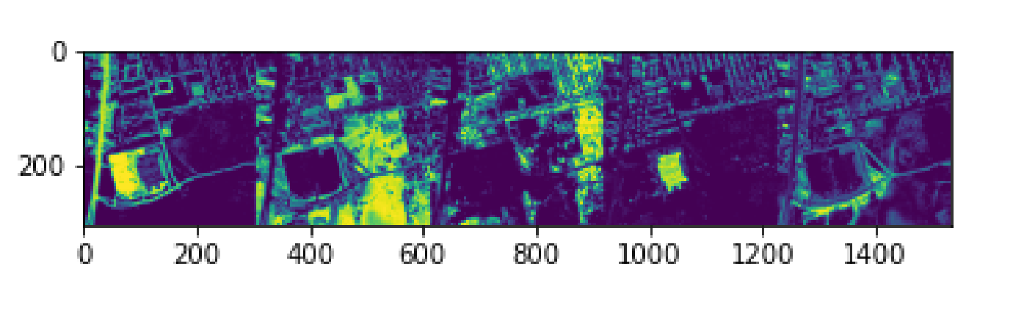
Endmembers of the dataset
In our experiment we will be using dataset which has ground truth of 5 endmembers:
They are:
Asphalt Road
Grass
Tree
Roof
Dirt

Slide 17
Conclusion
In this paper, we propose a novel deep neural network-based ICA without parametric estimation of mutual information. There are only two hyper-parameters in our mutual information estimation, i.e., order of Renyi’s entropy, kernel size. ´ Hence our framework is easier to train compared to variational approaches. We validate our model on hyper-spectral unmixing datasets. Our method outperforms other ICA-based approaches and achieves comparable results to the SOTA NMF-based ones.

Slide 18
Thank You

