Slide 1




Unlocking Growth: A Credit Card Opportunity Analysis
Mitron Bank's credit card analysis explores the growing demand in the Indian market, identifying key opportunities for strategic growth.
by Azeez Ibraheem

Slide 2
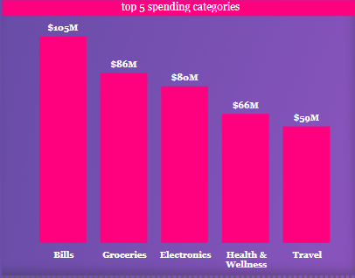
Understanding Customer Spending Habits
Key Insights
Top Spending Categories
Total spend: $531M across 4,000 customers in 5 cities
Bills
Groceries
Average spend: $614 per customer
Electronics
Average income utilization: 1.19%

Slide 3
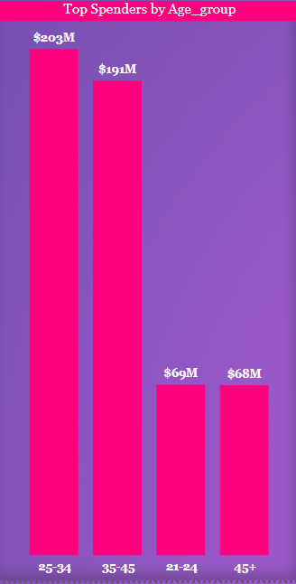
Identifying High-Potential Customer Segments
1
Ideal Credit Card Customer
Age: 25-45 years old
2
Occupation
Salaried IT employees
3
Location
Mumbai, Delhi NCR, Bengaluru
4
Marital Status
Married individuals

Slide 4
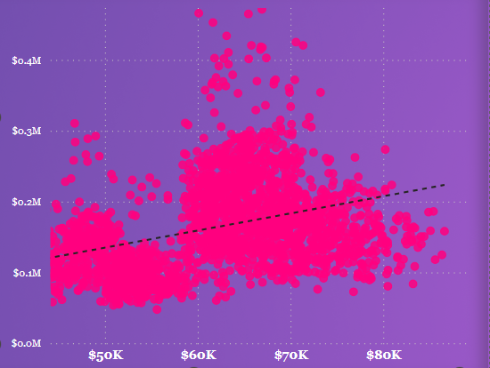
Understanding the Competitive Landscape
Feature
Mitron Bank
First Eagle
Rangers
Annual Fee
$50
$75
$60
Rewards Program
1 point per $1 spent
1.5 points per $1 spent
1 point per $2 spent
Welcome Bonus
10,000 points
15,000 points
5,000 points
Mitron Bank's credit card offerings need to be competitive with the market leaders to attract and retain high-value customers.

Slide 5





A Tailored Approach to Credit Card Growth
Target Marketing
Rewards Program
25-45 year old IT professionals in major cities
Focus on bills, groceries, and electronics
Retail Partnerships
City-Specific Features
Partner with popular brands in top spending categories
Tailor offerings for Mumbai, Delhi NCR, and Bengaluru

Slide 6


Conclusion: Data-Driven Strategy for Credit Card Growth
Leverage Insights
Implement the recommended strategies and monitor their effectiveness.
Continuous Improvement
Gather more data and refine the approach for long-term success.
Competitive Edge
A data-driven, customer-centric strategy will help Mitron Bank stand out in the credit card market.

Slide 7

Thank You
Collaboration
Looking forward to working with Mitron Bank to unlock the full potential of its credit card offerings.

