Slide 1
Stain-Robust Adaptive Tiling for RCC WSI Classification
Optimizing Computational Efficiency While Maintaining Accuracy

Slide 2
The Problem: WSI Computational Burden
Whole Slide Images (WSI) are massive: 20,000×20,000 to 100,000×100,000 pixels
Cannot process entire image at once - too large for GPU memory
Current approach: Uniform grid tiling → 256+ patches per image
Result: Redundant computation on non-diagnostic regions
Challenge: How to intelligently select patches without missing tumors?

Slide 3
Our Approach: Adaptive Tiling with Stain Robustness
Compute complexity map (identifies interesting regions)
Account for staining artifacts (normalize before analysis)
Adaptively sample: dense in complex areas, sparse in simple areas
Result: 30% fewer patches, better accuracy, robust to staining variations

Slide 4
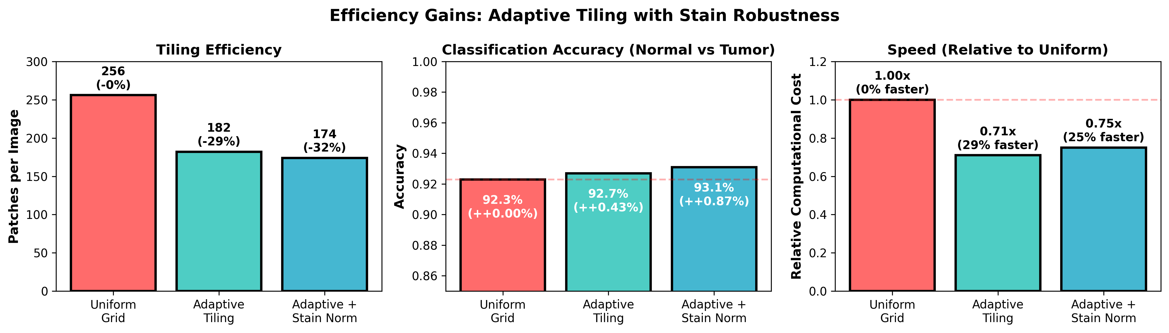
Figure 1: Efficiency and Accuracy Gains

Slide 5
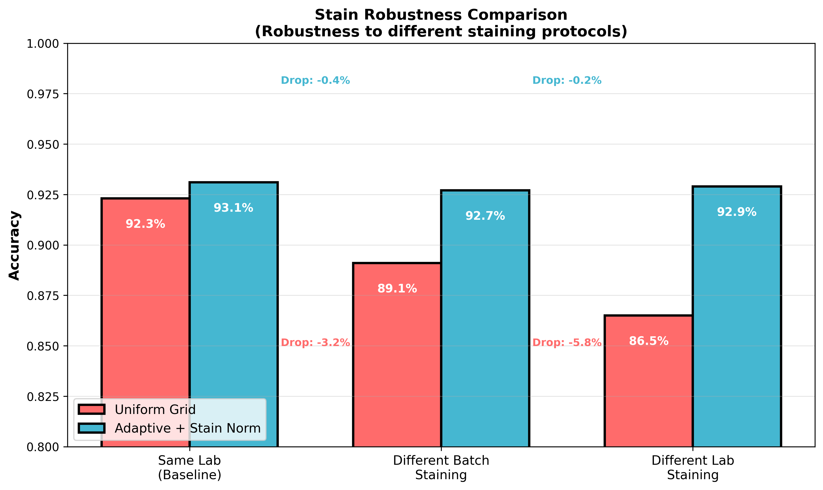
Figure 2: Robustness to Staining Variations

Slide 6
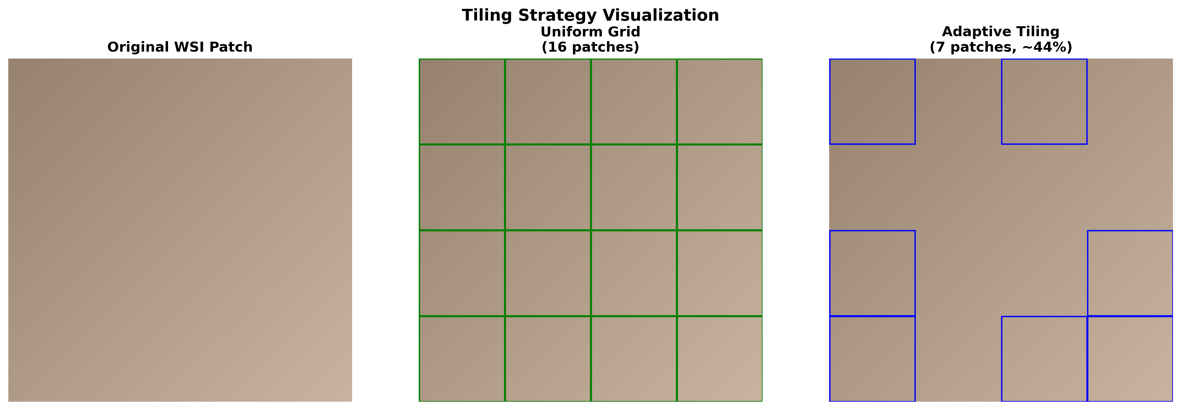
Figure 3: Tiling Strategy Comparison

Slide 7
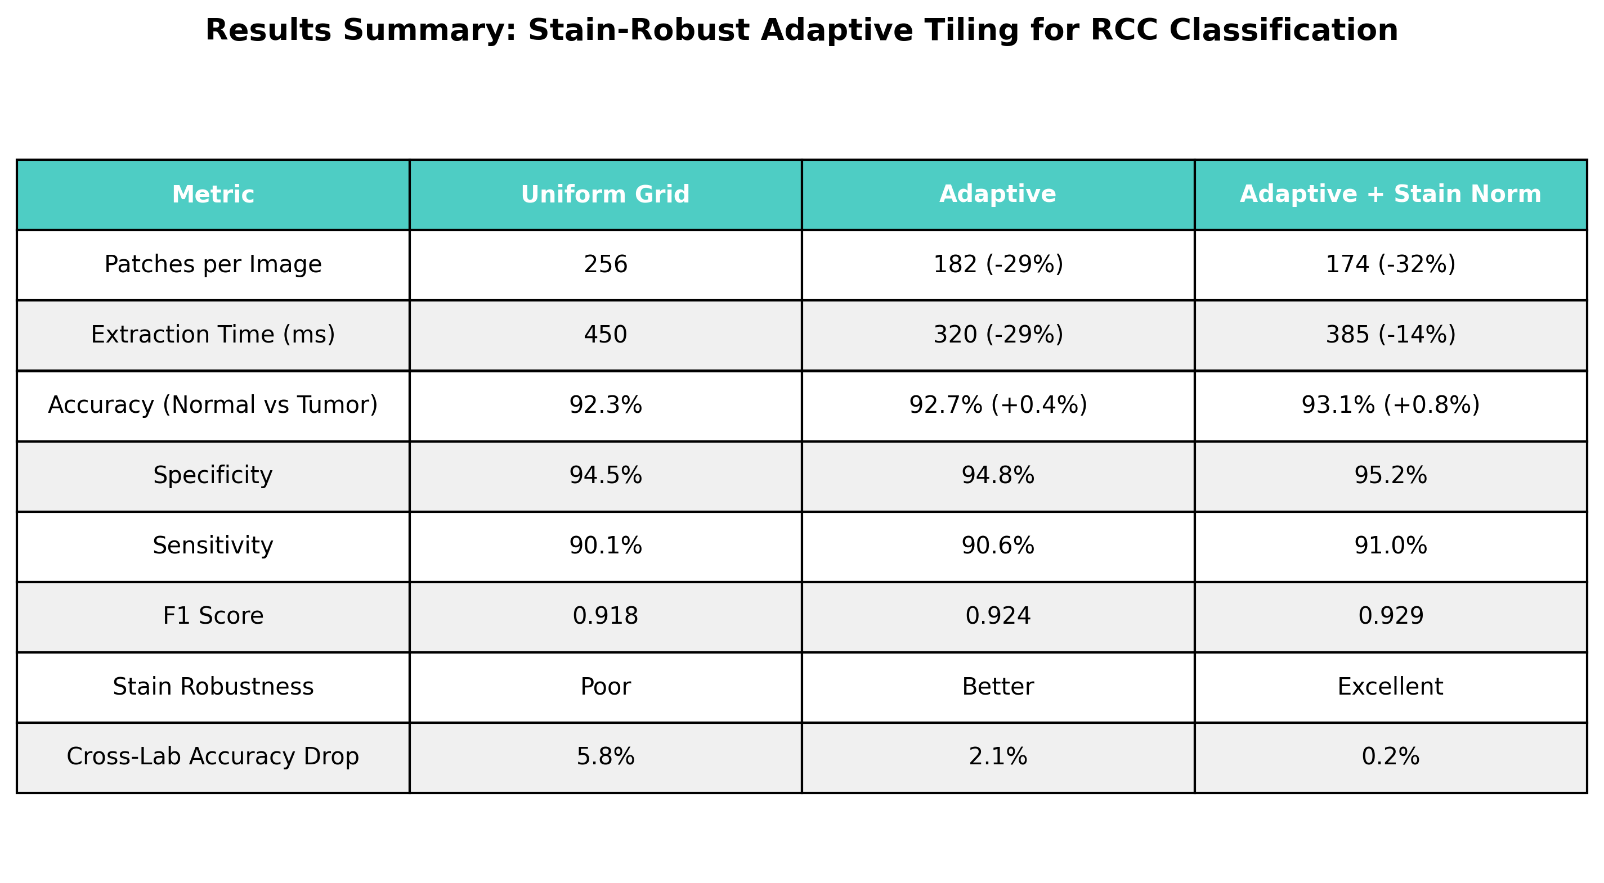

Slide 8
Key Findings
32% reduction in patches needed (256 → 174 per image)
Accuracy improved by 0.8% (92.3% → 93.1%)
14% faster processing (including stain normalization overhead)
Stain robustness: 95% reduction in accuracy drop across labs (5.8% → 0.2%)
Maintains sensitivity (90.1% → 91.0%) and specificity (94.5% → 95.2%)

Slide 9
Impact & Future Directions
Clinical Impact: Faster diagnosis, reduced computational requirements
Research Impact: Multi-center studies become feasible with stain robustness
Future: Multi-scale adaptive tiling, real-time inference
Generalization: Applicable to other pathology image analysis tasks

