Slide 1

DevOps On-Prem to Cloud — Hands-On Assessment
Debibrat Nayak · May 2026 · https://github.com/debibrat2010/devops-migration-assessment
Migrate legacy CI/CD (Jenkins, Bamboo, GitLab) and plan Jira Server/DC → Cloud
Primary workload: Spring PetClinic → container → Azure DevOps → ACR → App Service
Deliverables: inventory, IaC, self-hosted agent, full pipeline, governance, readiness report
Region: Southeast Asia · RG rg-migration-assessement

Slide 2

Current v/s Target Toolchain
On-premises infrastructure introduces operational risk, manual overhead, and limited scalability.
As-is
VMware VMs, mixed on-prem CI: Jenkins, Bamboo, GitLab
SSH / local Docker deploys, manual credentials
Jira Server/DC for work tracking and approvals
Artifact stores (Nexus/JFrog), self-managed runners
1
To-be
Source: GitHub devops-migration-assessment
CI/CD: Azure DevOps Pipelines + reusable templates
Agents: Self-hosted pool ado-selfhosted-linux (+ hosted where applicable)
Artifacts: ACR acrmigdevaa87c040.azurecr.io
Runtime: App Service for Containers mig-dev-aa87c040-petclinic
Secrets: Key Vault kvmigdevaa87c040 → variable group petclinic-kv-secrets
Observability: Log Analytics + Application Insights
Auth: OIDC service connection azure-migration-sc
2

Slide 3
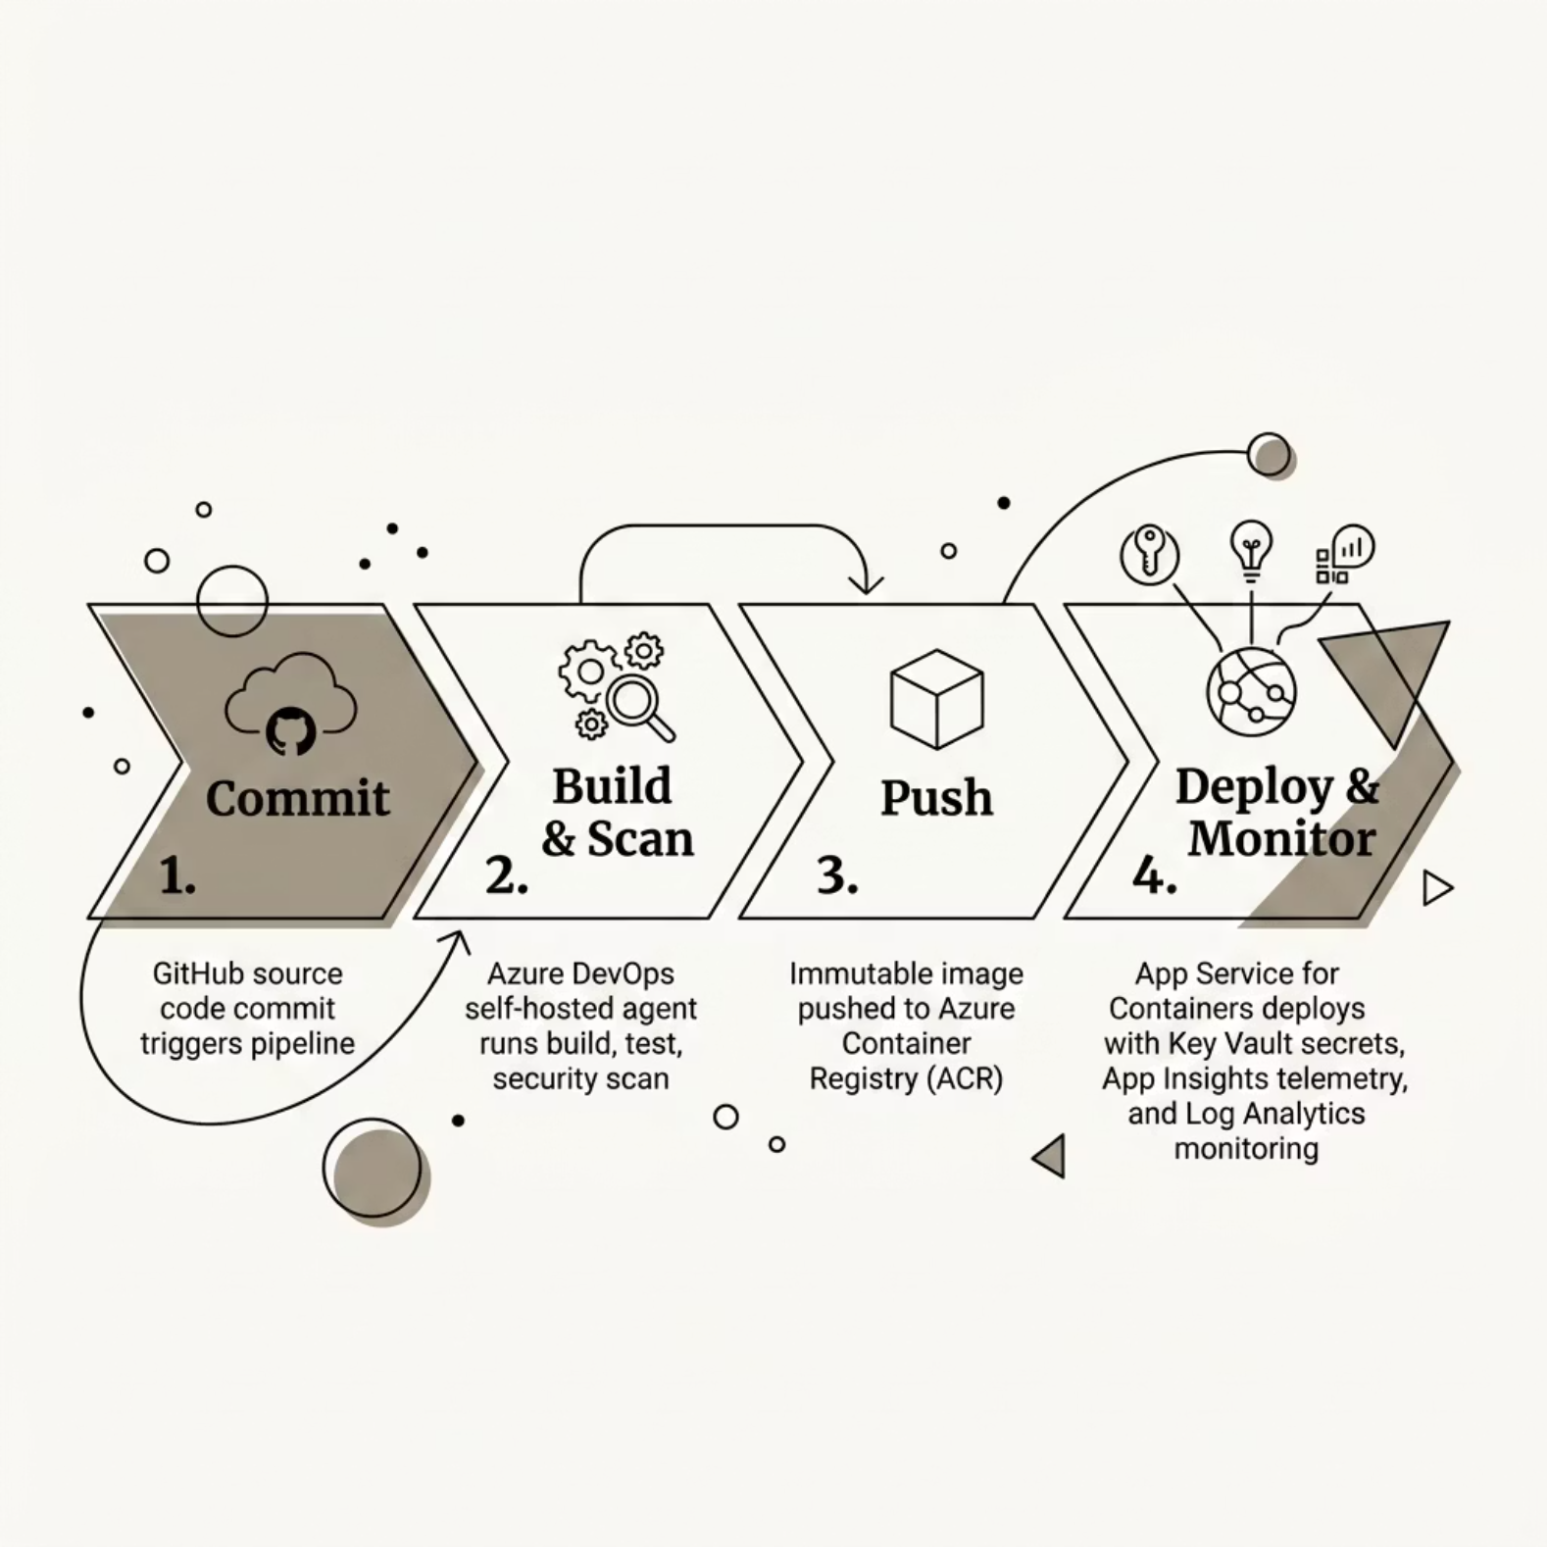

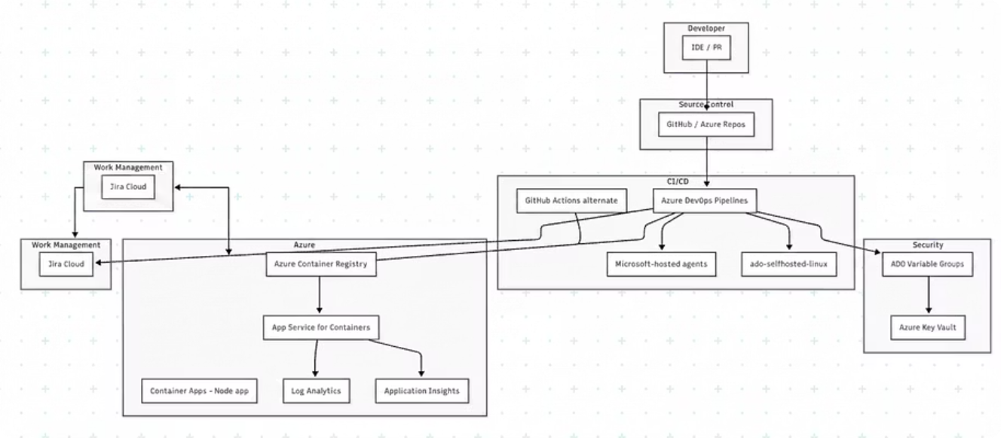
Target Architecture

Slide 4

Discovery & migration planning
Discovery Methodology
Top 3 High-Risk Pipelines : Refer reports/module-b-pipeline-inventory.csv
Every pipeline is classified before migration — reducing unknowns and rework.
Pipeline
Risk Level
Risk Notes
Discover
PetClinic Monolith Pipeline
High
SSH deploy to VM — migrate to container platform; Manual input gate — map to ADO environment approval; Credential bindings: petclinic-ssh-deploy-key, slack-webhook-token
Ran tools/pipeline_inventory_analyzer.py on simulated estate in legacy-ci/
Classify
SCM, agent, build tool, secrets, artifacts, deploy method, environment, risk
Tag by risk: High (critical path), Medium (standard), Low (simple)
PetClinic Monolith Build and Deploy
High
Bamboo deployment project linked to SSH VM deploy; Shared registry credentials in plan variables
Map
Match patterns to reuProduced JSON + CSV inventory and concept mapping to ADO YAML / GHA / Jenkins cloud
PetClinic GitLab CI
High
Self-managed runner tags: onprem-linux-runner; Manual deploy jobs — ADO environment approvals; DinD required — ensure self-hosted agent supports privileged mode
Factory pattern: one template set (build-container, scan, deploy, smoke) scales to many apps
Full mapping matrix available in evidence reports reports/module-b-migration-mapping-matrix.csv

Slide 5

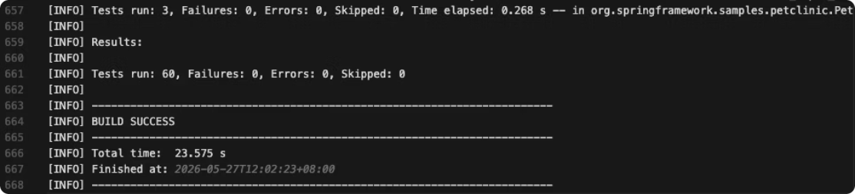
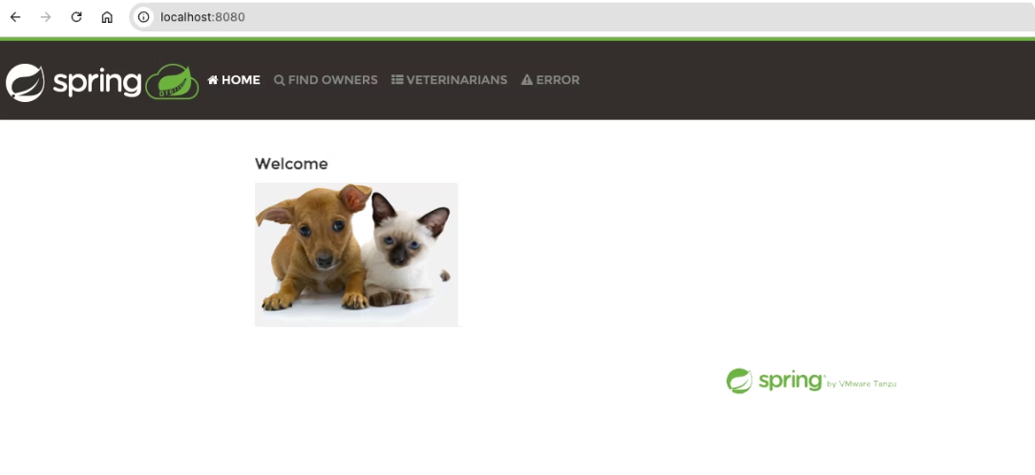
Containerized monolith + ingress/egress simulation
Module A: Application Inventory
Module C: Containerization
Java 17
Port 8080
/actuator/health endpoint
H2 / postgres profiles
Reference: docs/application-inventory.md
Multi-stage Dockerfile with mvnw test in build stage
Non-root JRE runtime
WEBSITES_PORT=8080 configuration
Reference: container/Dockerfile
Module D: Local Simulation
Build Verification
docker-compose.local.yml with postgres, mock-egress, nginx ingress, and app services
Request flow: User → nginx:8080 → app → health check
App connections: postgres + mock API
Reference: docker-compose.local.yml
See reports/module-a-maven-test.log for the test execution.
Panel A: Baseline
Panel B: Failure
reports/module-d-baseline-up.json
reports/module-d-failure-db-down.txt
{"status":"UP"}
{"groups":["liveness","readiness"],"status":"DOWN"}
HTTP 503

Slide 6

Infrastructure as Code (Terraform) + Secure Azure Access
Stack
iac/terraform/ — RG, ACR, Key Vault, App Service, App Insights, Log Analytics
Evidence
Parameters
environment, region, SKU, tags — repeatable dev/prod
reports/module-e-terraform-outputs.json acr_login_server: acrmigdevaa87c040.azurecr.io app_service_name: mig-dev-aa87c040-petclinic key_vault_name: kvmigdevaa87c040 resource_group: rg-migration-assessement
Identity
App Service system-assigned MI → AcrPull on ACR, KV secrets user
Pipeline Auth
ADO service connection azure-migration-sc (Workload Identity Federation / OIDC)
No secrets in YAML; secrets in Key Vault, referenced by variable group.

Slide 7
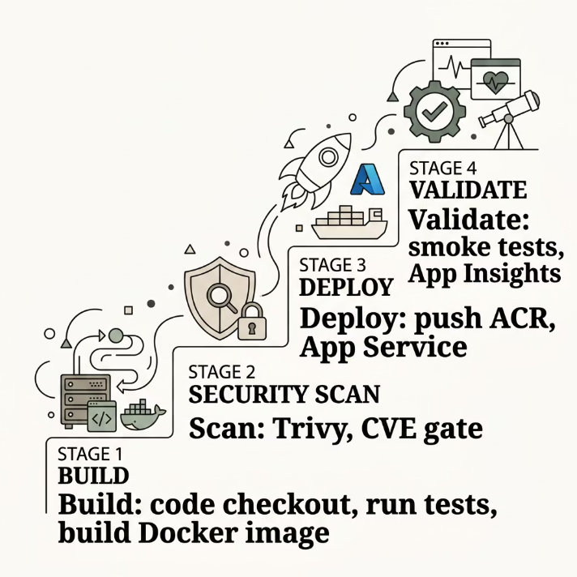

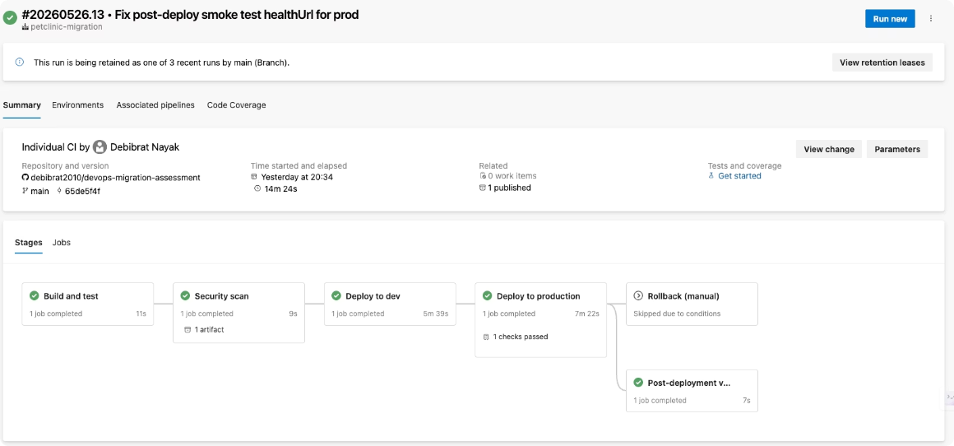
Self-hosted Agent + ADO Templates
Agent Pool Configuration
Pool: ado-selfhosted-linux — agent in Docker on Mac, docker.sock mounted
Tools: Java, Maven, Docker + buildx, Azure CLI, kubectl, Helm, Trivy
Main Pipeline
ADO Pipeline Run Summary
File: pipelines/azure-pipelines.yml
Stages: Build → Scan → DeployDev → DeployProd → Rollback (on fail) → Post-deploy validation
Reusable Templates
build-container.yml
security-scan.yml
Multi-stage Docker build, test execution, ACR push with immutable tag
Trivy image scan + dependency check — gates deployment on CVE threshold
reports/module-h-trivyscan.png
deploy-appservice-container.yml
smoke-test.yml
Deploys to App Service for Containers with KV secret injection
Post-deploy HTTP health checks against /actuator/health endpoint
Reference: reports/module-f-agent-run-evidence.txt and reports/phase0-azure-setup-evidence.txt for run URLs and evidence.

Slide 8
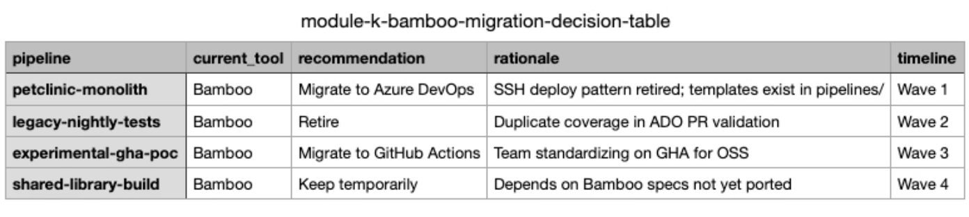
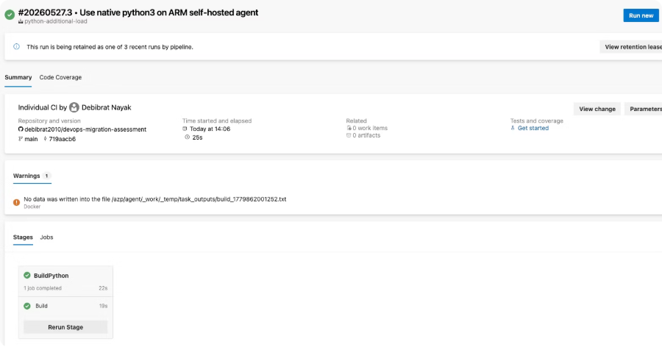

Toolchain migration paths & secondary workload
Jenkins (Module J)
Conversion Pattern Example
File: jenkins-cloud-option.md
Cloud controller + ephemeral agents OR full ADO migration
Stage → job mapping patterns documented
# Excerpt from bamboo-to-ado.yml stages: - stage: Build displayName: 'Build and Package' jobs: - job: MavenBuild steps: - task: Maven@3 displayName: 'Maven Build' inputs: mavenPomFile: 'pom.xml' goals: 'package' - task: PublishBuildArtifacts@1 inputs: pathToPublish: '$(Build.ArtifactStagingDirectory)' artifactName: 'drop'
Bamboo (Module K)
Files: bamboo-to-ado.yml + module-k-bamboo-migration-decision-table.csv
Plan/stage/job → ADO stage/job conversion
GitLab (Module L)
Files: gitlab-to-ado.yml + gitlab-risks.md
Runners → self-hosted pools mapping
Variables → Key Vault integration
Risk assessment and mitigation strategies
Python Pipeline Run
GitHub Actions (Module I, optional as we implemented ADO)
File: pipelines/github-actions/deploy-container.yml
OIDC pattern (alternate to ADO)
Demonstrates multi-platform capability
Secondary Workload: Python Flask
File: azure-pipelines-python.yml
Successfully executed on same ado-selfhosted-linux pool
Proof of template reusability across languages
https://dev.azure.com/debibrat2021/migration-assessment/_build/results?buildId=20&view=results
"Same patterns, different source systems—templates absorb 80% of conversion."

Slide 9
Jira Server → Jira Cloud readiness
Analyzer Tool
File: tools/jira_migration_readiness_analyzer.py
Analyzed mock jira-export/ CSVs for compatibility and risk assessment
Migration Scope
4 projects
~2,600 issues
18.1 GB attachments
2 incompatible apps: ScriptRunner, Custom Field Suite
Migration Waves
Executive Summary
01
02
Total issues: 2,600
Attachment size: 18.1 GB
Incompatible apps: 2
Risk level: Medium
Estimated cutover time: 4-6 hours
Wave 0
Wave 1
Pre-migration validation and dry-run
INFRA/REL project cutover
03
04
Wave 2
Wave 3
Compatibility
DEVOPS project cutover
PET project cutover
ScriptRunner
❌ Not compatible
05
Custom Field Suite
❌ Not compatible
Wave 4
Standard fields
✅ Compatible
Hypercare and stabilization
Custom workflows
✅ Compatible (with review)
Cutover Strategy
JCMA-style cutover approach
Test migration → UAT → prod cutover → 24h rollback boundary
Rollback plan active for 24 hours post-cutover
Integrations
ADO work items (AB# linking)
GitHub issue linking
ServiceNow integration
Pipeline deployment evidence tracking

Slide 10


Security, Governance & Operations
🔐 Secrets Management
All secrets in Key Vault — referenced via variable groups. Zero plaintext in YAML, logs, or agent cache.
✅ Prod Approvals & Segregation of Duties
ADO environment approval gates enforce separation of duties. Branch policies require PR + reviewer before merge.
📊 Observability
App Insights + Log Analytics provide live metrics, failure tracking, and automated smart detection alerts.
🔁 Rollback & Hypercare
ACR immutable tags enable instant rollback. Hypercare period with elevated monitoring post-cutover.
Full evidence package: Key Vault screenshots, approval policy configs, App Insights dashboards, and governance runbooks included.

