Slide 1

FitML: A Fairness-Audited Machine Learning System for Sizing and Intelligent Virtual Try-On in E-Commerce
Pillar 5: Capstone Project
Postgraduate Diploma in Artificial Intelligence and Machine Learning
Debie Galleros · July 2026
Technical presentation — fit-ml.netlify.app · github.com/debiegalleros/fitml-capstone

Slide 2
Problem framing and task type
35%
$100B+
2 questions
online clothing return rate (vs ~8% in physical stores)
annual cost of returns to retailers
“will it fit?” and “how will it look on me?” — both drive hesitation
The data science task
What makes it different
–
Supervised multi-class classification: predict reported fit outcome — fit / runs small / runs large — from body measurements + ordered size
–
A published fairness audit — disparate impact, equalized odds, SHAP, and a mitigation with honest before/after numbers
–
Labels are real customer fit feedback (not collaborative filtering)
–
Commercial sizing tools are black boxes; FitML treats the audit as a first-class deliverable
–
Selection metric: macro-F1 — accuracy is blind to minority classes under a 73%-majority target
–
Generative AI try-on (IDM-VTON/SDXL via Replicate) gives the visual answer, with a 2D compositor as automatic fallback — not 3D
FitML — Pillar 5: Capstone Project · Debie Galleros

Slide 3
Dataset: 251,047 real fit reviews
Kaggle “Clothing Fit Dataset for Size Recommendation” — ModCloth + RentTheRunway
Class balance (the core difficulty)
Women's core (graded ML)
Men's extension (demo)
Customers
251,047 real reviews
200 synthetic
72.7%
Labels
Real fit feedback
Uniqlo chart lookup
fit
Sizing logic
4 trained classifiers
Deterministic rule
13.7%
Fairness audit
Included (full)
Excluded (documented)
large
Why: both platforms sell women's apparel, so real data is women's-only. Real, citable data where it exists; a small, clearly-flagged synthetic extension for the gap — an explicit limitation, not a silently patched one.
13.6%
small
Features (all self-reported / user-entered)
72.7 / 13.7 / 13.6 — a model that always says “fit” gets 72.7% accuracy while being useless.
height · weight · bust band + cup · hip · body type · garment category · ordered size — target: fit / small / large
FitML — Pillar 5: Capstone Project · Debie Galleros

Slide 4
EDA and feature engineering
notebooks/02_eda_feature_engineering.ipynb · reusable logic in src/prepare_data.py
Two schemas, harmonized
Missingness is structural — flagged, not hidden
Height parsed from “5ft 6in” vs “5' 8"”; 68 RentTheRunway category tags mapped to a 4-bucket taxonomy; cup letters unified to an ordinal scale (AA=0 … K=11). 24,287 ModCloth rows with no garment signal dropped.
Weight absent for ALL ModCloth rows; hips for ALL RentTheRunway rows. Each gets a _missing indicator beside median imputation; body_type gets an explicit not_reported category (never a guessed shape). SHAP later proves the model uses these flags.
PCA: a useful negative result
Leakage discipline
Body-type clusters overlap heavily in 2D — components track overall size, not shape. Raw measurements won't trivially separate body types, so the fairness audit needs per-group metrics.
model_ready.csv ships unscaled and un-encoded; scaling and one-hot encoding are fitted inside each model's train-only Pipeline. Post-purchase fields (rating, review text) excluded as features.
FitML — Pillar 5: Capstone Project · Debie Galleros

Slide 5
Model comparison: four classifiers, one honest headline
Same stratified 80/20 split (200,837 / 50,210 rows, seed 42) · same features · preprocessing fitted train-only
model
accuracy
macro-F1
F1 fit
F1 large
F1 small
Why macro-F1?
XGBoost (selected)
0.7272
0.2918
0.8418
0.0219
0.0115
“Small” and “large” are the whole point: they are the cases where a recommendation prevents a return.
Macro-F1 weights each class equally, exposing the minority-class failure that accuracy hides.
Accuracy would call a coin-flip between these models; macro-F1 separates them.
Random Forest
0.7278
0.2848
0.8424
0.0101
0.0018
MLP (64/32)
0.7272
0.2825
0.8420
0.0043
0.0012
Logistic Regression
0.7267
0.2822
0.8418
0.0000
0.0046
Every unweighted model collapses toward the majority class — accuracy is pinned at the 72.7% baseline for all four; logistic regression never predicts “large” at all. XGBoost wins as the only model with non-trivial F1 on both minority classes.
Trees beat the MLP, as predicted — gradient-boosted trees dominate MLPs on modest tabular data. A legitimate finding, reported honestly (equal-footing, untuned hyperparameters for all four).
FitML — Pillar 5: Capstone Project · Debie Galleros

Slide 6
Fairness audit: methodology
src/fairness_audit.py re-derives the exact Phase 5 split and asserts it matches the pinned test indices
Two harms audited
–
Quality-of-service: misfit detection failing more for some groups → wrong “it fits” reassurance → returns
Baseline finding: “fair” numbers that mean nothing
–
No group is DI-flagged (all ≥ 0.98) — because the model predicts “fit” for 99.5% of rows in every group. A model that always says yes passes the four-fifths rule by construction.
Inside the predictions: a 7.3-point accuracy gap against size 24+ shoppers; “runs large” caught 8.2% of the time for full-bust vs 0.34% for pear (24×); zero “small” recall for apple body types.
The fit-class FPR is 0.96–1.00 everywhere: when an item does not fit, virtually every shopper is told it does.
Allocation-style: the favorable “fit” prediction handed out at unequal rates
Groups (each ≥ 1,000 test rows)
–
body_type — 8 groups incl. not_reported (n=14,800)
–
height_band — under 160 / 160–169 / 170+ cm
–
size_band — US 0–6 / 8–14 / 16–22 / 24+
Metrics
Per-group accuracy and per-class recall · disparate impact ratio (four-fifths rule, <0.8 flagged) · equalized-odds TPR/FPR spreads
FitML — Pillar 5: Capstone Project · Debie Galleros

Slide 7
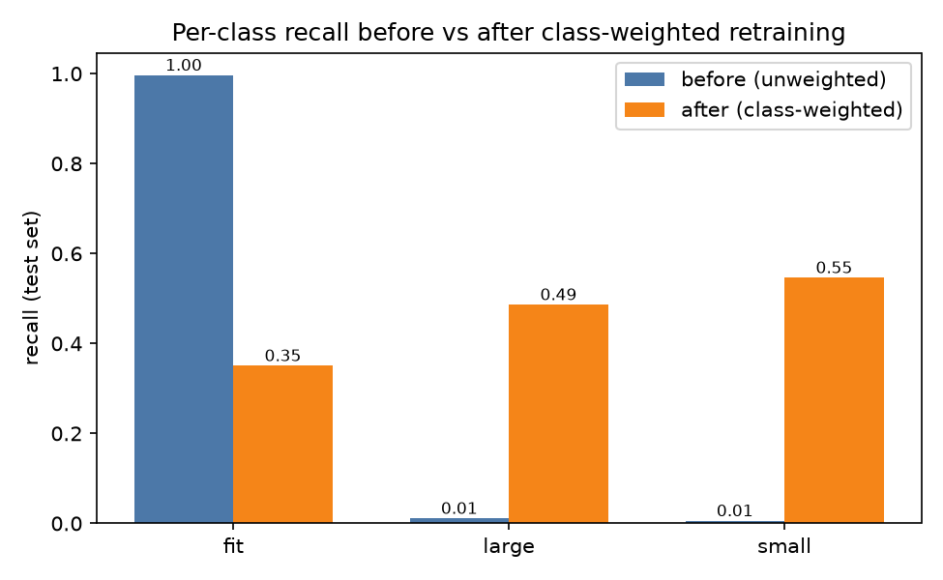
Mitigation: class-weighted retraining — before / after
Identical pipeline, split, and seed; the only change is balanced sample weights
metric
before
after
macro-F1 (selection metric)
0.2918
0.3596
recall — large
0.011
0.486
recall — small
0.006
0.546
worst-group fit FPR
0.996
0.346
accuracy
0.727
0.396
DI flags
0 (vacuous)
7 (informative)
The flags after mitigation are informative, not a regression — once the model actually discriminates between classes, it surfaces the real disparity the degenerate baseline had hidden (size 24+ DI 0.41; apple/full-bust 0.64–0.70). Height stays equal (≥ 0.99).
Deployed: the class-weighted model. Catching misfits matters more than raw accuracy; the confidence % and blue/amber advisory layer absorb the uncertainty.
FitML — Pillar 5: Capstone Project · Debie Galleros

Slide 8
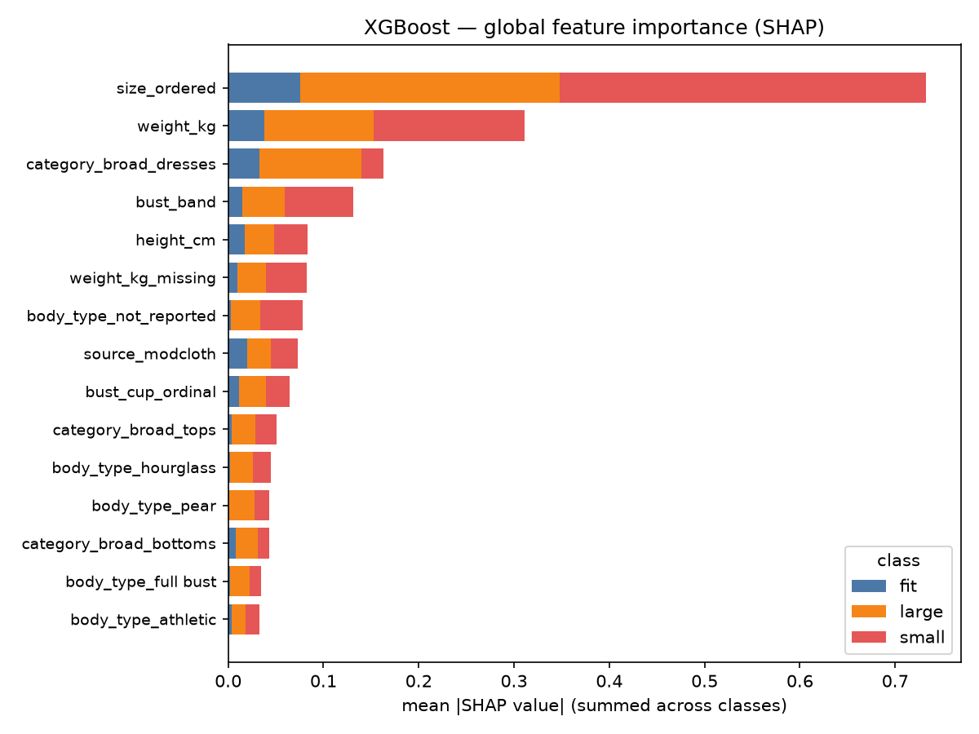
Explainability: SHAP on the winning model
TreeExplainer · 3,000 test rows · seed 42
–
size_ordered dominates (mean |SHAP| 0.38 for small, 0.27 for large vs 0.08 for fit) — and directionally correctly: high ordered size, low weight, small bust band all push toward “runs small”.
–
The model learned real sizing signal; it is the decision threshold, drowned by class imbalance, that fails — exactly what class weighting attacks.
–
Red flag: missingness is predictive. weight_kg_missing and body_type_not_reported rank in the top 7 for minority classes. Shoppers who disclose less get systematically different predictions — a data-completeness bias, answered with transparency in the product (confidence drops when key fields are absent).
FitML — Pillar 5: Capstone Project · Debie Galleros

Slide 9
Architecture: data to deployed product
OFFLINE — reproducible, seed 42
Kaggle fit data
model_ready.csv
train_models.py
fairness_audit.py
251k reviews
prepare_data.py
15 columns, flags,
no leakage
LogReg · RF ·
XGBoost · MLP
DI · equalized odds · SHAP
→ xgboost_weighted.joblib
Catalog pipeline
117 items · rembg cutouts
234 hue variants
served model (weighted XGBoost)
catalog assets
LIVE — fit-ml.onrender.com (Docker) + fit-ml.netlify.app
Frontend (vanilla JS)
Flask API
MediaPipe
6 pages · Canvas compositing
profile · catalog · try-on ·
history
/upload-profile (crop-at-upload, pose)
/recommend-size (weighted XGB,
chart-anchored) · /api/tryon · /advice
pose · crop-at-upload
Claude API
advice text only (read-only)
FitML — Pillar 5: Capstone Project · Debie Galleros

Slide 10
Generative AI: used deliberately, fenced off from the graded ML
Claude Vision + Replicate — generative try-on & fit advice
rembg / U²-Net — catalog background removal
Claude Vision analyzes the shopper's photo + garment, producing a structured prompt; IDM-VTON (default) or SDXL inpainting renders the try-on via Replicate. Claude then reviews the composited image for two paragraphs of plain-language advice (second must start “Note:”; tailoring jargon banned).
Try-on renders the recommended size, never decides it. Advice never estimates measurements or overrides the model — a read-only consumer of the prediction.
A pretrained segmentation CNN produces the transparent garment PNGs the try-on compositor warps.
Runs offline, once per image, at catalog build time. Sees no user data, produces no labels, touches no training data.
Why the fence?
–
Auditability — the audit's quantitative claims need a fixed, inspectable model; a generative model in the prediction path would make them unverifiable
–
No silent data invention — vision-estimated measurements would inject body-type-correlated error into exactly the variables the audit stratifies on
–
Reproducibility — graded artifacts rebuild from fixed seeds; generative output is confined to advice prose and one-time asset prep
FitML — Pillar 5: Capstone Project · Debie Galleros

Slide 11
Limitations and future work
Known limitations (documented, not hidden)
Future work
–
Severe class imbalance remains the dominant problem — one mitigation trialed, fully audited
–
Probability calibration + per-group thresholds to equalize misfit-detection rates — the clear next mitigation
–
Random split does not group repeat customers (IDs dropped upstream)
–
FIT dataset (2026, 1.13M fit-aware try-on triplets) — the research path beyond today's garment-conditioned rendering at a scaled size, toward true per-size drape
–
Self-reported measurements — noisy, plausibly in group-correlated ways
–
Transformer clothing parsing (SegFormer benchmarked: no net win today — 59 vs 56 clean items, 5 failures)
–
Groups are proxies: no age/ethnicity/disability fields in the data
–
Color-suitability matching — scoped out from the start
–
Men's extension is chart-based and unaudited, by design
–
bust_input_method audit once real usage data exists
Live demo: fit-ml.netlify.app Repository: github.com/debiegalleros/fitml-capstone Full audit: docs/fairness_report.md

