Slide 1

FitML: A Fairness-Audited Machine Learning System for Sizing and Intelligent Virtual Try-On in E-Commerce
Pillar 5: Capstone Project
Postgraduate Diploma in Artificial Intelligence and Machine Learning
Debie Galleros · July 2026
Business presentation — live demo: fit-ml.netlify.app

Slide 2
Returns are eating online fashion's margins
35%
$100B+
#1
of online clothing orders come back — vs about 8% in physical stores
what returns cost retailers every year
cause: sizing uncertainty — shoppers can't try before they buy
Two questions stop a shopper from clicking “buy”:
“Will it fit?”
Every wrong answer is a return — shipped twice, repacked, often discounted.
“How will it look on me?”
If the shopper can't picture it, they don't buy — or they order three sizes to try at home.
FitML — Pillar 5: Capstone Project · Debie Galleros

Slide 3
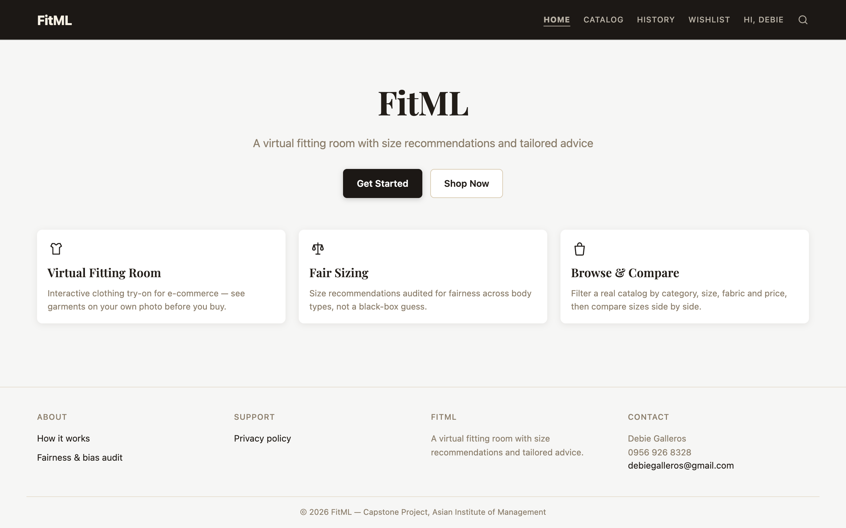
FitML answers both — before the purchase
A working prototype, live at fit-ml.netlify.app
1
Set up a profile once
The shopper enters their measurements and uploads one photo. Nothing is guessed from the photo — it is only used to show garments on them.
2
Browse and try on
117 real items with filters, prices, and color options. One tap shows the garment on the shopper's own photo.
3
Get a size and honest advice
A recommended size with a confidence level, plus two short paragraphs of plain-language advice — including what the try-on photo actually shows.
The live site
FitML — Pillar 5: Capstone Project · Debie Galleros

Slide 4

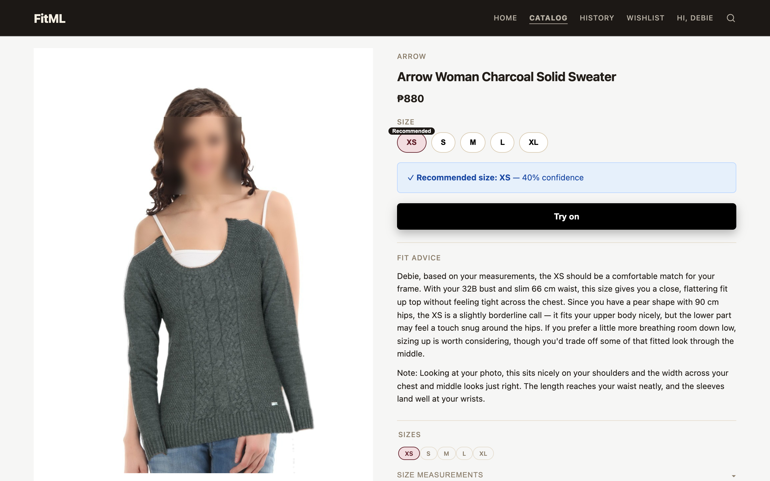
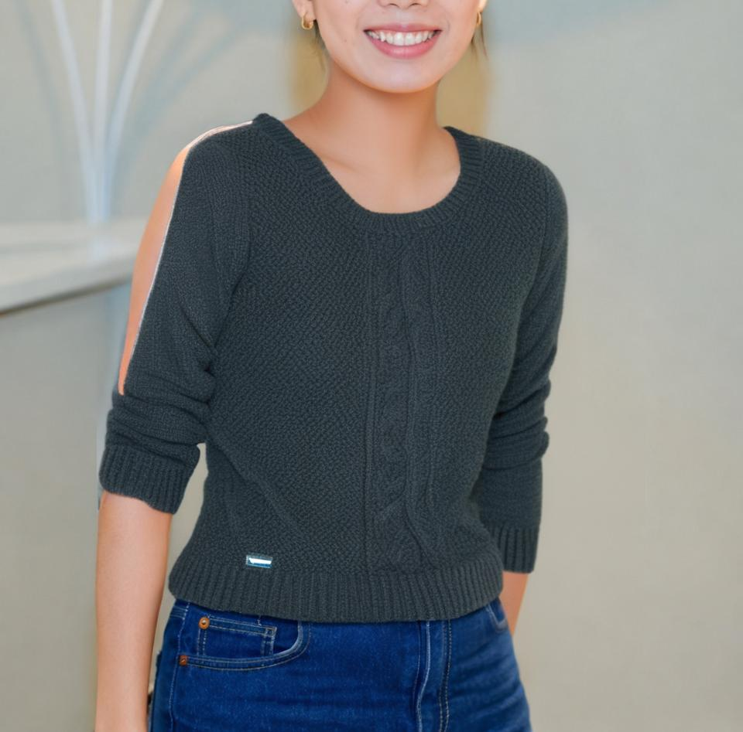


The virtual fitting room, on the shopper's own photo
A clear recommendation
“Recommended size: XS — 40% confidence” — the confidence level is shown, never hidden.
The garment on their body
The shirt is placed on the shopper's own photo, scaled and angled to their pose — picking a bigger size renders visibly bigger.
Advice a shopper actually understands
Plain words, no tailor talk: “the length ends right at your waistband, and the sleeves fall neatly at your wrists.”
Privacy by default
The upper face (forehead, eyes) can be cropped out before the photo is ever saved, opt-in; this screenshot shows the default, unchecked state — the real face preserved via paste-back.
Live try-on: recommendation, composite, and advice for a real catalog item
FitML — Pillar 5: Capstone Project · Debie Galleros

Slide 5
The differentiator: sizing that is checked for everyone
Most sizing tools are black boxes. FitML publishes its audit.
Sizing models are usually most accurate for “average” bodies — and quietly worse for everyone else. We measured ours across body types, heights, and size ranges, found exactly that problem, and retrained to fix what matters most.
1 in 100 → 1 in 2
misfit warnings the model catches, before vs after the fairness fix — the single number behind fewer wrong “it fits” promises
What we found: the first model told almost every shopper “it fits” — it was most wrong for plus-size shoppers, exactly the people returns hit hardest.
8 groups × 3 lenses
body types, heights, and size bands — every group's numbers published, none averaged away
What we did: retrained the model to take misfits seriously and published before/after numbers for every group — the full report is in the open repository.
0 guesses
measurements are always entered by the shopper — never estimated from a photo
FitML — Pillar 5: Capstone Project · Debie Galleros

Slide 6
What this is worth
Projected impact — to be validated in a pilot, not promised in advance
The mechanism
The target
–
Fewer wrong “it fits” moments. The retrained model catches about half of misfits before purchase, instead of almost none.
35% → 15–20%
–
Fewer “order 3, keep 1” baskets. Seeing the garment on their own photo replaces ordering multiple sizes to try at home.
return-rate goal for sizing-driven returns, in line with what published fit-technology deployments report
–
Higher purchase confidence. A visible confidence level and honest sizing tips build trust — and trust converts.
Illustrative: a shop doing 10,000 orders a month at 35% returns processes 3,500 returns. Cutting the rate to 20% removes 1,500 of them — every month, before counting the sales that no longer get lost to hesitation.
Every avoided return saves twice-paid shipping, inspection, repackaging, and markdown loss — and keeps the item sellable at full price.
FitML — Pillar 5: Capstone Project · Debie Galleros

Slide 7
Risks handled up front
Body photos are sensitive — the prototype treats them that way, by design
Photos deleted in 24 hours
Auto-deletion is enforced in code, not policy. Uploads live in anonymous, session-scoped folders — never linked to a name or email.
And the honest risk register
–
The model over-warns today: catching misfits costs some false sizing tips. The interface presents them as tips, not verdicts.
Face privacy, opt-in and automatic
An opt-in checkbox crops the upper face — forehead and eyes — out before saving. Left unchecked, FitML still protects you — your real face is restored over anything the AI drew in its place.
–
Trained on US women's rental/retail data; local fit habits will differ. The pilot exists to recalibrate on real local outcomes.
No body measurements are ever guessed
The photo is used only to show garments. Measurements come from the shopper, full stop — no silent AI estimation of anyone's body.
–
Men's sizing is a size-chart lookup, clearly labeled — not the audited model.
Compliant framing from day one
Built against the Philippines' Data Privacy Act (RA 10173): consent up front, one declared purpose, minimal collection, hard retention limits.
FitML — Pillar 5: Capstone Project · Debie Galleros

Slide 8
Rollout: pilot, measure, then scale
Phase 1 — Pilot
Phase 2 — Calibrate
Phase 3 — Scale
8–10 weeks
next quarter
quarter after
One women's category (dresses) on the existing store. Measure return rate, size-exchange rate, and conversion against a control group.
Retune the model's thresholds on real local outcomes, per body-type group — the audit framework is already built for exactly this.
Full women's catalog, then men's once enough real fit feedback exists to train and audit a proper men's model.
The gate between phases is a number, not a feeling: the pilot ships with the same measurement dashboard the capstone already produces — per-group accuracy, misfit-catch rate, and return-rate delta.
FitML — Pillar 5: Capstone Project · Debie Galleros

Slide 9
Where this goes next
Fit-accurate rendering
Smarter sizing over time
Today's generative try-on already shows the right garment on your own photo, photorealistically. The next step (the FIT dataset, 2026 — over a million fit-aware examples) renders how a specific size actually drapes and pulls, not just where it sits.
Every confirmed purchase and return becomes training signal. The fairness dashboard keeps the improvement honest across body types.
Color advice
Richer men's experience
“Does this shade suit me?” — scoped out of the capstone deliberately, and a natural add-on to the same advice panel.
Real men's fit data from the pilot replaces today's clearly-labeled size-chart lookup with an audited model.
FitML — Pillar 5: Capstone Project · Debie Galleros

Slide 10
Try it yourself
fit-ml.netlify.app
The full fairness audit, code, and documentation are public: github.com/debiegalleros/fitml-capstone
Debie Galleros · Postgraduate Diploma in Artificial Intelligence and Machine Learning · July 2026

