Slide 1

Analysis of the Cab Industry in the US
Identifying the Best Investment Opportunity for XYZ
DEBIKA MUKHERJEE

Slide 2
INTRODUCTION
Welcome and thank XYZ for the opportunity to analyze the cab industry data
Objective: To identify the best investment opportunity among two cab companies
Agenda:
Business problem
Industry overviews
XYZ investment plans
Data source
Hypothesis investigation
Customer segment and company comparisons
Results and recommendations

Slide 3
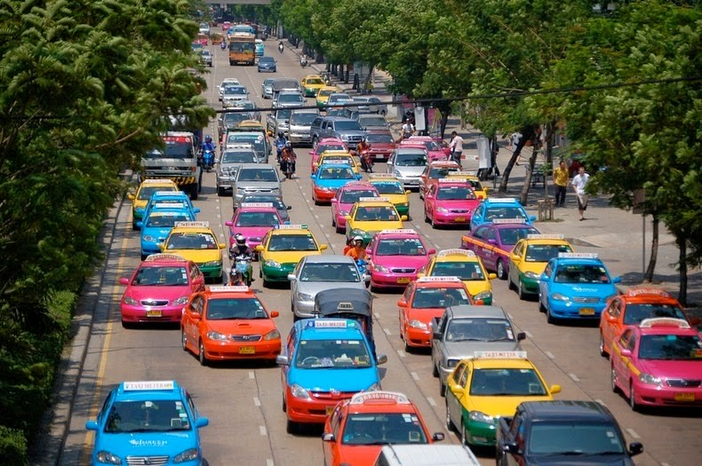
BUSINESS PROBLEM
XYZ's interest in investing in the cab industry
Need to identify the right company for investment. XYZ wants to make an informed decision based on market understanding and data-driven insights
Goal: Provide actionable insights to support the decision-making process.

Slide 4
Industry overviews
The Cab Industry in the US refers to the sector that provides transportation services through various modes, including traditional taxis, ride-hailing platforms, and car rental companies.
In recent years, the industry has experienced remarkable growth, fueled by factors such as urbanization, changing consumer preferences, and technological advancements.
This growth has led to the emergence of multiple key players, making the market highly competitive. The industry's expansion and the presence of these key players have reshaped the way people travel and increased convenience for consumers.

Slide 5
XYZ investment plans
By leveraging data-driven insights and conducting a thorough analysis, XYZ aims to make an informed decision regarding which company within the Cab Industry presents the best investment opportunity.
The investment plan of XYZ focuses on identifying the right company that exhibits strong growth potential, a solid customer base, profitability, competitive advantage, and alignment with their Go-to-Market strategy.
The goal is to maximize returns and secure a successful investment in the dynamic and rapidly growing Cab Industry.

Slide 6
02
Data source
There are several data sources I found. I have used the Kaggle data sets.
By leveraging data sources from Kaggle, we have expanded the scope of our analysis and gained valuable insights into the Cab Industry. The diverse datasets obtained have allowed us to explore different aspects of the industry, providing a comprehensive understanding of market dynamics, customer behavior, and performance indicators. The utilization of Kaggle datasets enhances the reliability and depth of our analysis, contributing to well-informed investment decisions for XYZ in the Cab Industry.

Slide 7
Hypothesis Investigation
Analyze historical data for recurring cost of trip and total distance of two cabs.
Analyze the data to identify which cities having more users of the cabs depending on the age, gender and income.
Explore the relationship between customer satisfaction ratings and cab usage frequency by analyzing feedback and ratings, determining if higher satisfaction correlates with a higher likelihood of repeat customers.
Investigate the impact of price surges during peak demand periods on profitability by analyzing pricing data and ride volumes, assessing the financial performance during these periods.

Slide 8
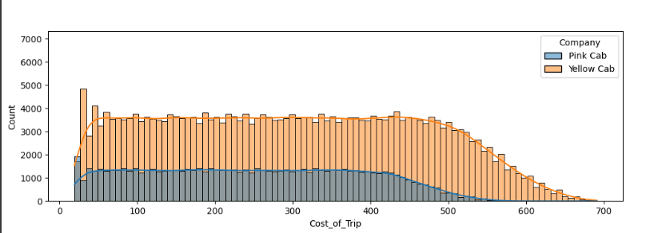
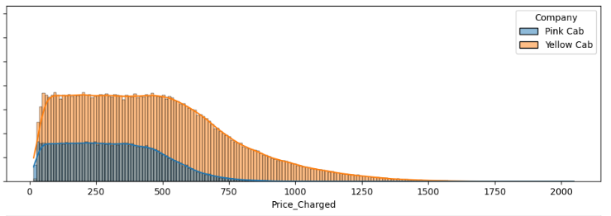
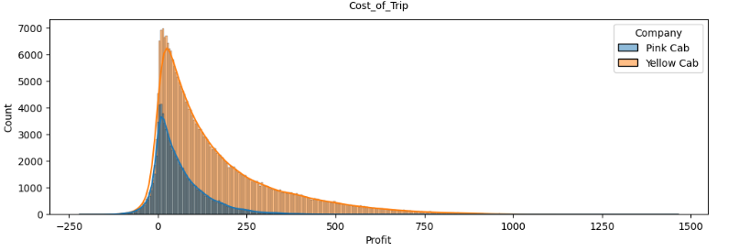
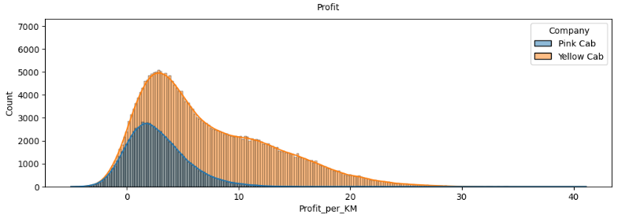
Observations & Analysis

Slide 9
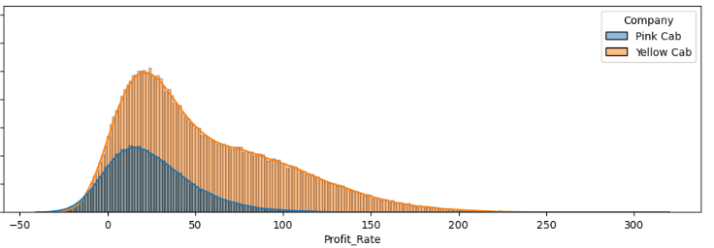
Based on previous figures, it is evident that the profit distributions are skewed to the right. However, there is a notable difference in the distribution for Yellow Cab, which shows a distinct bump to the right of the peak in both Profit Rate and Profit per KM. This suggests that Yellow Cab may have a higher total profit rate. To further investigate, we will examine the company's profit rate in the next analysis step.

Slide 10
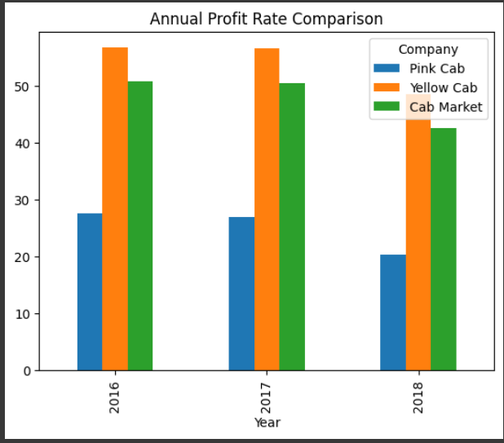
Based on the observations from the previous figure and table, it is evident that Yellow Cab consistently exhibits higher yearly profit rates (ranging from 48% to 56%) compared to Pink Cab (ranging from 21% to 27%) for each recorded year.
One contributing factor to this difference is that Yellow Cab has a higher proportion of high-profit-rate rides compared to Pink Cab. This suggests that Yellow Cab operates more efficiently.
However, to provide a comprehensive investment recommendation, further analysis is required to explore additional aspects of the data.

Slide 11
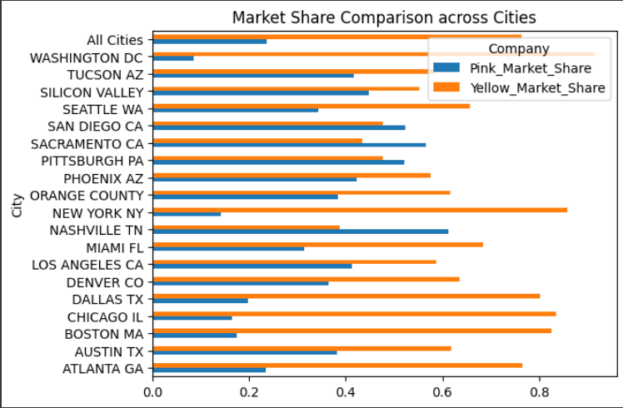
Suppose Pink and Yellow Cab are the exclusive cab companies in the United States.
Yellow Cab holds a national market share three times larger than that of Pink Cab, and this advantage extends across most cities.
Since market share is closely linked to the number of cabs owned by each company, this indicates a consistent and enduring advantage for Yellow Cab.

Slide 12
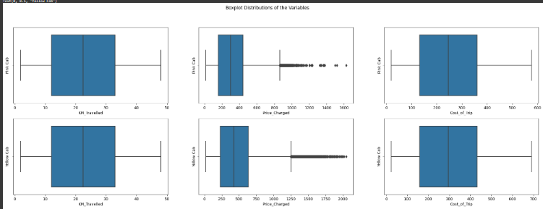
The distributions of KM_Traveled and Cost_of_Trip show similarities between both companies.
However, Yellow Cab exhibits a higher median in Price_Charged and a larger proportion of rides with higher prices.

Slide 13
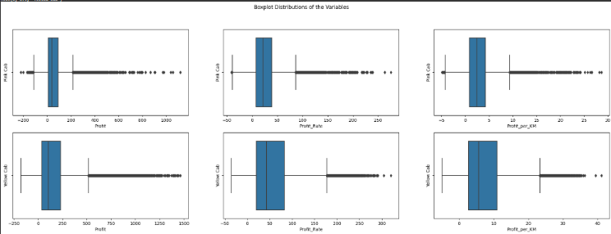
Despite Yellow Cab having a lower median profit, it demonstrates a higher proportion of high-profit rides in comparison.
Additionally, Yellow Cab surpasses Pink Cab in terms of median Profit_Rate and Profit_per_KM, further highlighting its stronger performance.
This observation hints at Yellow Cab's pricing strategy, which involves a lower initial rate but a higher average rate per kilometer traveled.

Slide 14
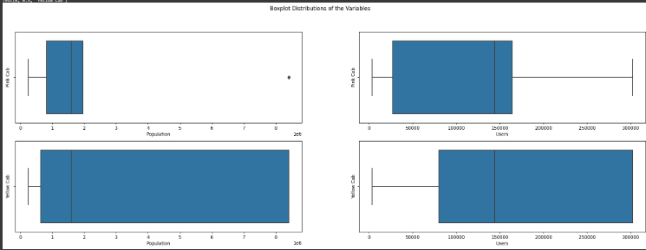
Based on the boxplot analysis of 'Population' and 'Users', it is evident that Pink Cab predominantly operates in smaller cities, whereas Yellow Cab has a higher volume of transactions occurring in larger cities.

Slide 15
Results & Recomdation
Yellow Cab consistently achieves a higher yearly profit rate (ranging from 48% to 56%) compared to Pink Cab (ranging from 21% to 27%) for each recorded year. This indicates that Yellow Cab captures a significant portion of the profitable share within the Cab Market.
Despite having only half the number of customers compared to Pink Cab, Yellow Cab maintains a market share that is twice as large.
Yellow Cab dominates in the majority of cities, except for San Diego, Sacramento, Pittsburgh, and Nashville where its presence is not as prominent. But there is very little difference between the income of two cab companies. Customer preference is not very clear from the data.
Given that we only have data for three years, it remains uncertain if Yellow Cab can sustain its profit indexes due to a decrease in 2018 compared to 2016 and 2017. However, considering its dominant market share and superior pricing strategy, Yellow Cab is expected to continue earning more profit than Pink Cab in the long run.

Slide 16
Thank You

